Slide 1
Bootstrapped Named Entity Recognition for Product Attribute Extraction

Slide 2
Introduction
Short listings are typical in classified ads where each seller is given limited space (in terms of words) to describe the product
These Titles present a unique challenge, with the lack of informative context and grammatical structure.

Slide 3
Challenges in Extracting Product Attributes
Loss of grammatical structure in short listings where many nouns are piled together.
Typographical errors, abbreviations, and acronyms that must be normalized to the standardized values
Lack of contextual information to infer product attribute value

Slide 4
Formulation and Approach
Formulate the product attribute extraction problem as Named Entity Recognition (NER) task
Investigate supervised and semi-supervised approaches to this problem.
Also investigate attribute discovery, and normalization to standardized values.

Slide 5
Supervised Learning Approach
Train a sequential classifier and evaluate the extraction performance on a set of hand-labeled listings.
Uses maximum entropy and SVM as the base classifier for classifying the individual word tokens
Next, hidden Markov model (HMM) is trained on the the probabilistic output of the base classifier
A Sequential label prediction is obtained using a Viterbi decoding

Slide 6
Corpus Used
Data from eBay’s clothing and shoes category
Attributes of interest: brand (B), garment type/style (G), size (S), and color (C).
105, 335 listings from men’s clothing category and 72,628 listings from women’s clothing category
dataset of 1, 380, 337 word tokens. On average, each listing title contains 7.76 words.

Slide 7
Hidden Markov Model
Explicitly captures temporal statistics in the data by modeling state transitions over time. (Generative)
a sequence of word tokens from listing titles are our observations.
Pros-simple to use. Set a hidden state to correspond to a tag class. In the training phase, since all the tags are given, the hidden states become visible and inference in this model becomes simplified
Cons- in order to account for rich, overlapping feature sets, e.g. text formatting features, the correlation structures in the overlapping features must be explicitly modeled.

Slide 8
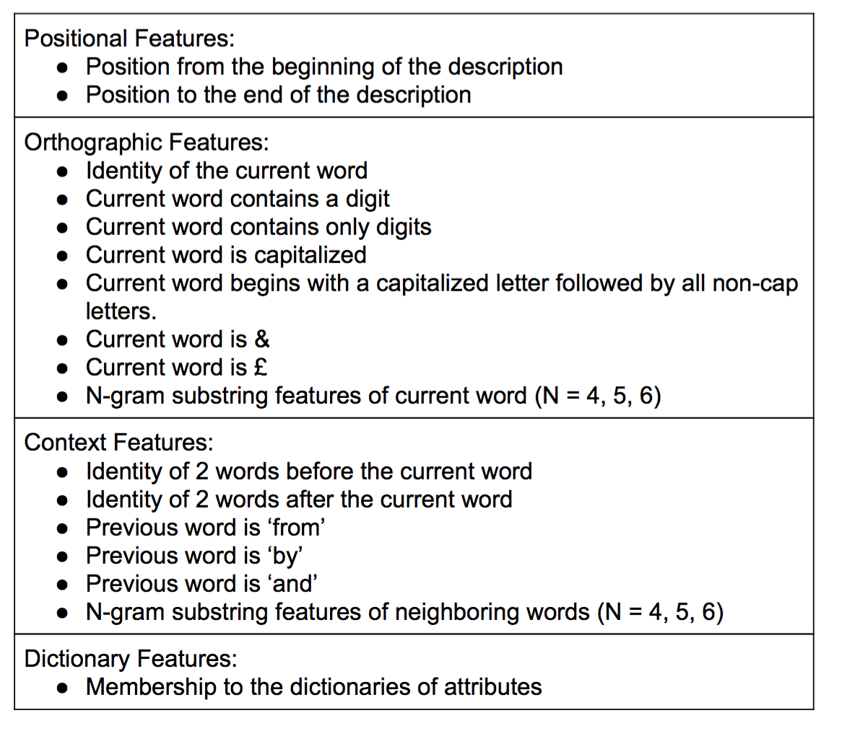
Maximum Entropy Models & SVM
Input features for discriminative classifiers

Slide 9
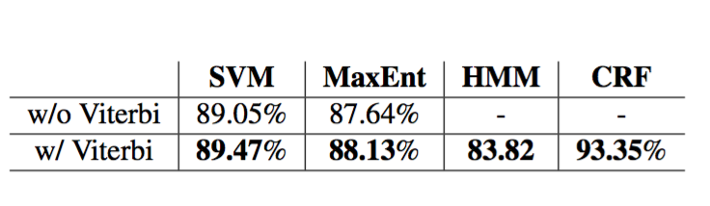
Experiemental Results
adopt a 90-10 split and use 90% of the data for training and 10% for testing
All the discriminative classifiers — CRF, Max- Ent, and SVM — outperform the baseline by HMM, with CRF improving on the baseline performance by the largest margin,

Slide 10
Bootstrapped Algorithm for attribute value discovery
Focus on the problem of how to grow the seed dictionary and discovering new brand names from eBay listing data
Given an initial list of unambiguous brands, we grow the seed dictionary by discovering context patterns that are often associated with such attribute type
A classifier is then trained to learn context patterns surrounding the known brands from the training set, and is used to discover new brands from the test set.
Finally, for known attribute values, we normalize the results to match to words in our dictionary

Slide 11
Normalization
For known attribute values, we normalize the results to match to words in our dictionary.
Investigate several string similarity/distance measures for this task and found that n-gram sub- string similarity yields accurate normalization results.

Slide 12
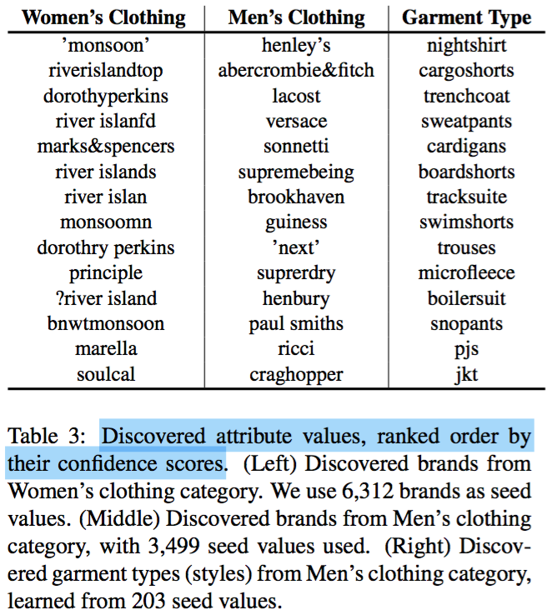
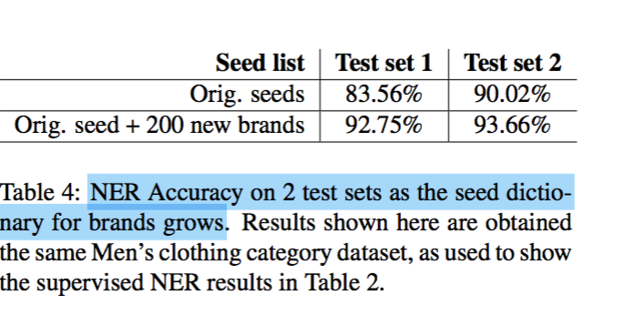
Results Obtained
B

