Slide 1
Data Science Job Salaries Prediction

Slide 2
Introduction
• Data Science is one of the highest paying IT domains.
• Salary varies based on role, experience, location & skills.
• Machine Learning can predict salaries based on features.

Slide 3
Problem Statement
• Predict salary of a data science professional.
• Use historical salary dataset.
• Build regression model for prediction.

Slide 4
Dataset Overview
• Dataset: Data Science Job Salaries Dataset
• Features: Experience Level, Job Title, Company Size,
Employment Type, Remote Ratio, Location
• Target: Salary (USD)

Slide 5
Machine Learning Workflow
1. Data Collection
2. Data Cleaning & Preprocessing
3. Feature Encoding
4. Train-Test Split
5. Model Training
6. Evaluation & Prediction

Slide 6
Data Preprocessing
• Handle missing values
• Encode categorical variables
• Feature scaling
• Remove outliers (if any)

Slide 7
Algorithms Used
• Linear Regression
• Random Forest Regressor
• Decision Tree Regressor
•

Slide 8
Model Training
• Split dataset into 80% Training & 20% Testing
• Train regression model
• Hyperparameter tuning using GridSearchCV

Slide 9
Model Evaluation
• R² Score
• Mean Absolute Error (MAE)
• Mean Squared Error (MSE)
• Compare model performance

Slide 10
Results & Insights
• Experience level strongly impacts salary.
• ML Engineers & Data Scientists earn highest.
• Remote jobs may influence salary range.

Slide 11
Future Improvements
• Add more real-time datasets
• Deploy as web salary predictor app
• Integrate dashboard visualization
• Continuous model retraining

Slide 12
Code & ScreenShots

Slide 13
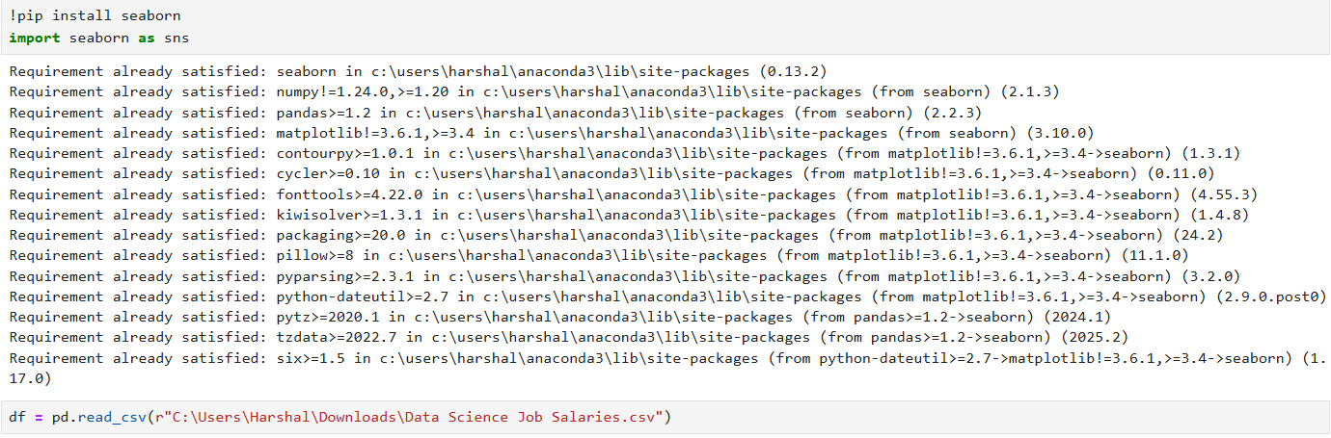
Code & ScreenShots

Slide 14
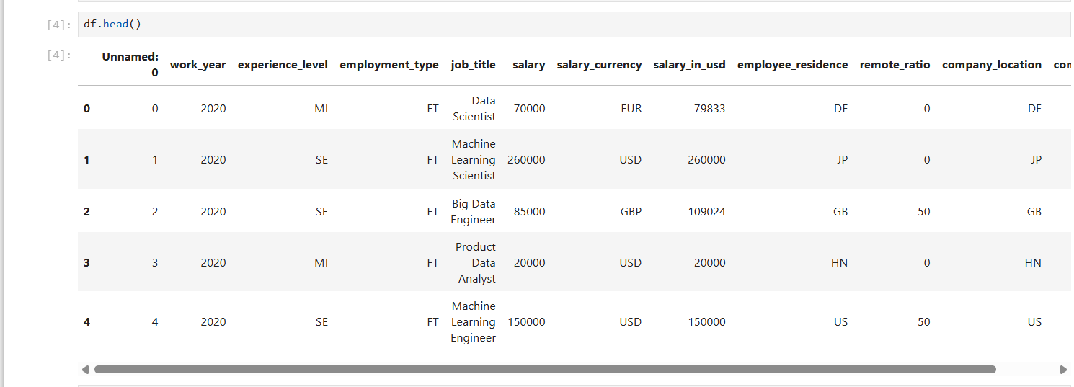
Code & ScreenShots

Slide 15
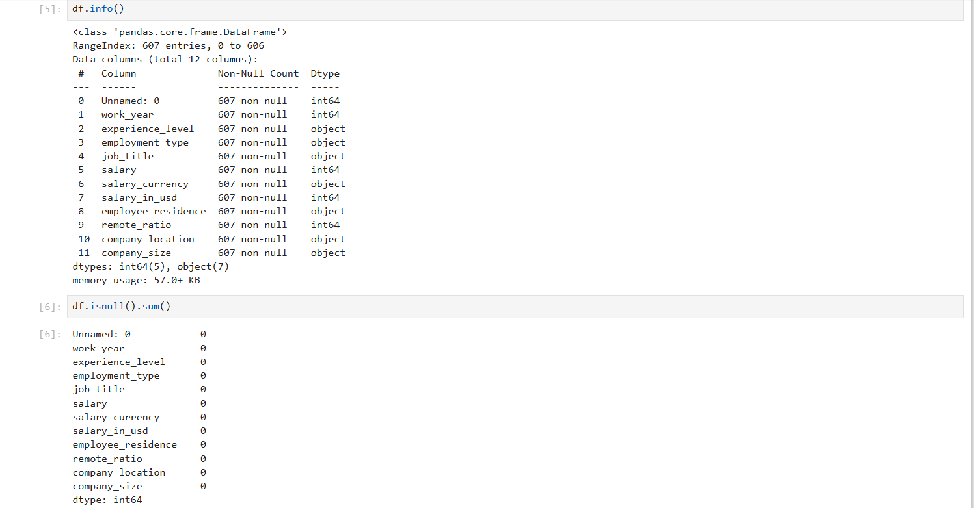
Code & ScreenShots

Slide 16
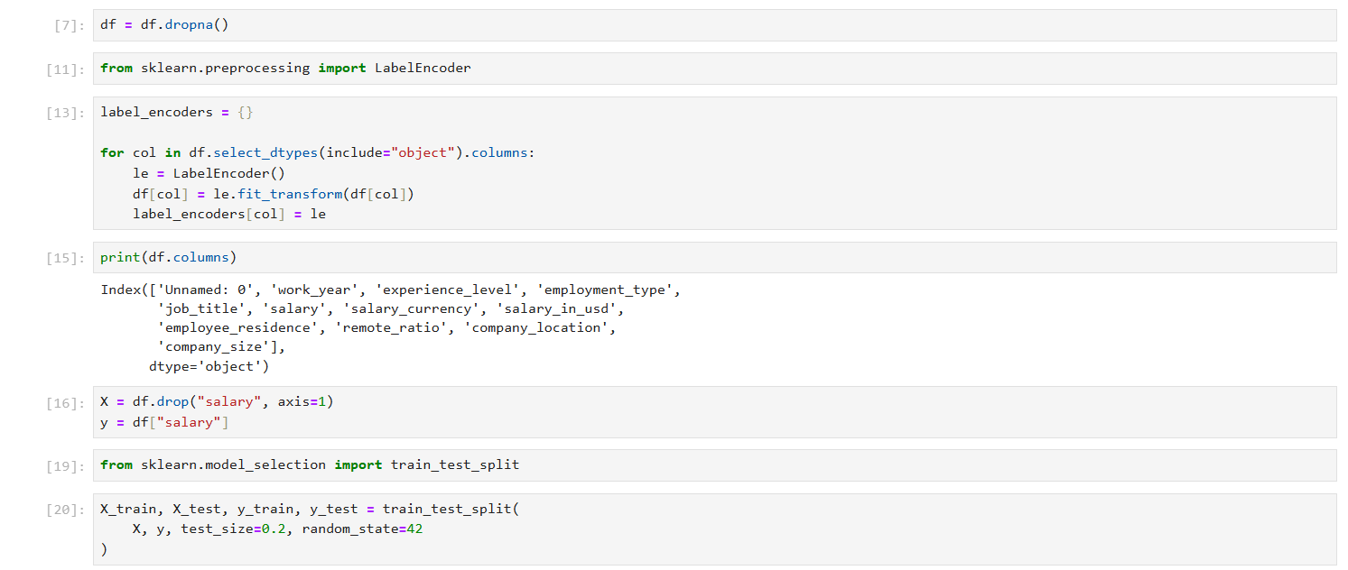
Code & ScreenShots

Slide 17
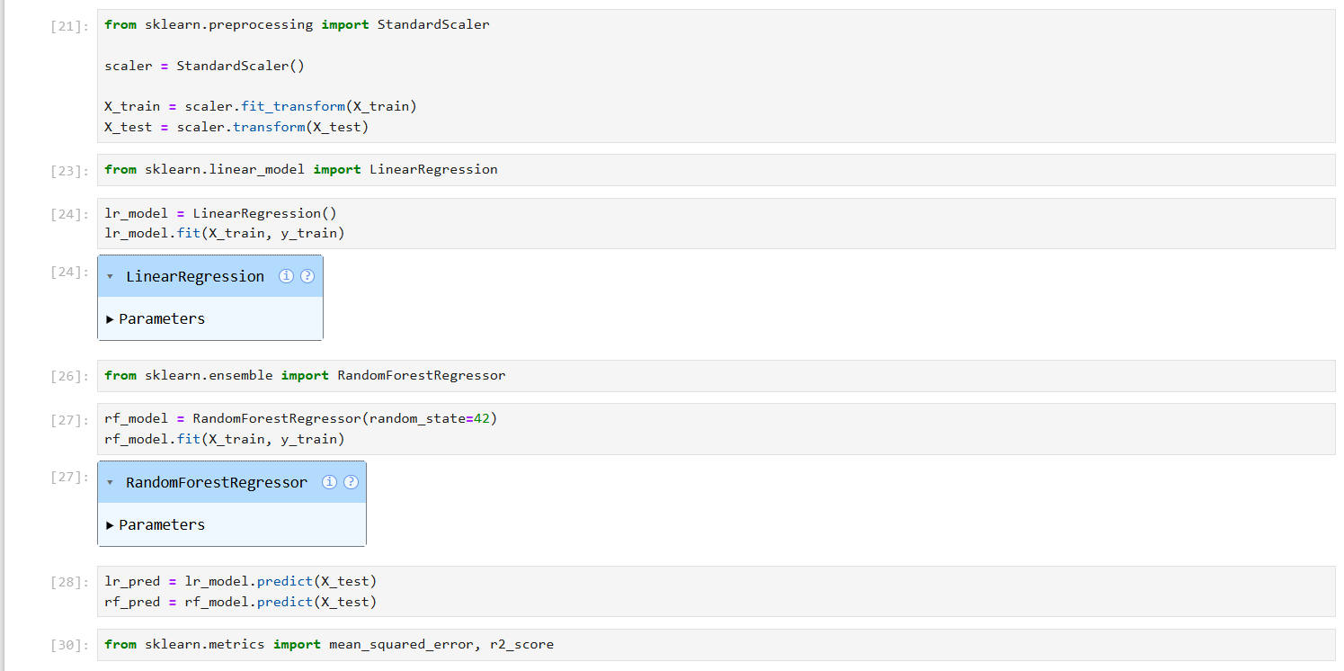
Code & ScreenShots

Slide 18
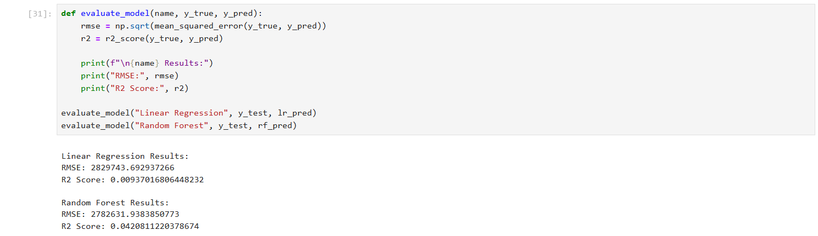
Code & ScreenShots

Slide 19
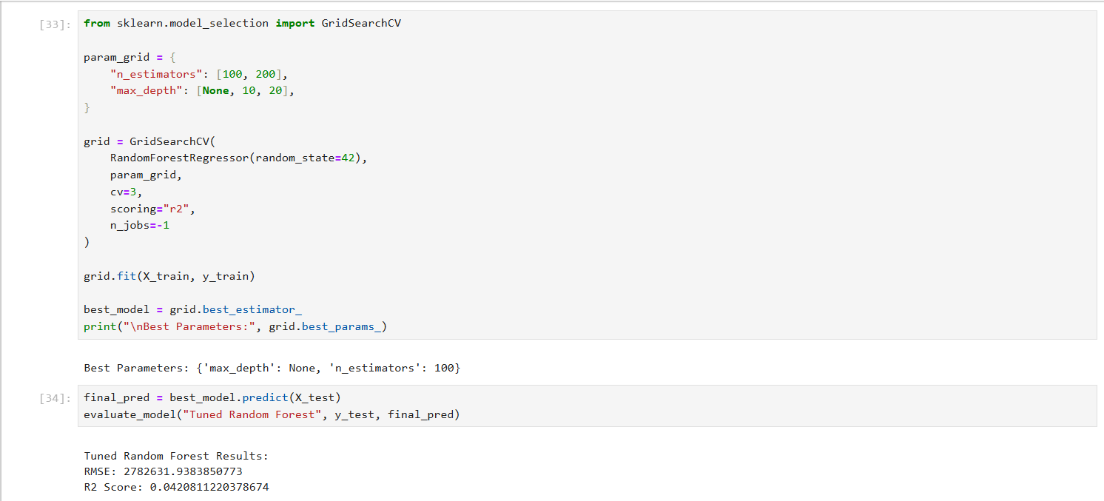
Code & ScreenShots

Slide 20
Code & ScreenShots

Slide 21
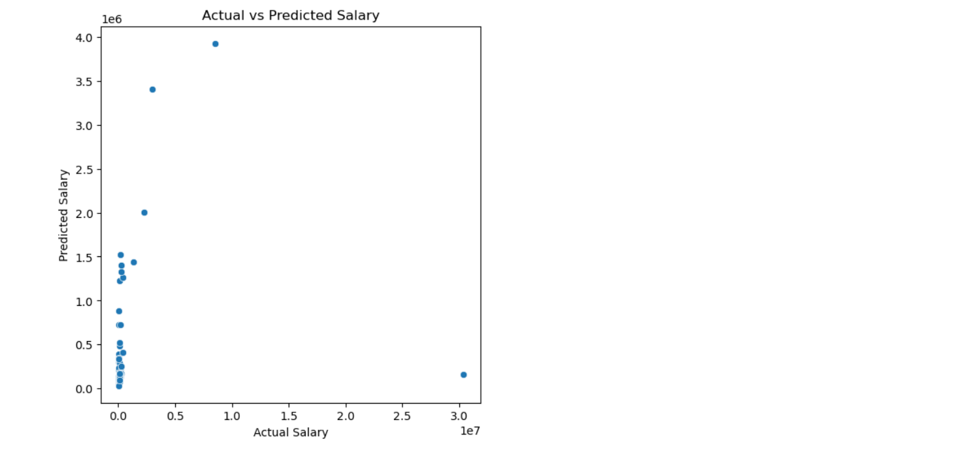
Code & ScreenShots

Slide 22
Conclusion
• Machine Learning helps in salary prediction.
• Useful for students & job seekers.
• Helps companies benchmark compensation.

