Slide 1
Customer Satisfaction Prediction
Machine Learning Project Presentation
Your Name
2026

Slide 2
Introduction
  Customer satisfaction is crucial for business success.
  Predicting satisfaction helps reduce churn.
  Machine Learning can analyze patterns in customer data.

Slide 3
Problem Statement
  Manual analysis is time-consuming.
  Businesses struggle to identify unhappy customers.
  Need an automated prediction system.

Slide 4
Dataset Description
  Ticket ID, Customer Age, Gender
  Product Purchased, Ticket Type
  Purchase Date, Issue Category
  Target Variable: Satisfaction (Satisfied/Unsatisfied)

Slide 5
Data Preprocessing
  Handled missing values.
  Encoded categorical variables.
  Feature scaling applied.
  Train-Test Split (80-20).

Slide 6
Machine Learning Models
  Logistic Regression
  Random Forest Classifier
  Decision Tree
  Support Vector Machine (SVM)

Slide 7
Model Training
  Model trained on training dataset.
  Hyperparameter tuning performed.
  Cross-validation applied.

Slide 8
Model Evaluation
  Accuracy Score
  Confusion Matrix
  Precision & Recall

Slide 9
Results
  Random Forest achieved highest accuracy.
  Improved prediction performance.
  Helps businesses take proactive action.

Slide 10
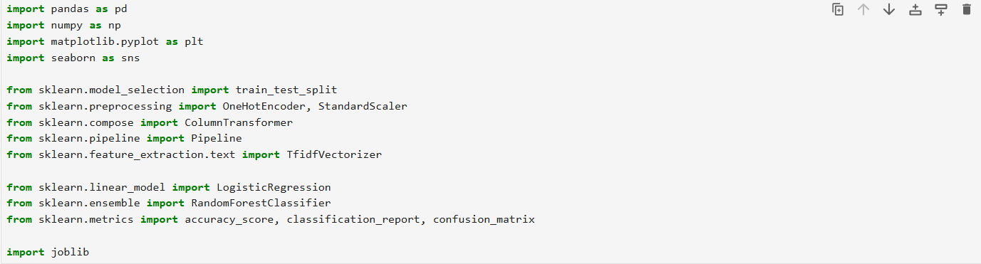
Code & Screen Shots

Slide 11
Code & Screenshots

Slide 12
Code & Screenshots

Slide 13
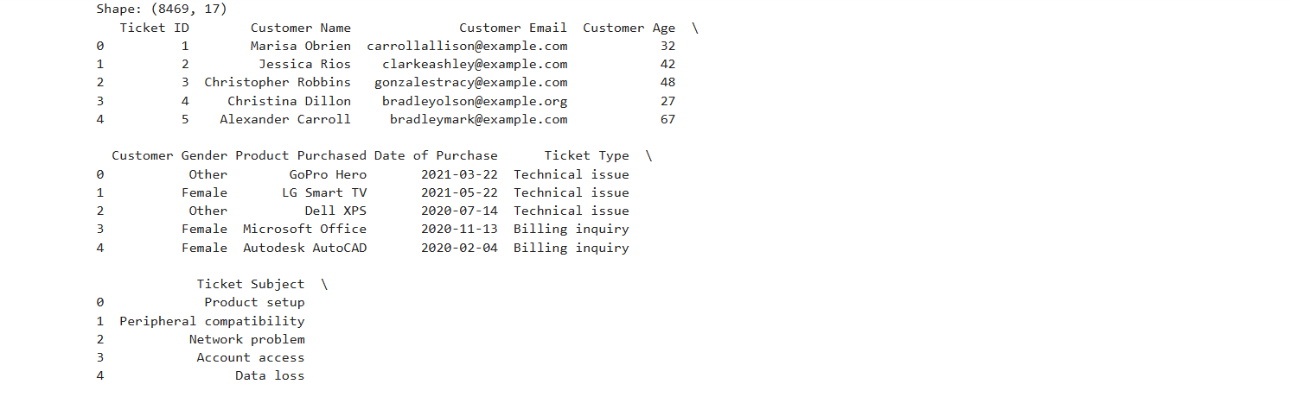
Code & Screen Shots

Slide 14
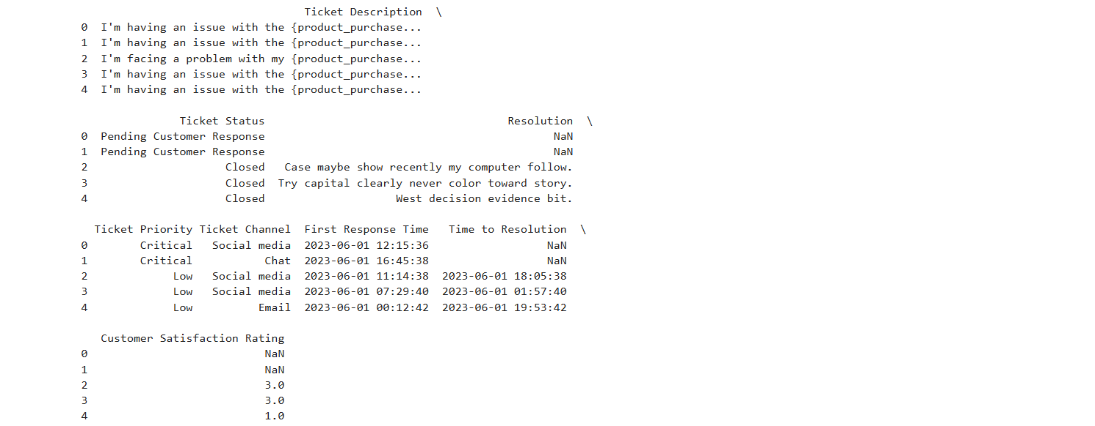
Code & Screen Shots

Slide 15
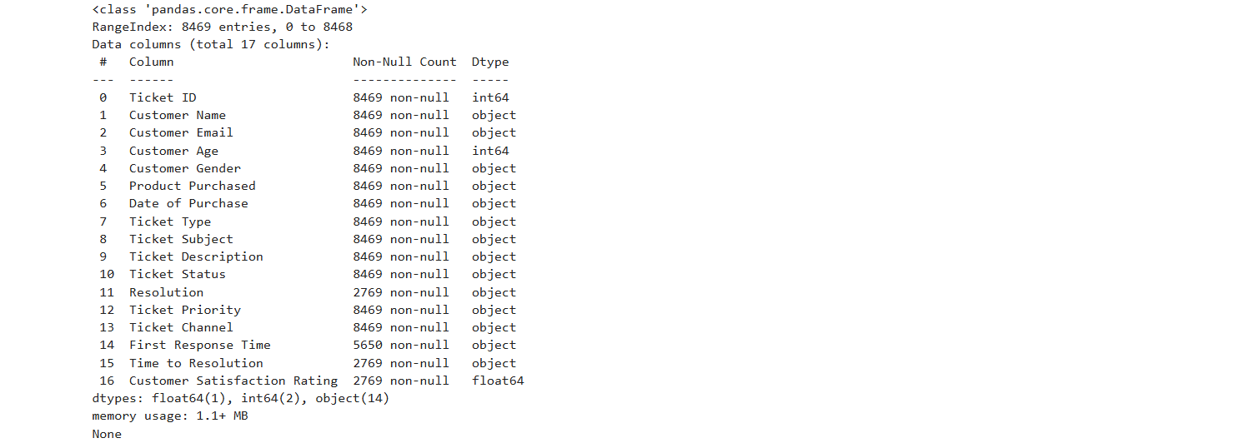
Code & Screen Shots

Slide 16
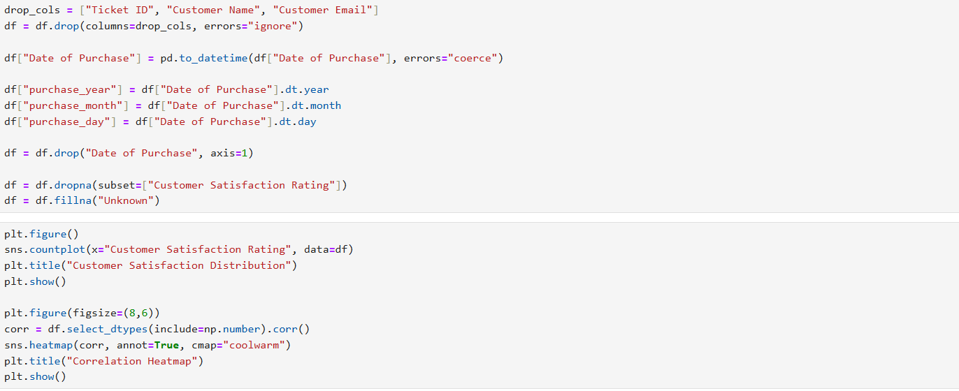
Code & Screen Shots

Slide 17
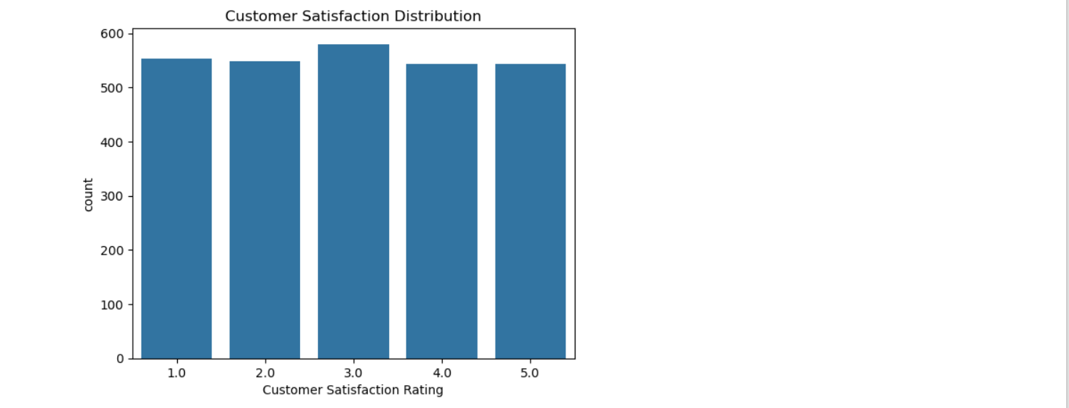
Code & ScreenShots

Slide 18
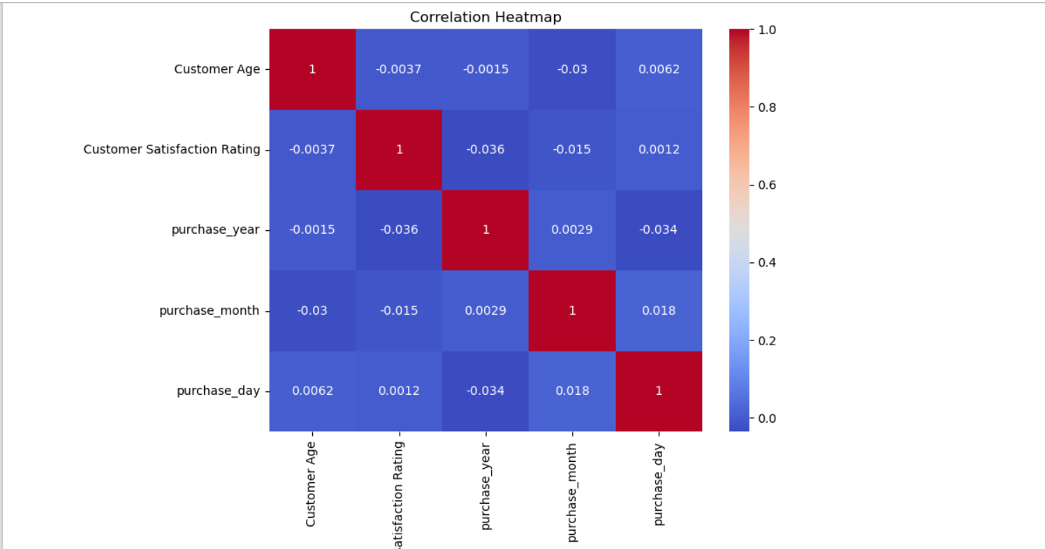
Code & ScreenShots

Slide 19
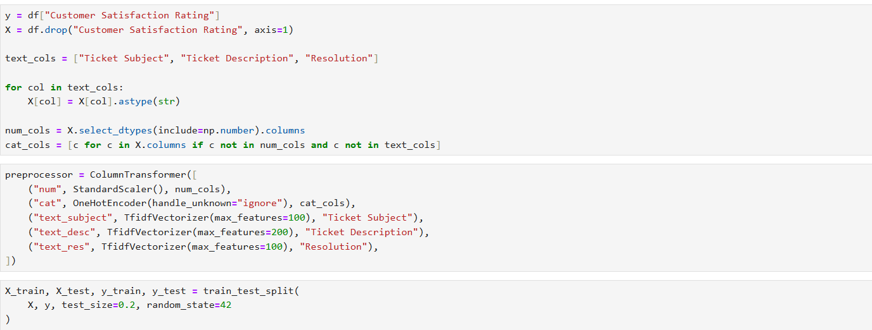
Code & Screen Shots

Slide 20
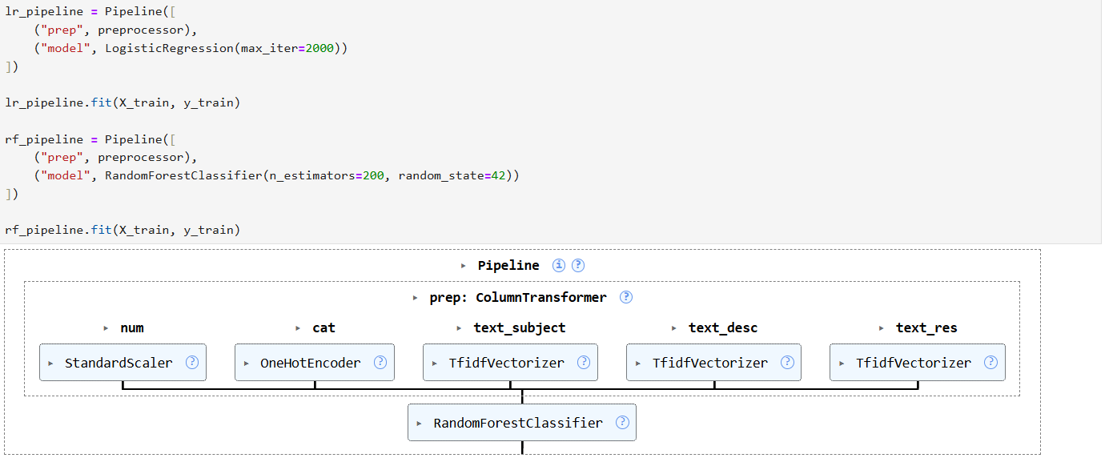
Code & Screen Shots

Slide 21
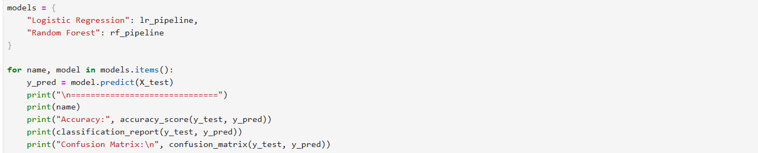
Code & ScreenShots

Slide 22
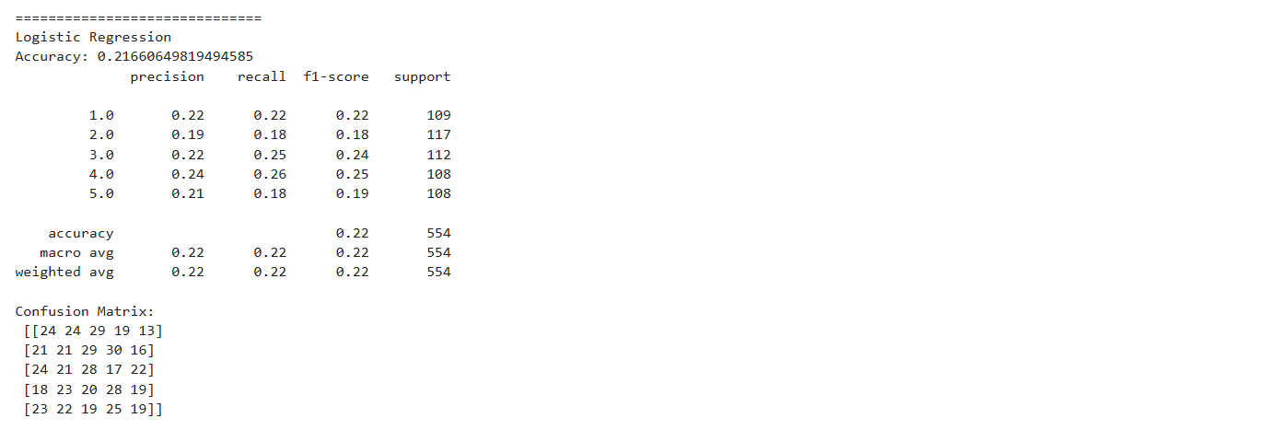
Code & Screen Shots

Slide 23
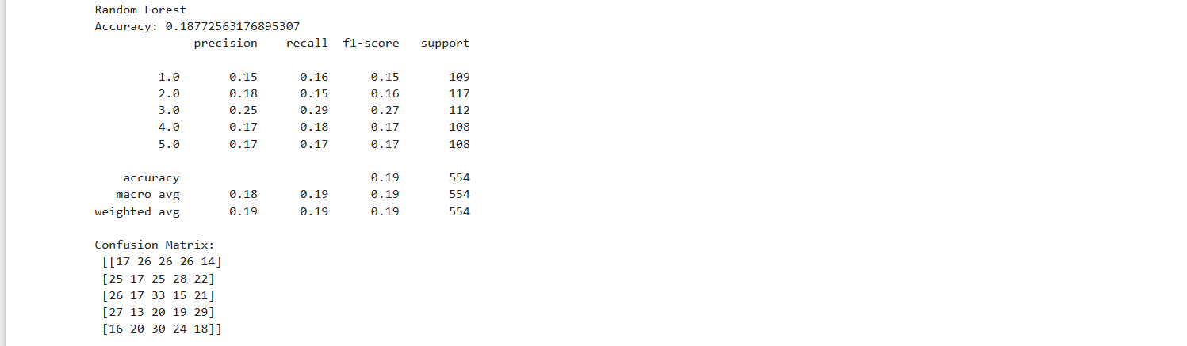
Code & Screen Shots

Slide 24
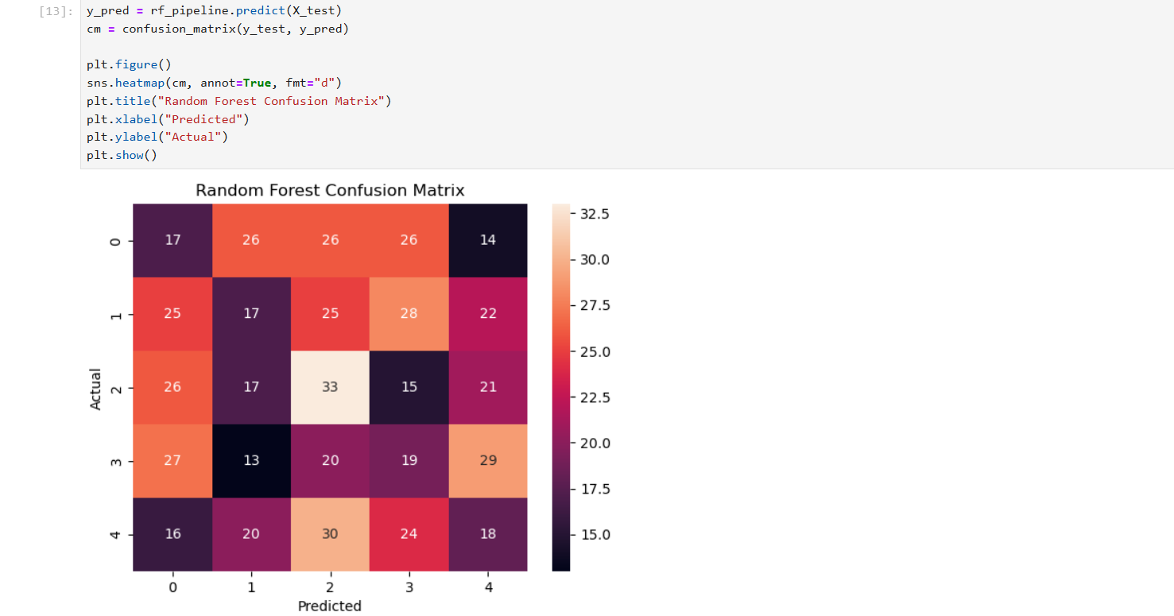
Code & Screen Shots

Slide 25
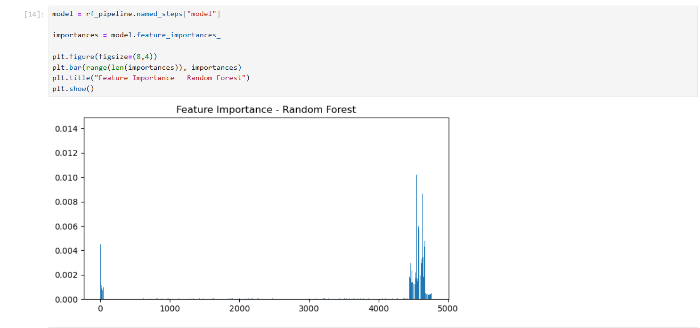
Code & Screen Shots

Slide 26
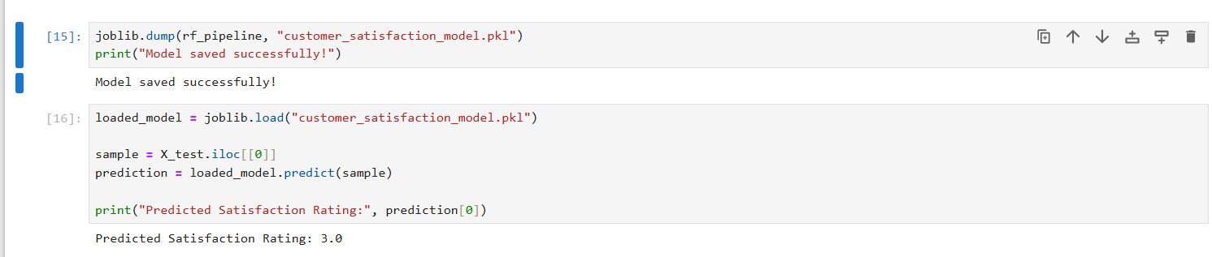
Code & Screen Shots

Slide 27
Conclusion
  ML effectively predicts customer satisfaction.
  Can improve customer retention.
  Future scope: Deploy as web application.

