Slide 1
Iris Classification using Machine Learning

Slide 2
Introduction
• Iris classification is a supervised machine learning problem.
• Goal: Classify iris flowers into three species.
• It is one of the most famous beginner ML datasets.
• Used for learning classification algorithms.

Slide 3
Dataset Overview
• Dataset: Iris Dataset
• Total Samples: 150
• Features: 4 (Sepal Length, Sepal Width, Petal Length, Petal Width)
• Target Classes: Setosa, Versicolor, Virginica

Slide 4
Problem Statement
• Given flower measurements,
• Predict the species of the iris flower.
• Multi-class classification problem.

Slide 5
Machine Learning Workflow
1. Import Dataset
2. Data Preprocessing
3. Train-Test Split
4. Model Training
5. Model Evaluation
6. Prediction

Slide 6
Data Preprocessing
• Check for missing values
• Feature selection
• Encoding labels (if needed)
• Data normalization (optional)

Slide 7
Algorithms Used
• Logistic Regression
• K-Nearest Neighbors (KNN)
• Decision Tree
• Random Forest
• Support Vector Machine (SVM)

Slide 8
Model Training
• Split dataset into Training (80%) and Testing (20%)
• Train selected model on training data
• Adjust hyperparameters if required

Slide 9
Model Evaluation
• Accuracy Score
• Confusion Matrix
• Classification Report
• Cross Validation

Slide 10
Results
• Iris dataset usually achieves 95%+ accuracy.
• Setosa is easily separable.
• Versicolor and Virginica slightly overlap.

Slide 11
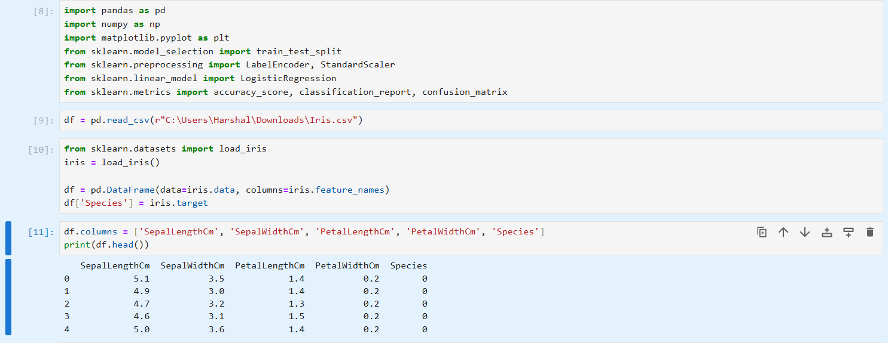
Code & Screenshots

Slide 12
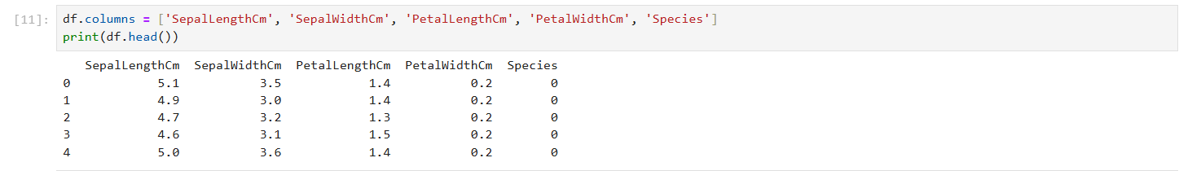
Code & ScreenShots

Slide 13
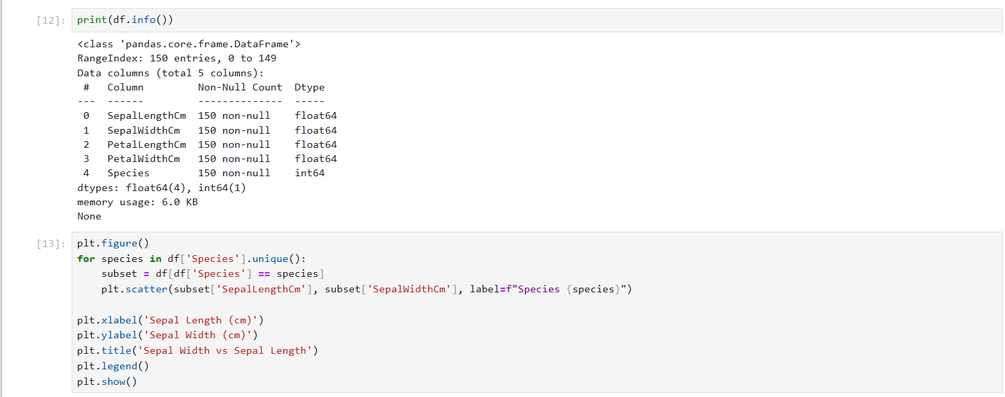
Code & ScreenShots

Slide 14
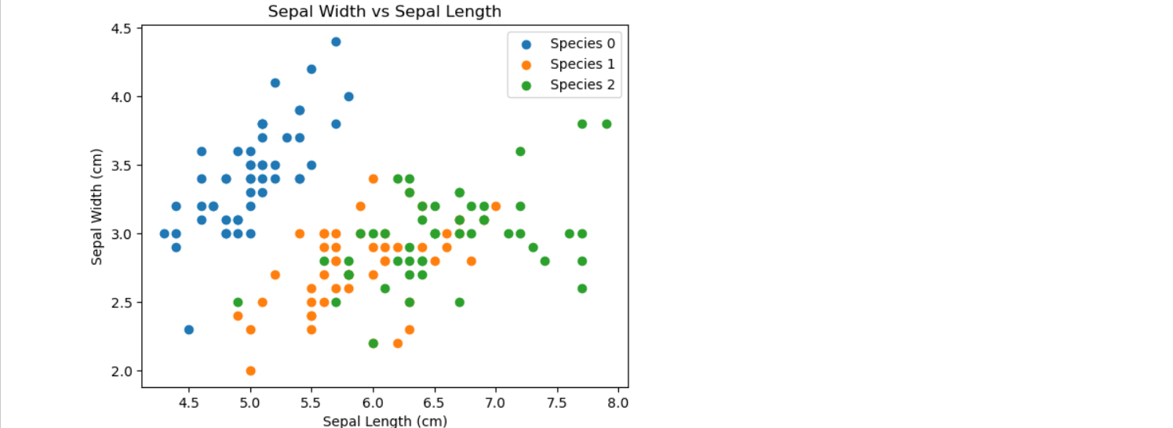
Code & ScreenShots

Slide 15
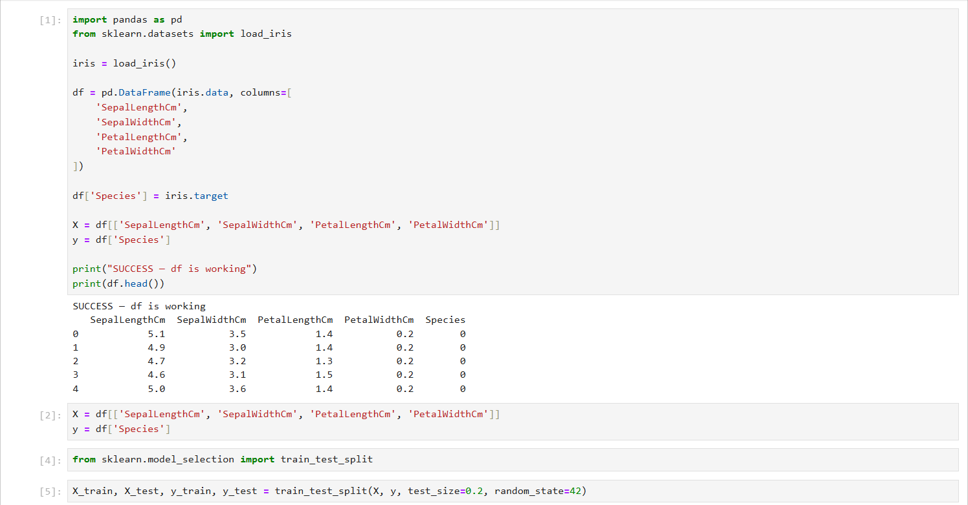
Code & ScreenShots

Slide 16
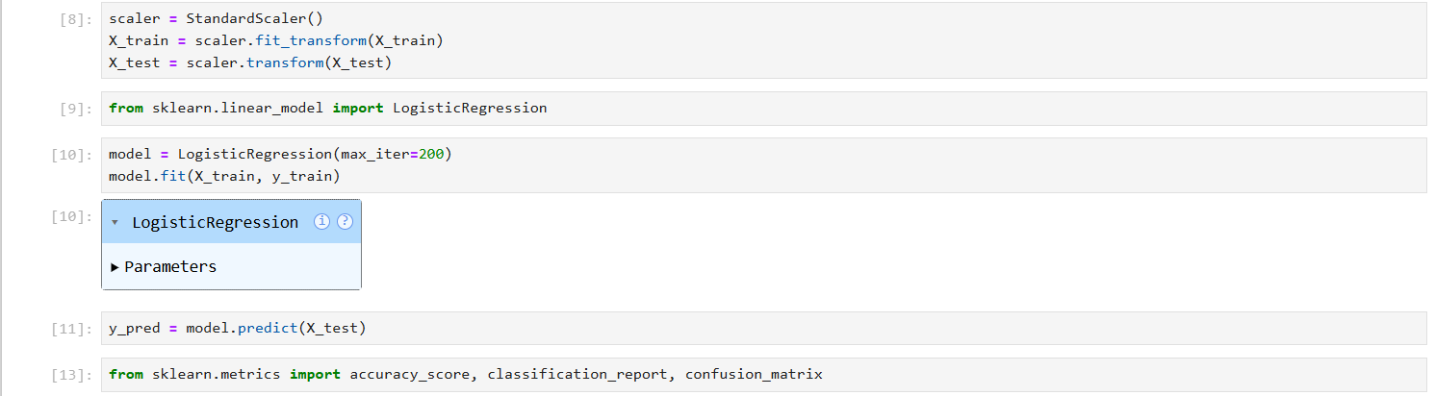
Code & ScreenShots

Slide 17
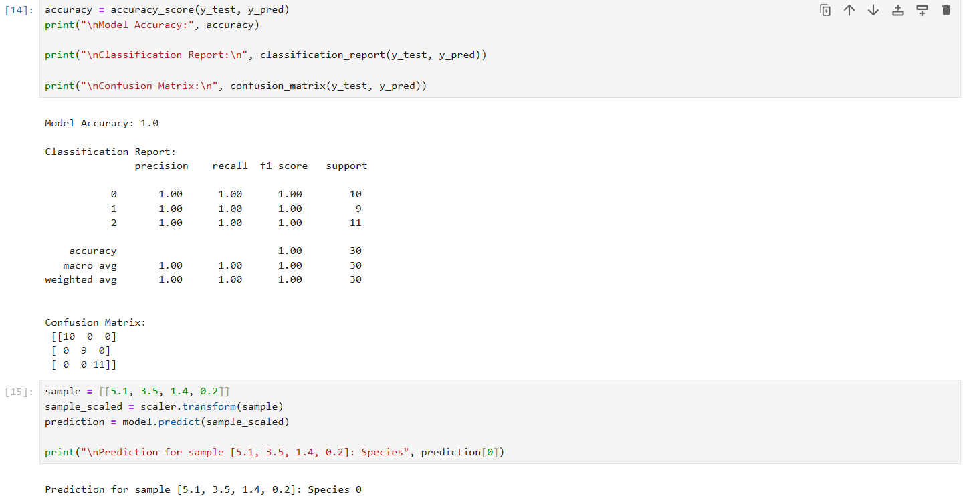
Code & ScreenShots

Slide 18
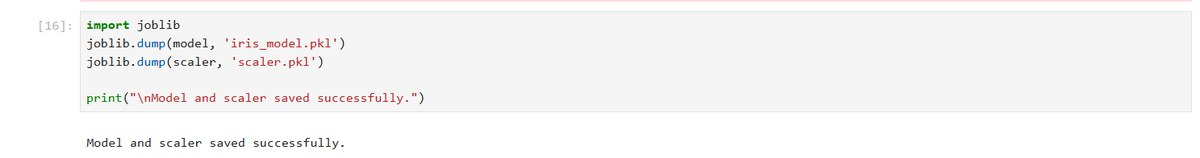
Code & ScreenShots

Slide 19
Conclusion
• Iris classification demonstrates basic ML concepts.
• Multiple algorithms can solve it effectively.
• Useful for understanding supervised learning.

Slide 20
Future Improvements
• Hyperparameter tuning
• Try advanced ensemble methods
• Deploy as web application
• Add visualization dashboards

