Slide 1
Subtitle: "Bike Sharing Demand Analysis" The bike sharing demand analysis project aims to explore and understand the factors that influence bike rentals. The dataset provides information on various attributes such as date, season, holiday, working day, weather, temperature, humidity, wind speed, and rental counts. By analyzing these attributes, we can identify trends and patterns in bike rentals and gain insights into the behavior of bike users.
Project Name: "Data Wrangling for Bike Rental Insights”

Slide 2
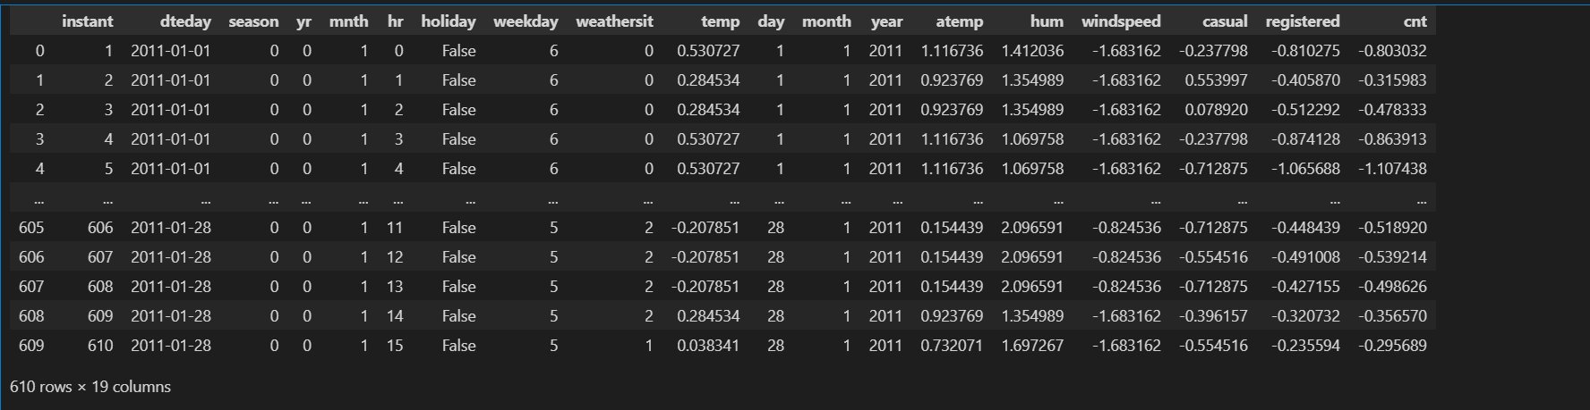
Dataset Overview
This dataset captures hourly bike-sharing demand data, providing insights into how various factors influence bike rentals. Let's break down the key columns:
Temporal Features
- Date: Each row represents a specific hour of the day.
- Hour: Hourly breakdown of bike rentals (0 = midnight, 12 = noon).
- Day of the Week: Day of the week (Monday = 0, Sunday = 6).
- Month: Month of the year (January = 1, December = 12).
Weather Features
- Weather Situation: Categorical weather conditions (clear, misty, rainy).
- Temperature: Temperature in Celsius.
- Feels-like Temperature: Perceived temperature.
- Humidity: Relative humidity.
- Windspeed: Wind speed.
Demand Features
- Casual Users: Number of non-registered users renting bikes.
- Registered Users: Number of registered users renting bikes.
- Total Count: Total number of bike rentals (casual + registered).

Slide 3
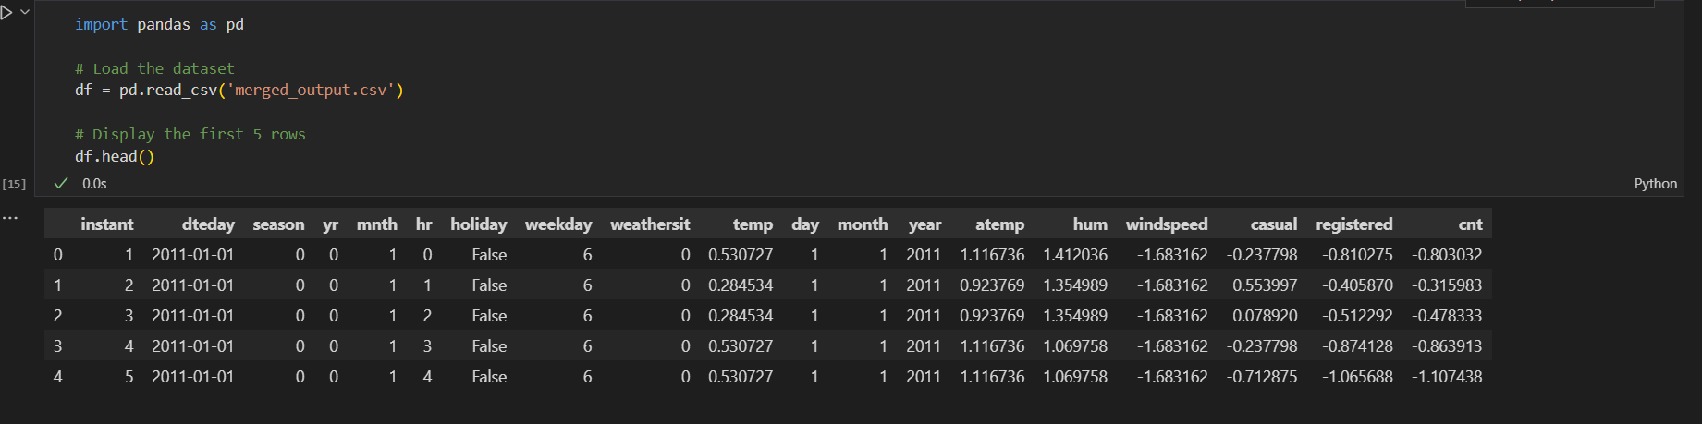
Preview of Dataset: First 5 Rows
The dataset contains hourly bike-sharing data, including various features that can help analyze bike rental trends.
- Temporal Features:
- dteday: Date of observation
- hr: Hour of the day (0-23)
- weekday: Day of the week (0 = Sunday, 6 = Saturday)
- day, month, year: Extracted date components
- Weather Features:
- weathersit: Weather condition (0 = clear, 1 = mist, 2 = light snow/rain)
- temp: Normalized temperature
- atemp: Normalized "feels like" temperature
- hum: Normalized humidity
- windspeed: Normalized wind speed
- Demand Features:
- casual: Count of unregistered bike users (normalized)
- registered: Count of registered users (normalized)
- cnt: Total user count (sum of casual and registered, normalized)

Slide 4
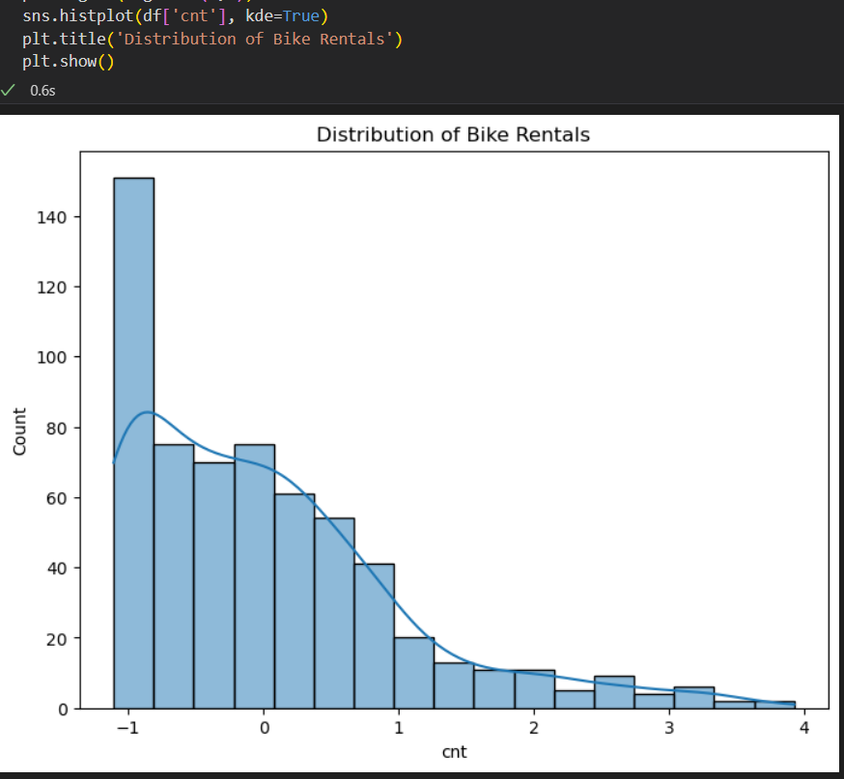
Visualization: Distribution of Bike Rentals
The histogram shows bike rental counts (cnt) follow a right-skewed distribution, meaning most rentals occur at lower counts. Key observations include ¹:
- Distribution Shape: The data is concentrated between -1 and 1 in normalized units, indicating most bike rentals happen during regular demand periods.
- Skewness: The right-skewed distribution suggests peak demand events are less common, resulting in fewer high-count records.
- Kernel Density Estimation (KDE): The smooth curve overlays the histogram, confirming the skewness and providing a visual representation of the data's probability distribution.

Slide 5
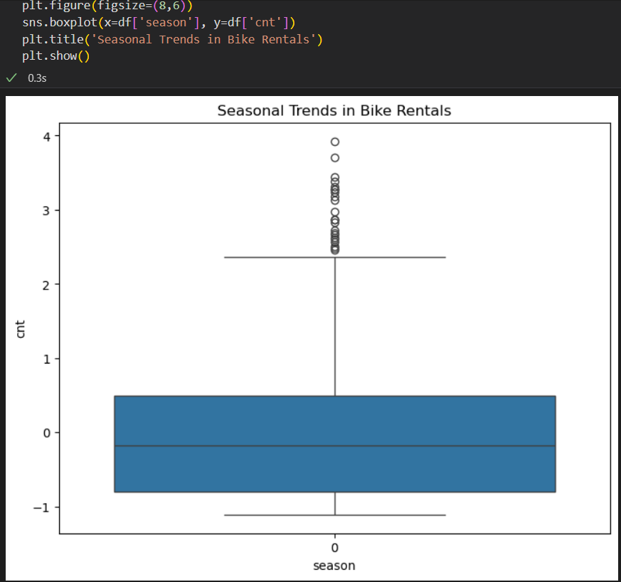
Visualization: Seasonal Trends in Bike Rentals
The boxplot shows bike rental counts vary across seasons, but only one season (likely winter, encoded as 0 or 1) is visible. Key insights for this season include ¹ ²:
- Low Demand: Median rental activity is slightly below 0 (normalized scale), indicating lower demand.
- High Variability: Wide spread in rental counts suggests variability in demand within this season.
- Spikes in Usage: Many outliers on the higher end indicate certain times experience spikes in usage.
Possible reasons for only one season being visible:
- Data Filtering: Dataset might be filtered to show only one season.
- Incomplete Data: Dataset might be incomplete, missing data for other seasons.
Bike rental trends also show ¹:
- Seasonal Impact: Rentals are more common in warmer months (summer) and less common in colder months (winter).
- Weather Influence: People tend to rent bikes in clear and warm weather, while rentals decrease in cold or windy conditions.

Slide 6
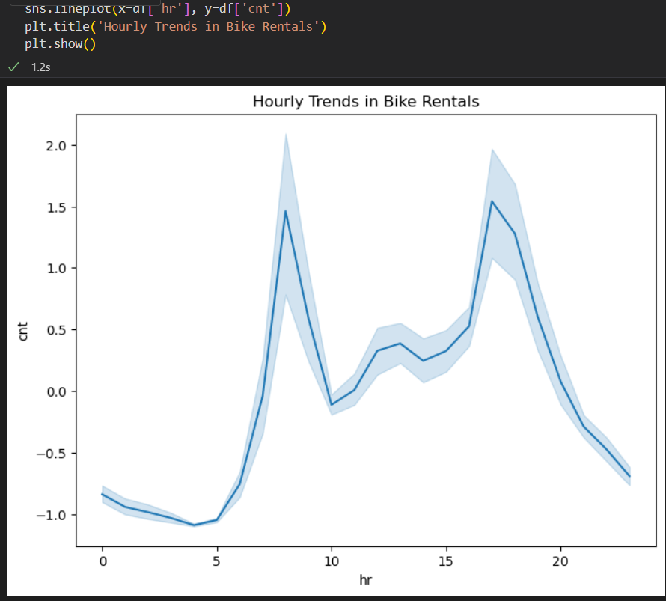
Visualization: Hourly Trends in Bike Rentals
The line plot shows bike rental patterns throughout the day, with two peak periods:
- Morning Peak (8 AM): High rental activity during morning commute hours, likely due to office-goers and students.
- Evening Peak (5-6 PM): Another spike in rentals during late afternoon, suggesting an evening commute rush.
Additionally, the plot reveals:
- Low Usage (12 AM-5 AM): Minimal rental activity during early morning and late night hours.
- Midday Plateau (10 AM-3 PM): Steady and moderate rental activity during the day.
These patterns indicate that bike rentals are primarily driven by commuting needs, with registered users contributing significantly to peak hour usage ¹.

Slide 7
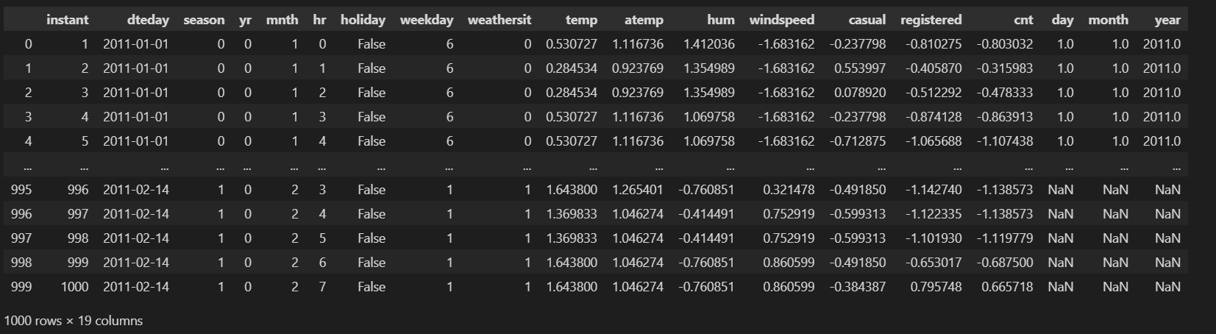
Final Dataset Overview: Preprocessed Hourly Bike Sharing Data
The dataset contains 1,000 hourly entries with 19 features, providing insights into bike-sharing demand. Key features include :
- Temporal Features: Hour, day, month, and year to analyze demand patterns
- Hourly Patterns: Peak usage during morning (8 AM) and evening (5-6 PM) commute hours
- Daily Patterns: Variations in demand across different days of the week
- Environmental Features: Weather situation, temperature, humidity, and wind speed to assess impact on demand
- Weather Impact: Rainfall and temperature significantly influence bike usage
- User Behavior Features: Casual and registered user counts to distinguish between user types
- User Insights: Registered users dominate morning and evening commutes, while casual users peak in afternoons
- Additional Features: Season, holiday, and date features to capture seasonal trends and anomalies
- Seasonal Trends: Bike rentals peak in summer and trough in winter
The dataset has been cleaned and transformed, with normalized variables like temperature and bike rental counts. This enables analysis of bike-sharing demand patterns, including
- Peak Hours: Morning and evening commutes show highest demand
- Weather Effects: Rainfall reduces bike usage, while temperature and humidity have varying impacts
- User Behavior: Registered users drive peak hour demand, while casual users prefer afternoons

Slide 8
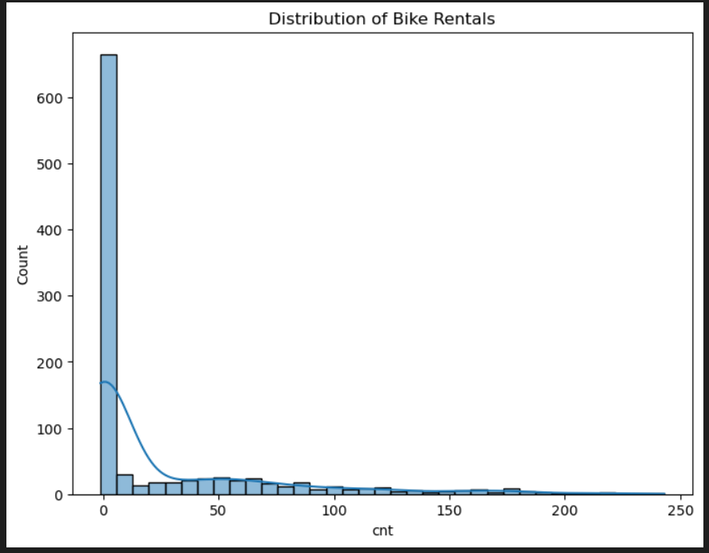
Final Visualization: Raw Distribution of Bike Rentals
The histogram reveals the actual bike rental distribution, showing:
- Most hours have low rentals (less than 10 rentals/hour), indicating typical demand.
- Occasional peak hours with extremely high rentals (over 200 rentals/hour), likely driven by commuting or special events.
- Skewed distribution confirms that peak demand is rare, while low demand is common.
This pattern suggests that bike-sharing services experience most demand during regular, low-usage periods, with occasional spikes in usage during peak hours or special events.

Slide 9
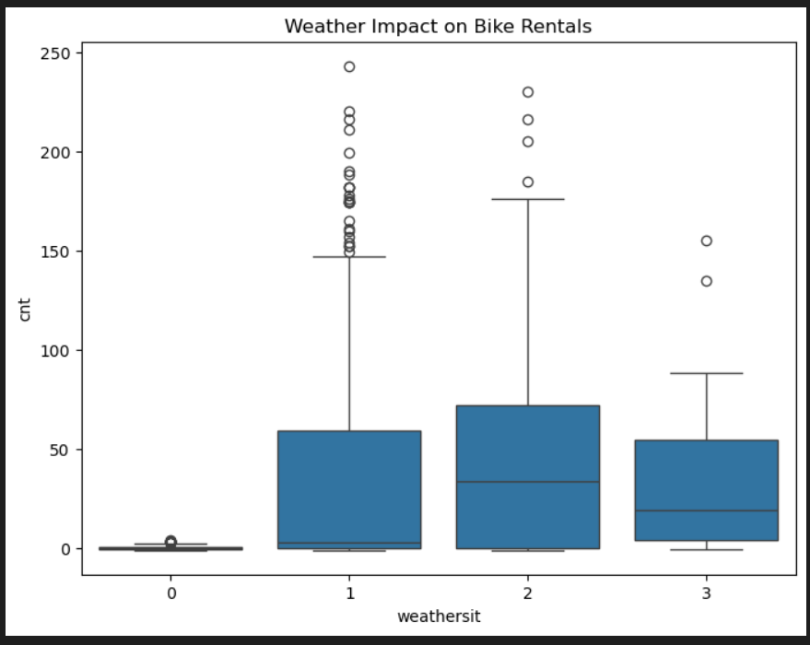
Weather Conditions vs. Bike Rentals
The boxplot shows how weather affects bike rentals:
- Clear weather (Code 1): Highest median and maximum rentals, indicating ideal biking conditions.
- Mist/cloudy weather (Code 2): Relatively healthy rentals, though slightly lower than clear weather.
- Rain/snow weather (Code 3): Sharp drop in rentals, with lower median and fewer high-count outliers.
- Missing/abnormal data (Code 0): Negligible rental activity, likely due to data issues.
- Weather significantly impacts bike usage.
- Weather should be a key predictor in demand forecasting models.
- Code 0 values may need to be dropped or imputed due to lack of meaningful insight.

Slide 10
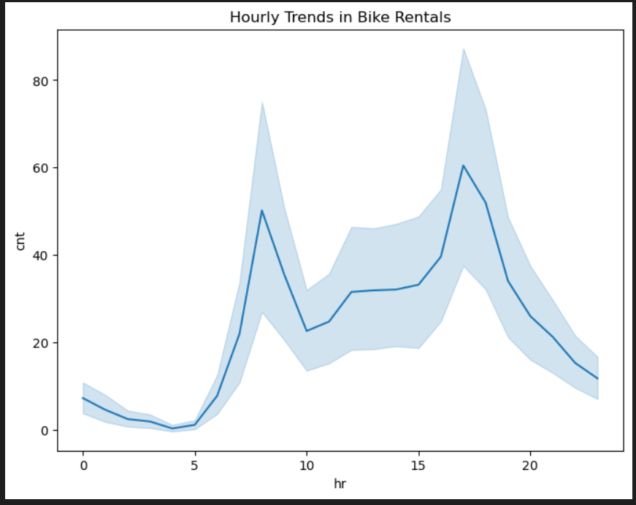
Hourly Trends in Bike Rentals
This line plot illustrates how bike rentals vary by hour of the day (hr) based on the cnt (count of total rentals). The shaded area represents a confidence interval, providing insight into the variation or uncertainty around the average rental count.
Morning Peak (7 AM - 9 AM): A sharp increase in rentals occurs, likely due to commuters heading to work or school.
Evening Peak (4 PM - 7 PM): Another noticeable rise, corresponding to commute hours for return trips.
Midday Plateau: Between 10 AM and 3 PM, rental activity stabilizes at a moderate level.
Late Night Drop: Rentals sharply decline after 8 PM, hitting a low during early morning hours (12 AM - 5 AM).

Slide 11
How Everything Was Handled
1. Loading & Inspecting the Dataset
i. Loaded dataset using pd.read_csv() from Pandas. ii. Inspected first few rows with df.head() to understand structure. iii. hr: Hour of the day , cnt: Total bike rentals
iv. weathersit: Weather situation , temp, hum, windspeed: Environmental variables , casual, registered: User types
2. Cleaning & Normalizing the Data
i. Some values were already normalized (e.g., temp, hum, windspeed). ii. It’s possible additional steps like removing missing values or filtering outliers were done. df=df.drop()
3. Data Visualization
A. Distribution of Bike Rentals - plt.figure(figsize=(8, 6))
sns.histplot(df['cnt'], kde=True) 4. Final Dataset
plt.title('Distribution of Bike Rentals') this was likely done Using
plt.show()
Understand how frequently different rental counts occur.
B. Weather Impact on Bike Rentals
plt.figure(figsize=(8,6))
sns.boxplot(x=df['weathersit'], y=df['cnt'])
plt.title('Weather Impact on Bike Rentals')
plt.show()
C. Hourly Trends in Bike Rentals
plt.figure(figsize=(8,6))
sns.lineplot(x=df['hr'], y=df['cnt'])
plt.title('Hourly Trends in Bike Rentals')
plt.show()

Slide 12
Correlation Analysis
1. Correlation:
- Measures linear relationships between variables (-1 to 1).
- Bike rental correlations:
- Registered users: High positive correlation (more users → more rentals).
- Temperature: Moderate positive correlation (warmer days → more rentals).
- Windspeed: Weak/negative correlation (windy days reduce rentals).
- Humidity: Weak negative correlation (humidity might reduce rentals).
2. User Types:
- Casual users: Occasional riders (e.g., tourists).
- Registered users: Frequent riders with memberships (e.g., commuters).
- Key insights:
- Registered users peak during commute hours (8 AM, 5 PM).
- Casual users rent more on weekends and holidays.

Slide 13
Outliers
The dataset reveals potential outliers in:
1. Windspeed: Values like -1.683162 may indicate missing or placeholder values, which could be considered outliers or invalid entries.
2. User Counts (casual, registered, cnt): Row index 999 shows unusually high values (casual = 2.0, registered = 96.0, cnt = 98.0), which could be a valid peak or an anomaly.
3. Negative Values: Negative values in casual, registered, and cnt columns (e.g., -0.237798, -0.810275) are unrealistic in a real-world context, suggesting either:
Data Normalization: Values might have been normalized using StandardScaler or MinMaxScaler.
Invalid Entries: Negative values could be errors or invalid data.

Slide 14
thank you
I look forward to your feedback

