Slide 1
Tasking problems
Dymkou Siarhei
Temasek Laboratories
Control Science Group,
National University of Singapore
Technical Report
— April 2014 —

Slide 2
Outline
Summary of the Results
Problem class description
Overview of the whole system
Achievements and Limitations
Simulations
Conclusion and Future Work

Slide 3
Summary of D8 Results
Algo | Final Validation Objective | Phase | Means | Results
B-3 | Resource Allocation. To show that the optimal assignment and schedule can be found faster than conventional method. Conventional method: The operator manually determines the optimal assignment and schedule. | Final | The simulation results will be provided | Completed
 | Distributed Tasking. To show that the near optimal assignment can be found faster than conventional method. Conventional method: The operator manually determines the optimal assignment. | Final | The simulation results will be provided | Completed We have developed a distributed approach and enhanced the existing ones in order to give a mathematical description of models for task assignment problems of MAS for different possible scenarios, namely we show the functionality of the Control Net Protocol algorithm for the Benchmark Problem 3 (Search and Track) and also have tested the Consensus-Based Bundle algorithm for Tethered UAVs Self-Assignment Problem where it is not possible to identify the “leader” among UAVs.

Slide 4
Problem Class Description

Slide 5
Overview of the Whole System
Notes:
The Proposed System include two main parts: the vision-based relative sensing, and tracking and following control
A modulated and flexible vision-based relative sensing system is proposed as follows. It include the following parts: object detector, image tracker, data fusion, estimator and data fusion.
The proposed target detector is developed based on geometry and shape information of the target, which consists of the following key steps

Slide 6
Rationale
Algorithms | Rationale
North West Corner (NSW) (centralised) | Applicable to scenario when the CSG is available; Very fast computation by using the special optimality conditions, which is suitable for the online calculations.
Consensus Based Bundle algorithm (CBBA). (decentralised) | Applicable to scenario when the CSG is not available; Very fast computation by using the special structure of the algo, which is necessity for the planning over large teams due to the increasing communication and computation overhead required for centralised planning with a large number of agents.
Contract Net Protocol CNP. | Applicable for the Collaborative Search & Track scenario. Namely, the algorithm can automatically search the area and automatically task UAVs to track the targets found and automatically adjust the “search plan” when UAVs originally performing search are now doing tracking.

Slide 7
General requirements
Objective: assign the tasks between UAVs
7

Slide 8
Achievements and Limitations
Achievements | Limitations
Optimal solutions can be found (NSW) • Task selection - Polynomial-time, provably good feasible solutions (CBBA,CNP) Guaranteed real-time convergence even with inconsistent environment knowledge (NSW,CBBA,CNP) Time-varying score functions (NSW,CBBA,CNP) | NSW can be apply only for homogenuos service UAVs. To find optimal assignment is possible only in case when CSG available all the time.

Slide 9
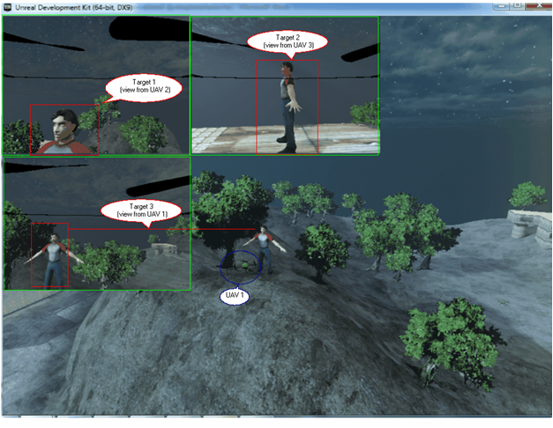
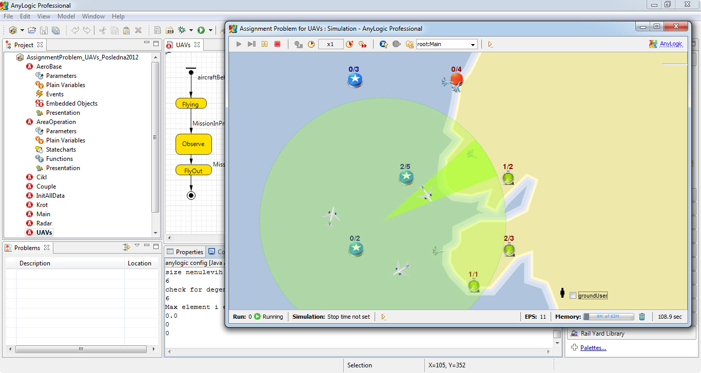
Concluding Remarks
NSW has been successfully implemented in AnyLogic environments.
CBBA and CNP are successfully tested for asked scenarios.
The objective of D8 has been achieved
Deliverables
AnyLogic simulator for NSW
Integrated simulator for CNP (see Meng Wei slides)
Toolbox for CBBA (using Matlab and UDK)
9
Notes:
9

Slide 10
Thank you!

