Slide 1
Cooperative UAV Project (Urban Mission)
Presented by
Dymkou Siarhei
Temasek Laboratories
Control Science Group,
National University of Singapore
Technical Report
— May 2014 —

Slide 2
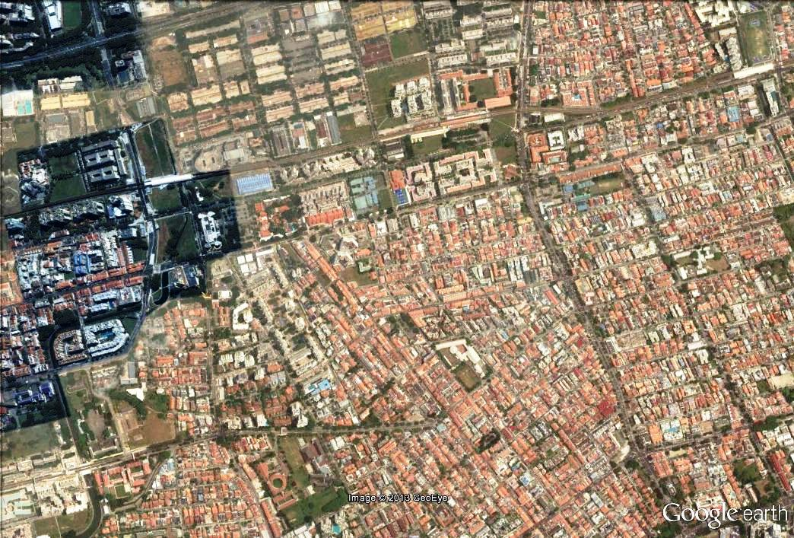
Problem Statement
Surveillance VTOLs (static)
Role – To provide persistent surveillance of the areas of interest.
Behaviour – To station over vantage points.
Surveillance VTOLs (mobile)
Role – To provide surveillance of the major roads and key vantage points surrounding the area of operations.
Behaviour – To fly around patrol circuit
Notes
Vantage points and patrol circuits – These will be input by the operator. Each will be assigned a priority level.
Initial tasking of UAVs to vantage points and patrol circuits can be performed on the GCS.
During operations, if a UAV is lost, auto-replacement will take place without communications to GCS.
If a new UAV is sent in, it will be assigned to the empty position with the highest priority.

Slide 3
Algos Reqd
Initially, how to assign tasks to UAVs from GCS?
During operations, how to detect loss of UAV (that is supposed to take up a certain task) based on the regular broadcasts and the table maintained by each UAV?
What are the contents of the messages and the table? How are they updated?
How to capture, for the logic, which task the lost UAV was supposed to take up?
How to re-assign UAVs to tasks using centralized MILP version?
How to appoint leader? How to re-appoint leader if leader is lost before assignment is made?
How to avoid double assignment?
How to avoid non-assignment?
How to do this for one or more tasks occurring simultaneously?
How to do this for one or more tasks occurring one after the other?
How to do this while enroute (i.e. UAVs have not yet reached their assigned positions) for one or more tasks?
Sometimes, new UAVs are sent in while the rest are already assigned. How to assign new UAVs?
Collision avoidance. Logic for collision avoidance.

Slide 4
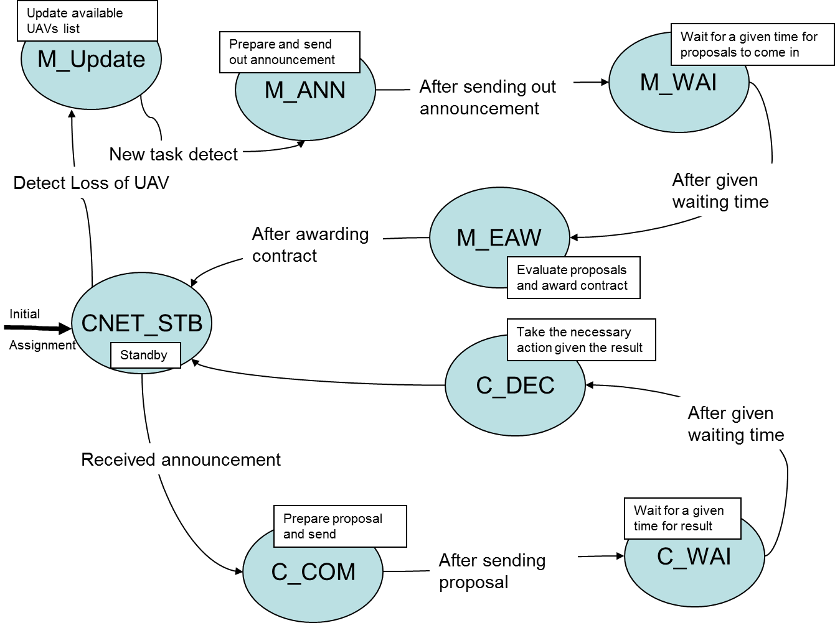
UAVs Logic (Manager and contractors)

Slide 5
UAVs Heartbeat Data used for Loss Detect
N x N matrix (“Counters”), where N is a number of UAVs
N x 2 matrix (containing information about current assignments UAV-Task)

Slide 6
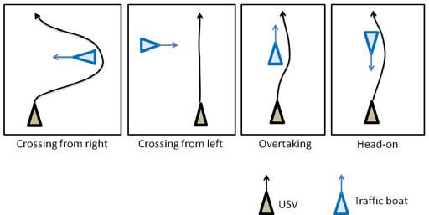

Velocity obstacle approach for collision avoidance
A ray starting from p going into the direction of v is defined as
Furthermore, the following set operations are used to express
the VO.
Given: • a near-term waypoint,
• a reference speed, and
• a list of objects representing moving and static hazards, find the best velocity command that avoids the hazards
Given a robot of shape A and a obstacle of shape B moving
at velocity , the VO in the velocity space of robot A is
given as

Slide 7
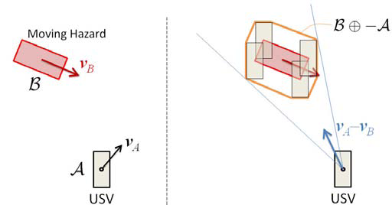
Graphical interpretation of Velocity Obstacles. When the relative
velocity of the robot points inside the cone formed by the robot
center and the expanded obstacle , they will collide. The VO imposed
on robot’s velocity is this cone shifted by a vector .

Slide 8
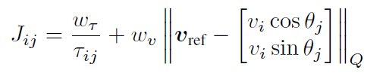
Rule Selector
• Distance: pA− pB ≤ Dmax
• Heading: |hA − hB| ≤ hmax
• Cross-track: yB ≤ ymax
• Along-track: xB ≥ xmin
Overtake situation
• Distance: pA− pB ≤ Dmax
• Heading: |hA − hB + π| ≤ hmax
• Cross-track: yB ≤ ymax
• Along-track: xB ≥ xmin
Head-on situation
Heading: hmin ≤ hB − hA ≤ hmax
• Bearing: bmin ≤ bB ≤ bmax
• Heading–Bearing relation: hB > bB − π
• Cross-track: yB ≥ ymin
Crossing form the right
Heading: hmin ≤ hB − hA + π ≤hmax
• Cross-track: yB ≤ −ymin
Crossing from the left
We use a regular discrete grid in the v–θ space to find the best velocity vector. Once the constraint sets of VO is generated, for each vi and θj that is still admissible, compute the following cost
Once all the cost is computed, the (vi, θj) pair with the minimum cost is selected and the velocity command is sent to the vehicle controller.

Slide 9
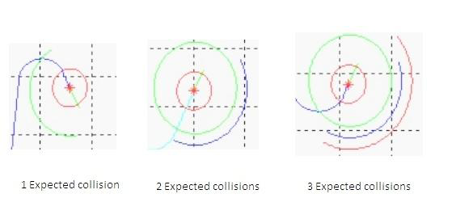
Examples of available angles
Angles are shown by green , blue and red arcs i.e if the UAV is expected to collide with one obstacle it will show one green arc of available angles , and if expected to collide with two, it will show green and blue arcs , and if 3 then green, blue and red arcs .
The final available angles is the intersection of the all these arcs. and one angle from them is chosen based on its cost :

Slide 10
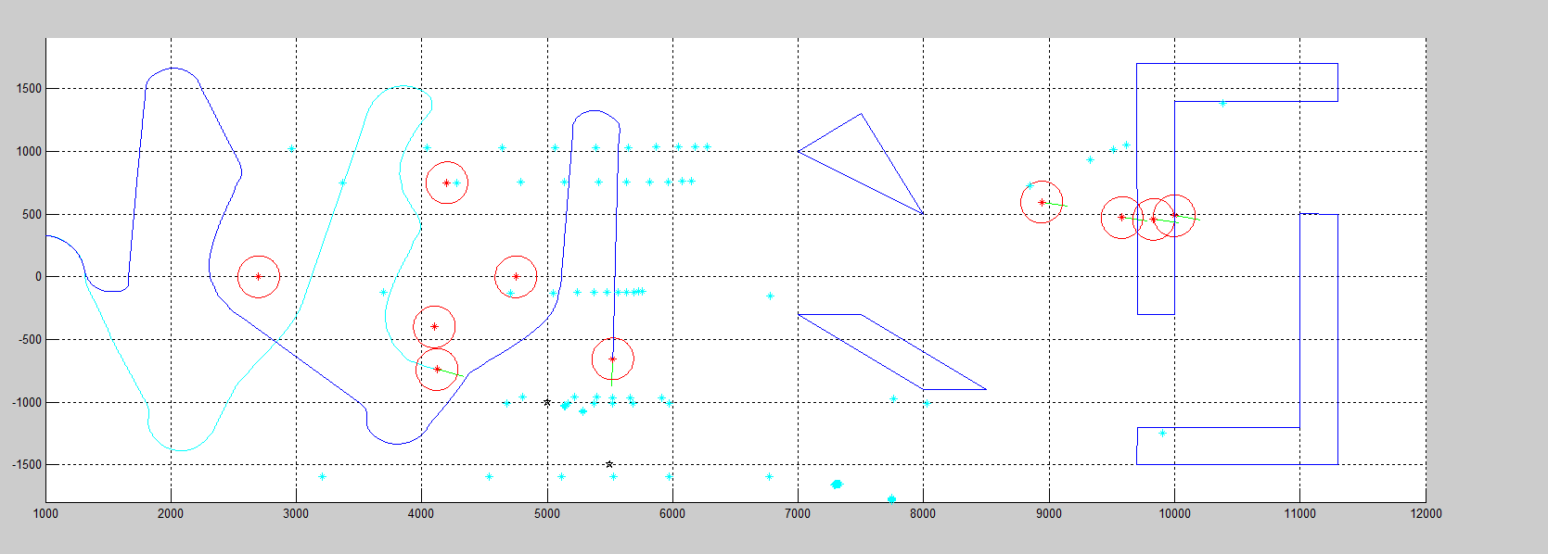

Slide 11
Thank you!

