Slide 1
SMART WATER FOUNTAIN
PHASE 5

Slide 2
Describe the project's objectives, IoT sensor setup, mobile app development, Raspberry Pi integration, and code implementation.
Include diagrams, schematics, and screenshots of the IoT sensors and mobile app.
Explain how the real-time water fountain status system promotes water efficiency and public awareness.

Slide 3
Describe the project's objectives, IoT sensor setup, mobile app development, Raspberry Pi integration, and code implementation.

Slide 4
Project Objectives : The project aims to develop a real-time water fountain status system that monitors the availability and usage of public water fountains. The objectives are to promote water efficiency by reducing wastage and raise public awareness about water conservation .
IoT Sensor Setup : Water Flow Sensors: Install flow sensors on each water fountain to measure water usage in real-time
Ultrasonic Sensors: Use ultrasonic sensors to detect the presence of users in front of the fountain.
Raspberry Pi: Each water fountain is equipped with a Raspberry Pi for data collection and transmission.
Mobile App Development: User Interface: Develop a user-friendly mobile app with features for finding nearby water fountains and displaying their real-time status.
Real-Time Data: The app should display the availability of water, the number of users at each fountain, and recent usage statistics.
Notifications: Implement push notifications to alert users when a nearby fountain becomes available or crowded.
Data Visualization: Use charts and graphs to visualize historical water usage and savings.
Raspberry Pi Integration :
Data Collection: Raspberry Pi collects data from the water flow and ultrasonic sensors.Data Transmission: It sends this data to a central server or cloud platform.

Slide 5
Local Processing: Raspberry Pi can also perform some local processing to determine the fountain's status (e.g., available, busy).
Code Implementation:
Raspberry Pi Code: Write code to read data from sensors and transmit it to the server. Implement logic to calculate water usage and fountain availability.
Server/Cloud Code: Develop the backend code for data storage, user authentication, and managing the real-time status of fountains.
Mobile App Code: Code the mobile app for user interface, real-time data retrieval, and push notifications

Slide 6
Include diagrams, schematics, and screenshots of the IoT sensors and mobile app.

Slide 7
Diagrams and Schematics:
IoT Sensor Setup: To create diagrams and schematics for your IoT sensor setup, you can use software tools like Microsoft Visio, Lucidchart, draw.io, or even hand-sketch and scan your drawings.
Raspberry Pi Integration: Similarly, use the same tools to create diagrams showing how Raspberry Pi is integrated with sensors, power sources, and communication components.
Screenshots of the Mobile App: Design the Mobile App: Use design tools like Adobe XD, Figma, Sketch, or even paper prototyping to create a visual design of your mobile app.

Slide 8
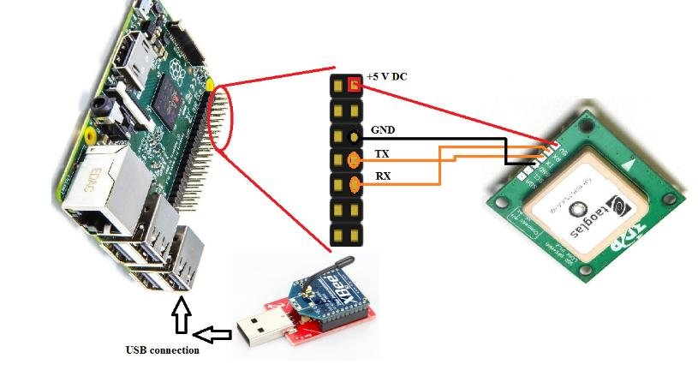

Slide 9


Slide 10
Explain how the real-time water fountain status system promotes water efficiency and public awareness.

Slide 11
Water Efficiency:
Real-Time Availability: The system provides real-time information on the availability of water fountains. Visitors can quickly identify which fountains are in use and which ones are available. This encourages users to choose available fountains, reducing waiting times and preventing unnecessary water wastage.
Reduced Waiting Time: By knowing the status of nearby fountains, users can avoid standing in line, especially during peak times. Reduced waiting times lead to more efficient water consumption and an overall positive experience for park visitors.
Water Conservation: The system helps conserve water by discouraging the use of multiple fountains simultaneously. Users can see if a nearby fountain is already in use and opt for a different one, thus reducing the overall water consumption.Public
Awareness:
Education: The mobile app or system can include educational content about water conservation, the importance of responsible water use, and the environmental impact of water wastage. This information raises public awareness about the value of water resources.
Data Visualization: The system can display charts and graphs showing historical water usage and savings. Visualizing the impact of efficient water consumption provides a tangible way for the public to understand their contribution to conservation efforts.
Push Notifications: Push notifications can be used to share water-saving tips and information about the importance of water efficiency with app users. These messages serve as reminders and further educate the public.

Slide 12
Community Engagement: Users of the system can share their experiences and water-saving achievements on social media, fostering a sense of community and encouraging others to participate in water conservation efforts.
Data Insights: The system can provide insights into the cumulative water savings achieved by using available fountains. This information allows users to see the direct result of their water-conscious choices.
Behavior Change: By making people aware of their water consumption and the environmental consequences, the system encourages a change in behavior . Visitors are more likely to adopt water-efficient practices both within the park and in their daily lives

