Slide 1

A Presentation on
Weather Forecasting-AI
Presented By:
Annada Prasad Parida-230301121552
Shubhankar Parida-230301121567
Chandan Kumar Nanda -230301121573
Department of computer science Engineering

Slide 2
CONTENTS
INTRODUCTION
OBJECTIVE
SYSTEM OVERVIEW
FEATURES
FEATURE MODEL
FLOW CHART & LIBRARIES
CONCLUSION

Slide 3
INTRODUCTION
Weather forecasting platforms play a vital role in modern society by helping people make informed decisions in their daily lives. Accurate weather predictions allow individuals to plan activities such as travel, farming, outdoor events, and work schedules.

Slide 4
Objectives
- Most weather apps show raw forecasts without transparent analytics
- Goal: combine live data, local ML, and interactive exploration
- Provide a reproducible, student-friendly pipeline

Slide 5
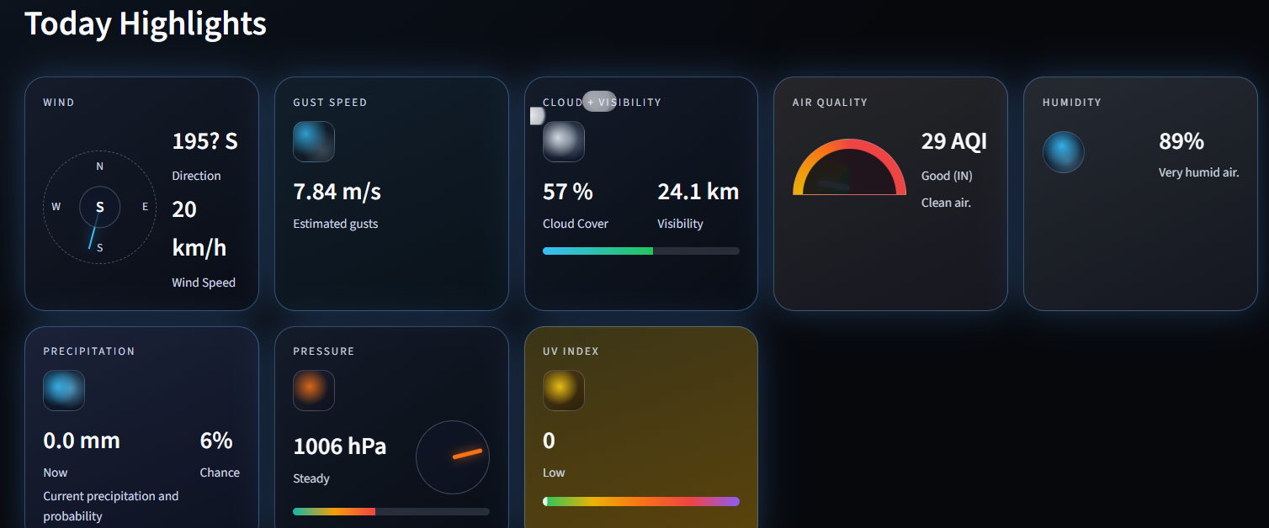
System Overview
- Live weather ingestion from public APIs
- Local historical dataset creation
- ML model for short-horizon temperature prediction
- Streamlit multi-page UI + agentic chat routing

Slide 6
Features-
- Live Weather: current conditions + short-term forecast
- AI Forecast: predicted temperatures + MAE display
- Data Lab: charts + map exploration
- Chat Agent: routes requests to tools
- Glass morphism UI with light/dark modes

Slide 7
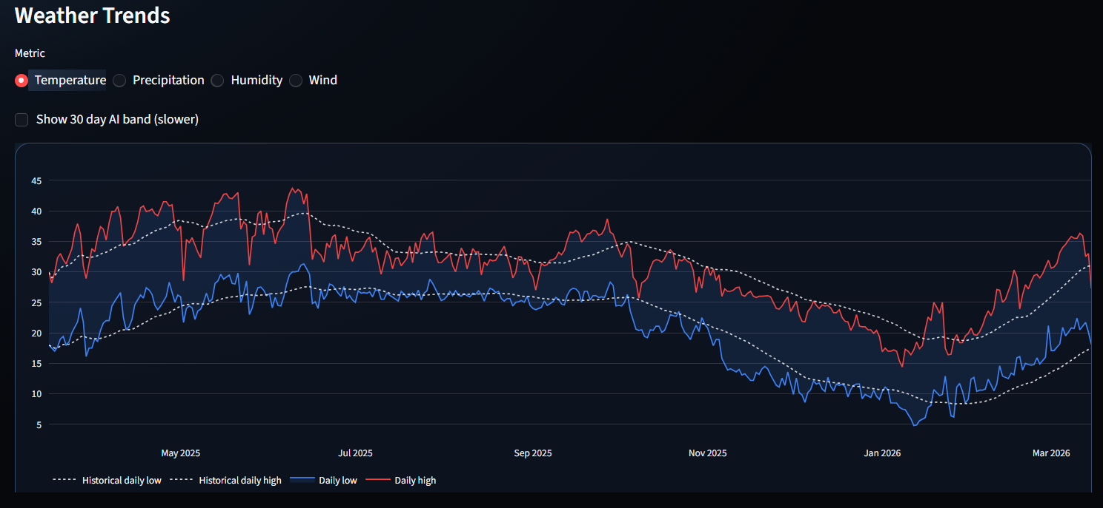
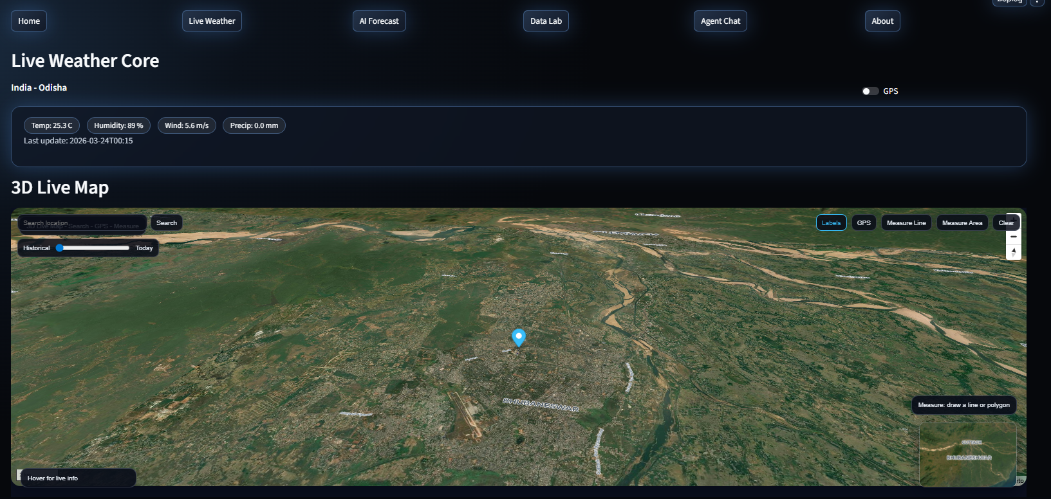
Feature Model
- Inputs: temperature, humidity, wind, precipitation
- Time features: hour, day-of-year, month
- Lag features: 1-hour and 24-hour temperature
- Rolling 24-hour temperature mean
- Model: HistGradientBoostingRegressor
- Metric: Mean Absolute Error (MAE)

Slide 8
Flowchart & Libraries
Flowchart (text):
Start -> Open Streamlit App -> Select Module -> Live Weather / AI Forecast / Data Lab / Chat Agent -> Visualize -> End
Libraries:
- streamlit, pandas, numpy, scikit-learn, requests
- plotly, joblib, folium, streamlit-folium

Slide 9
Conclusion
This project demonstrates that effective weather forecasting systems can be developed using open data sources and standard Python tools, without requiring large-scale infrastructure or highly complex models.
By focusing on local, short-term predictions, the system shows that even compact machine learning solutions can deliver meaningful results

Slide 10
THANK YOU

