Slide 1
Ethical Hacking
Cyber Security
Student Name:D.Kalaiyarasan
College Name:The Kavery Engineering College
Department:Computer Scince and Engineering
http://www.free-powerpoint-templates-design.com

Slide 2
OUTLINE
Problem Statement (Should not include solution)
Proposed System/Solution
System Development Approach (Technology Used)
Algorithm & Deployment
Result (Output Image)
Conclusion
Future Scope
References

Slide 3
Problem Statement
Your Text
Phishing attacks, where cybercriminals masquerade as trustworthy entities to deceive individuals into providing sensitive information or performing actions, remain a persistent threat. These attacks often lead to financial loss, data breaches, identity theft, and reputational damage for victims and organizations alike.
Example Text :
Get a modern PowerPoint Presentation that is beautifully designed.
Your Text
Example Text :
Get a modern PowerPoint Presentation that is beautifully designed.

Slide 4
Proposed Solution
Our proposed solution aims to equip individuals and organizations with the knowledge and tools necessary to recognize, prevent, and respond to phishing attacks effectively. By understanding phishing techniques, practicing caution, and implementing security best practices, we can mitigate the risks associated with these malicious activities.

Slide 5
System Approach
>Development of PowerPoint slides featuring informative content, visual aids, and interactive elements.
>Incorporation of graphics, animations, and multimedia to enhance engagement and retention.
>Utilization of presentation software tools such as Microsoft PowerPoint or Google Slides for content creation and delivery.

Slide 6
Algorithm & Deployment
>No specific algorithm is employed; however, deployment involves strategic dissemination of the presentation materials to target audiences.
>Presentations can be delivered in various formats, including in-person seminars, webinars, online courses, and self-paced modules.

Slide 7
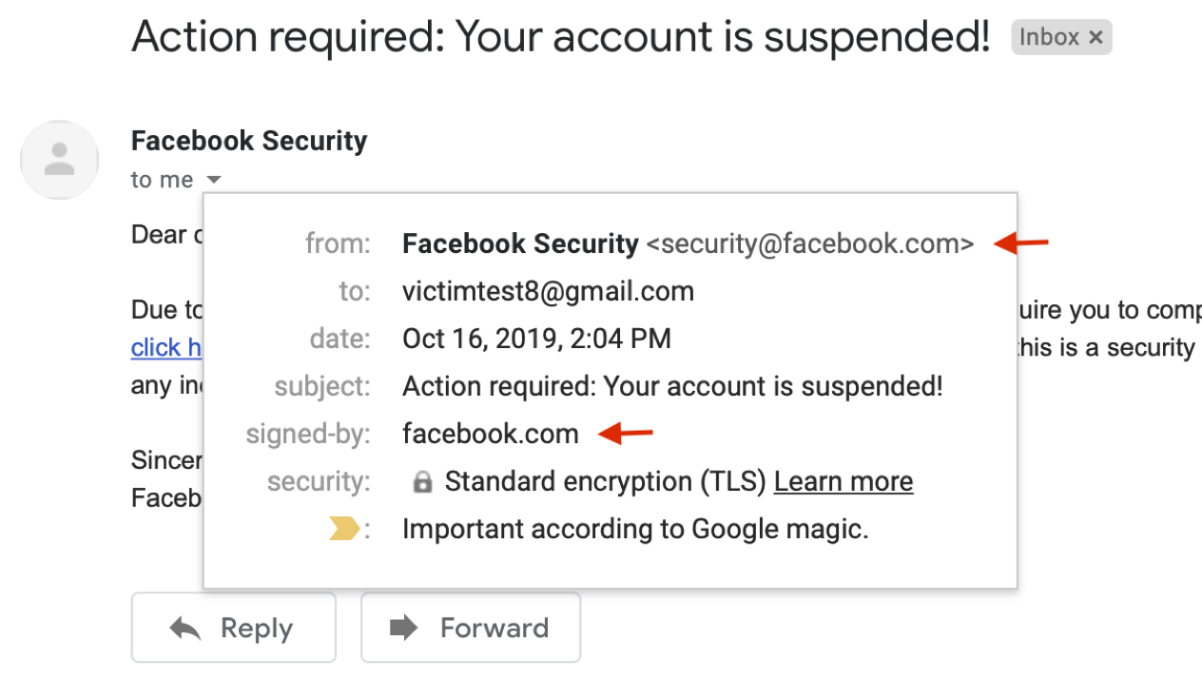
Result
Content Here
Visual representations of security awareness tips, best practices, and red flags to look out for in potential phishing attempts.

Slide 8
Conclusion
Phishing attacks continue to evolve in sophistication and frequency, posing significant challenges to cybersecurity. By empowering individuals and organizations with knowledge and awareness, we can strengthen our defenses against these malicious activities and safeguard sensitive information.

Slide 9

Future scope
Continuous updates and enhancements to the presentation content to address emerging phishing trends and tactics.
Collaboration with cybersecurity experts, industry partners, and stakeholders to develop comprehensive phishing awareness programs.
Integration of feedback mechanisms and assessment tools to measure the effectiveness of the educational initiatives and identify areas for improvement.
Add Contents Title
You can simply impress your audience and add a unique zing and appeal to your Presentations. Easy to change colors, photos and Text. I hope and I believtthis Template will your Time, Money and Reputation.

Slide 10
Include citations to reputable sources, industry reports, case studies, and cybersecurity resources used to inform the content of the presentation.
This expanded outline provides a more detailed framework for creating a PowerPoint presentation on phishing, encompassing various aspects such as content development, deployment strategies, and future considerations for ongoing improvement and adaptation.
References

Slide 11
THANK YOU

