Slide 1
EMPLOYEE DATA ANALYSIS USING EXCEL
STUDENT NAME: MADHUSHA.P
REGISTER NO : asunm203bcm22121
DEPARTMENT : COMMERCE
COLLEGE : KCS KASI NADAR COLLEGE OF ARTS & SCIENCE

Slide 2
PROJECT TITLE
EMPLOYEE RATING CARD ANALYSIS

Slide 3
AGENDA
Problem Statement
Project Overview
End Users
Our Solution and Proposition
Dataset Description
Modelling Approach
Results and Discussion
Conclusion
3/21/2024 Annual Review

Slide 4
PROBLEM STATEMENT
Analyzed employee data to identify reasons for high turnover, ensure fair salary distribution, and link attendance to productivity. Evaluate workforce diversity, assess performance appraisal trends, measure training effectiveness, and connect employee satisfaction to retention rates. Additionally, forecast future staffing needs to optimize workforce planning.

Slide 5
PROJECT OVERVIEW
In this analysis, I aim to streamline the process of identifying employee ratings based on their department, gender, and technical knowledge using excel, with the help of below stated tools in excel
Table
Slicers
Pivot chart (line chart & pie chart)
Pivot formula

Slide 6

WHO ARE THE END USERS?
Civil engineering
Computer engineering
Electrical engineering
Electronics engineering

Slide 7
OUR SOLUTION AND ITS VALUE PROPOSITION
Advanced analytical tools
Formulas and function
Pivot table
2. Comprehensive data management
Data organisation
Data integration
3. Scenario Analysis
Used to analyse differentsituation
4. User-Friendly interface
Accessibility
Ease of use
5. Visual Representation
Chart and graphics

Slide 8
DATASET DESCRIPTION
DATA OVERVIEW
The dataset contains information about employees within the organization, including their scores on Punctuality and Teamwork. This data is used to calculate the total score for each employee.
DATA FIELDS
Problem Solving
Punctuality
Communication
Technical knowledge
Team work
Meeting headline

Slide 9
MODELLING
Data Cleaning
Creating Table
Creating pivot chart
Creating dashboard
Inserting pivot chart in dashboard
Inserting formula in dashboard to make interaction
Creating interactive dashboard by putting all together elements
9

Slide 10
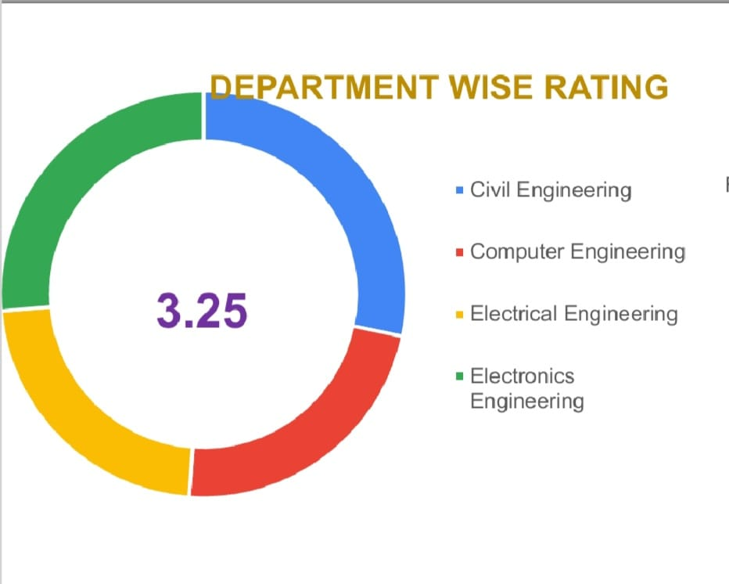
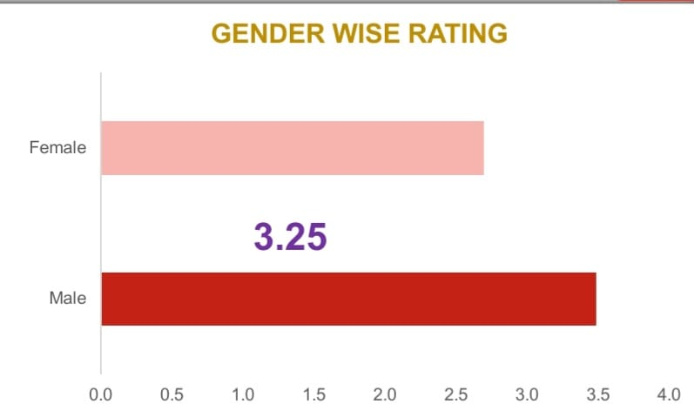
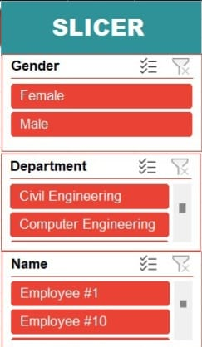
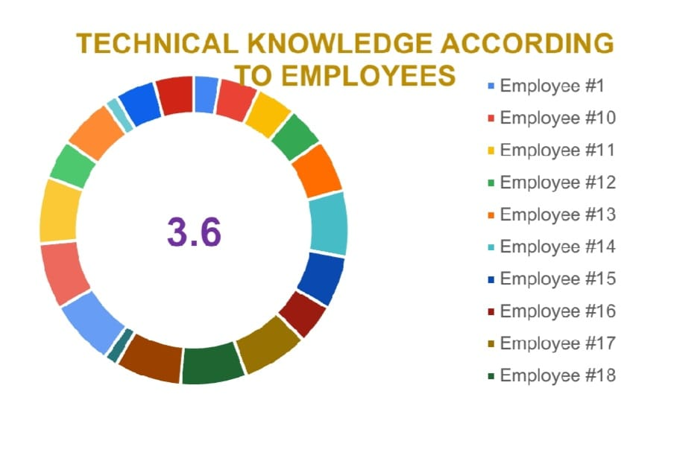
RESULTS
(Click to open file)
10

Slide 11
CONCLUSION
In conclusion, employee data analysis using Excel provides valuable insights that can significantly enhance decision-making processes within an organization. By analyzing key metrics such as turnover rates, salary distribution, attendance patterns, diversity, performance appraisals, and training outcomes, companies can identify areas for improvement, ensure equity and inclusivity, and optimize workforce management. Excel’s powerful data visualization and analysis tools make it an accessible and effective platform for driving strategic initiatives that improve employee satisfaction, retention, and overall organizational performance.

