Slide 1
Employee Salary Analysis
STUDENT NAME: SRIMATHI. A
REGISTER NO: 312204634, DBC37E08156BCD6A7B544572B9A32CB7
DEPARTMENT: COMMERCE
COLLEGE: K.C.S KASI NADAR COLLEGE OF ARTS & SCIENCE

Slide 2
PROJECT TITLE
Employee Salary Analysis

Slide 3
AGENDA
Problem Statement
Project Overview
End Users
Our Solution and Proposition
Dataset Description
Modelling Approach
Results and Discussion
Conclusion

Slide 4
PROBLEM STATEMENT
Analyzed the employee salary structure to identify disparities and ensure fairness.
Compare salaries across roles, experience levels, and demographic factors. Benchmark salaries against industry standards. Assess the impact of current salaries on employee satisfaction and retention. Provide recommendations for optimizing compensation strategies.

Slide 5
PROJECT OVERVIEW
The Employee Salary Analysis project aims to assess salary fairness and competitiveness by analyzing salary data across roles and demographics. The project seeks to identify disparities, benchmark against industry standards, and provide insights for salary adjustments to enhance employee satisfaction and retention.
Tables
Slicer
Pivot Chart( Line chart, Pie chart, Bar chart)
By inserting formula to make interactive dashboard

Slide 6

WHO ARE THE END USERS?
Human Resources Department
Finance Department
Compensation and Benefit specialist
Operational Manager
IT and Data management team

Slide 7
OUR SOLUTION AND ITS VALUE PROPOSITION
Visual Representation
Chart and Graphs
2. Scenario Analysis
Used to analyses different situation
3. Comprehensive Data Management
Data Organization
Data Integration
4. User-Friendly Interface:
Accessibility
Ease of Use
5. Advanced Analytical Tools:
Formulas and function
Pivot Tables

Slide 8
Dataset Description
1.Data overview
For employee salary analysis, gather data on employee demographics, salary
components(base, bonuses, etc.), and market comparisons.
2. Data Fields
ID
Name
Surname
Age
Tenure
Gender
Region
Department
Manager
Hours
Salary band
FTE Salary
Salary
Performance

Slide 9
MODELLING
Data cleaning
Creating table
Creating pivot chart
Creating dashboard
Inserting pivot chart in dashboard
Inserting formulas in dash board to make interaction
Creating interactive dashboard by putting all together elements.
9

Slide 10
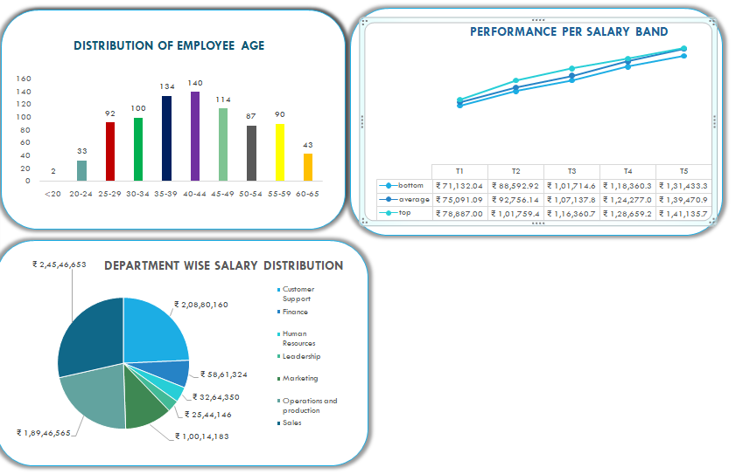
RESULTS
10

Slide 11
Conclusion
A thorough salary analysis ensures a fair and competitive compensation structure. Identifying and addressing salary disparities can improve employee satisfaction and reduce turnover. The analysis helps attract and retain top talent by aligning salaries with industry standards. Insights from the analysis guide informed decisions in compensation strategies.
Overall, it fosters a more equitable and motivated workforce.

