Slide 1
Performance Test Using Jmeter – Part 2

Slide 2

Contents
Recording a Use Case
Parameterization
Regular Expression Extractor (Correlation)
Running The Test Plan
Remote Run
Test Monitoring

Slide 3
Recording a Use Case

Slide 4
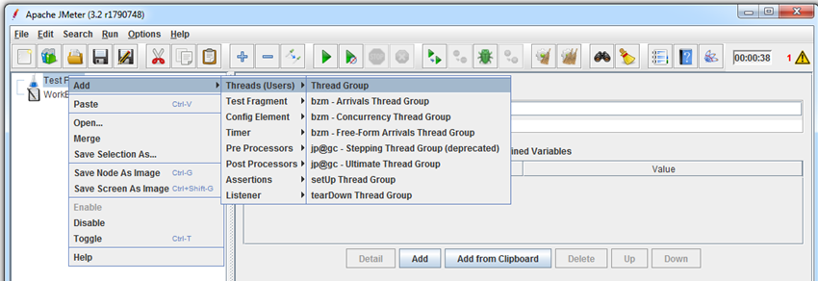
Recording a Use Case
Right click on test plan choose Add → Thread Group

Slide 5
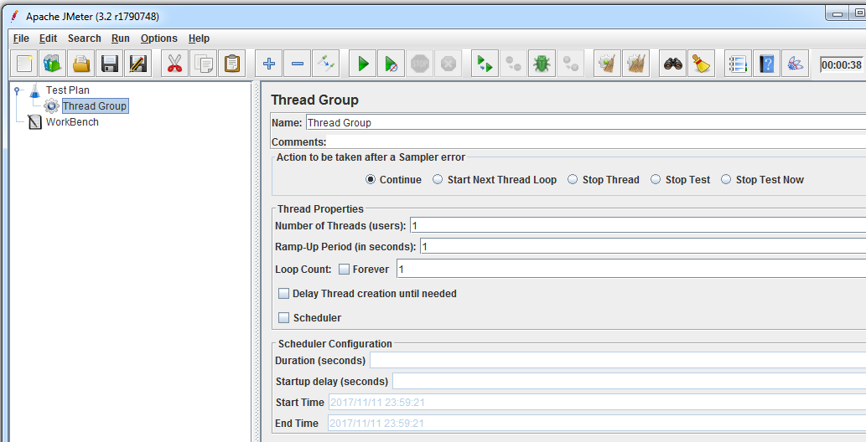
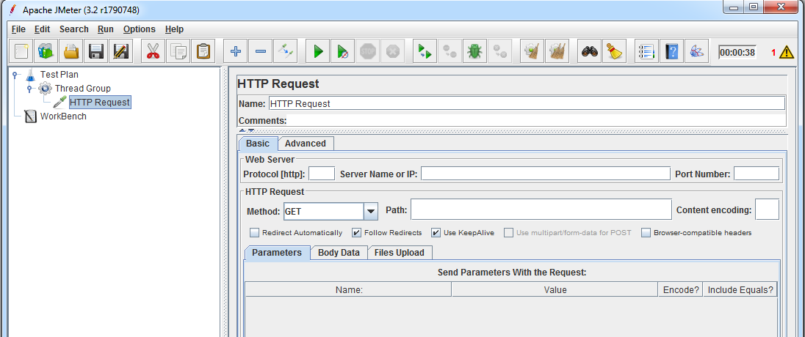
Recording a Use Case
Select the run time options like # of threads, ramp up period and iterations.
Add a HTTP request to the Thread group from Sampler

Slide 6
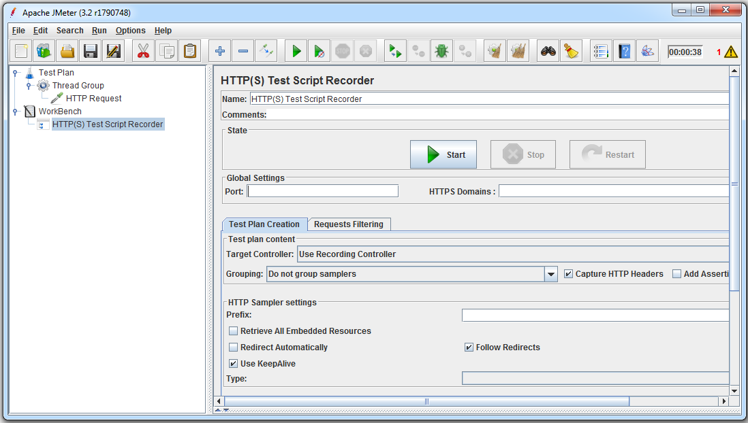
Recording a Use Case
Add a HTTP(S) Test Script Recorder to the workbench

Slide 7
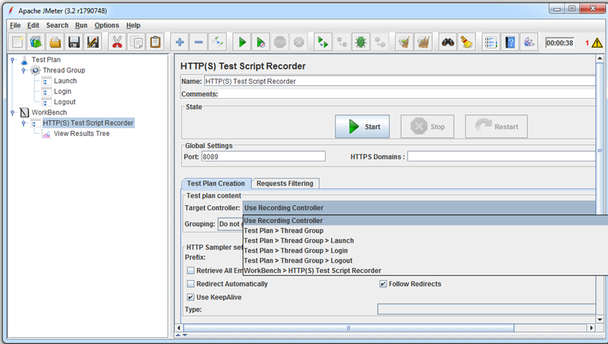
Recording a Use Case
Change the Port Number and Start Recording the script

Slide 8
Recording a Use Case
The HTTP(S) Test Script Recorder allows JMeter to intercept and record actions while browsing web application with normal browser. JMeter will create test sample objects and store them directly into the test plan

Slide 9
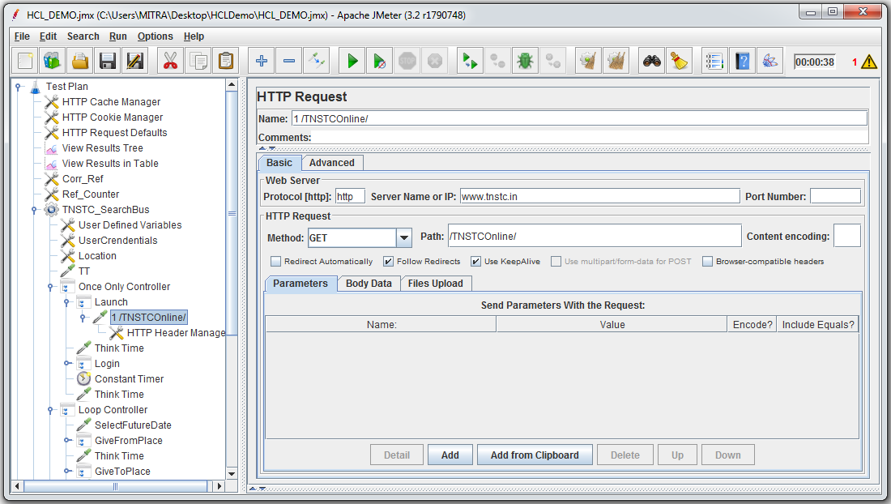
Recording a Use Case
Now go to Internet explorer and open a application and perform some user actions
Then the recordings would be generated as script in the JMeter window

Slide 10
Parameterization

Slide 11
Parameterization
Parameters can be set at both the Test Plan and Thread Group levels.
At the Test Plan level, parameters can be used as constants to minimize changes throughout the test plan when a server or port changes.
Within Thread Groups, the User Parameters Pre-Processor can be used to set different parameters for each simulated user.
If only one user (i.e. User_1) is defined, the value will be used for all threads.
Using CSV data set config
CSV Data Set Config is used to read lines from a file, and split them into variables. CSV Data Set Config serves the purpose of data source which can supply a large amount of data as per the scenario which you are testing.
For example, if you want to test login of 100 users, you can pick the values of email ID and password from the file. For picking the values you need to match the variables with column headings of excel sheet and provide the delimiter which could be “,” or a “\t(tab)”

Slide 12
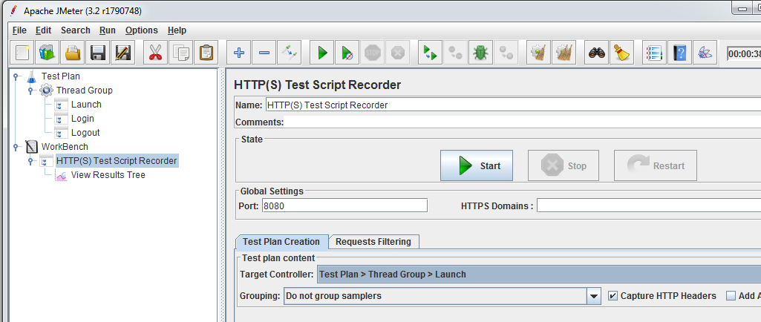
Parameterization
Start the HTTP(S) Test Script Recorder and go to http://www.tnstc.in. After recording a few transactions, close the browser and stop the HTTP(S) Test Script Recorder in Jmeter.

Slide 13
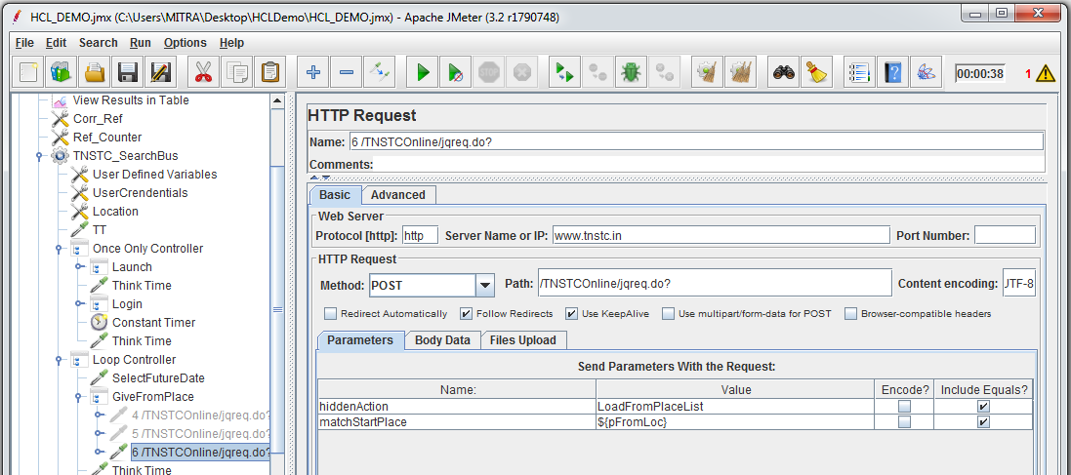
Parameterization
Here we are searching tickets between 2 locations
Now we will parameterize the start and destination place
Now add a CSV Data set Config and a Listener element to the thread group.
Add->Config Element->CSV Data Set Config
Add->Listener->View Results Tree

Slide 14
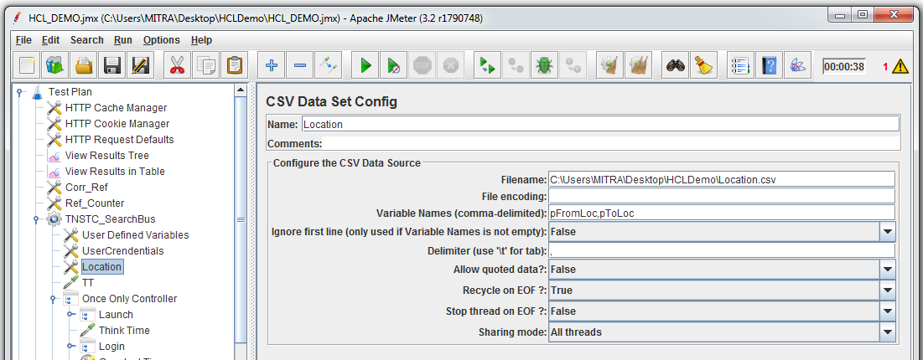
Parameterization
Now we will parameterize the Start and destination location
Create a CSV file with different locations to be searched and save it
Browse the file and add it to CSV data set config
Create the variable name for the data

Slide 15
Parameterization
Now select the CSV Data set Config element and fill in the fields as follows
Filename: Loaction.csv
(Give the path name if you have put it inside a subfolder e.g. folder name\search.csv)
Variable Names: pFromLoc,pToLoc
(This variable name is referenced in the search sample.)
Delimiter: ,

Slide 16
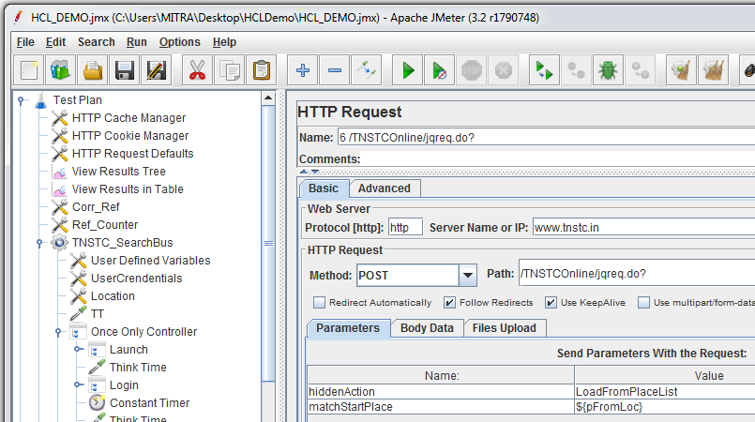
Parameterization
Now go to the Booking select bus and change the value of variable matchStartPlace to ${pFromLoc}.In Jmeter we reference a variable using ${}. For each iteration the value of matchStartPlace will be replaced as fetched by variable pFromLoc

Slide 17
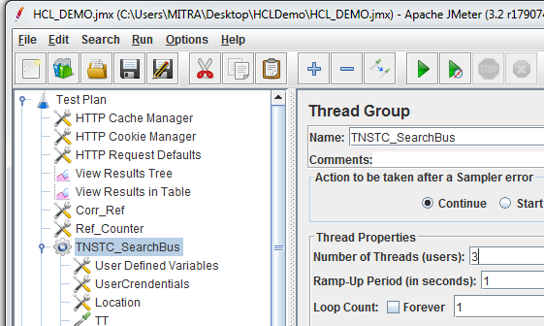
Parameterization
Now go to thread group and make the number of threads (users) to 3.
Run the script(ctr+R) and observe the result in result tree.
See the Results:
Check the start and destination places.
.

Slide 18
Regular Expression Extractor (Correlation)

Slide 19
Regular Expression Extractor
Allows the user to extract values (dynamically changing) from a server response using a Perl-type regular expression. As a post-processor, this element will execute after each Sample request in its scope, applying the regular expression, extracting the requested values, generate the template string, and store the result into the given variable name.

Slide 20
Regular Expression Extractor
Consider a request ‘B’ consisting of a dynamic value, following are the steps to extract this value dynamically during runtime:
Run the script for 1 user 1 iteration with the listener View Results Tree enabled.
After the run, select View Results Tree→ Response data Tab→Show Text radio button.
Search in the functions above function ‘B’ for the dynamic value to be captured.
Now let us consider a function ‘A’ whose response contains the dynamic value to be captured. Let us assume that the dynamic value along with its left and right boundaries looks like this sessionid=sxiqSsazH4KMjAfY1LGFCA” where, sessionid= is the left boundary and ” is the right boundary.

Slide 21
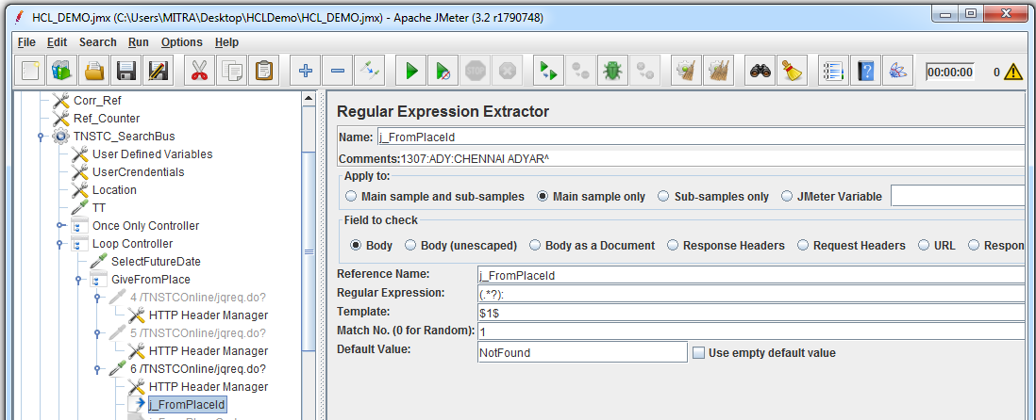
Regular Expression Extractor
Add “Regular Expression extractor” to the request

Slide 22
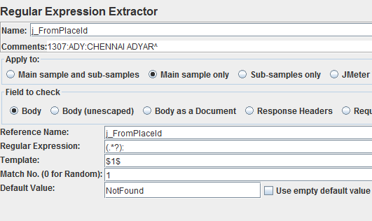
Regular Expression Extractor
Select the Regular Expression Extractor link under the request “6” and fill the fields as shown below:

Slide 23
Regular Expression Extractor
Reference Name
The name of the JMeter variable in which to store the result. Also note that each group is stored as [refname]_g#, where [refname] is the string you entered as the reference name, and # is the group number, where group 0 is the entire match, group 1 is the match from the first set of parentheses, etc.
Regular Expression
The regular expression used to parse the response data. This must contain at least one set of parentheses "()" to capture a portion of the string, unless using the group $0$. Do not enclose the expression in // - unless of course you want to match these characters as well.
Template
The template used to create a string from the matches found. This is an arbitrary string with special elements to refer to groups within the regular expression. The syntax to refer to a group is: '$1$' to refer to group 1, '$2$' to refer to group 2, etc. $0$ refers to whatever the entire expression matches.
Match No.
Indicates which match to use. The regular expression may match multiple times.
Use a value of zero to indicate JMeter should choose a match at random.
A positive number N means to select the nth match.
Negative numbers are used in conjunction with the For Each controller - see below.
Default Value
If the regular expression does not match, then the reference variable will be set to the default value. This is particularly useful for debugging tests. If no default is provided, then it is difficult to tell whether the regular expression did not match, or the RE element was not processed or maybe the wrong variable is being used.
However, if you have several test elements that set the same variable, you may wish to leave the variable unchanged if the expression does not match. In this case, remove the default value once debugging is complete.

Slide 24
Remote Run

Slide 25
Remote Run
Like other commercial tools, we can configure machines in the same network having Jmeter installed on them to act as load generators, i.e. we can use one machine to configure the scenarios and other machines to generate load (load generator).
Following are the steps to add load generator machines:
Go to the Jmeter bin folder.
Open jmeter. properties file with notepad.
In the notepad search for the text “remote_hosts=” and goto the end of that line and append the IP addresses of the load generator machines separated by comma(,).
Save the file and restart Jmeter, if open, to ensure that the changes take effect.
Now, if you want to run the test using any specific load generator machine that we have added then choose Run-→ Remote start→ IP address.

Slide 26
Running the Test Plan

Slide 27
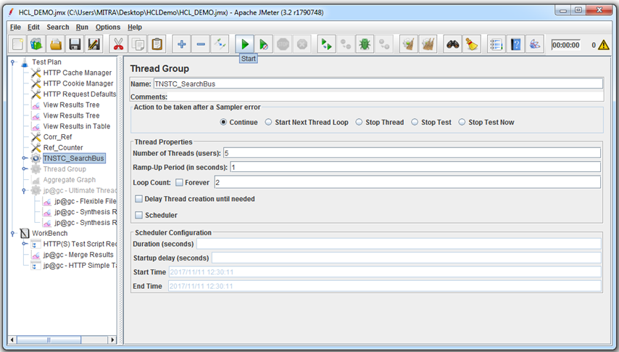
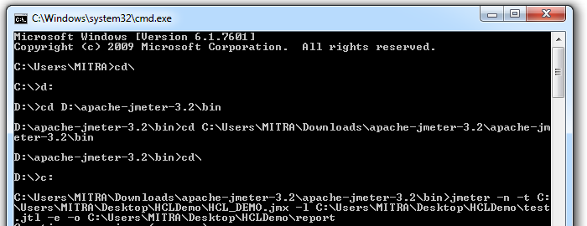
Running the Test Plan
Executing the test can be done through GUI mode and Non GUI mode.

Slide 28
Test Runtime Monitoring

Slide 29
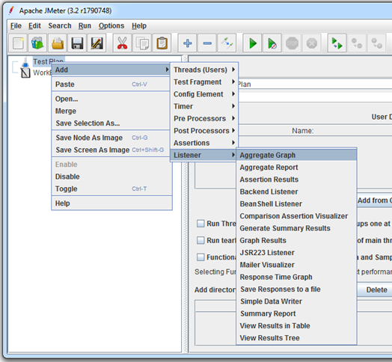
Test Runtime Monitoring
While running the test we can add the following listeners to monitor different counters.

