Slide 1


Raspberry Helper
김진용 이동현 홍기욱

Slide 2
Content
Overview
Business mission & objectives
Situation analysis
Identify opportunities
Implement marketing mix
Financial projections
Implementation plan
Evaluate performance using marketing metrics

Slide 3
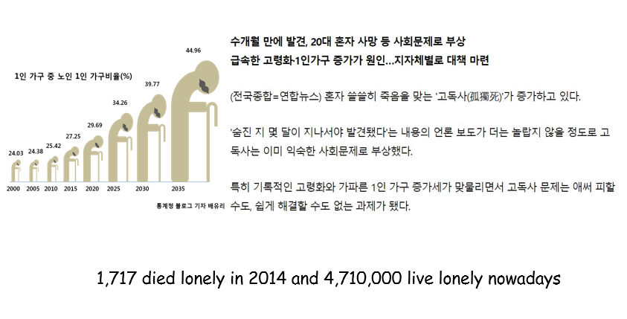
Overview

Slide 4
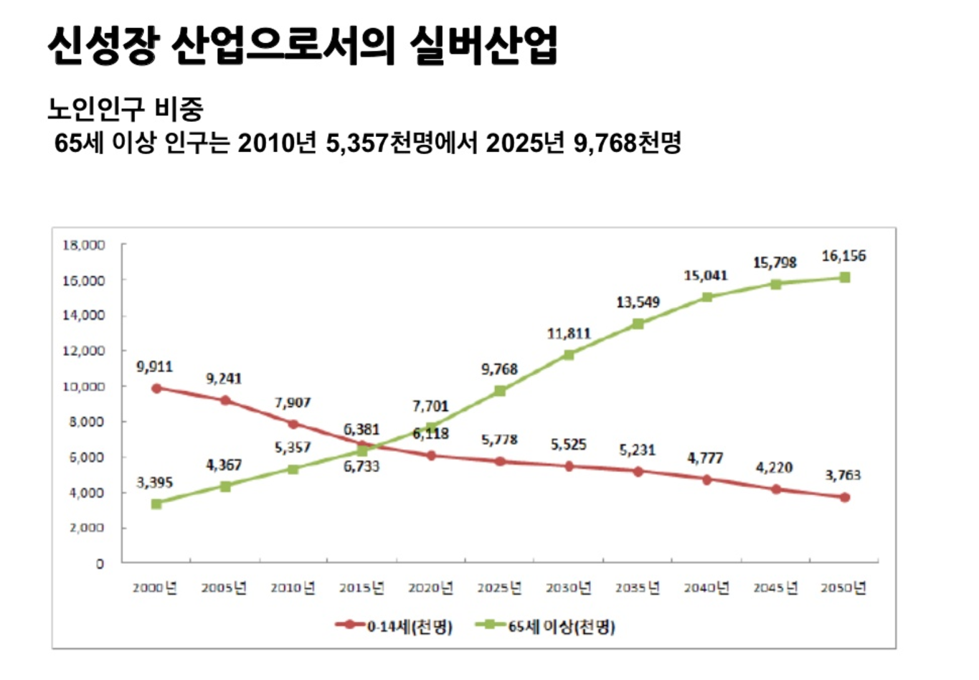
Overview

Slide 5
Business mission & objectives
Making people feel safe anywhere with raspberry helper.

Slide 6
Situation analysis

Slide 7
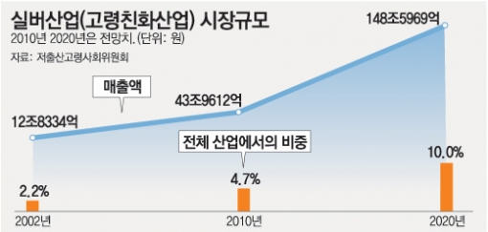
Business environment analysis
Market
Number of people: 10.9% of the population aged 65 and over, 13.9% of the elderly population use the silver industry.
People pay for a helping equipment 50,000won
Market size
14.6% of the population of the elderly people buy an equipment for emergency prevention.
Market growth
The silver market grew 14.2% over last year.

Slide 8
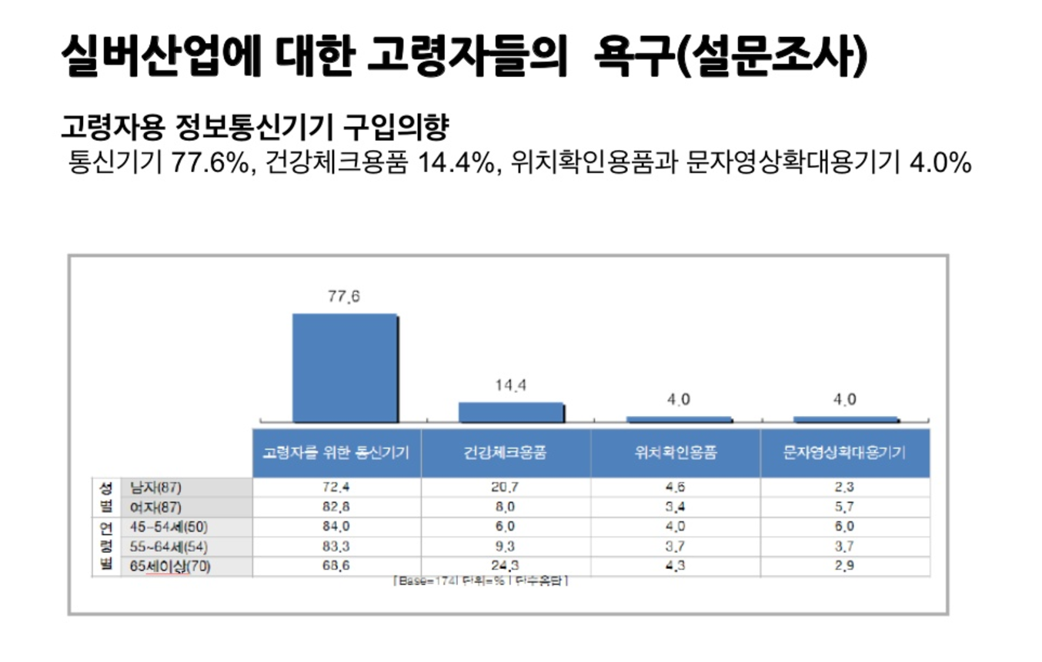
Market needs Older people are worried about health, worried about emergencies, and want to be able to respond quickly in an emergency
Market trends The need for information and communication equipment for the elderly among the elderly in the silver industry increased 77% compared to last year.

Slide 9
Customers The old people who live alone and often need help.
Handicapped person, Child.
Product / Service
When in a dangerous situation customer can request help with push button.
Customer can request help easily.
Helper can know the location of requester.
Competitors Help Request Application, Smart Alarm

Slide 10
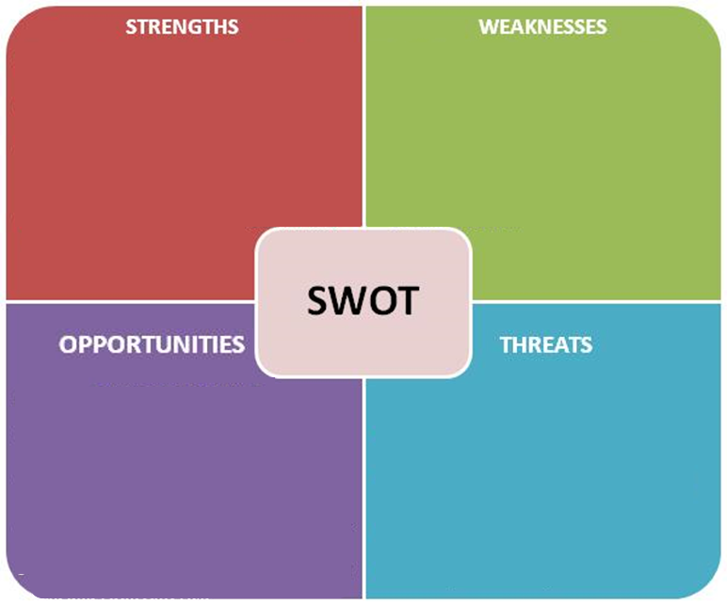
Risk analysis : SWOT
Simple product that anyone can use easily.
Easy to carry.
There is no development labor cost.
The motivation for helping someone is small
Consistent server management required
- Sightseeing with Hanbok
- Unique business item that has traditionality and beauty
- Lower cost than traditional Hanbok
- Networking among our rental shops.
- Durability of Hanbok
- Large cost for opening three rental shops
Products that can be socially helpful
Increase of the elderly people and living alone
Increase of government supports for silver industry
- Government support
- Increasing popularity of Korean culture
- growing the number of Chinese tourist
- no - visa entry at Jeju
- decreasing price of plane ticket
It can be used for other purposes
Government policy changes on smart devices

Slide 11
Risk analysis : Critical success factors
Prepare a policy for rewards after helping
Make partnerships with welfare institution.
Eg) Nursing home, Orphanage …

Slide 12
Identify opportunities

Slide 13
Segment
Location – Densely population area, downtown, remote area, apartment, detached house
Age – 20, 30, 40, 50, 60+
Gender – Male and female
Family relation – Large family, nuclear family, single person household, married
Physical condition – Healthy, handicap

Slide 14
Target
Location – Densely population area, downtown, remote area, apartment, detached house
Age – 20, 30, 40, 50, 60+
Gender – Male and female
Family relation – Large family, nuclear family, single person household, married
Physical condition – Healthy, handicap

Slide 15
Positioning
Ensure the safety of emergency situations for the socially vulnerable people such as the disabled, the elderly living alone, and those living alone.

Slide 16
Marketing mix

Slide 17
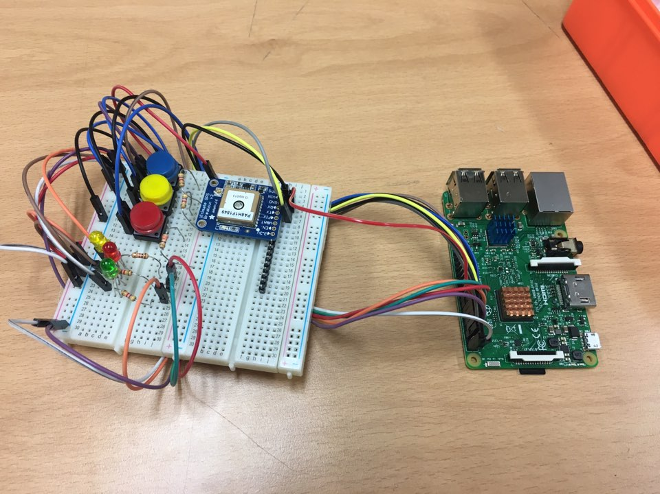
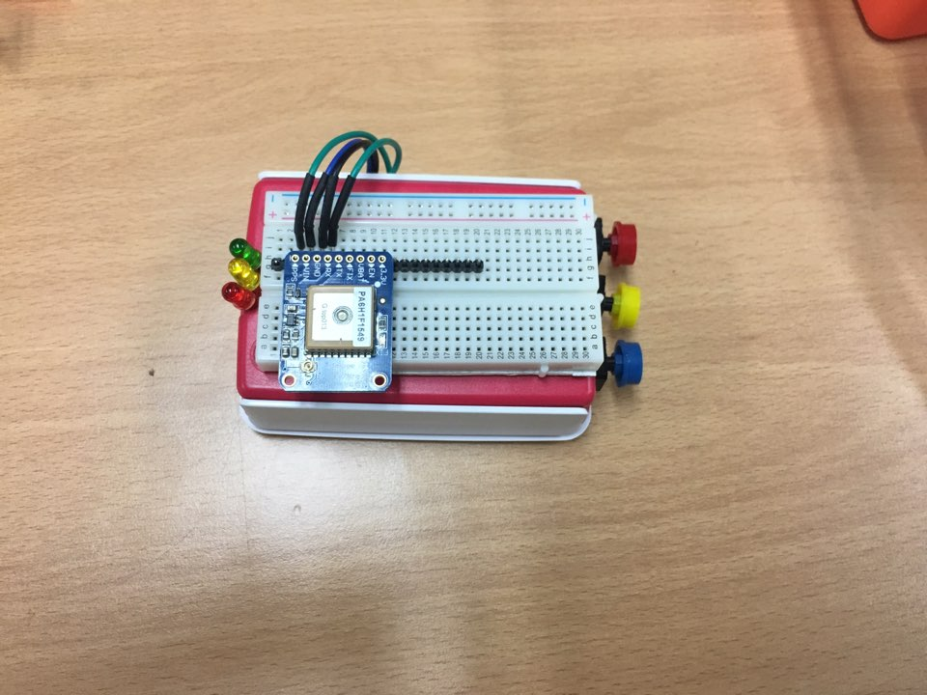
Product & Service

Slide 18
Product & Service
Raspberry Helper
Beacon
Android App
Emergency Service
Data Analysis Alarm Service

Slide 19
Price
Raspberry helper Depends on function (real time location) Rental : 5000 won per month Sell : 50000 won
Device insurance 3000 won per month
Emergency service Depends on location (rural, urban) : 5000 won, 10000 won per month

Slide 20
Price
Fixed cost | Maintenance cost of stores (eg, Charge of water, electronic, employee...) Hardware production cost, server maintenance cost, new sensor purchase cost Total : 200,000 won per a day
Variable cost | Public relations costs, service center part-time employment costs, application management alba employment costs Total : 100,000 won per a day

Slide 21
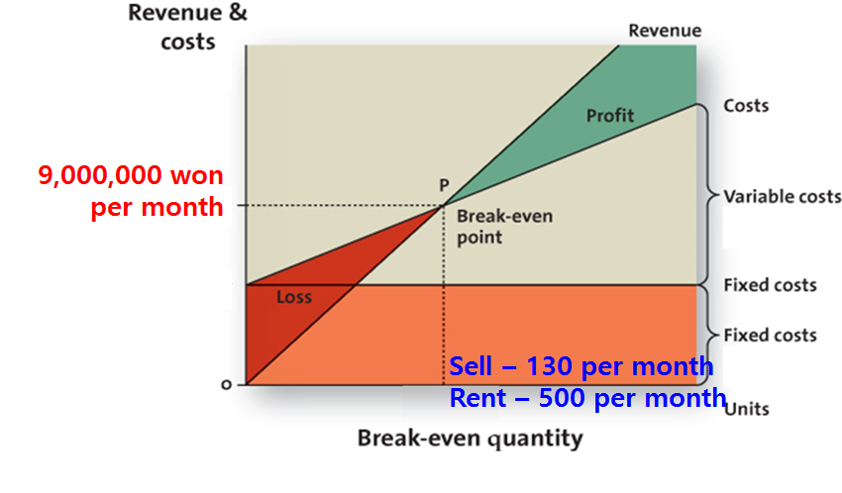
Break even analysis

Slide 22
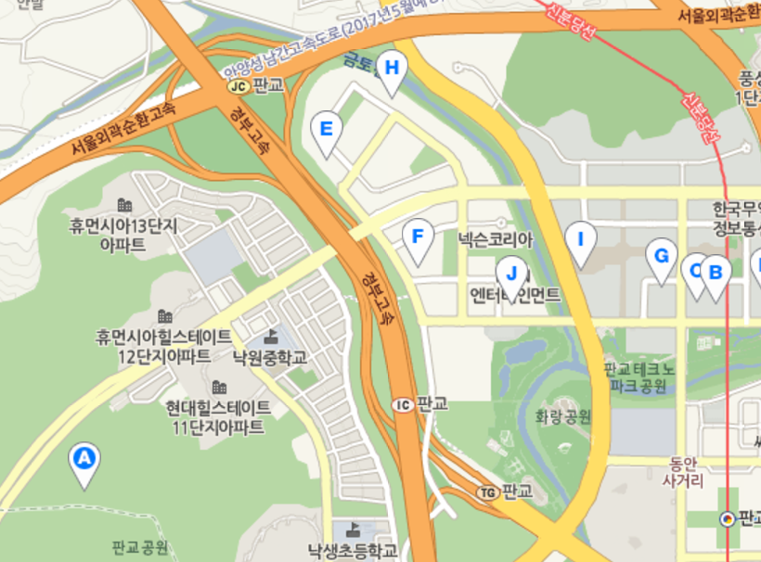
Place
Head office is located in Seoul, which has good transportation, and the branch offices and service centers are located in the center of each province, population density area.

Slide 23
Promotion
Launch banner ad at public institution
Conference booth registration
SNS (facebook, instagram..) popular account (50 won per one follower)
Register at social commerce (eg. coupang, wemakeprice…)

Slide 24
Financial projection

Slide 25
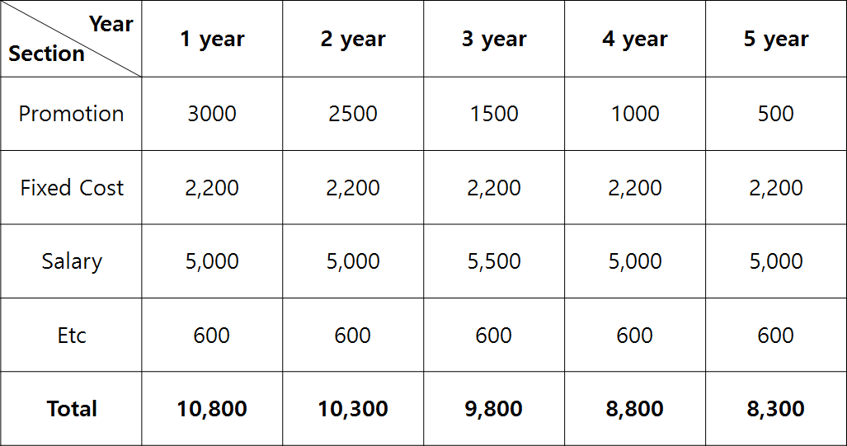
Expenses

Slide 26
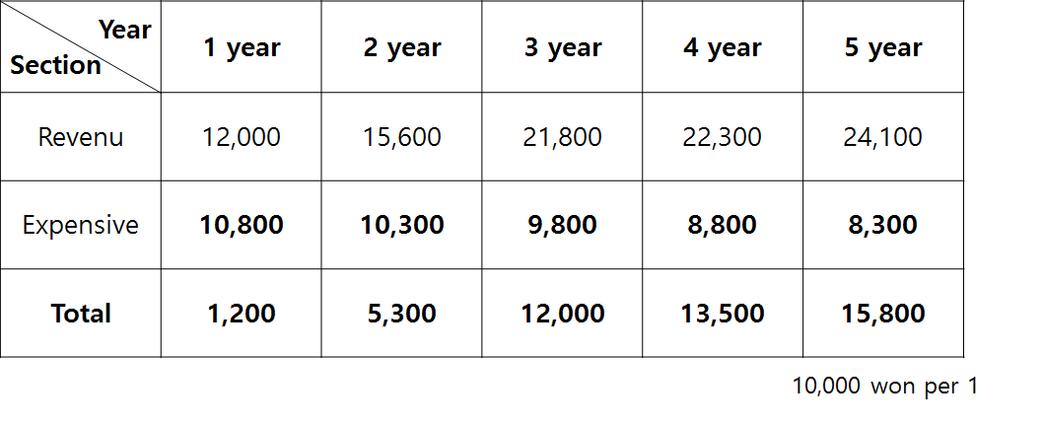
Profits (expenses - revenue)

Slide 27
Implementation plan

Slide 28
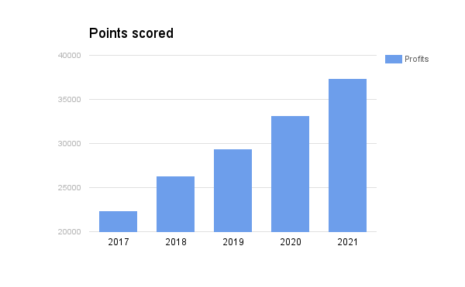

Milestone for business growth
10,000 won per 1

Slide 29
Business operation
Hire at least three employees, train them server design, and motivate them
Manage relationship with government(institution)
Maintenance locker room clean and other facilities

Slide 30
Evaluate performance

Slide 31
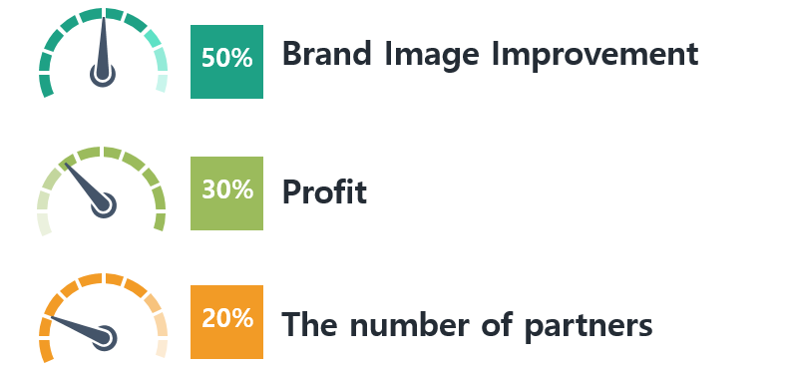
Evaluate performance

Slide 32
Thank you

