Slide 1
Topic: Marketing campaign for a Portuguese Bank
Submitted by- Arpan Kumar (s3696599), and
Vamika Pardeshi (s3701024)

Slide 2
Business Objective
Problem statement: Improving the marketing campaign for one of the Portuguese bank using historical data and analyzing it to recommend the potential customers.
Problem motivation: How bank can target their customers in the most effective way by improving their marketing campaign, using prediction algorithms.
The Portuguese bank, Banco de Portugal ran a marketing campaign offering ‘Term Deposit’ (target feature) to their customers. The data collected during the campaign was about the client generic details, mode of contact, and the outcome.
Data Exploration and Preparation
Programming done in Python 2.0 (jupyter notebook)
Extensive use of packages: ‘pandas’, ‘seaborn’, ‘numpy’, ‘matplotlib’ and ‘sklearn’.
The dataset contains 41,188 no. of instances (observations) and 20 no. of features (columns)
Features in the dataset are both categorical and numerical. The target feature, term deposit labelled as ‘y’ is binary (‘Yes’ or ‘No’)
Dataset was imported and uploaded as a data-frame in the python environment
Univariate and multivariate visualisation for both categorical and numerical features were created with the help of ‘seaborn’ and ‘matplotlib’ packages.
Missing value treatment for ‘unknown’ values present in the categorical features were imputed with the help of a cross-tabulation interpretations between two features. For example, between ‘job’ and ‘education’. Numerical feature ‘pdays’ had missing values ‘999’ which was majorly present in the column.
To deal with this case, ‘pdays’ was converted into 4 different categorical features, <6 days, 6-18 days, etc.
To measure strong correlations between the dependent variable, ‘y’, and other independent variables a heatmap was created.

Slide 3
Model Building
The final dataset was split into three instances of training and testing dataset, to evaluate the predicting model, using ‘sklearn.model_selection import train_test_split’, specified by train or test size.
Three instances were: 50%-50% (training and testing), 60%-40% (training and testing), and 80%-20% (training and testing) respectively.
Implemented supervised machine learning algorithm to solve the labeled classification problem, whether a client subscribes to term deposit or not.
Two supervised machine learning algorithm implemented: kNN (k-Nearest neighbor) and Decision Tree.
kNN (K-Nearest Neighbor)
Decision Tree
sklearn.neighbors.KneighborsClassifier
Find the k-most similar instances for the new data point based on distance metrics (Euclidean, Manhattan, and Minkowski)
Non-parametric technique.
sklearn.tree.DecisionTreeClassifier
Based on a single feature, it splits the data at each node
Information gain is used as a measure for split
Hyper-parameter tuning
Performed 10-fold cross validation on training set
For kNN model, the optimal no. of neighbors was identified, assumption: all points in each neighborhood are equally weighted, and the distance selected was ‘Manhattan distance’.
For Decision-tree model, the optimal ‘max_depth’ was identified, assumption: criterion was selected as ‘entropy’ for the information gain.

Slide 4
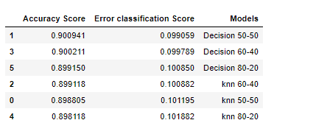
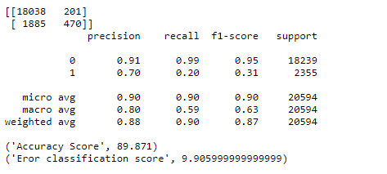
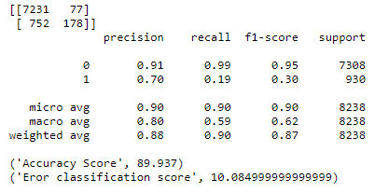
Model Evaluation and Results
Clearly, from the output below we can see that the model with the lowest classification error score is Decision Tree model trained and test for 50% each. (Classification error score = 1-Accuracy score). Also, Decision Tree performs better in terms of accuracy as compared to kNN models.
Confusion matrix and classification report for Decision Tree (50% test and 50% train)
But before drawing any conclusion, it is important to understand the ‘end objective’. That is where classification report and confusion matrix becomes important.
We need to check for two values, FALSE POSITIVE and FALSE NEGATIVE. FALSE POSITIVE, the client did not subscribed for the term deposit, however model predicted that it did. FALSE NEGATIVE, the client did subscribed for term deposit, however model predicted it did not.
Therefore, a model with ‘lowest recall score’ for ‘1’ should be considered.
Hence, model ‘Decision 80-20’, trained and tested for 80% and 20% respectively is the best model with lowest recall score for 1, i.e., 19% (0.19)
Confusion matrix and classification report for Decision Tree (80% test and 20% train)

