Slide 1






Vs (mx52300)
Ws (mx40)
Cs (40x52300)
=
.
$$s_{0}$$
$$c_{S,0}$$
Vn (mx52300)
Wn (mx40)
Cn (40x52300)
=
.
$$n_{0}$$
$$c_{N,0}$$
$$x_{t}=α_{S,t}s_{t}+α_{N,t}n_{t}$$
$$c_{t}=[\begin{matrix}α_{S,t}c_{S,t} \\ α_{N,t}c_{N,t}\end{matrix}]$$

Slide 2
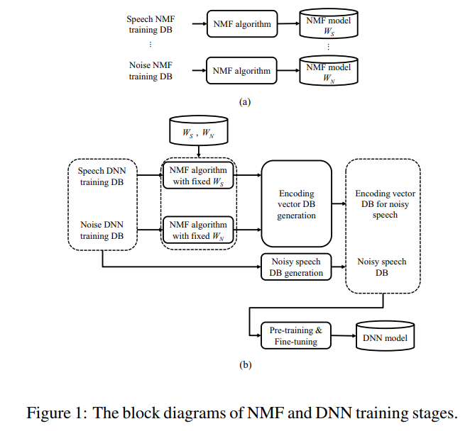


$$c_{t}=[\begin{matrix}α_{S,t}c_{S,t} \\ α_{N,t}c_{N,t}\end{matrix}]$$
$$x_{t}=α_{S,t}s_{t}+α_{N,t}n_{t}$$

