Slide 1
목차
EC2 인스턴스
Docker, Docker Compose 설치
n8n 실행

Slide 2
1. EC2 인스턴스

Slide 3
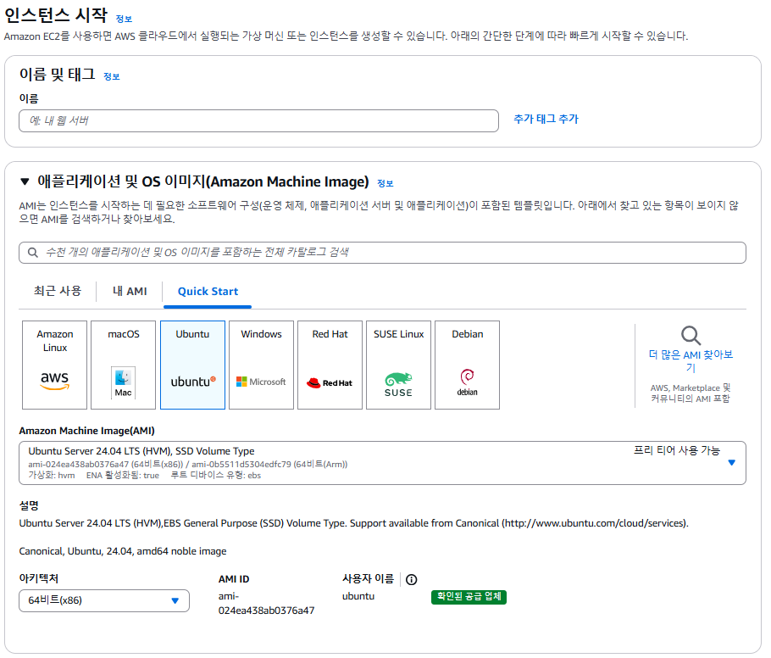
1) OS 이미지
1
n8n-demo
2

Slide 4
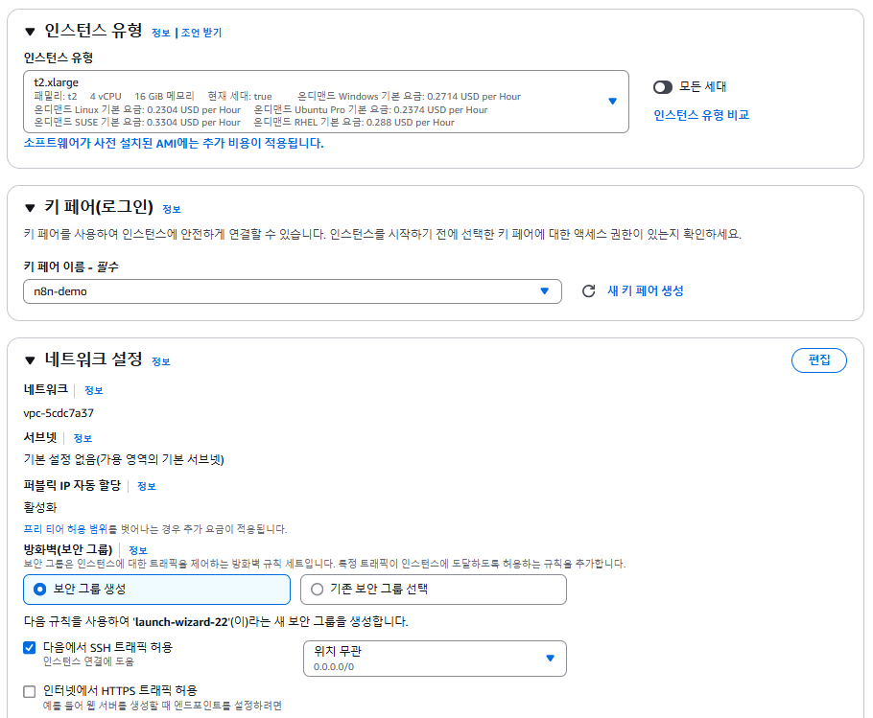
2) 인스턴스 유형
3
4

Slide 5
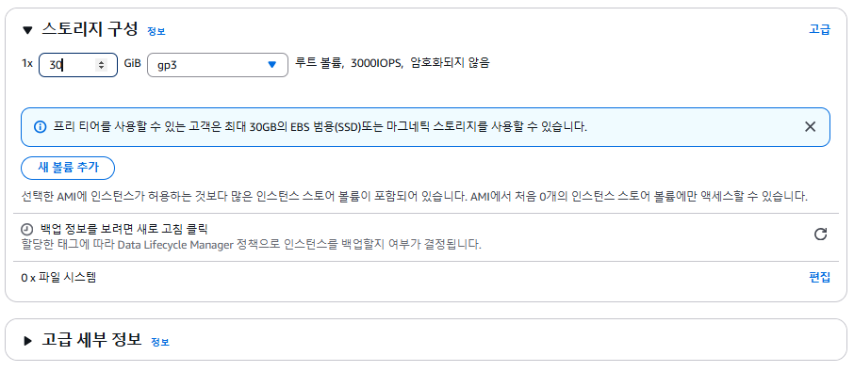
3) 스토리지 구성
5

Slide 6
2. Docker, Docker Compose 설치

Slide 7
1) Docker, Docker compose 설치
chmod 600 n8n-demo.pem
ssh -i ./n8n-demo.pem ubuntu@3.39.71.204
mkdir n8n
cd n8n
sudo apt-get update
sudo apt-get upgrade
sudo apt-get install docker.io --yes
# Add Docker's official GPG key:
sudo apt-get update
sudo apt-get install ca-certificates curl
sudo install -m 0755 -d /etc/apt/keyrings
sudo curl -fsSL https://download.docker.com/linux/ubuntu/gpg -o /etc/apt/keyrings/docker.asc
sudo chmod a+r /etc/apt/keyrings/docker.asc
# Add the repository to Apt sources:
echo \
"deb [arch=$(dpkg --print-architecture) signed-by=/etc/apt/keyrings/docker.asc] https://download.docker.com/linux/ubuntu \
$(. /etc/os-release && echo "${UBUNTU_CODENAME:-$VERSION_CODENAME}") stable" | \
sudo tee /etc/apt/sources.list.d/docker.list > /dev/null
sudo apt-get update
sudo apt-get install docker-compose-plugin

Slide 8
2) docker-compose.yml
volumes:
db_storage:
n8n_storage:
services:
postgres:
image: postgres:16
restart: always
environment:
- POSTGRES_USER
- POSTGRES_PASSWORD
- POSTGRES_DB
- POSTGRES_NON_ROOT_USER
- POSTGRES_NON_ROOT_PASSWORD
volumes:
- db_storage:/var/lib/postgresql/data
- ./init-data.sh:/docker-entrypoint-initdb.d/init-data.sh
healthcheck:
test: ['CMD-SHELL', 'pg_isready -h localhost -U ${POSTGRES_USER} -d ${POSTGRES_DB}']
interval: 5s
timeout: 5s
retries: 10
n8n:
image: docker.n8n.io/n8nio/n8n:1.80.5
restart: always
#network_mode: bridge
environment:
- "N8N_SECURE_COOKIE=false"
- "WEBHOOK_URL=http://3.39.71.204:5678"
- N8N_AUTH_EXCLUDE_ENDPOINTS=workflows/demo.
- DB_TYPE=postgresdb
- DB_POSTGRESDB_HOST=postgres
- DB_POSTGRESDB_PORT=5432
- DB_POSTGRESDB_DATABASE=${POSTGRES_DB}
- DB_POSTGRESDB_USER=${POSTGRES_NON_ROOT_USER}
- DB_POSTGRESDB_PASSWORD=${POSTGRES_NON_ROOT_PASSWORD}
ports:
- 5678:5678
links:
- postgres
volumes:
- n8n_storage:/home/node/.n8n
depends_on:
postgres:
condition: service_healthy

Slide 9
3) .env, init-data.sh
.env
POSTGRES_USER=changeUser
POSTGRES_PASSWORD=changePassword
POSTGRES_DB=n8n
POSTGRES_NON_ROOT_USER=changeUser
POSTGRES_NON_ROOT_PASSWORD=changePassword
DOMAIN_NAME=selfhosted.com
SUBDOMAIN=n8n
GENERIC_TIMEZONE=Asia/Seoul
.init-data.sh
#!/bin/bash
set -e;
if [ -n "${POSTGRES_NON_ROOT_USER:-}" ] && [ -n "${POSTGRES_NON_ROOT_PASSWORD:-}" ]; then
psql -v ON_ERROR_STOP=1 --username "$POSTGRES_USER" --dbname "$POSTGRES_DB" <<-EOSQL
CREATE USER ${POSTGRES_NON_ROOT_USER} WITH PASSWORD '${POSTGRES_NON_ROOT_PASSWORD}';
GRANT ALL PRIVILEGES ON DATABASE ${POSTGRES_DB} TO ${POSTGRES_NON_ROOT_USER};
GRANT CREATE ON SCHEMA public TO ${POSTGRES_NON_ROOT_USER};
EOSQL
else
echo "SETUP INFO: No Environment variables given!"
fi

Slide 10
3. n8n 실행

Slide 11
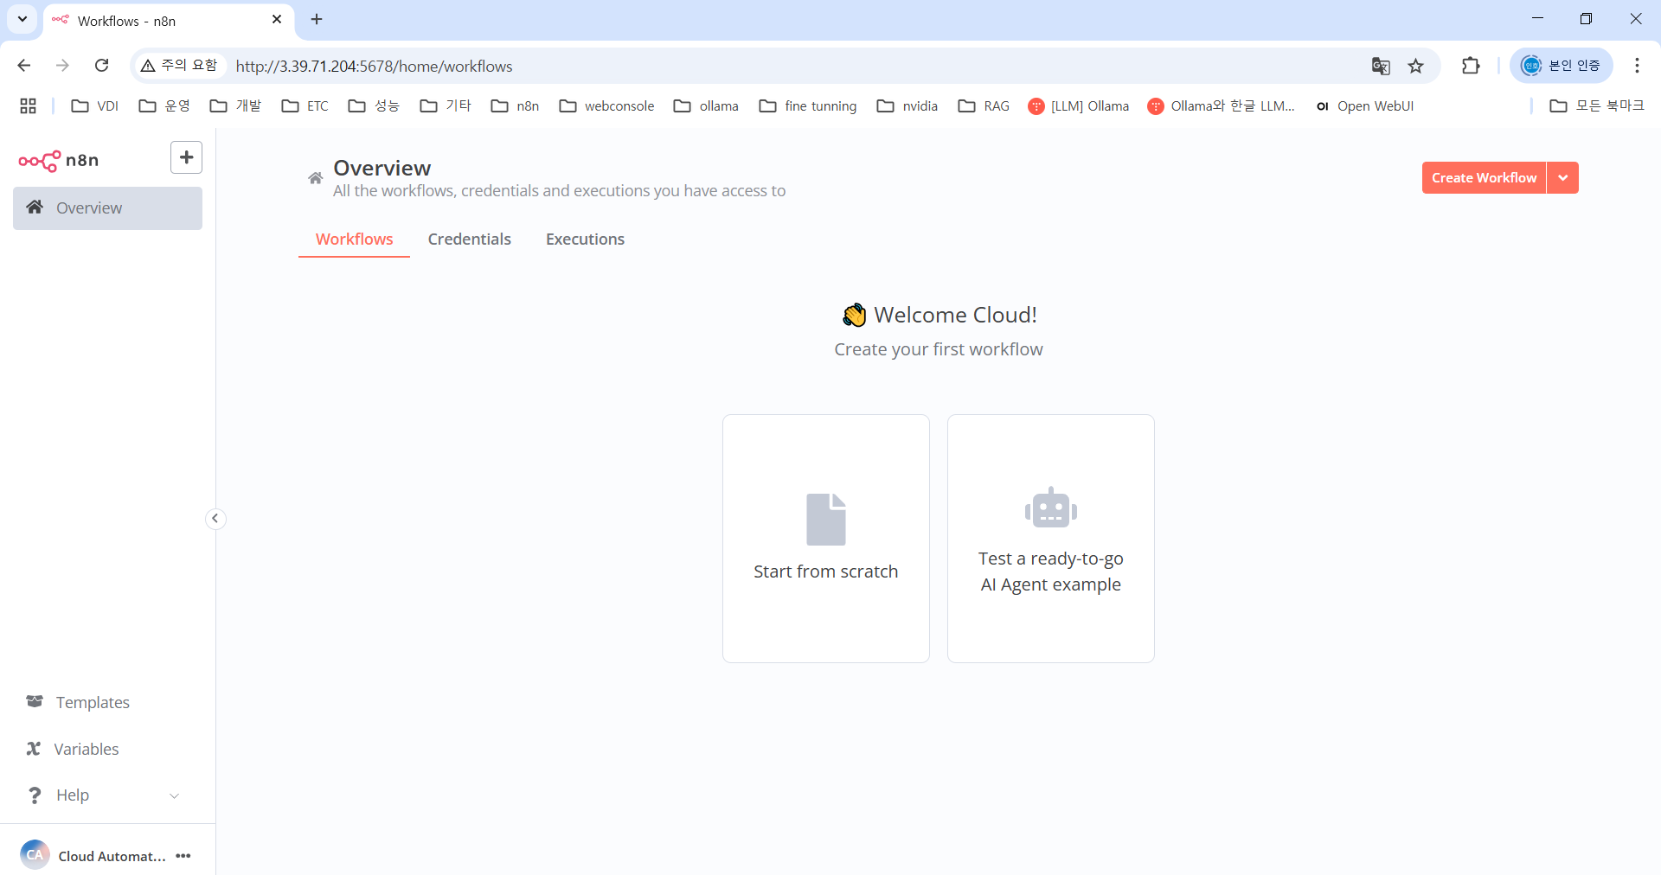
1) n8n 실행
sudo docker compose up -d
http://3.39.71.204:5678
email : ca@sk.com
First name : Cloud
Last name : Automation
Password : CloudAutomation1!

