Slide 1
Promoting Responsible Driving
by
The Tech Tycoons

Slide 2
This project presents a comprehensive solution for monitoring vehicle speeds, detecting instances of over-speeding, and penalizing offenders using GPS-based location tracking. The system leverages the inbuilt GPS module in vehicles to obtain real-time latitude and longitude coordinates. By analysing the speed and location data, the system identifies instances of over-speeding and automatically issues penalties to the respective drivers. The integration of GPS technology enables accurate tracking of vehicle positions, allowing for precise identification of speeding violations. This project serves as an effective tool for enforcing speed limits and promoting safer driving practices, ultimately contributing to enhanced road safety and reduced traffic accidents.
Problem Statement

Slide 3
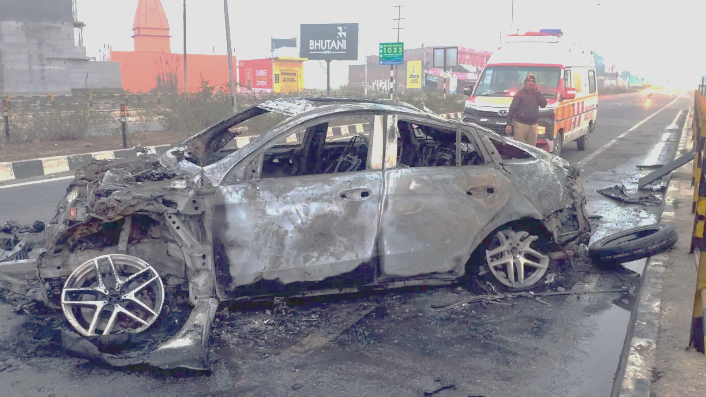
DISOBEYING RULES
DEATH
PROBLEMS
4 D’s
DELAY
DISPATCH

Slide 4
ROAD CONDITIONS
NOT GETTING HELP AT TIME
OVER SPEEDING
Why it happens?
DEATHS

Slide 5
accident
Sensor activated
Info sent
Help dispatched
Life saved
This project aims to study the various types of accidents that can happen and explore the measures that can be implemented to prevent or minimize their impact. The project will focus on the role of technology, education, and training in accident control. By analyzing these factors, the project will provide recommendations on effective accident control measures that can be implemented to enhance safety in our communities.
How it works?

Slide 6
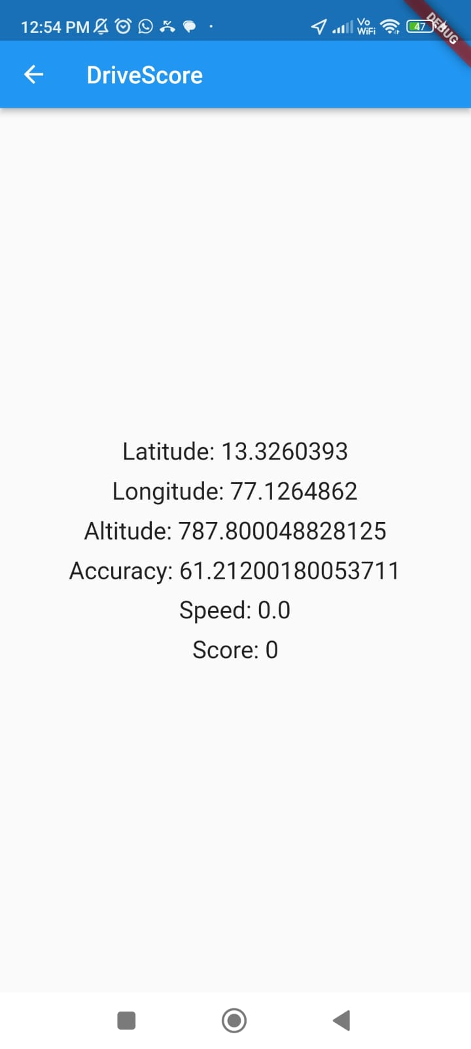
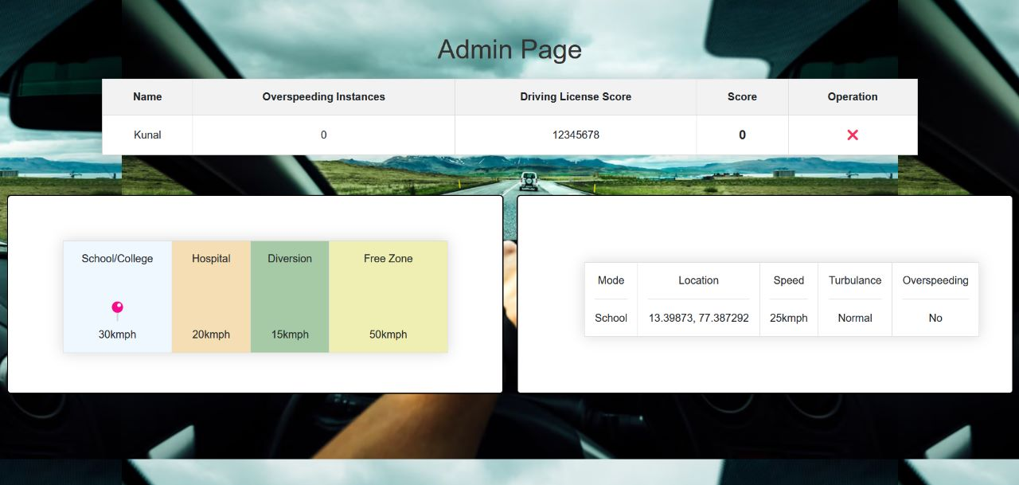
Mobile Application
App and Web Work
Web application

Slide 7
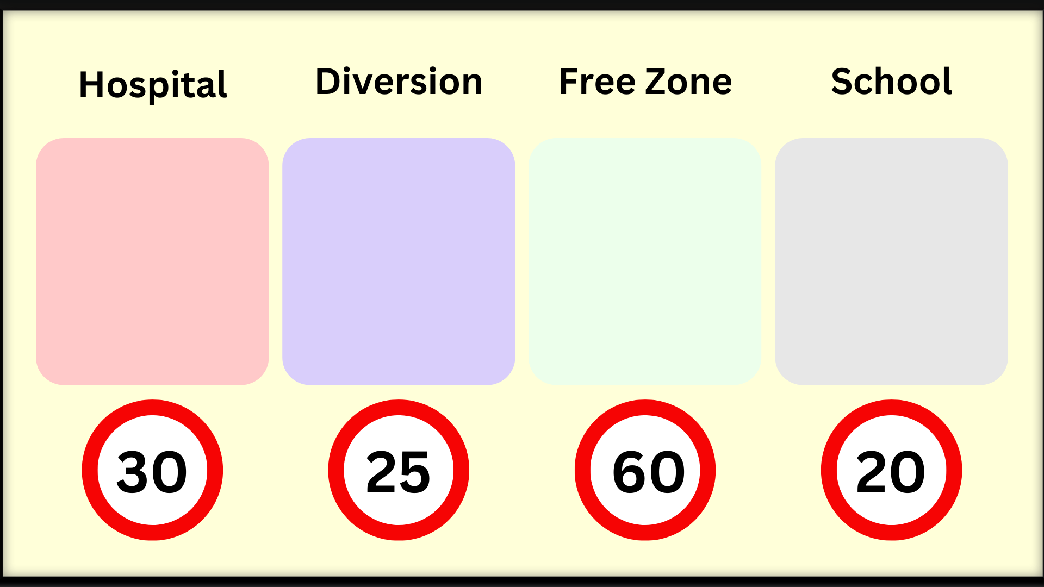
How it works?

Slide 8
CONCLUSION
The project aims to study various types of accidents that can happen and explore measures that can be implemented to prevent or minimize their impact. The project will focus on the role of technology, education, and training in accident control.
The project will analyze the effectiveness of existing safety technologies and identify new technologies that can be developed and implemented to improve safety.
The recommendations will be practical, effective, and sustainable, making it possible for communities to implement them over the long term. Implementing the recommended measures can enhance safety and reduce the incidence of accidents.
Reducing the frequency and severity of accidents can save lives and prevent injuries, which can have far-reaching benefits for individuals and society as a whole. Overall, the project will play a critical role in promoting safety and reducing the incidence of accidents in our society.

