Slide 1
ZOMATO
PREDICTING RESTAURANT’S POPULARITY

Slide 2
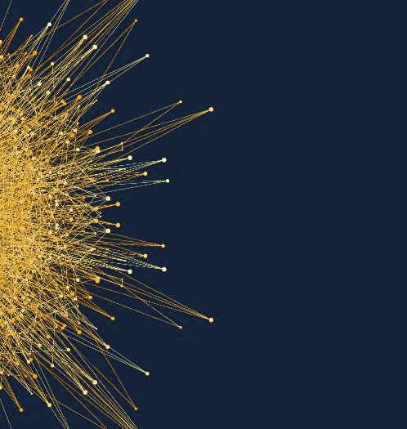
Under Guidance of :
Mr. Rahul Mishra
Team Members :
Mohammad Noman
Naman Gupta
Shubhangi Agarwal

Slide 3
Table of Content
Introduction
Dataset description and analysis
Preprocessing of dataset
Training models and comparing accuracy
Conclusion
6
References

Slide 4
Introduction
The basic idea of our project is to train a model to predict the expected popularity (rating out of 5) of a newly added restaurant in Bengaluru according to it’s location, cuisines, menu items etc. That are the given attributes of datasets used to train our model.
This is a regression problem where the rating is the output which varies from 0.1 to 5.0.

Slide 5
Dataset description and Analysis
Dataset
Attributes
URL
Contains the URL of the
restaurant in the Zomato website.
1
Contains the address of the
restaurant in Bengaluru.
ADDRESS
2
NAME
Contains the name of the
restaurant.
3
Whether online ordering is available
in the restaurant or not.
ONLINE
ORDER
4
BOOK TABLE
Whether table book option
is available or not.
5
Contains list of menus available
in the restaurant.
MENU
ITEMS
6
LISTED IN(TYPE)
7
Contains the type of
Meal serving.
LISTED
IN(CITY)
Contains the neighborhood in which
the restaurant is listed.
8
Continued…

Slide 6
Dataset
Attributes
9
Rate
Contains the overall rating of the restaurant out of 5.
10
Votes
Dish liked
11
Contains total number of rating for the restaurant as of the above mentioned date.
Dishes people liked in the restaurant.
12
13
Phone
Cuisines
Contains the phone number of the restaurant.
Food styles, separated by comma.
14
Location
Approx_cost
15
Contains the phone number of the restaurant.
Contains the approximate cost for meal for two people.
16
Rest_type
Review_list
17
Type of restaurant.
List of tuples containing reviews for the restaurant, each tuple consists of two values, rating and review by the customer.

Slide 7
DATASET ANALYSIS
CLICK HERE

Slide 8
Preprocessing of dataset
Elimination
Check for null
Filling blanks
Removing
Removing attributes from dataset that are not useful.
Eliminating rows with null values in required attributes
Filling missing values in cost attribute with mode of the column.
Removing special symbols and spaces from attributes.
02
03
04
05
Importing
Writing
Imported dataset and essential libraries such as pandas, numpy etc.
Writing preprocessed dataframe into a new csv file.
01
Steps
06

Slide 9

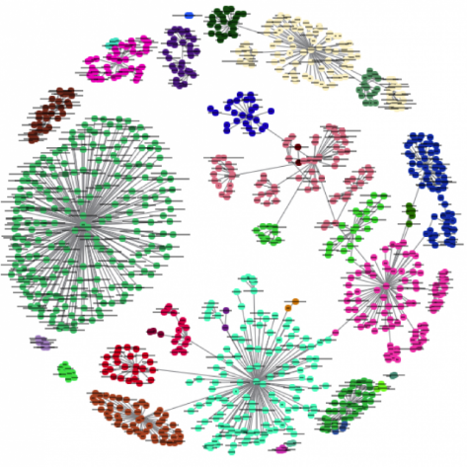


Algorithms Used
K-Nearest Neighbors
Random Forest
It’s a classifier algorithm where the learning is based “how similar” is a data (a vector) from other .
Each tree depends on the values of a random vector sampled independently and with the same distribution for all trees in the forest
Decision Tree
In this, we split the sample into two or more sub-samples based on most significant splitter in input variables.

Slide 10
K-Nearest Neighbors
KNN (K — Nearest Neighbors) is one of many (supervised learning) algorithms used in data mining and machine learning, it’s a classifier algorithm where the learning is based “how similar” is a data (a vector) from other .
Function used
KNeighborsClassifier()

Slide 11
Decision Tree
Decision Tree Classifier, repetitively divides the working area(plot) into sub part by identifying lines.
Impurity is when we have a traces of one class division into other. This can arise due to following reason.
1
We run out of available features to divide the class upon.
We tolerate some percentage of impurity (we stop further division) for faster performance. (There is always trade off between accuracy and performance).
2
Functions used
DecisionTreeClassifier()
DecisionTreeClassifier(criterion = ‘entropy’)

Slide 12
Random Forest
Random forests or random decision forests are an ensemble learning method for classification, regression and other tasks that operates by constructing a multitude of decision trees at training time and outputting the class that is the mode of the classes or mean prediction of the individual trees.
So the prerequisites for random forest to perform well are:
1
There needs to be some actual signal in our features so that models built using those features do better than random guessing.
2
The predictions (and therefore the errors) made by the individual trees need to have low correlations with each other.
Functions used
RandomForestRegressor(criterion = ‘entropy’)

Slide 13
CONCLUSION
The prediction on Zomato Dataset has been successfully implemented and analyzed.
ACCURACY SCORE
1
Random Forest
R^2 score of this model is 92%.
Mean Absolute Error : 0.045
Mean Squared Error: 0.014
Root Mean Squared Error: 0.120
2
Decision (criterion = Gini)
Accuracy score: 87.04%
3
Decision (criterion = Entropy)
Accuracy score: 86.58%
4
K-Nearest Neighbors
Accuracy score: 72.84%

Slide 14
REFERENCES
[1] www.medium.com last visited on 15/07/2019
[2] www.kaggle.com last visited on 20/06/2019
[3] www.queirozf.com last visited on 11/07/2019
[4] www.geeksforgeeks.com last visited on 14/07/2019
[5] www.edureka.com last visited on 15/07/2019
[6] www.pythonprogramming.net last visited on 15/07/2019
[7] www.coursera.com last visited on 13/07/2019

Slide 15
Thank you

