Slide 1
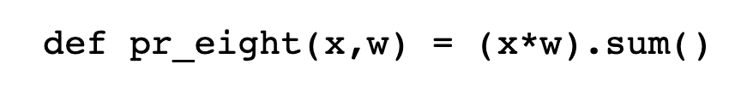
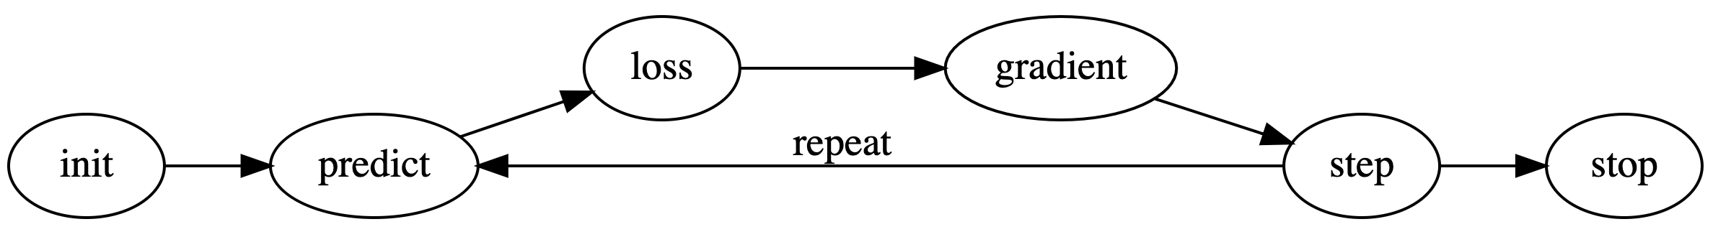
Stochastic Gradient Descent
Altering the weight assignment so as to maximize the performance
Machine learning by Arthur Samuel
Update!!!

Slide 2
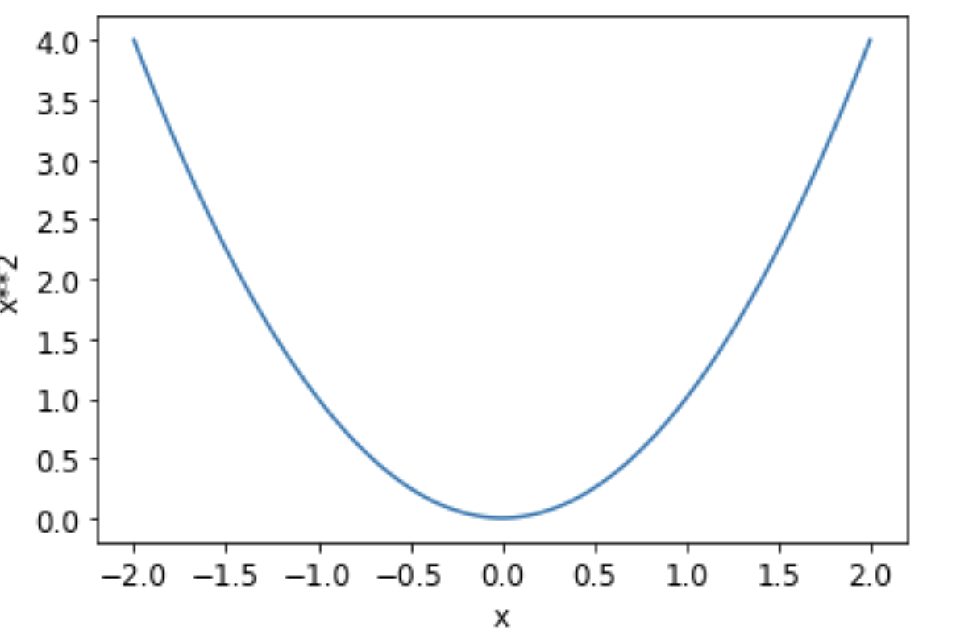
Guidelines
Initialize : We initialize the parameters(w) to random values
Loss : need some function
Step : find the correct direction, a weight should be increased or decreased a bit
Start here!
1 step
Loss = x^2

Slide 3
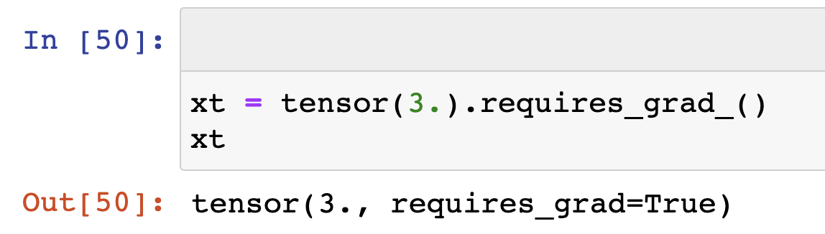
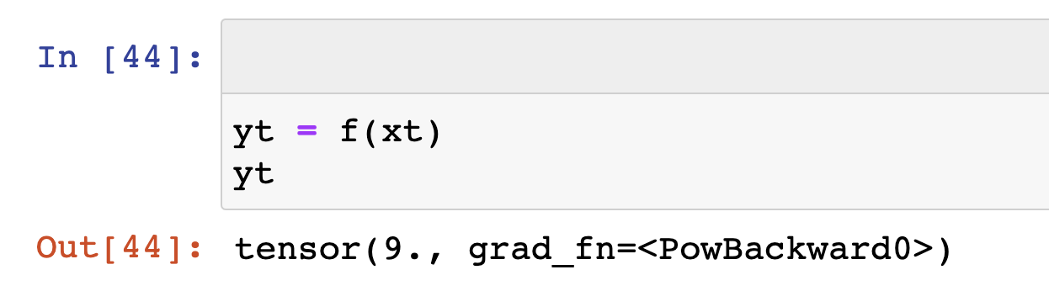


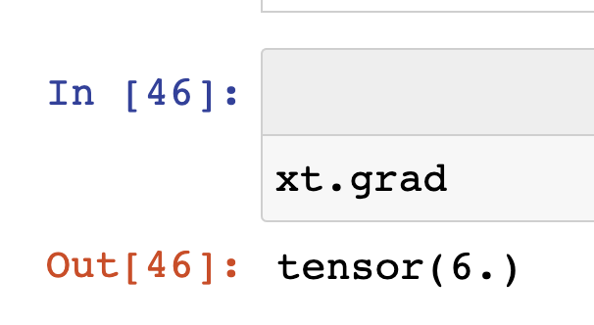
Calculating Gradients (on pytorch)
xt는 tensor이면서 gradient를 기록하는 변수임
Backward는 backpropagation을 의미

Slide 4
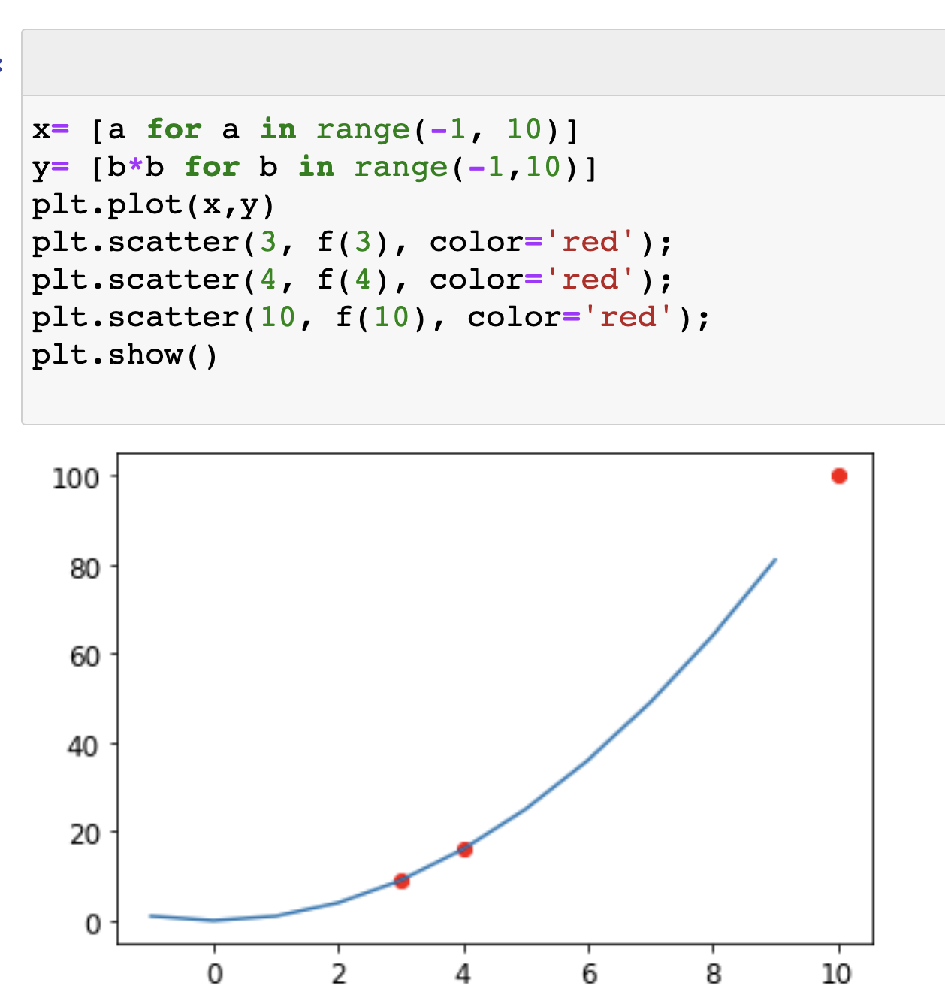
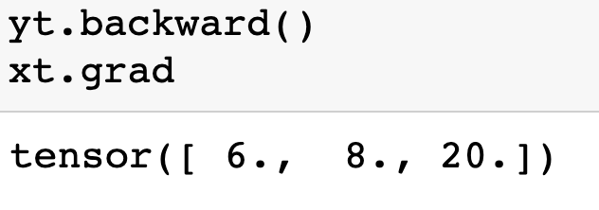

xt.grad의 값들은 goal에서 얼마나 멀리 있는지 힌트를 준다

