Slide 1

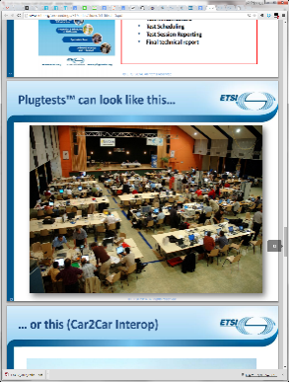










“oneM2M Conformance 테스트 툴 및 QoS 기술 개발”
- WP4 oneM2M QoS Support-
WP4 Leader
Sung-Chan Choi

Slide 2
WP4 Objectives
oneM2M 기반 인더스트리 도메인 응용의 요구사항을 만족하는 높은 QoS (실시간, 신뢰성) 기술 개발
산업도메인 적용을 위한 실시간, 신뢰성 QoS 지원 기술 개발
디바이스 제어, 관리 메시지에 대한 트랜잭션 처리 QoS 지원 기술 개발
WP4 연구개발 내용
oneM2M 기반 인더스트리 도메인 응용을 위한 QoS 지원 요구사항 및 기능 도출
인더스트리 도메인 응용서비스를 위한 QoS (실시간, 신뢰성) 지원 아키텍쳐 설계
oneM2M 아키텍쳐 및 프로토콜 QoS 지원 기술 표준 개발
인더스트리 도메인 응용을 위한 QoS 지원 기술 소프트웨어 개발 및 성능평가 수행

Slide 3
WP4 Workplan Y1
5월 | 6월 | 7월 | 8월 | 9월 | 10월 | 11월 | 12월 | 1월 | 2월 | 3월 | 4월
1 | 2 | 3 | 4 | 5 | 6 | 7 | 8 | 9 | 10 | 11 | 12
WP | WP Leader | T | Type | From | To
4 | KETI |  |  | M2 | M12
4 | KETI | T 4.1 | RD | M2 | M6
4 | KETI | T 4.2 | RD | M6 | M8
4 | KETI | T 4.3 | RD | M6 | M10
4 | KETI | T 4.4 | RD | M10 | M12
Tasks Status
Task 4.1 started M2
Deliverable D4.1.1 Analysis report for QoS framework
Deliverable D4.1.2 Requirement report for QoS support in industry domain
Task 4.2 started M4
Deliverable D4.2.1 Design documents for QoS support framework
Task 4.3 started M4
Deliverable D4.3.1 Standard documents for oneM2M enhancement for QoS support
Task 4.4 started M7
Deliverable D4.4.1 oneM2M QoS support framework SW design documents
Deliverable D4.4.2 oneM2M QoS support framework SW development

Slide 4
Tasks Details
Task 4.1 (M2-M6)
주요 연구개발 내용:
산업도메인의 QoS (실시간, 신뢰성) 기술 지원을 위한 요구사항 분석 및 기술연구
스마트 팩토리 시스템을 위한 GW 중심의 QoS지원 요구사항, 고려사항 도출
IoT 서비스 응용의 제어, 관리 시스템을 위한 QoS지원 요구사항, 고려사항 도출
예상 결과물:
IoT QoS 기술동향 보고서
산업도메인 QoS (실시간, 신뢰성) 지원을 위한 IoT QoS 요구사항 분석서
진행사항:
IoT QoS 기술동향 보고서
IoT QoS 요구사항 분석서

Slide 5
Tasks Details
Task 4.3 (M6-M10)
주요 연구개발 내용:
QoS 지원 구조 oneM2M 아키텍쳐 반영
QoS 지원 구조 oneM2M 프로토콜 반영
예상 결과물:
oneM2M 아키텍쳐 표준 기고서
oneM2M 프로토콜 표준 기고서
진행사항:
트랜잭션 처리 지원 방안 분석
TimeSeries 지원을 위한 리소스 분석
EvnetCategrory, Aggregation 지원 방안 분석

Slide 6
Tasks Details
Task 4.4 (M10-M12)
주요 연구개발 내용:
GW 기반의 QoS지원을 위한 oneM2M 플랫폼 SW 개발
제어,관리 메시지의 트랜잭션 QoS지원을 위한 oneM2M 플랫폼 SW 개발
예상 결과물:
oneM2M 기반 QoS 기술 적용 SW 설계서
oneM2M 기반 QoS 기술 적용 SW 프로토타입
진행사항:
oneM2M 신규리소스, 신규 프로토콜 반영한 SW 개발 예정

Slide 7
WP4 Deliverables Y1
Overview to WP4 deliverables:
No. | Deliverable | Responsible Partner | Contributors | Due Date | Status
D4.1.1 | Analysis report of QoS framework | SJU | KETI | M6 | Complete
D4.1.2 | Requirement report of QoS support in industry domain | SJU | KETI | M6 | Complete
D4.2.1 | Design documents for QoS support framework | KETI | SJU | M8 | Complete
D4.3.1 | Standard documents for oneM2M enhancement for QoS support | SJU | KETI | M10 | On going
D4.4.1 | oneM2M QoS support framework SW design documents | KETI | KETI | M11 | On going
D4.4.2 | oneM2M QoS support framework SW development | KETI | KETI | M11 | On going

Slide 9
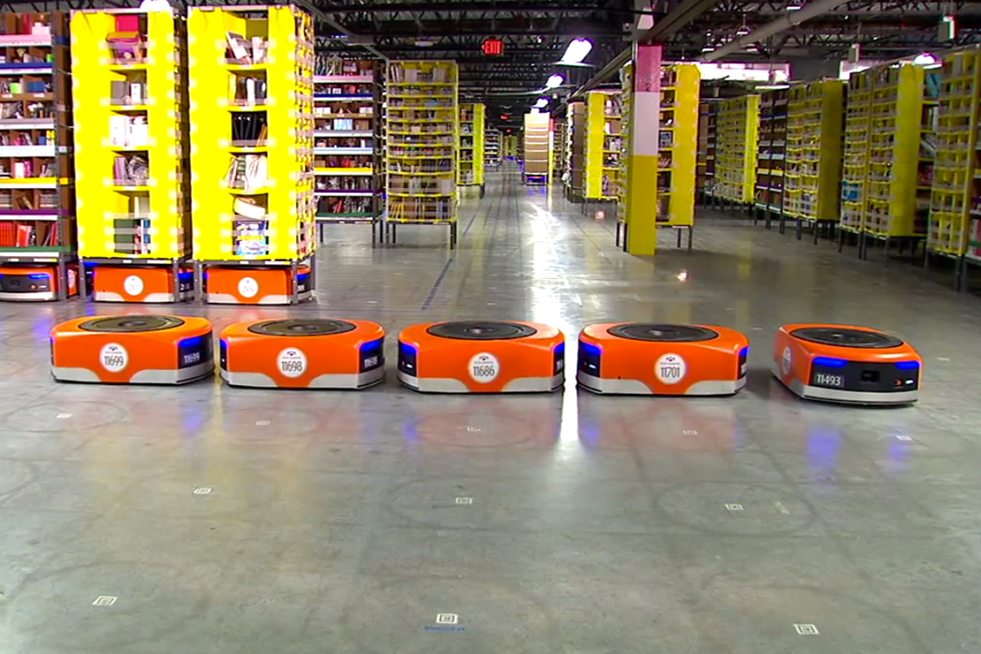
Collaborative work system
AE
Update
Update
Update
Update
CSE
CSE
AE
AE
CON
CON
CON
CON

Slide 10
Collaborative work system
AE
Update
Update
Update
Update
Success
Fail
Success
Success
CSE
CSE
AE
AE
CON
CON
CON
CON

Slide 11
Transaction Management
AE
Update
Update
Update
Update
CSE
CSE
AE
AE
CON
CON
CON
CON
Success
Fail
Success
Success
Policy1
Revoke
Revoke
Revoke
Revoke
Commit
Revoke
Commit
Revoke
Policy2
Rescheduling

Slide 12
Transaction Management
AE
AE
Begin
Begin
Commit / Revoke
Commit / Revoke
Success
Fail
CSE
CSE
CSE
CSE
CON
CON
CON
CON
For the purpose of the transaction management, oneM2M Request message accommodates two additional optional parameters (Transaction ID, Transaction Type).
Transaction ID is used for identifying each transaction and Transaction Type is to tag on each transaction message. (begin, commit, revoke)

Slide 13
.
Transaction Management
Request/Response Primitive
AE
UPDATE Request (Begin [Transaction Command])
AE
UPDATE Response
CON
UPDATE Request (Commit or Revoke [Transaction Command])
UPDATE Response
<Request primitive>
<Response primitive>
Primitive Parameter | Data Type | Multiplicity
Operation | m2m:operation | 1
To | xs:anyURI | 1
From | m2m:ID | 1
Request Identifier | m2m:requestID | 1
Resource Type | m2m:resourceType | 0..1
Name | xs:NCName | 0..1
Content | m2m:primitiveContent | 0..1
Transaction Type | m2m:transactionType | 0..1
Transaction ID | m2m:ID | 0..1
Primitive Parameter | Data Type | Multiplicity
Response Status Code | m2m:responseStatusCode | 1
Response Identifier | m2m:requestID | 1
Content | m2m:primitiveContent | 0..1

Slide 14
.
Transaction Management
Resource type <transaction>
AE
UPDATE Request (Transaction Command)
AE
UPDATE Response
CON
TR
Attributes of <transactionCommand> | Multiplicity | RW/ RO/ WO | Description
resourceType | 1 | RO | See clause 9.6.1.3.
resourceID | 1 | RO | See clause 9.6.1.3.
resourceName | 1 | WO | See clause 9.6.1.3.
parentID | 1 | RO | See clause 9.6.1.3.
expirationTime | 1 | RW | See clause 9.6.1.3
labels | 0..1 (L) | WO | See clause 9.6.1.3.
creationTime | 1 | RO | See clause 9.6.1.3.
lastModifiedTime | 1 | RO | See clause 9.6.1.3.
Transaction Operation | 1 | WO | This attribute contains the operation parameter of the received transaction message.
Tranaction Content | 1 | WO | This attribute contains the content parameter of the received transaction message.
Transaction Status | 1 | RW | This attribute contains the transaction status when the transaction message was received regarding the parent resource.
Transaction ID | 1 | WO | This attribute contains the transaction ID of the received transaction message.

Slide 15
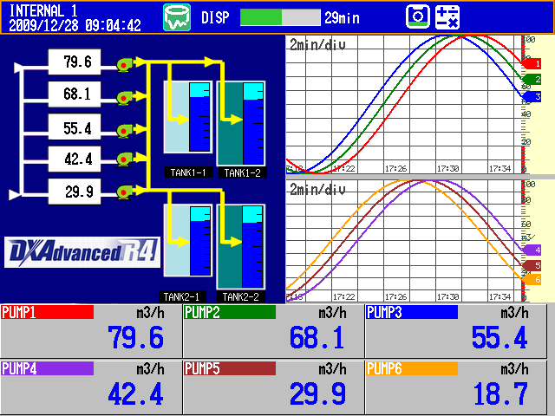
Time Series Data is Everywhere
Financial markets pricing (stock ticks)
Sensors (temperature, pressure, proximity)
Industrial fleets (location, velocity, operational)
Social networks (status updates)
Mobile devices (calls, texts)
Systems (server logs, application logs)

Slide 16
Time Series Data
Resource Type <timeSeries>
A container for Time Series Data instances
Providing to track, detect and report the missing data in Time Series
Resource Type | Short Description | Parent Resource Types | Child Resource Types
timeSeries | Stores and Shares Time Series Data instances among entities. | AE, AEAnnc, remoteCSE, remoteCESAnnc, CSEBase | timeSeriesInstance, subscription, semanticDescriptor

Slide 17
Time Series Data
Resource Type <timeSeries>
A container for Time Series Data instances
Providing to track, detect and report the missing data in Time Series
Attributes of <timeSeries> | Multiplicity | RW/ RO/ WO | Description | <timeSeriesAnnc> Attributes
periodicInterval | 0..1 | WO | If the Time Sereis Data is periodic, this attribute shall contain the expected amount of time between two instances of Time Series Data. | OA
missingDataDetect | 0..1 | WO | Indicates whether the Receiver shall detect the missing Time Series Data if it is periodic. | NA
ontologyRef | 0..1 | RW | A reference (URI) of the ontology used to represent the information that is stored in the child <timeSeriesInstance> resources of the present <timeSeriesData> resource (see note). | OA
missingDataMaxNr | 0..1 | RW | Maximum number of entries in the missingDataList if the periodicInterval is set and the missingDataDetect is TRUE. | OA
missingDataList | 0..1(L) | RO | The list of the dataGenerationTime value representing the missing Time Series Data in descending order by time if the periodicInterval is set and the missingDataDetect is TRUE. | OA
missingDataCurrentNr | 0..1 | RO | Current number of the missing Time Series Data in the missingDataList. | OA
missingDataDetectTimer | 0..1 | RW | The missingDataDetectTimer shall be set if the periodicInterval is set and the missingDataDetect is TRUE. The expecting Time Series Data shall be considered to be lost when the amount of time equal to missingDataDetectTimer has passed. | OA

Slide 18
Time Series Data
Resource Type <timeSeriesInstance>
A data instance in the <timeSeries> resource
<timeSeriesInstance> shall not be modified once created
Resource Type | Short Description | Parent Resource Types | Child Resource Types
timeSeriesInstance | Represents a Time Series Data instance in the <timeSeries> resource | timeSeries, timeSeriesAnnc | None specified

Slide 19
Time Series Data
Resource Type <timeSeriesInstance>
A data instance in the <timeSeries> resource
<timeSeriesInstance> shall not be modified once created
Attributes of <timeSeriesInstance> | Multiplicity | RW/ RO/ WO | Description | <timeSeriesInstanceAnnc> Attributes
dataGenerationTime | 1 | WO | This attribute contains the time when the data was generated by the AE/CSE. | OA
content | 1 | WO | This attribute contains the data generated by the AE/CSE. | OA
sequenceNr | 0..1 | WO | This attribute contains the data sequence number generated by the AE/CSE | OA

Slide 20
MTC Traffic Characteristics
Short and small number of packets
Low duty cycle packets
Uplink dominant packets
Real time and non-real time packets
Periodic and event-driven packets
Raw and aggregated packets
Unsynchronized and synchronized packet
* 3GPP “Service Requirements for Machine-Type Communications

Slide 21
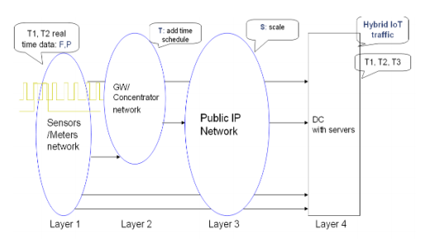
Traffic Classification
Traffic pattern 1: Periodical traffic
Environmental monitoring, Smart meter reading
Traffic pattern 2: Sessional traffic, event-driven, query-driven
Emergency report, booting
Traffic pattern 3: Payload data exchange traffic
Interactive, conversational, streaming
<IoT Traffic patterns with Layered Structure>

Slide 22
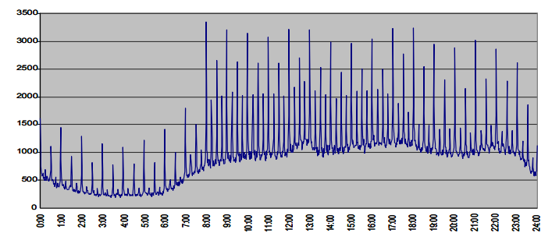
IoT Periodic Traffic - monitoring
Constant load of periodic communications
Traffic Storms
GSMA: 375k IoT devices led to a 48h network breakdown in 2013
ENISA: 45 incidents for each time 1.4 Mio mobile users in 2013

Slide 23


IoT Traffic Storm
관제센터
Internet

Slide 24



Delivery Aggregation, CMDH
Create resource in CSE3
AE1
(originator)
CSE1
(registrar)
CSE2
(transit)
CSE3
(target)
AE1
(originator)
AE1
(originator)
Registered
Registered
Registered
AE1
(originator)
AE1
(originator)
Delivery related parameters included in the original CREATE request
Request Expiration Timestamp
Event Category
Delivery Aggregation
Result Persistence

Slide 25
Delivery Aggregation
Resource Type <delivery>
If Delivery Aggregation parameter is set to ON, <delivery> resource is used.
<delivery> resource is deleted on successful delivery of the data to the next hop CSE
The parent of a <delivery> resource is the <CSEBase> resource of the CSE that accepted the request
Attributes of <timeSeries> | Multiplicity | RW/ RO/ WO | Description
source | 1 | WO | The CSE-ID of the CSE that initiated the delivery process represented by this <delivery> resource.
target | 1 | WO | CSE-ID that defines the Hosting CSE for delivering the data contained in the aggregatedRequest attribute
lifespan | 1 | RW | Defines the time limit when the delivery of the information in the aggregatedRequest attribute needs to complete. If the lifespan expires before successful delivery, no further attempts to deliver the information in the aggregatedRequest attribute need to be executed. If the delivery fails, a feedback may be expected by the source CSE depending on options reflected in the deliveryMetaData attribute. The lifespan attribute of a <delivery> resource shall be set consistent with the Request Expiration Timestamp parameters of the set of original requests contained in the aggregatedRequest attribute, i.e. lifespan shall not extend beyond the earliest expiring Request Expiration Timestamp parameter in the set of the original requests contained in the aggregatedRequest attribute.
eventCat | 1 | RW | Defines the category of the event that triggered the delivery request represented by this <delivery> resource.
deliveryMetaData | 1 | RW | Contains meta information on the delivery process represented by this <delivery> resource, such as delivery status, delivery options, tracing information, etc. → Delivery status (holding, forwarded)
aggregatedRequest | 1 | WO | Attribute containing the request(s) to be delivered to the Hosting CSE. This represents one or more original requests that were targeting the same Hosting CSE.

Slide 26
Receiver Procedure
Start
Recv-1.0: “Check the validity of received request primitive”
nonBlockingRequestAsynch
Recv-2.0: Communication method?
nonBlockingRequestSynch
Recv-3.0: “Create <request> resource locally”
blockingRequest
Recv-3.0: “Create <request> resource locally”
Recv-4.0: “Create a success Response”
Recv-4.0: “Create a success Response”
Recv-5.0: “Send Response primitive”
Recv-5.0: “Send Response primitive”
Recv-6.0: Resource handling procedures
Recv-6.0: Resource handling procedures
Recv-6.0: Resource handling procedures
Recv-7.0: “Update <request> resource”
Recv-7.0: “Update <request> resource”
Recv-8.0: “Send Notification”
Recv-9.0: “Wait for Response primitive”
Finish

Slide 27
Event Category Buffer
AE1
(originator)
CSE1
(registrar)
CSE2
(transit)
CSE3
(target)
AE1
(originator)
AE1
(originator)
Registered
Registered
Registered
AE1
(originator)
AE1
(originator)
Originator - Target
Originator - Target
Priority Data Forwarding Parameter
Request Expiration Timestamp: Deadline
Event Category: Priority
CSE
CSE
CSE
CSE

Slide 28
Receiver CMDH Procedure
Start
Hosting CSE of the targeted resource?
no
yes
Event Category == Immediate
Create a success response
yes
no
Forwarding
Send Response Primitive
Queue request primitive and execute CMDH forwarding
Finish

Slide 29
Event Category
Event Category: Indicates the event category that should be used to handle this request.
Event Category = Immediate (For real-time event-driven data, command)
Requests of this category shall be sent as soon as possible and shall not be subject to any further CMDH processing, i.e. the request will not be subject to storing in CMDH buffers when communication over an underlying network is possible.
Event Category = BestEffort (For periodic reporting data)
Requests of this category can be stored in CMDH buffers at the discretion of the CSE that is processing the request for an arbitrary time and shall be forwarded via Mcc on a best effort basis. The CSE does not assume any responsibility to meet any time limits for delivering the information to the next CSE.

Slide 30
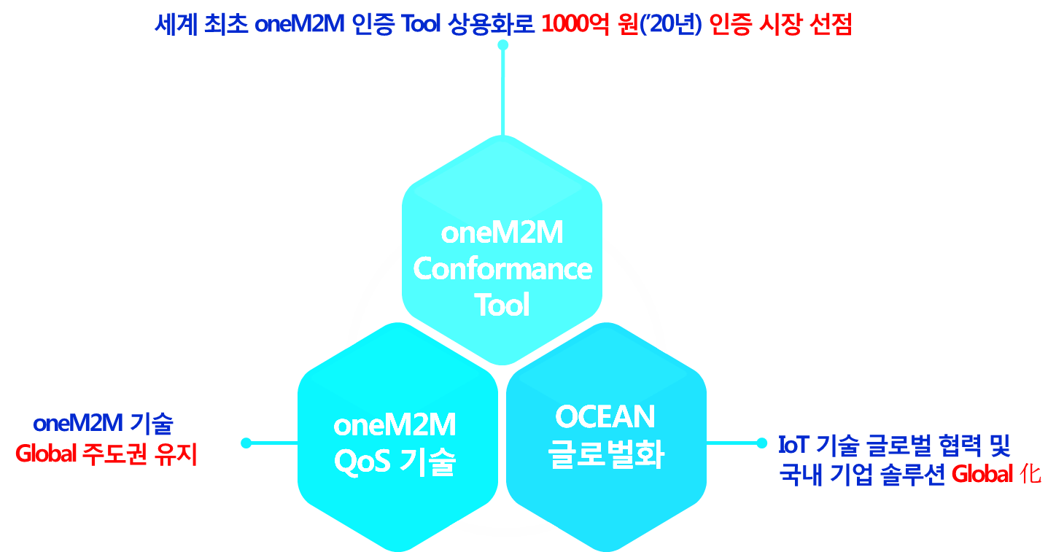
Q&A

