Slide 1


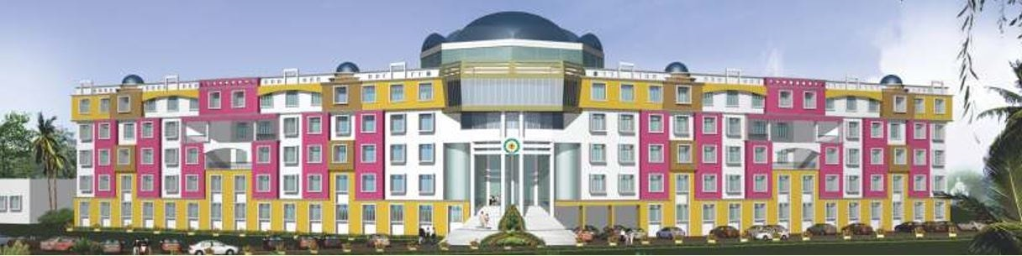
SITYOG INSTITUTE OF TECHNOLOGY
AURNAGABAD(BIHAR)
Guidance By: -
Shivani Rai ma’am
(CSE Faculty)
Submitted By: -
NAME ROLL NO.
Abhishik kumar 19CSE32
Supervised by: -
(HOD: Ranjeet Pandey Sir)
Computer Science Department
Submitted in partial fulfillment of requirement for the degree of Engineering in Computer Science.

Slide 2
Speech recognition
What is the task?
How do humans do it?
How might computer do it?
What’s hard about that?
Discontinuous Speech

Slide 3
What is the task?
Getting a computer to understand spoken language
By “understand” we might mean
React appropriately
Convert the input speech into another medium, e.g. text
Several variables impinge on this (see later)

Slide 4
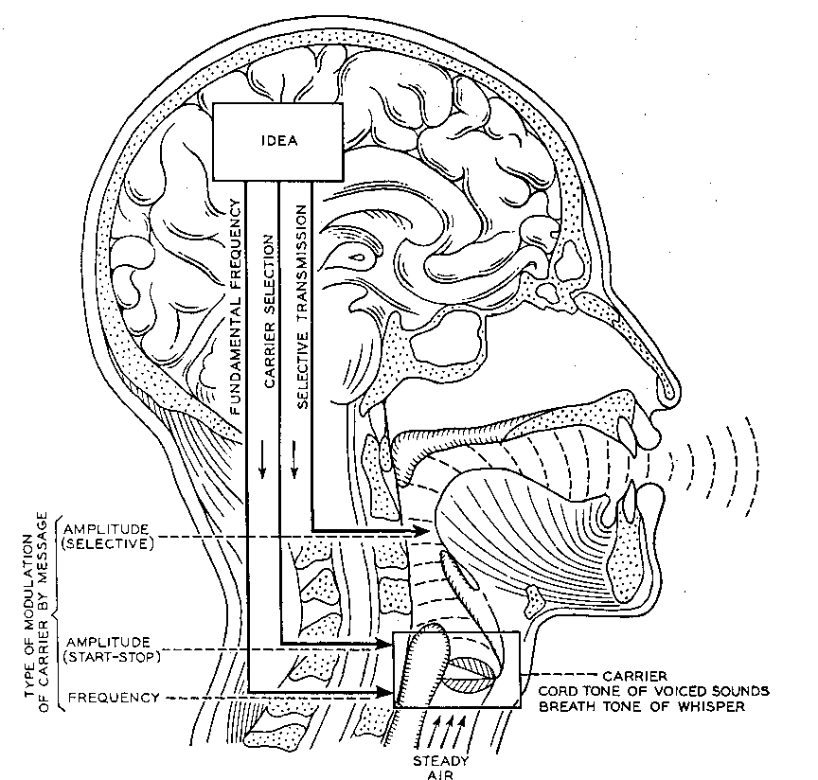
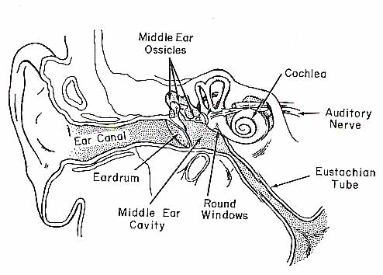

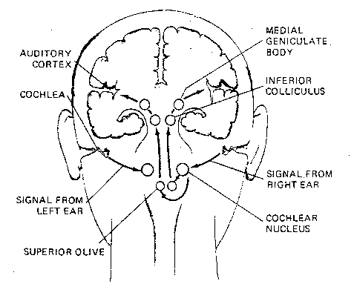
How do humans do it?
Articulation produces
sound waves which
the ear conveys to the brain
for processing

Slide 5

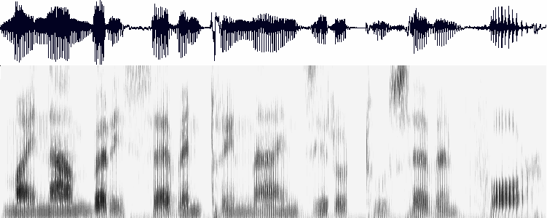
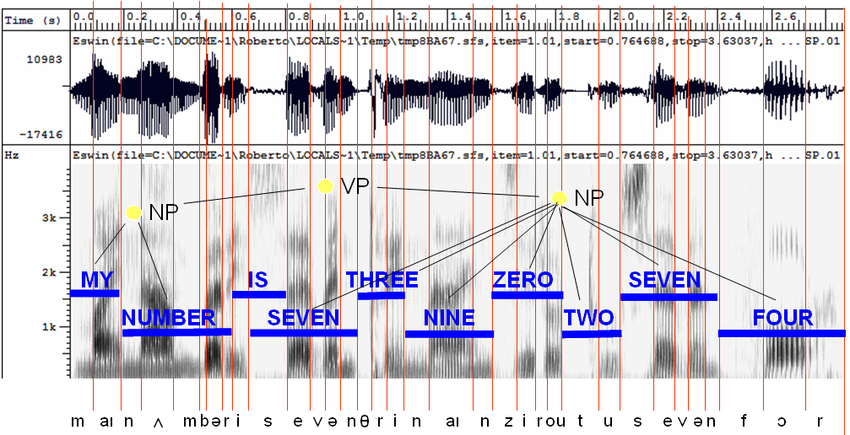
How might computers do it?
Acoustic waveform
Acoustic signal
Digitization
Acoustic analysis of the speech signal
Linguistic interpretation
Speech recognition

Slide 6
What’s hard about that?
Digitization
Converting analogue signal into digital representation
Signal processing
Separating speech from background noise
Phonetics
Variability in human speech
Phonology
Recognizing individual sound distinctions (similar phonemes)
Lexicology and syntax
Disambiguating homophones
Features of continuous speech
Syntax and pragmatics
Interpreting prosodic features
Pragmatics
Filtering of performance errors (disfluencies)

Slide 7
Separating speech from background noise
Noise cancelling microphones
Two mics, one facing speaker, the other facing away
Ambient noise is roughly same for both mics
Knowing which bits of the signal relate to speech
Spectrograph analysis

Slide 8
(Dis)continuous speech
Discontinuous speech much easier to recognize
Single words tend to be pronounced more clearly
Continuous speech involves contextual coarticulation effects
Weak forms
Assimilation
Contractions

Slide 9
Performance errors
Performance “errors” include
Non-speech sounds
Hesitations
False starts, repetitions
Filtering implies handling at syntactic level or above
Some disfluencies are deliberate and have pragmatic effect – this is not something we can handle in the near future

Slide 10
Identify individual phonemes
Identify words
Identify sentence structure and/or meaning
Interpret prosodic features (pitch, loudness, length)

Slide 11
Machine learning
Acoustic and Lexical Models
Analyse training data in terms of relevant features
Learn from large amount of data different possibilities
different phone sequences for a given word
different combinations of elements of the speech signal for a given phone/phoneme
Combine these into a Hidden Markov Model expressing the probabilities

Slide 12
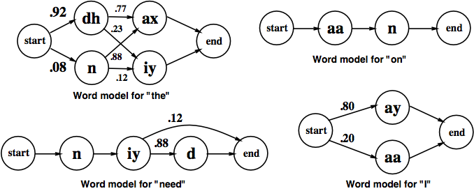
HMMs for some words

Slide 13
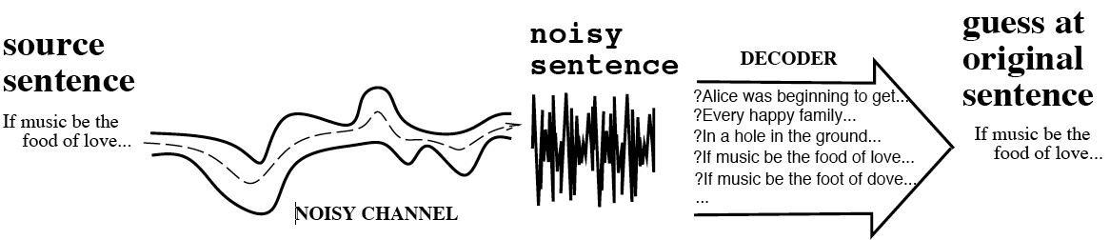
The Noisy Channel Model
Search through space of all possible sentences
Pick the one that is most probable given the waveform

Slide 14
HMMs for some words

Slide 15
Remaining problems
Robustness – graceful degradation, not catastrophic failure
Portability – independence of computing platform
Adaptability – to changing conditions (different mic, background noise, new speaker, new task domain, new language even)
Language Modelling – is there a role for linguistics in improving the language models?
Confidence Measures – better methods to evaluate the absolute correctness of hypotheses.
Out-of-Vocabulary (OOV) Words – Systems must have some method of detecting OOV words, and dealing with them in a sensible way.
Spontaneous Speech – disfluencies (filled pauses, false starts, hesitations, ungrammatical constructions etc) remain a problem.
Prosody –Stress, intonation, and rhythm convey important information for word recognition and the user's intentions (e.g., sarcasm, anger)
Accent, dialect and mixed language – non-native speech is a huge problem, especially where code-switching is commonplace

Slide 16
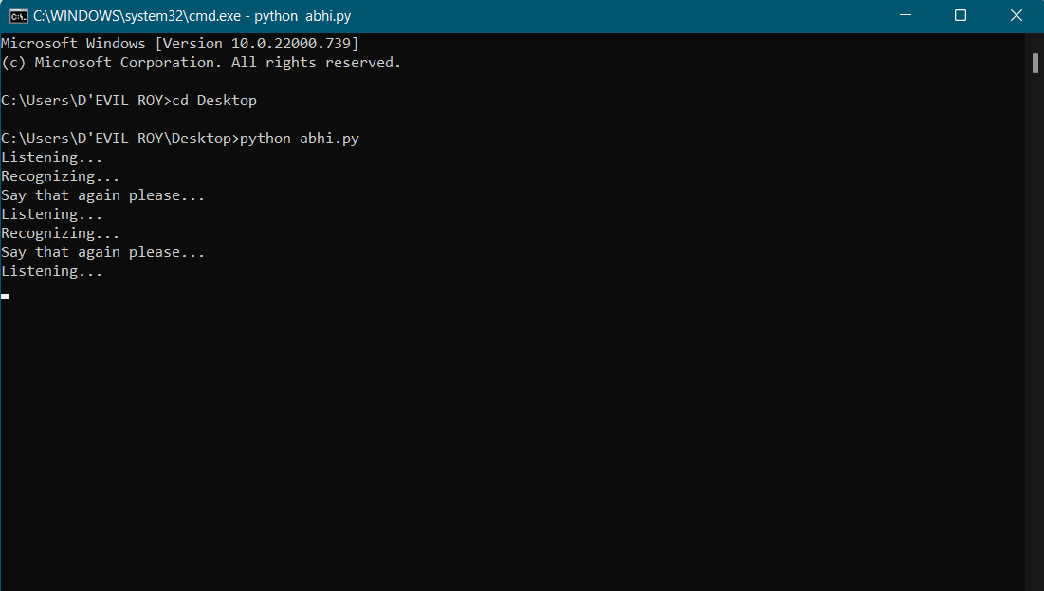
Here a Sample of my work: -

Slide 17

SITYOG INSTITUTE OF TECHNOLOGY
AURNAGABAD(BIHAR)
Thanks you

