Slide 1
MACHINE LEARNING TECHNIQUES
FOR INTRUSION DETECTION IN SCADA SYSTEMS
Author:
Rocío LÓPEZ PÉREZ
Supervisor:
Prof. Dr. Thomas ENGEL
Reviewer:
Prof. Dr. Ulrich SORGER
Advisors:
Dr. Ridha SOUA
Dr. Florian ADAMSKY
Dr. Andriy PANCHENKO

Slide 2
Agenda
Problem Statement
Background
Introduction to SCADA systems
SCADA systems in the spotlight of cyber attacks
Machine learning techniques for Network Intrusion Detection Systems
Gas pipeline SCADA system dataset
Analysis of the dataset
Data mining tasks
Experiments
Results & Comparison
Conclusion & Future Work

Slide 3
Problem statement
Critical systems use isolation as security strategy
This is unrealistic in an increasingly connected world
Many SCADA systems do not use the air gap strategy anymore
Networks demand more elaborate measures of protection
Machine learning techniques are suitable for NIDS

Slide 4
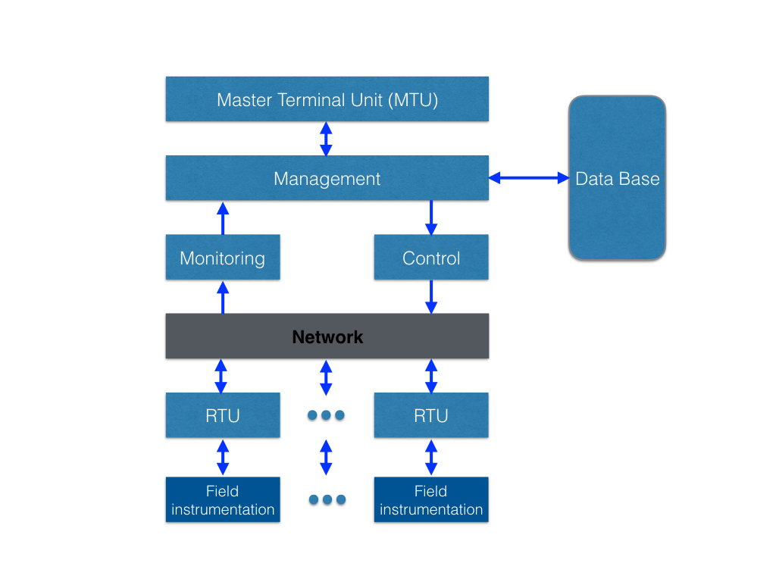
Background
SCADA - Supervisory Control and Data Acquisition
Figure 1: SCADA system architecture

Slide 5
SCADA systems in the spotlight of cyber attacks
background
Traditional SCADA systems communicated over serial analog circuits
Modern SCADA systems increased their interconnectivity
Deployment of IP communication protocols
Additional level of connectivity
Malicious network packets can reach the system from anywhere

Slide 6
SCADA systems in the spotlight of cyber attacks
background
Gazprom gas plant (April 1999, Russia)
Davis-Besse nuclear power plant (January 2003, Ohio)
Stuxnet (January 2010, Iran)
The first electric blackout (December 2015, Ukraine)

Slide 7
Machine learning techniques for NIDS
background
NIDS - mechanism that silently listens to network traffic to detect anomalies or suspicious activities
ML - if a computer goes through an experience, and through that experience learns to do that task better
Presented techniques:
Support Vector Machine
Random Forests
Long Short Term Memory

Slide 8
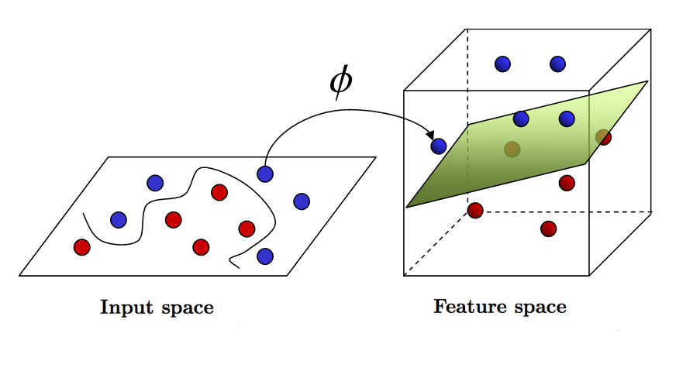


SVM
background
Linear machine for pattern classification
Kerneled learning algorithm (RBF)
Feed-forward neural network
Figure 2: Optimal Hyperplane for Linearly Separable Patterns
Figure 3: Transformation from input space to feature space

Slide 9
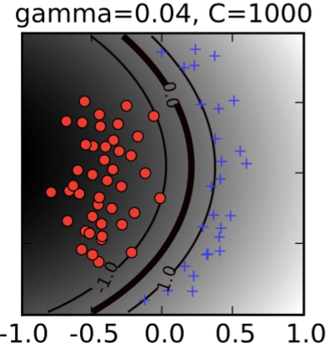
hyper-parameters svm
background
Figure 6: Decision boundary shape depending on C and γ hyper-parameters values

Slide 10
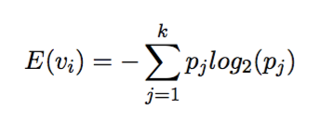
Random Forest
background
Based in the decision tree technique
Improves classification accuracy by incorporating randomness (e.g. bagging, max-features per split)
Easy and fast algorithms
The split criterion is the entropy measure of a feature

Slide 11
hyper-parameters random forest
background
x
tree
1
tree
2
tree
B
k
2
k
B
k
1
voting
k
Figure 7: Number of estimators & Maximal tree depth

Slide 12
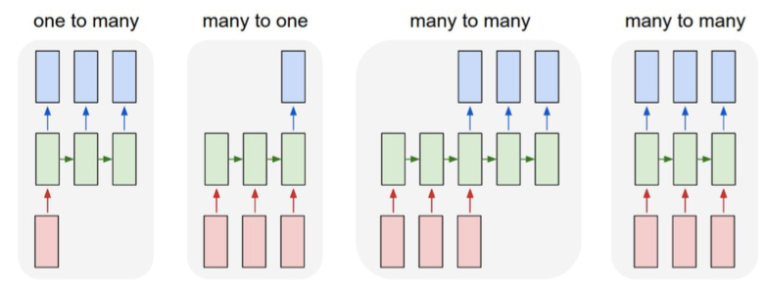
LSTM
background
Recurrent Neural Network
Composed of memory blocks containing memory cells
e.g. Image Captioning
image —> seq. of words
e.g. Sentiment Classification
seq. of words —>sentiment
e.g. Machine Translation
seq. of words —> seq. of words
e.g. Video classification on frame level
Figure 8: LSTM - different architectures

Slide 13
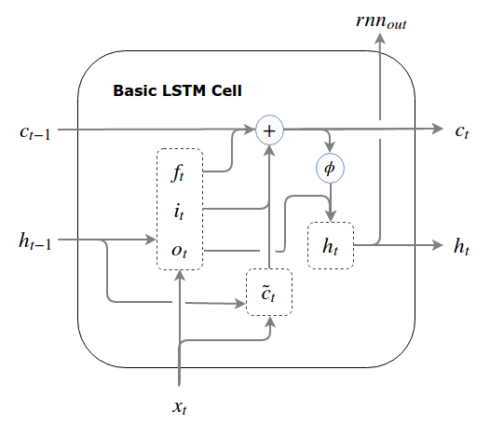
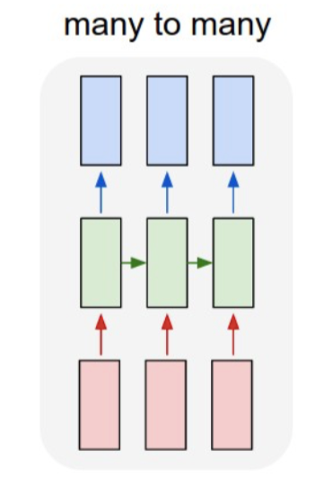


LSTM
background
Figure 9: LSTM - computational operations within a cell

Slide 14
hyper-parameters lstm
background
Learning rate
Sequence length
Dropout rate
Hidden layer length

Slide 15





Methodology
background

Slide 16
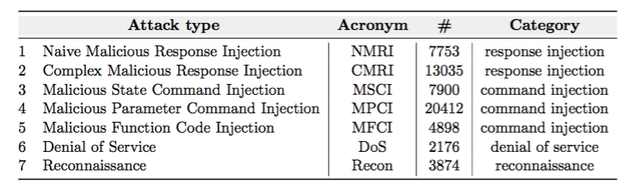
SCADA dataset
gas pipeline scada system dataset
Gas pipeline system provided by the Mississippi State University’s in-house SCADA lab
274628 instances
17 features
Binary labels and categorical labels
Table 1: Types and categories of attacks

Slide 17

SCADA dataset
gas pipeline scada system dataset
Results & Comparison
Data Analysis
Data Analysis
Data mining tasks:
Dealing with missing values & Data normalization
ML models development & Run experiments
Figure 10: dataset experiment pipeline

Slide 18
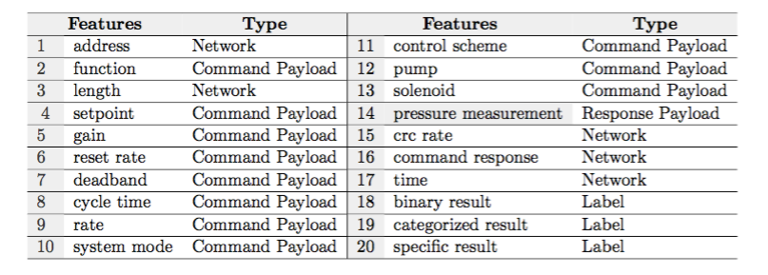
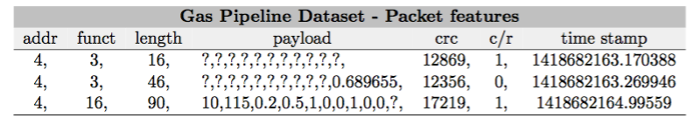
Data analysis
gas pipeline scada system dataset
Table 2: Gas pipeline dataset — feature list
Table 3: Missing values in the gas pipeline packets

Slide 19
SCADA dataset
gas pipeline scada system dataset
Results & Comparison
Data Analysis
Data mining tasks:
Dealing with missing values & Data normalization
Data mining tasks:
Dealing with missing values & Data normalization
ML models development & Run experiments
Figure 10: dataset experiment pipeline

Slide 20
Data mining tasks
gas pipeline scada system dataset
Dealing with missing values (4 approaches):
Clustering the payloads with GMM
Clustering the payloads with K-means
Zeros imputation & indicators
Imputing missing values by keeping the prior existing value
Data normalization (2 approaches)
Mean & Std deviation
Min-Max

Slide 21
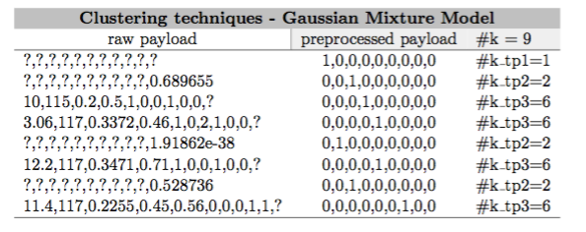
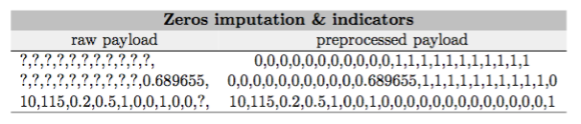
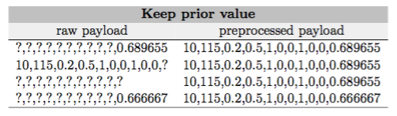
Dealing with missing values
gas pipeline scada system dataset
Table 4: Different approaches to deal with missing values

Slide 22
SCADA dataset
gas pipeline scada system dataset
https://github.com/rocionightwater/ML-techniques-for-NIDS
Results & Comparison
Data Analysis
Data mining tasks:
Dealing with missing values & Data normalization
ML models development & Run experiments
ML models development & Run experiments
Figure 10: dataset experiment pipeline

Slide 23




Experiments
gas pipeline scada system dataset
16 datasets
SVM, RFs and LSTM classification models
Training set 60% (164776 instances), validation set 20%
(54926 instances) and test set 20% (54926 instances)
Figure 15: measurements to evaluate the classifier accuracy

Slide 24
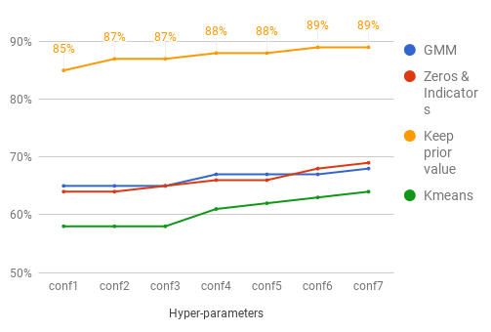
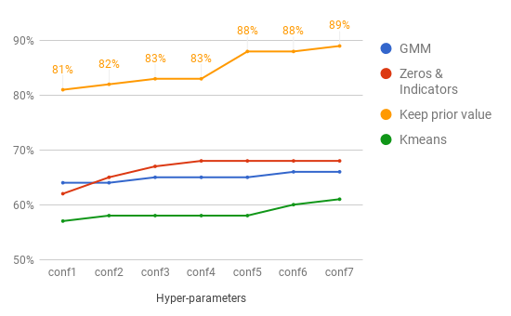
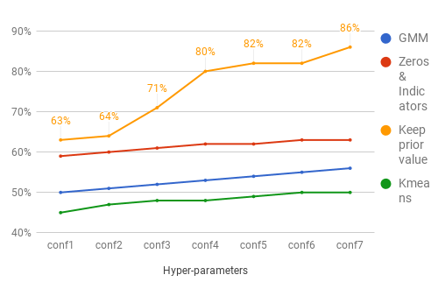
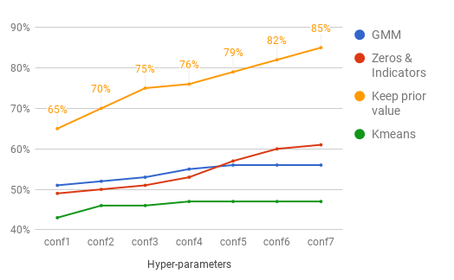
Experiments - SVM
gas pipeline scada system dataset
f1-score
Fig11: SVM - binary & mean normalization
Fig12: SVM - binary & minmax normalization
Fig13: SVM - category & mean normalization
Fig14: SVM - category & minmax normalization

Slide 25
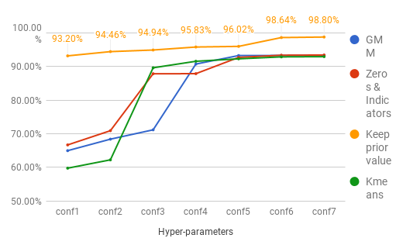
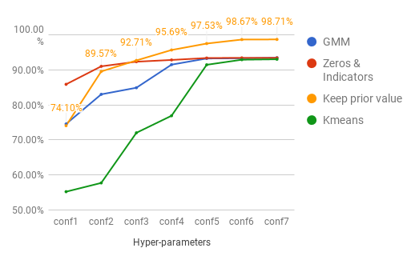
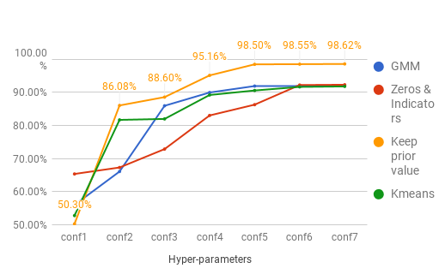
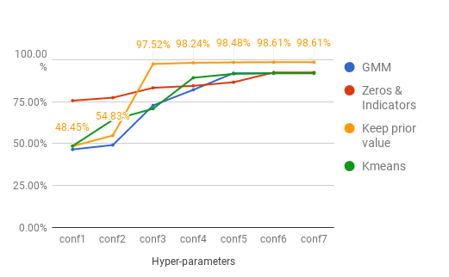
Experiments - RF
gas pipeline scada system dataset
f1-score
Fig15: RF - binary & mean normalization
Fig16: RF - binary & minmax normalization
Fig17: RF - category & mean normalization
Fig18: RF - category & minmax normalization

Slide 26
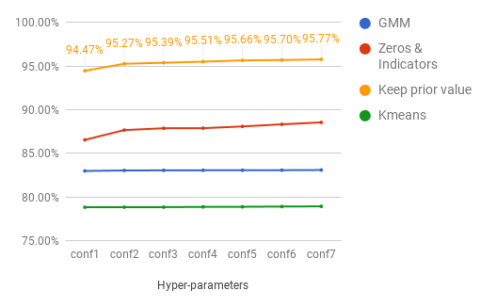
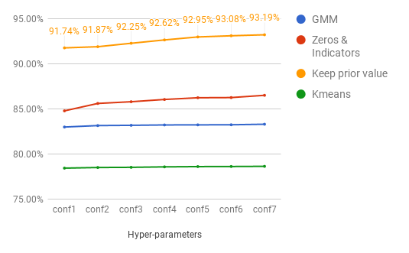
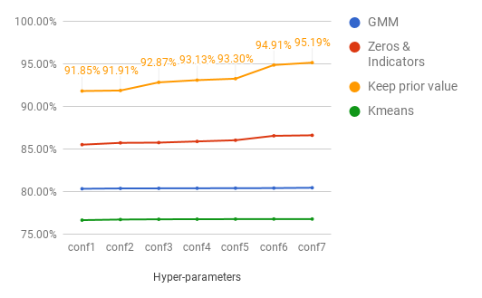
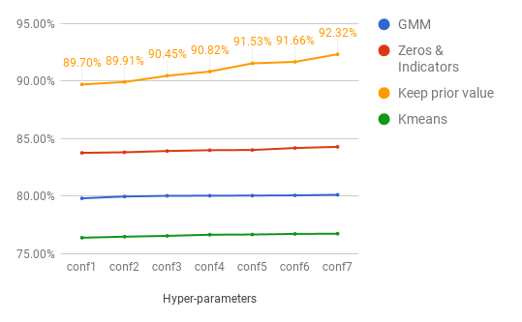
Experiments - LSTM
gas pipeline scada system dataset
f1-score
Fig19: LSTM - binary & mean normalization
Fig20: LSTM - binary & minmax normalization
Fig21: LSTM - categorical & mean normalization
Fig22: LSTM - categorical & minmax normalization

Slide 27
SCADA dataset
gas pipeline scada system dataset
Results & Comparison
Results & Comparison
Data Analysis
Data mining tasks:
Dealing with missing values & Data normalization
ML models development & Run experiments
Figure 10: dataset experiment pipeline

Slide 28

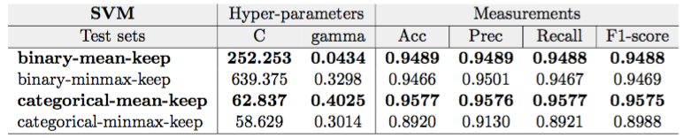

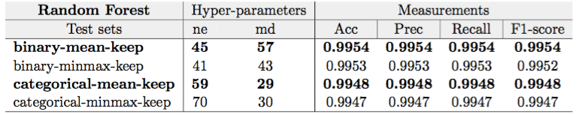

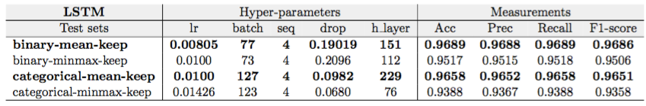
Results
gas pipeline scada system dataset
Table 5: Best binary and categorical classifiers modeled with SVM, RFs and LSTM

Slide 29
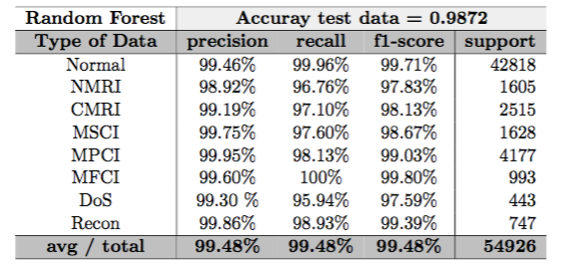
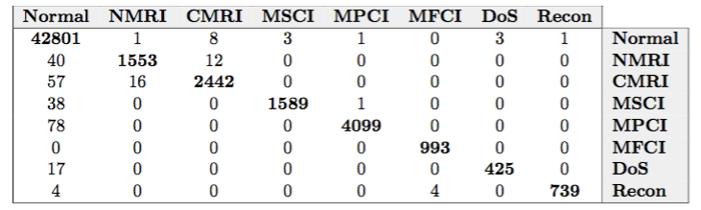
Results
gas pipeline scada system dataset
Table 6: Random Forest-Classification matrix (above) and confusion matrix (below)

Slide 30
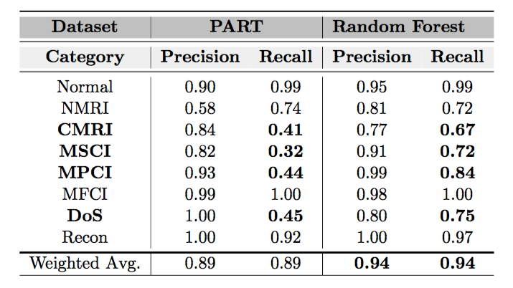
related work
gas pipeline scada system dataset
Table 7: Categorical classifiers — comparison between a related work & our work

Slide 31
Conclusions
Preparation of sixteen preprocessed datasets by applying different interesting data mining techniques
Use of machine learning algorithms to implement diverse NIDS classifiers
Correct use of test set accuracy measurements
Random Forest has given us excellent results (benign data recall = 99.97%, attacks recall = 98.04%; overall detection rate (recall) = 99.54%)

Slide 32
Future work
LSTM algorithm — worth further investigation in future research
Extraction of rules from RFs to integrate them with signature-based NIDS (e.g. Snort)

Slide 33
Thank you very much!
Q&A
https://github.com/rocionightwater/ML-techniques-for-NIDS

Slide 34
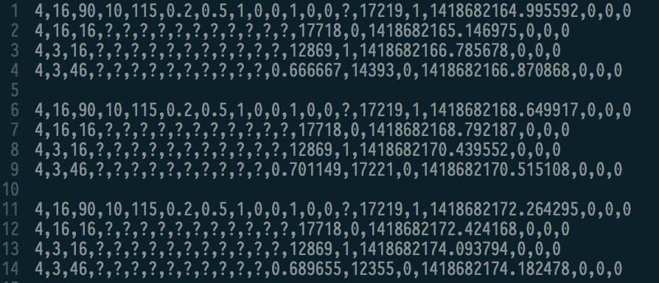
Dataset - sequence length Lstm

Slide 35
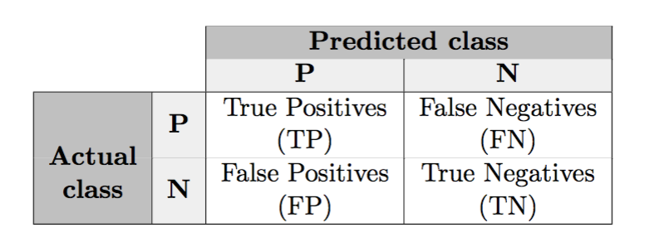
Confusion or error matrix

Slide 36


SVM
background
Misclassified
point
b
Figure 4: Optimal Hyperplane for Non-separable Patterns

Slide 37
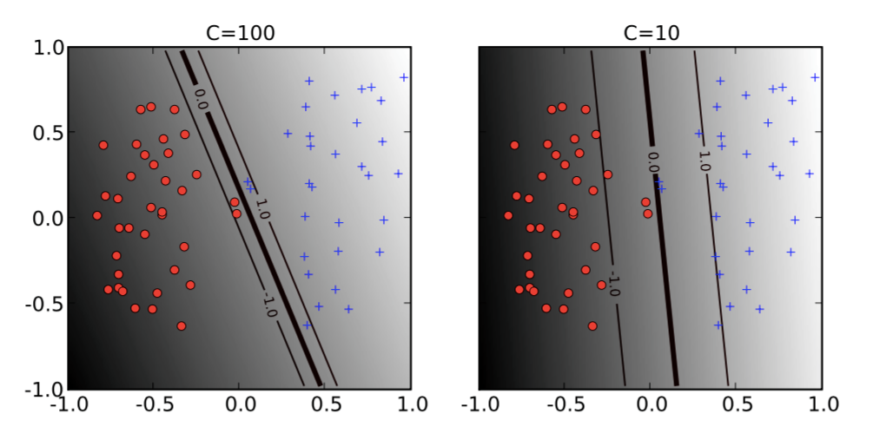
Hyper-parameters SVM
background
C
Figure 5: The effect of the soft-margin constant, C, on the decision boundary.
Low value of C (right) ignores more points; High values (left) aims at classifying all observations correctly.

Slide 38
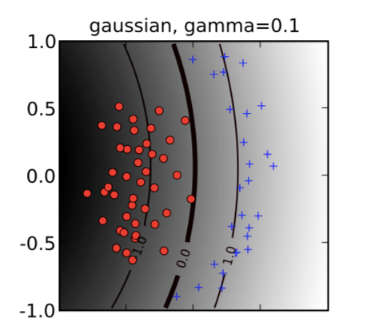
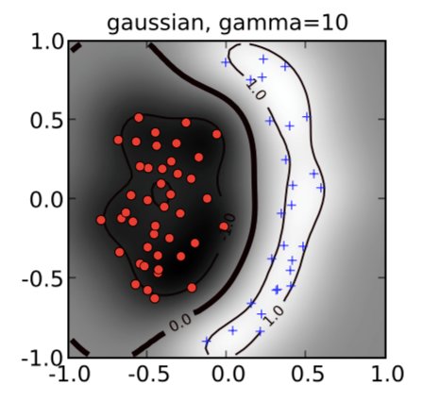
Hyper-parameters SVM
background
gamma (γ)
Figure 6: The effect of the inverse-width parameter of the Gaussian kernel (γ).
Small values (left) of γ lead in a decision boundary almost linear.
Large values of γ (right) lead to overfitting.

Slide 39
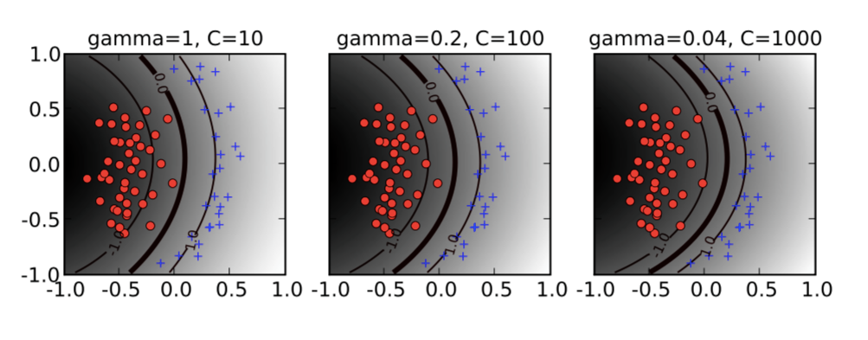
Hyper-parameters SVM
background
Figure7: Decision boundaries obtained by different combinations
of SVM hyper-parameters

Slide 40
hyper-parameters lstm
background
Epoch: one forward and backward pass for an entire training set
Learning rate: it controls how fast or slow the synaptic weights of the RNN are updated in each epoch
Batch size: the number of training samples used in one forward/backward pass
Sequence length: separation of the input samples into partitions
Dropout rate: randomly select neurons to be ignored during training
Hidden layer: number of neurons/cells in a hidden layer

Slide 41
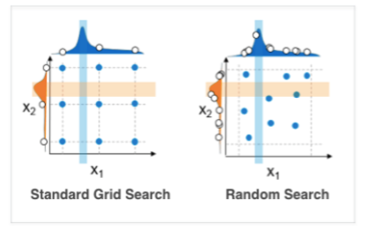
grid search vs random search
Grid search and manual search are the most widely used techniques for hyper-parameter optimization but it has been empirically and theoretically demonstrated that randomly chosen tests are more efficient for hyper-parameter optimization than tests on a predefined grid: Random Search for Hyper-Parameter Optimization, Yoshua Bengio (http://www.jmlr.org/papers/volume13/bergstra12a/bergstra12a.pdf)

Slide 42
