Slide 1
Project: registrar of companies
Ai_phase-4
Submited by:
T.Nithishkumar ,
BE-CSE,
712521104026

Slide 2
Exploring and predicting company registration trends with the Registrar of Companies (RoC) data using AI can be a valuable endeavor. Here are some guidelines to get started: Data Collection: Gather historical data from the RoC, which includes information about newly registered companies, industry types, locations, and registration dates. Data Preprocessing: Clean and preprocess the data to handle missing values and outliers. Ensure data consistency and accuracy. Feature Engineering: Extract relevant features, such as registration date, industry sector, geographical location, and economic indicators, to enhance the predictive power of your model. Exploratory Data Analysis (EDA): Perform EDA to understand the distribution of data, identify patterns, and visualize trends in company registrations.

Slide 3
Model Selection: Choose appropriate machine learning or deep learning models for time series forecasting and regression tasks, as they are commonly used for predicting trends. Training and Testing: Split the data into training and testing sets, and possibly into validation sets if needed. Use time series cross-validation techniques for robust model evaluation. Feature Selection: Select the most relevant features for prediction to improve model accuracy. Model Tuning: Fine-tune hyperparameters and optimize your chosen model to achieve the best performance. Evaluation Metrics: Select appropriate evaluation metrics, such as Mean Absolute Error (MAE), Mean Squared Error (MSE), or R-squared, to measure the model's predictive accuracy.

Slide 4
Exploring and predicting company registration trends with the Registrar of Companies (RoC) data using AI can be a valuable endeavor. Here are some guidelines to get started: Data Collection: Gather historical data from the RoC, which includes information about newly registered companies, industry types, locations, and registration dates. Data Preprocessing: Clean and preprocess the data to handle missing values and outliers. Ensure data consistency and accuracy. Feature Engineering: Extract relevant features, such as registration date, industry sector, geographical location, and economic indicators, to enhance the predictive power of your model. Exploratory Data Analysis (EDA): Perform EDA to understand the distribution of data, identify patterns, and visualize trends in company registrations.Model Selection:Choose appropriate machine learning or deep learning models for time series forecasting and regression tasks, as they are commonly used for predicting trends. Exploratory Data Analysis (EDA):Perform EDA to understand the distribution of data, identify patterns, and visualize trends in company registrations. Model Selection: Choose appropriate machine learning or deep learning models for time series forecasting and regression tasks, as they are commonly used for predicting trends.

Slide 5
Training and Testing: Split the data into training and testing sets, and possibly into validation sets if needed. Use time series cross-validation techniques for robust model evaluation. Feature Selection: Select the most relevant features for prediction to improve model accuracy. Model Tuning: Fine-tune hyperparameters and optimize your chosen model to achieve the best performance. Evaluation Metrics: Select appropriate evaluation metrics, such as Mean Absolute Error (MAE), Mean Squared Error (MSE), or R-squared, to measure the model's predictive accuracy. Deployment: Deploy the AI model to make real-time predictions or generate forecasts based on new data. Continuous Monitoring: Regularly update the model with fresh data to ensure its predictive accuracy over time.Interpretability:

Slide 6
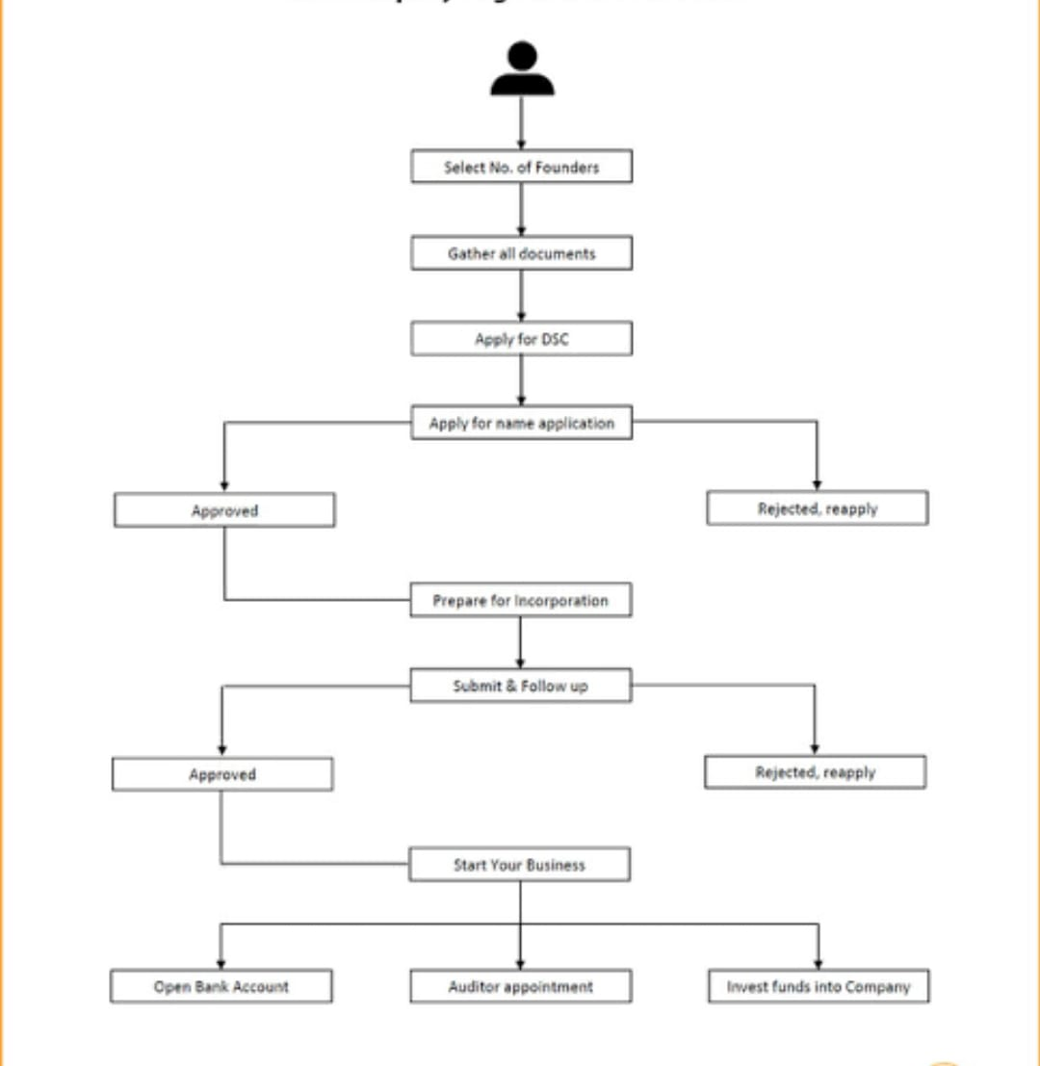
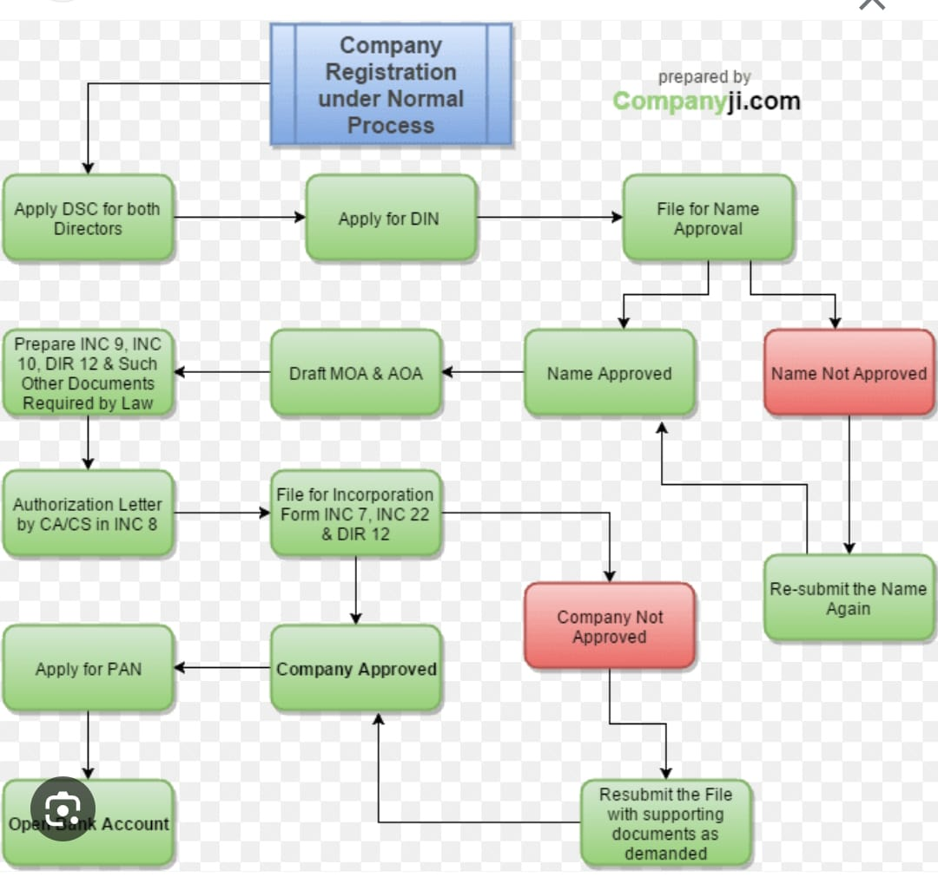

Slide 7
import sqlite3 # Connect to the database conn = sqlite3.connect('company_registry.db') cursor = conn.cursor() # Create a table to store company information cursor.execute(''' CREATE TABLE IF NOT EXISTS companies ( id INTEGER PRIMARY KEY AUTOINCREMENT, name TEXT NOT NULL, registration_number TEXT NOT NULL, address TEXT NOT NULL ) ''') conn.commit() def register_company(name, registration_number, address): cursor.execute(''' INSERT INTO companies (name, registration_number, address) VALUES (?, ?, ?)

Slide 8
''', (name, registration_number, address)) conn.commit() print(f"Company '{name}' registered successfully.") def get_company_details(company_id): cursor.execute(''' SELECT * FROM companies WHERE id = ? ''', (company_id,)) company = cursor.fetchone() if company: print(f"Company ID: {company[0]}") print(f"Name: {company[1]}") print(f"Registration Number: {company[2]}") print(f"Address: {company[3]}") else: print("Company not found.") # Example usage: register_company("ABC Inc.", "123456", "123 Main St") get_company_details(1) # Close the connection when done conn.close()

Slide 9
Exploratory Data Analysis (EDA): Exploratory Data Analysis is a crucial step to understand the characteristics of the RoC data and uncover insights. Here's what you can do: Summary Statistics: Compute basic statistics such as mean, median, standard deviation, and quartiles for relevant features. Data Visualization: Create visualizations like histograms, time series plots, and scatter plots to visualize data distributions, trends, and relationships between variables. Seasonal Decomposition: Use seasonal decomposition techniques like STL (Seasonal and Trend decomposition using Loess) to identify underlying trends and seasonality in company registrations. Correlation Analysis: Investigate the correlation between features to understand how they relate to one another. Geospatial Analysis: If geographical data is available, create maps to visualize the distribution of registered companies across regions.

Slide 10
Feature Engineering: Feature engineering aims to create meaningful and informative features for predictive modeling. Some ideas for feature engineering include: Time-Based Features: Extract features like day of the week, month, and year from registration dates. Lagged Features: Create lag features to capture historical trends and dependencies in the registration data. Rolling Statistics: Compute rolling averages or moving sums to capture short-term trends. One-Hot Encoding: Convert categorical variables (e.g., industry sectors) into binary features. Text Mining: If textual descriptions of companies are available, use natural language processing techniques to extract valuable information .External Data: Incorporate external economic indicators, news sentiment data, or market data that may impact company registrations.

Slide 11
Predictive Modeling: Now, it's time to build predictive models to forecast company registration trends. You can start with the following steps: Data Split: Split the data into training, validation, and test sets. Ensure that the time-series nature of the data is preserved. Select Models: Choose appropriate predictive models. Time series forecasting models like ARIMA, Exponential Smoothing, or machine learning models such as XGBoost or LSTM can be effective. Hyperparameter Tuning: Fine-tune model hyperparameters using techniques like grid search or Bayesian optimization.Model Evaluation: Evaluate models using appropriate metrics (e.g., MAE, MSE) and compare their performance on the validation set. Ensemble Models: Consider ensemble methods to combine the strengths of multiple models for improved accuracy.Deployment: Once you have a well-performing model, deploy it in a production environment to make real-time predictions. Monitoring: Implement continuous monitoring to detect model degradation or data shifts and trigger retraining when necessary.

Slide 12
Interpretation: Make sure the model's predictions are interpretable, so stakeholders can understand the reasons behind forecasts. Conclusion: Establish a feedback mechanism to incorporate new data and user feedback for model improvement.Remember that the success of your AI-driven project heavily depends on the quality of data and iterations in model development. It's essential to continually refine and improve your models to make accurate predictions of company registration trends.

