Slide 1
Employee Data Analysis using Excel
STUDENT NAME: E.MAGESHWARI
REGISTER NO:312220819 USERNAME: asunm1743312220819
DEPARTMENT:COMMERCE –B.COM (GENERAL)
COLLEGE: GOVERNMENT ARTS AND SCIENCE COLLEGE SRIPERUMBUDUR

Slide 2
PROJECT TITLE
Employee salary Analysis using Excel

Slide 3


AGENDA
Problem Statement
Project Overview
End Users
Our Solution and Proposition
Dataset Description
Modelling Approach
Results and Discussion
Conclusion
3/21/2024 Annual Review

Slide 4

PROBLEM STATEMENT
The organization needs to analyze salary data to identify and address pay disparities, ensure competitive compensation, and evaluate the effectiveness of its salary structure. This analysis aims to provide insights into equity, market alignment, and budget impact to inform strategic HR decisions.

Slide 5

PROJECT OVERVIEW
.
COLLECT DATA: Gather details on employee roles ,salaries, and project allocations.
BREAK DOWN ANALYSIS : Calculate total salary costs ,analyze salaries by role,
department, and experience level, and compare with industry benchmarks.
USE VISUALIZATIONS: Use charts and graphs to display salary distributions and trends.
EVALUATE KEY METRICS: Focus on average salary, median salary, salary range, and salary’s share of the project budget.
PROVIDE INSIGHTS: Identify cost-saving opportunities, suggest salary adjustments, and recommend budget reallocation .

Slide 6




WHO ARE THE END USERS?
IT SECTOR
ORGANISATION

Slide 7

OUR SOLUTION AND ITS VALUE PROPOSITION
Fair compensation: Ensuring equitable pay for all employees.
Informed decision –making: Providing data-driven insights to HR and management.
Formula use: Employees salary level analysis
Efficiency: Automating salary analysis, saving time and reducing errors
Pivot table: Summary analysis
Graph: Data visualization.

Slide 8
Dataset Description
Employee dataset: Kaggle.
Employee ID: Unique identifier for each employee.
Gender : Male, Female , or Other for gender analysis.
Department: sales Executive, Research Scientist, Sales Representative, Health care Representative, etc. (e.g. HR,IT).
Years of Experience: Total years of experience.
Salary: Current salary of the employee.
Performance Rating: Employees performance score or grade.
Married status: Single, Marriage and Divorced.
Human Resources: Technical, Medical , Marketing, Life Science, etc.
Distance From Home: For traveling facility.

Slide 9

THE "WOW" IN OUR SOLUTION
The data is collected for Salary, Age, Experience ,Gender Department, Performance rating, Married status ,Human resource, etc.
I analysis the data in Human resource, Research and Development, and Sales.
3/21/2024 Annual Review
9

Slide 10
MODELLING
DATA COLLECTION :
Kaggle
Feature collection
DATA CLEANING :
Missing value
Filtering value
SALARY LEVEL CALCULATE :
Employee Income salary
PIVOT TABLE:
Data visualization
Charts
Graph
10

Slide 11
MODELING APPROACH:
A modeling approach is a way of using a particular type of model to study a scientific phenomenon.
It can involve combining different methods and techniques and the approach you take may depend on the problem you retrying to solve and the domain you re working.
Statistical modeling.
Modeling instruction.
Integrated modeling method.
IFS True condition formula.

Slide 12
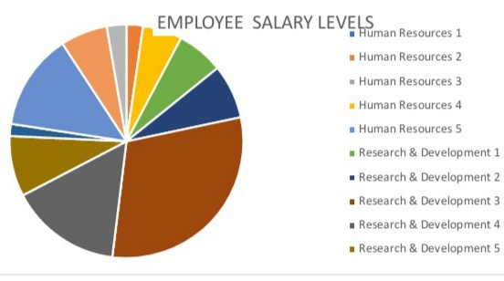
RESULTS
12

Slide 13
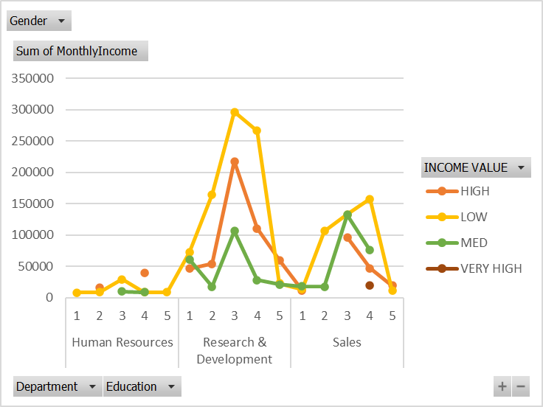

Slide 14
conclusion
The analysis of employee salary from different departments and performance rating.
However ,challenges such as workload, research quality, and time management remain critical factors influencing outcomes at each level. Addressing these challenges with targeted support can further enhance academic success across all tires.
Collecting all the information about the company and it’s workers.

