Slide 1
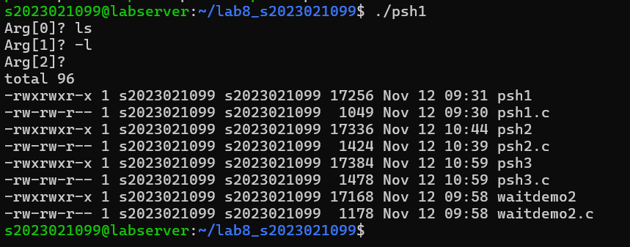
psh1.c

Slide 2

waitdemo2.c

Slide 3
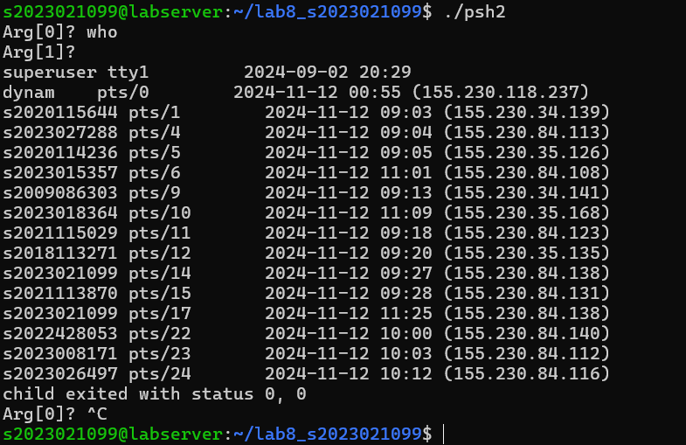
psh2.c

Slide 4
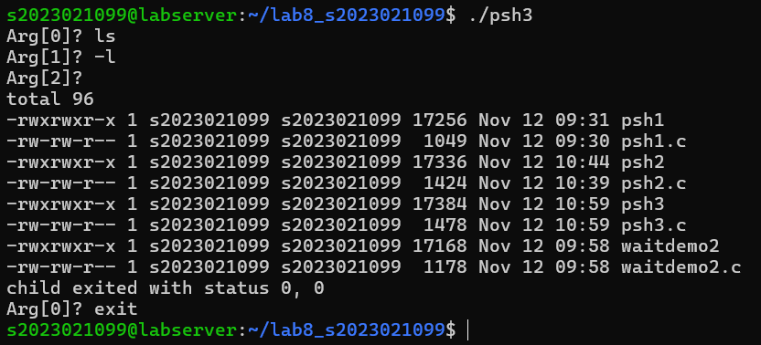
psh3.c

