Slide 1
Text Recognition
Tong, Hu, Wang

Slide 2
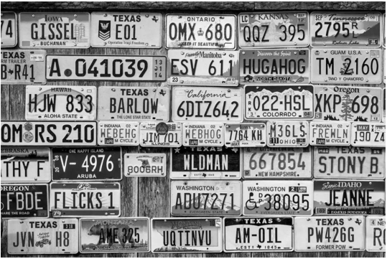
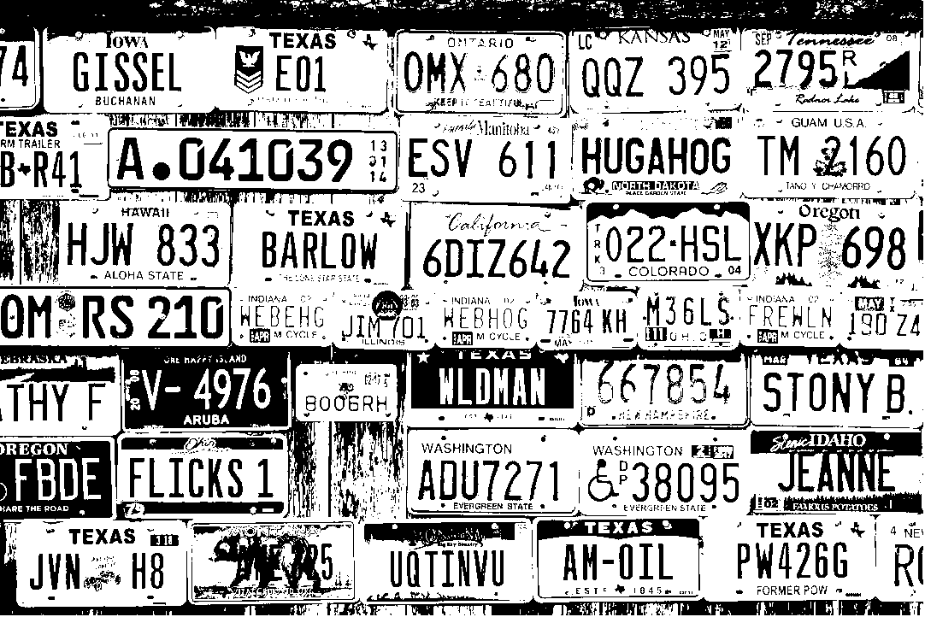
License Plate Detection
Convert the color image to gray image;
Convert to binary based on gray image;
Gray Image
Binary

Slide 3
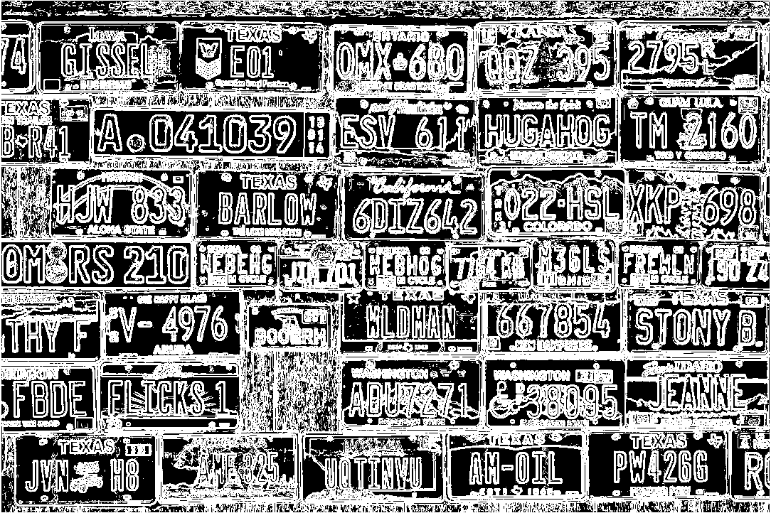
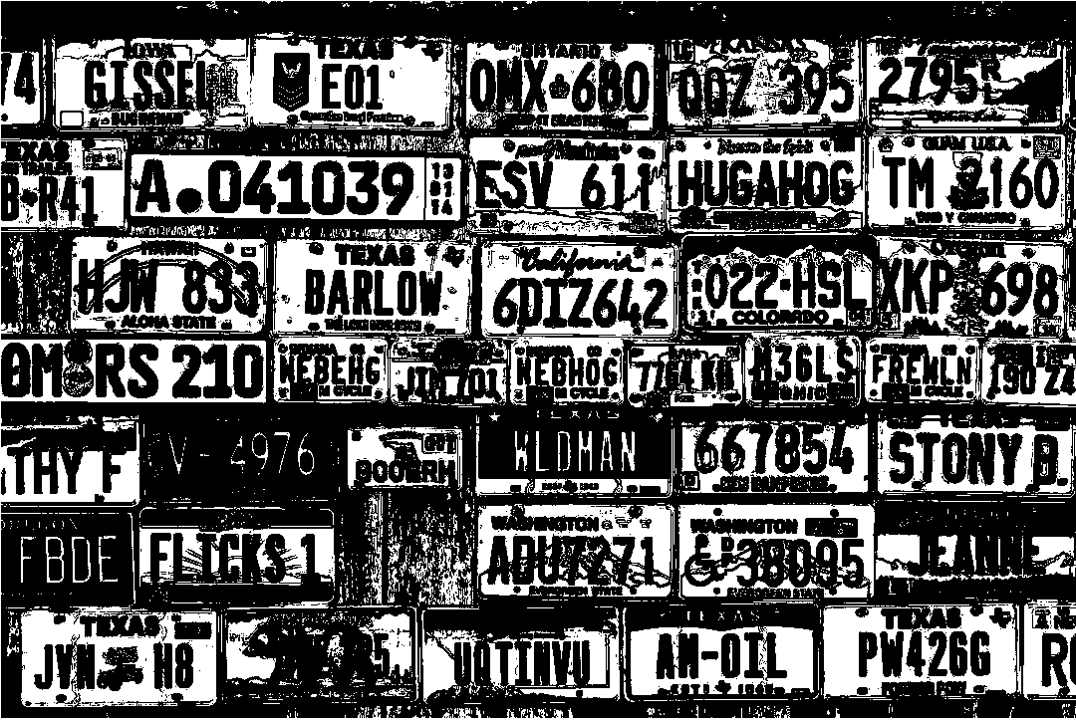
License Plate Detection
Edge detection;
Dilate and erode on binary image;
Binary – Edge = Mod image
-
=
Binary
Edge
Mod

Slide 4
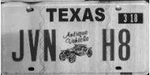
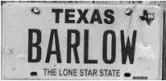

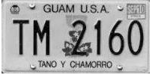


License Plate Detection
Compute the Connected Components on mod image;
Select the components whose area >= 1000 as the detected license plates.
Some examples of detected license plates.

Slide 5



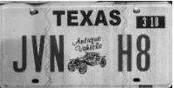






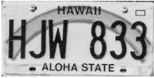


























License Plate Detection
38 license plates have been detected

Slide 6
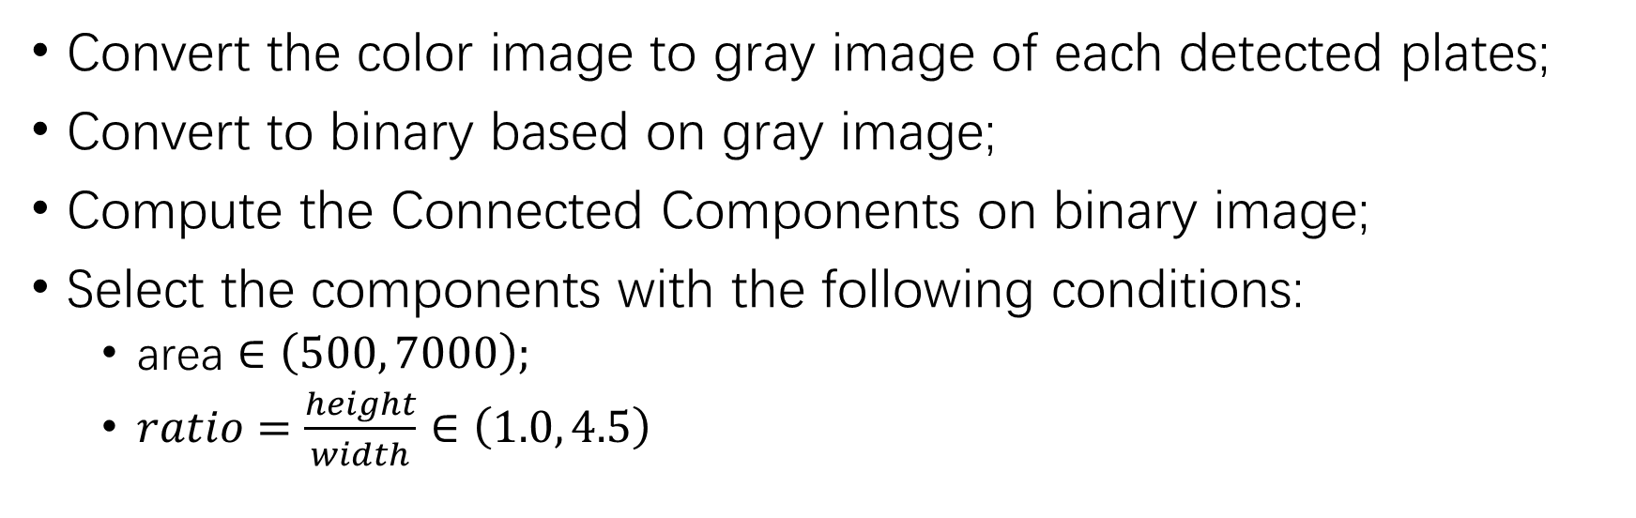
Character Segmentation
Convert the color image to gray image of each detected plates;
Convert to binary based on gray image;
Compute the Connected Components on binary image;
Select the components with the following conditions:
area $∈\left(500, 7000\right);$
$ratio=\frac{height}{width}∈\left(1.0, 4.5\right)$

Slide 7











Character Segmentation
Example results of character segmentation

Slide 8
Character Recognition
Image skeletonizion for each character;
Compute the distance between the character and each template characters
Choose the label with the smallest distance.
skeletonizion

Slide 9
Recognition Results
A 041039
HUGAHOG

Slide 10
Thanks

