Slide 1
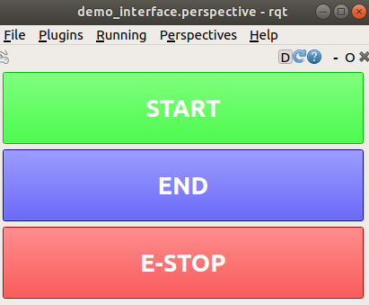
/change_mode (it's a service)
behavior_selector/MissionModeChange
{KILL, END, START}
/SQ01s/mader/who_plans
WhoPlans
{MADER, OTHER}
behaviour_selector.py
mader_commands.py
mader_ros.cpp
/globalfightmode
QuadFlightMode
{GO, LAND, KILL}
goal
goal
perfect_tracker.py
state
During takeoff and landing, (and when on the ground/killed), who_plans is OTHER (because mader_commands.py is the one sending goals)

