Slide 1

Walchand College of Engineering
(Government Aided Autonomous Institution)
Vishrambag, Sangli, 416415
Department of Computer Science & Engineering
Presentation on
1947
“Gro-Field : Crop suggestion, fertilizer recommendation and leaf disease detection system”
AY:2022-23
Team Members:
2019BTECS00014 : Siddhi Lokhande
2019BTECS00027: Shrutika Adhav
2019BTECS00049: Bhavika Ghadage
2019BTECS00095 : Vaishnavi Daware
Under the guidance of
Prof. Pooja Mundada Ma’am
Date:28/09/2022

Slide 2
Introduction
Precision agriculture is in trend nowadays. Precision agriculture is a modern farming technique that uses the data of soil characteristics, soil types, crop yield data, weather conditions and suggests the farmers with the most optimal crop to grow in their farms for maximum yield and profit. This technique can reduce the crop failures and will help the farmers to take informed decision about their farming strategy.
In order to mitigate the agrarian crisis in the current status, there is a need for better recommendation systems to alleviate the crisis by helping the farmers to make an informed decision before starting the cultivation of crops.
Half the question of right harvest is solved with right crop sowing. The second issue comes of the right nutrition. For that a fertilizer recommendation system is being built.
Getting rid of the pests has always remained a task in farming. But the first step to it is the correct identification of the disease, thus the idea of disease detection system

Slide 3
Problem statement
“ To build an application that suggest crops, recommend fertilizers and detect leaf disease using machine learning and deep learning paradigm to leverage the agriculture capacities ”

Slide 4
Objectives
1. To study and analyze different ML and Deep learning algorithms
2. Apply the studied ML algorithms to accurately suggest crops and recommend
appropriate fertilizers for the same
3. Use studied Deep learning algorithms to detect the leaf diseases

Slide 5
Methodology

Slide 6
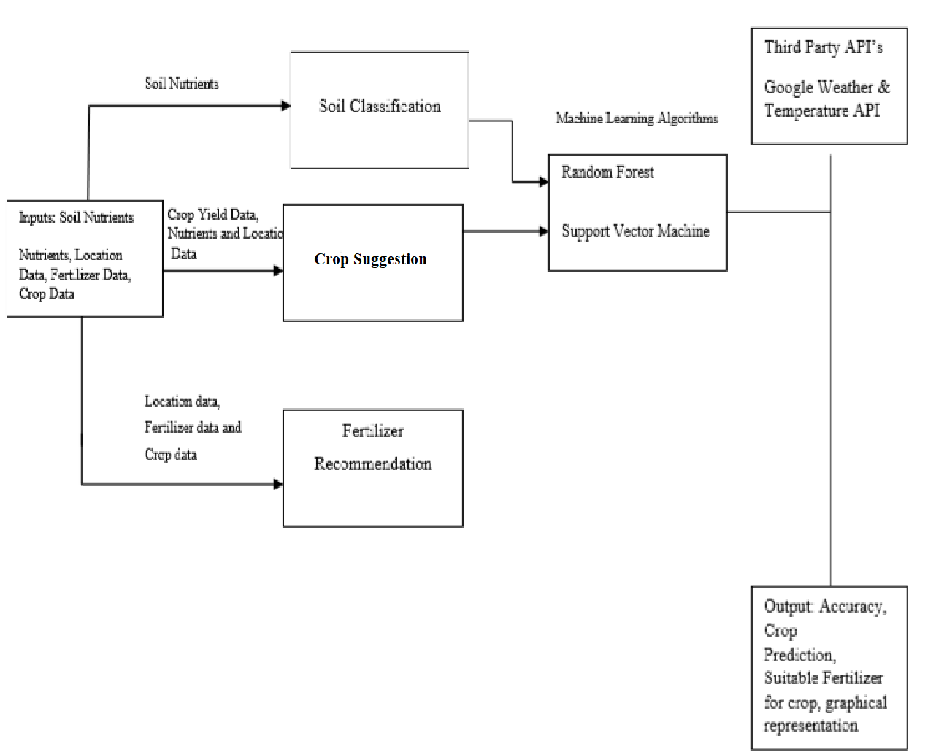

Slide 7
Technology Stack used
Python Libraries: NumPy, Pandas, Matplotlib, Scikit-learn, PyTorch
Web Tech Stack: MERN
Deployment: Heroku

Slide 8
Conclusion
The key achievement of the application is that it suggests crops and fertilizers beforehand saving a lot of resources. The harnessing of deep learning algorithms to predict diseases adds to the usage.

Slide 9
Thank You!

