Slide 1


Chapter 2: Compliance and Cloud Governance

Slide 2

Overview
Azure Regions
Azure Subscriptions
Azure Cost Management
Azure Policy
Azure Role Based Access Control
Resource Locks
Resource Tags
2

Slide 3
Regions
Collection of datacenters
Provides scale and flexibility
Data residency and compliance
Some services are global while others are region specific.
Ensure service availability before planning deployment.
High availability is offered with the help of region pairs.
3

Slide 4
Azure Subscriptions
Provides environmental, security and billing boundary for the resources.
Every subscription is linked to an Azure Account.
Subscription can be created by any identity that is part of Azure AD or any identity that is part of a directory that Azure AD trusts.
4

Slide 5

Azure Cost Management
Cost analysis
Cost Alerts
Budgets
Cost Recommendations
Exports
5

Slide 6
Cost savings
Reserved Instances
Azure Hybrid Benefits
Azure Credits
Dev/Test subscriptions
Budgets
Regions
6

Slide 7
Azure Policy
Helps you to create, assign and manage policies in Azure
Azure Policy enforces compliance with the help of evaluations and scans for non-compliant resources.
Policies can be applied at scale
Remediation strategy
7

Slide 8
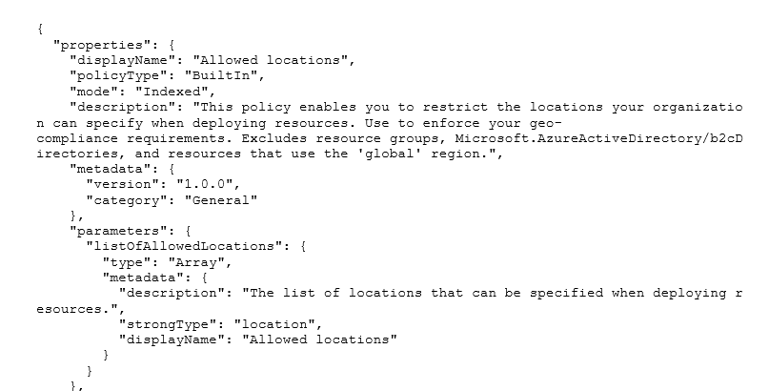
Implementing Azure Policy
Policy definition
Policy scope
Policy assignment
Policy Evaluation
8

Slide 9
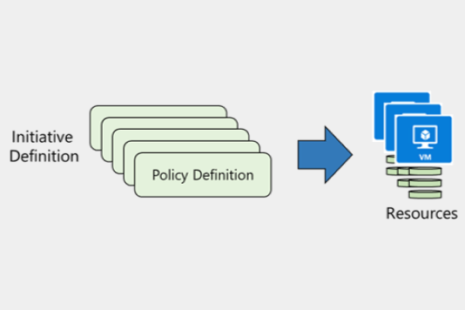
Initiative
Chaining of multiple policy definitions.
Overall compliance can be easily evaluated.
9

Slide 10
Role Based Access Control
Grant access to users, groups, service principals or managed identities.
Only the amount of access is granted that is needed to perform their jobs.
Built on Azure Resource Manager
Helps to segregate duties within the team.
There are built in roles provided by Azure, and you can create your custom roles.
Azure RBAC roles are different from Azure AD roles.
10

Slide 11
Azure Locks
Two types of locks:
CanNotDelete
ReadOnly
CanNotDelete (shown as Delete lock in Azure Portal) can be used to restrict users from accidental deletion of resources.
ReadOnly locks protects resources from accidental deletion as well as modification.
Even if you have RBAC permissions to delete or modify, you need to remove the lock before making changes.
11

Slide 12
Resource Tags
Metadata can be added to resources with the help of tags.
Tags are represented as name-value pairs.
Provides logical grouping of resources.
Resource tags will be propagated to the billing report and can be used to group consumption based on tags.
Tags applied at the resource group level is not inherited to the resource level by default.
12

