Slide 1

Dynamic Route Recommendation Web Service based on Real-time Fuel Price
Project: Urbana Fleet Fuel Management
Team Member: Josh, Terry, Zhaoqin, Jianzhang, Lynn

Slide 2
Team Introduction
Diverse Background
School Year:
Undergrad(1)
Master(3)
PhD(1)
Major:
Computer Science(1)
Agriculture(1)
Business(1)
Information Sciences(2)
Expertise:
Web Development(1)
Data Analysis(1)
Data Visualization(1)
Software Programming(1)
Machine Learning(1)
Web Scraping(1)
……

Slide 3
What we made?
A website for recommending fleet driver to find the best gas station choice
A reusable, interactive dashboards for fleet fuel manager monitoring
A overall optimization solution for Environmental Sustainability Manager to save more cost & reduce more fuel-use

Slide 4
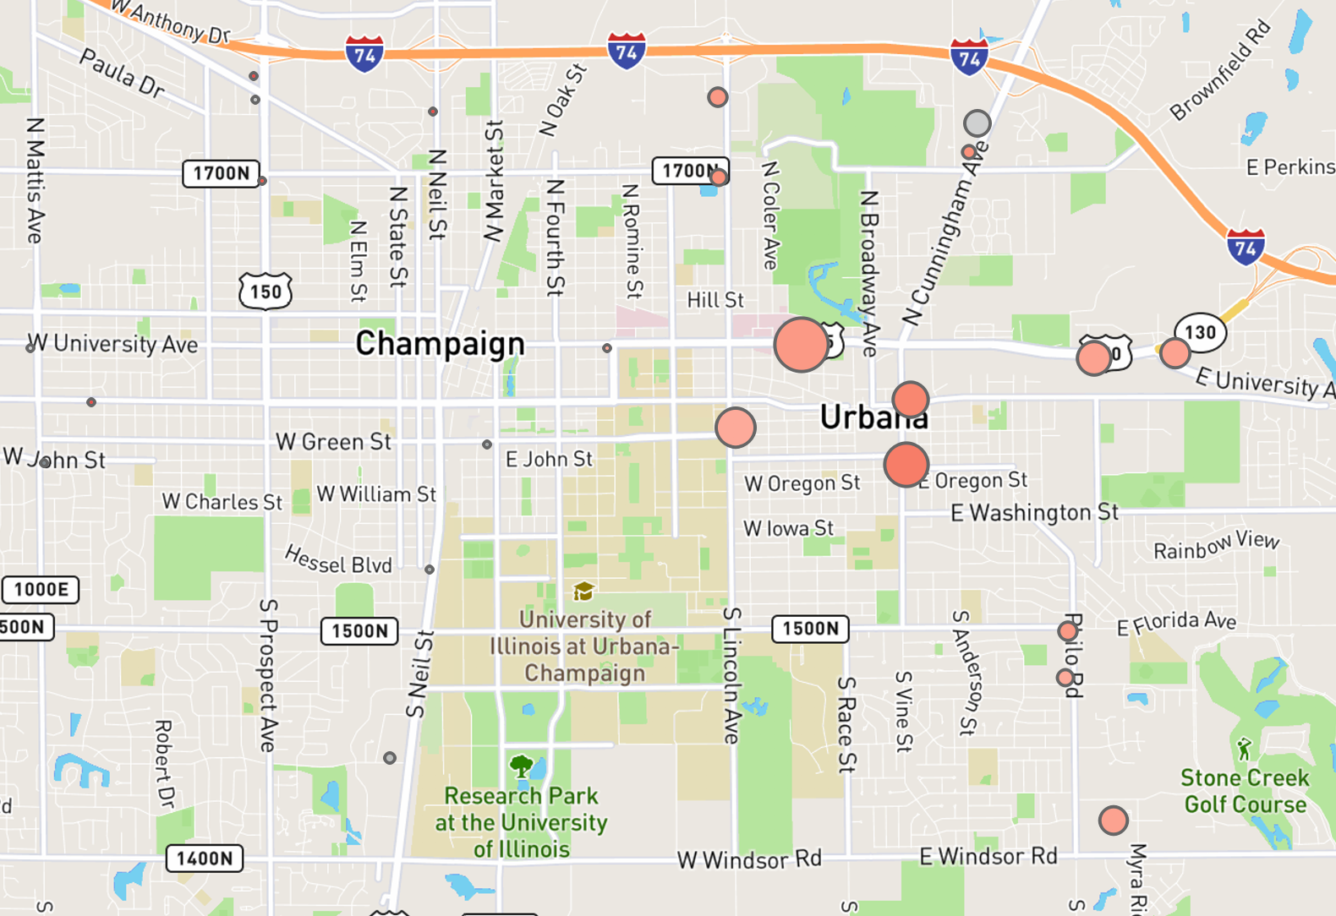
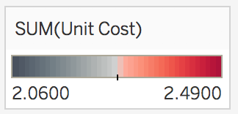
Why we did this?
From historical data, we found the drivers choose the gas station by convenience, but their choice is not the most cost-effective one, which lead to spent more money.
Cheaper
More expensive
The size of circle represents the visit frequency to the gas station

Slide 5
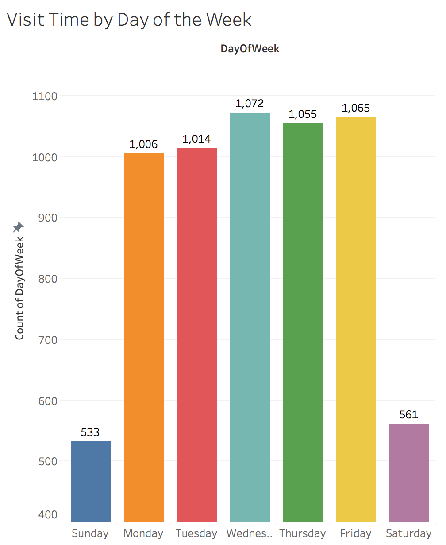
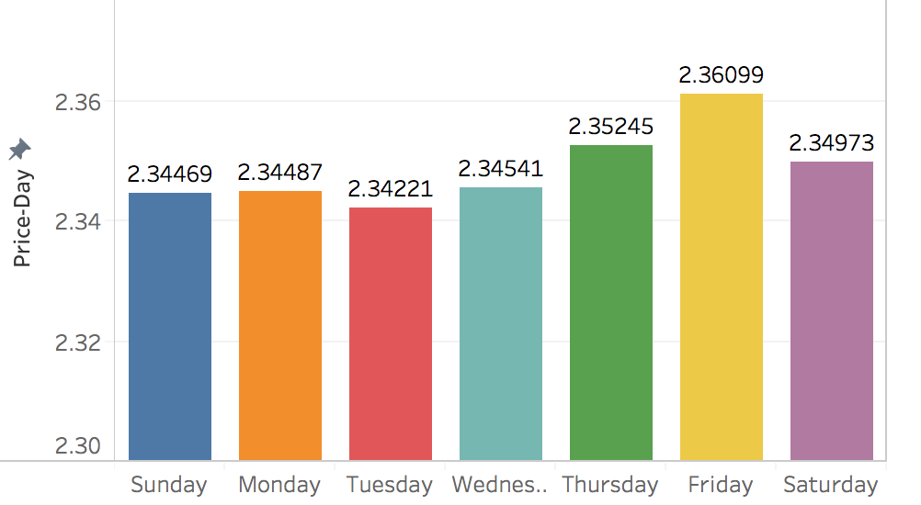
Why we did this?
Meanwhile, the price is fluctuating by the day of week.
Tuesday is usually the lowest
Friday is usually the highest
But our current visit time distribution by day of the week didn’t follow this strategy

Slide 6
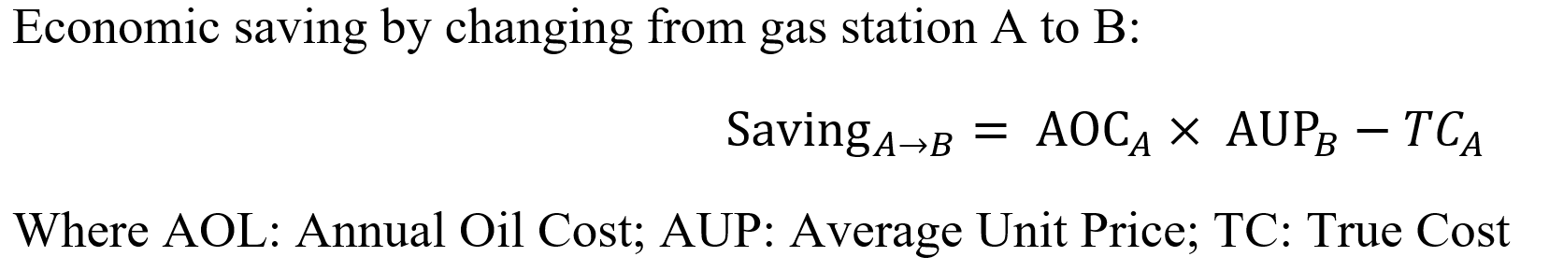
Here is our solution
From the map below, follow the arrow sign, we can move our gas station choice to the cheaper one. If we implement this strategy, it will save us around $15000 per year.
Less cost
Less cost
Less cost
The size of circle represents the visit frequency to the gas station

Slide 7
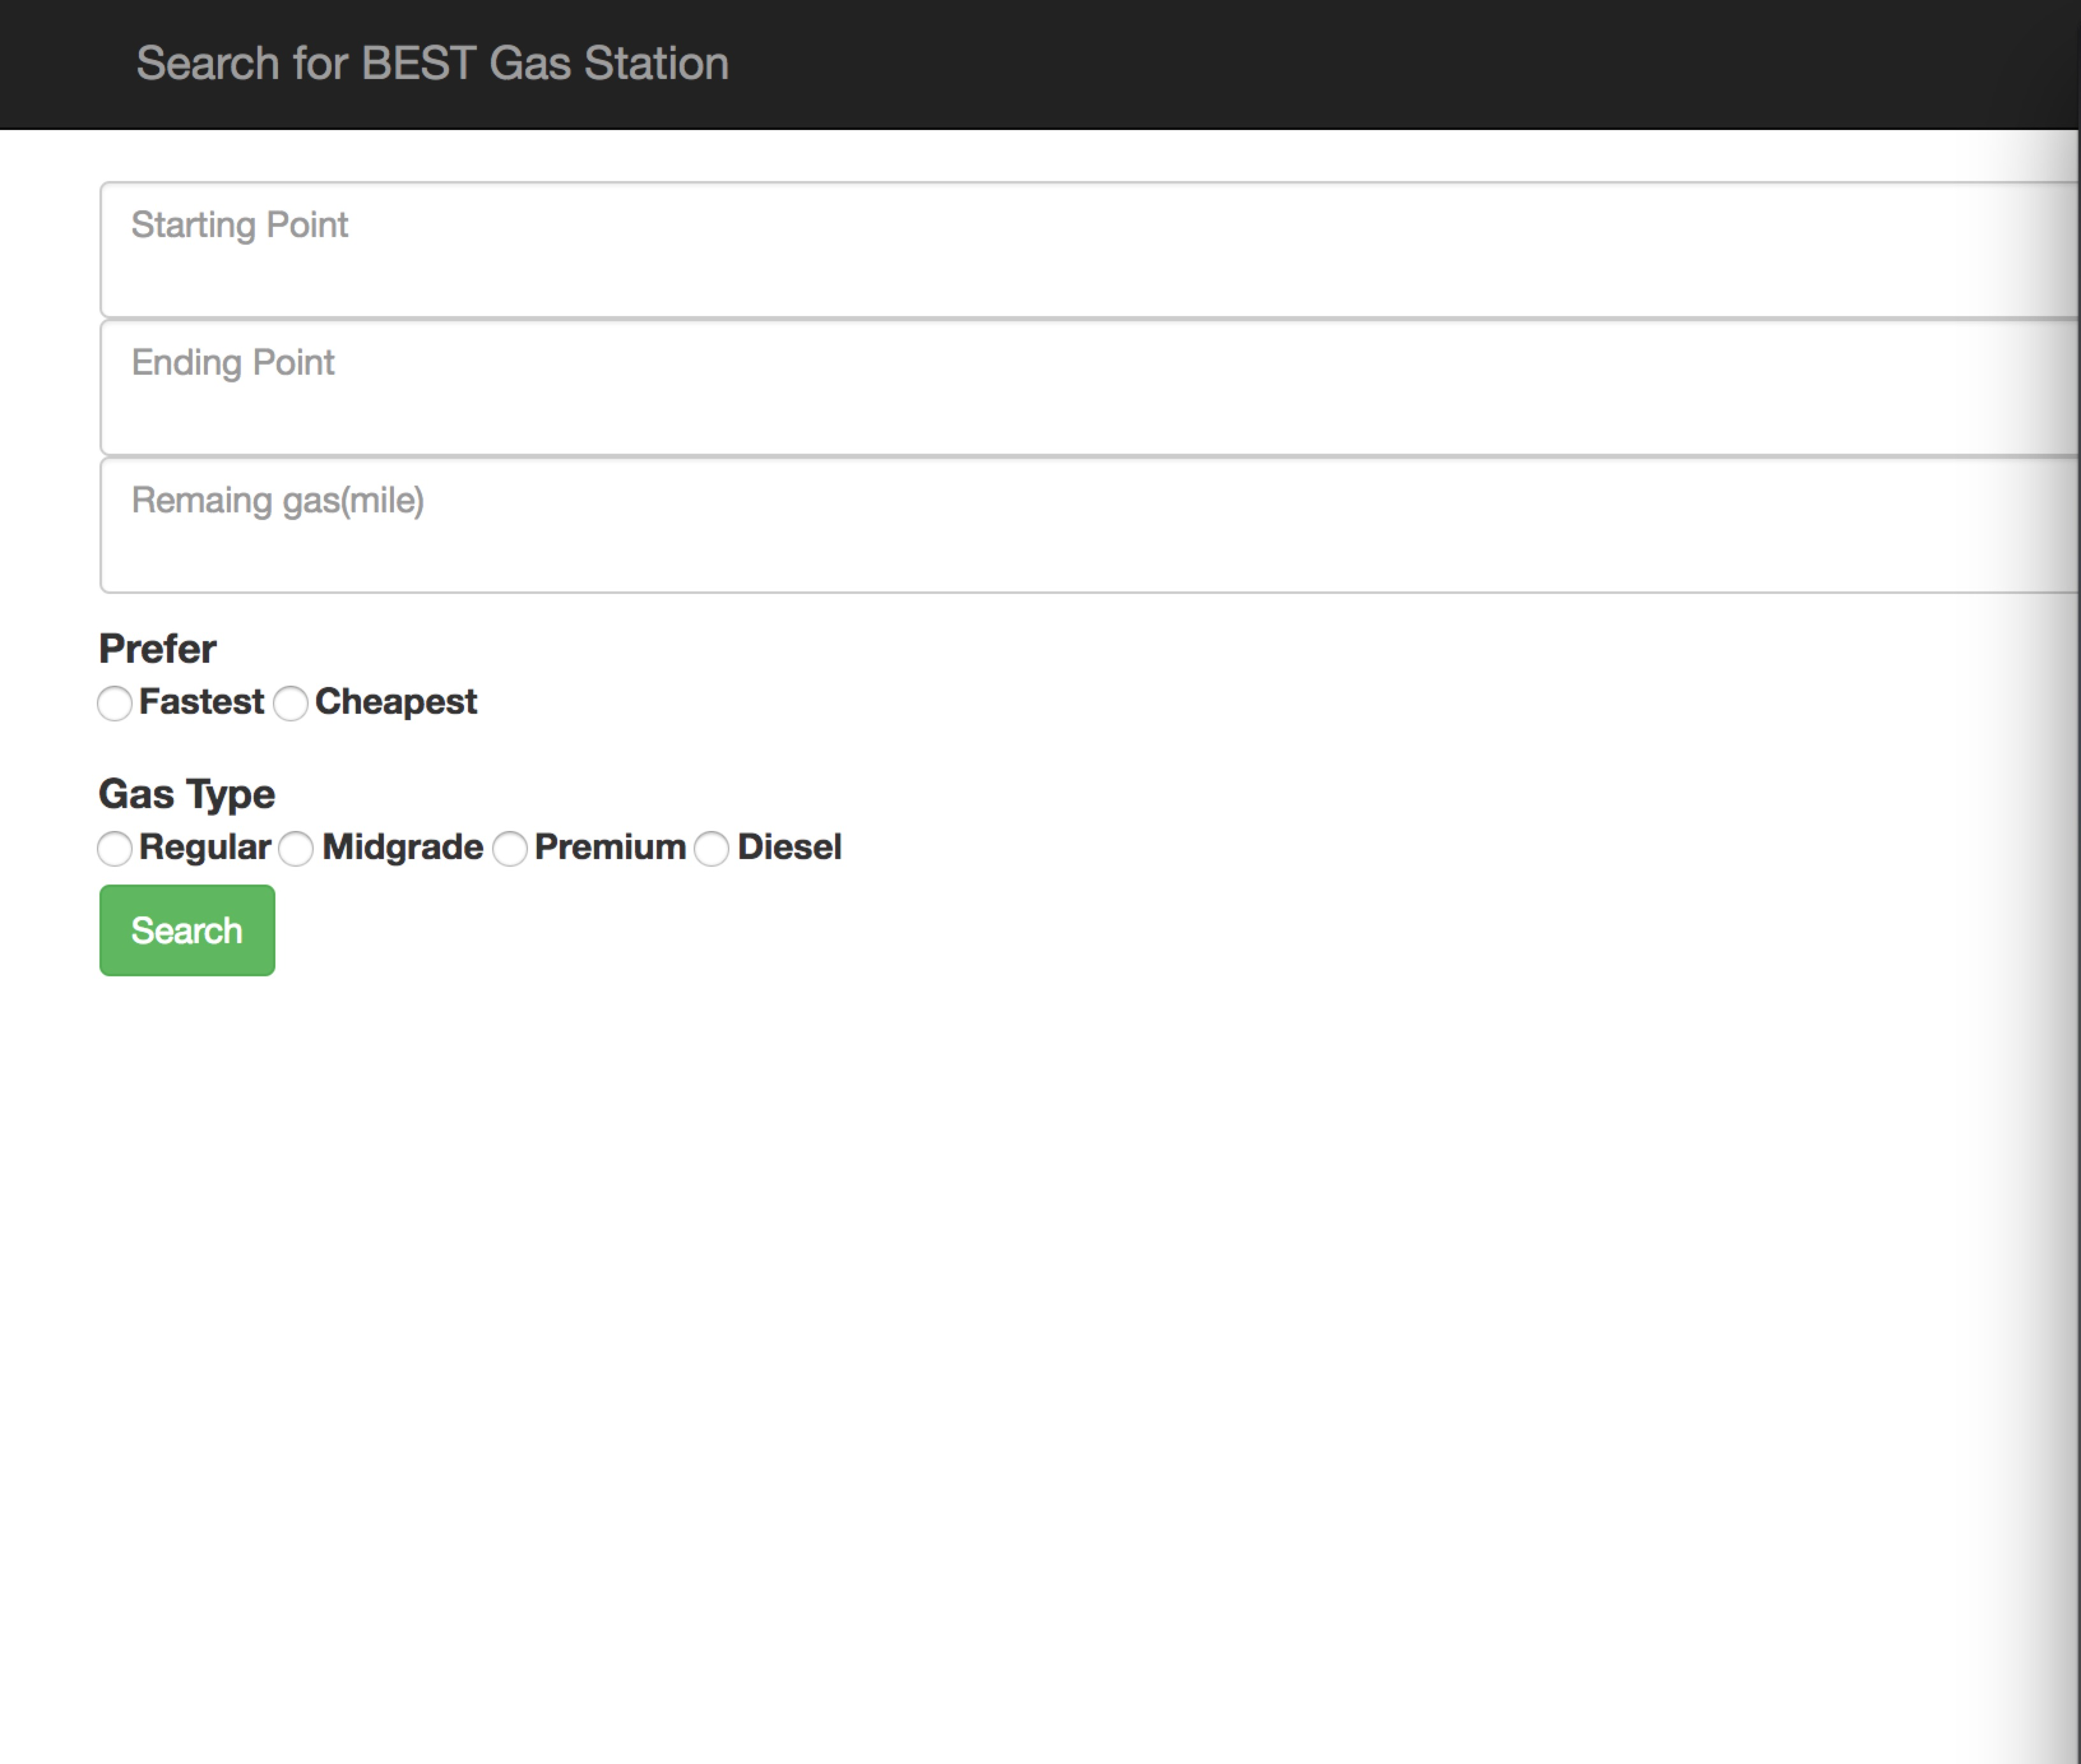
Dynamic recommendation web service
Website Screen Shot
Daily fuel price source: gasbuddy
Input (like google map, but more than a map!)
Start point
End point
Fuel filling type
Emergency Option:
Cheapest or Fastest
Remaining fuel mileage
Output: best route map based on your need!

Slide 8
Best route calculation
Fixed start and end points: get the gas station nearby
Grab the real-time fuel price from gasbuddy
Calculate the fuel cost based for each gas station nearby
Optimize the route by take into the consideration of total distance; reachability of target station with current fuel mileage; fuel cost saving; travel time and drivers need

Slide 9
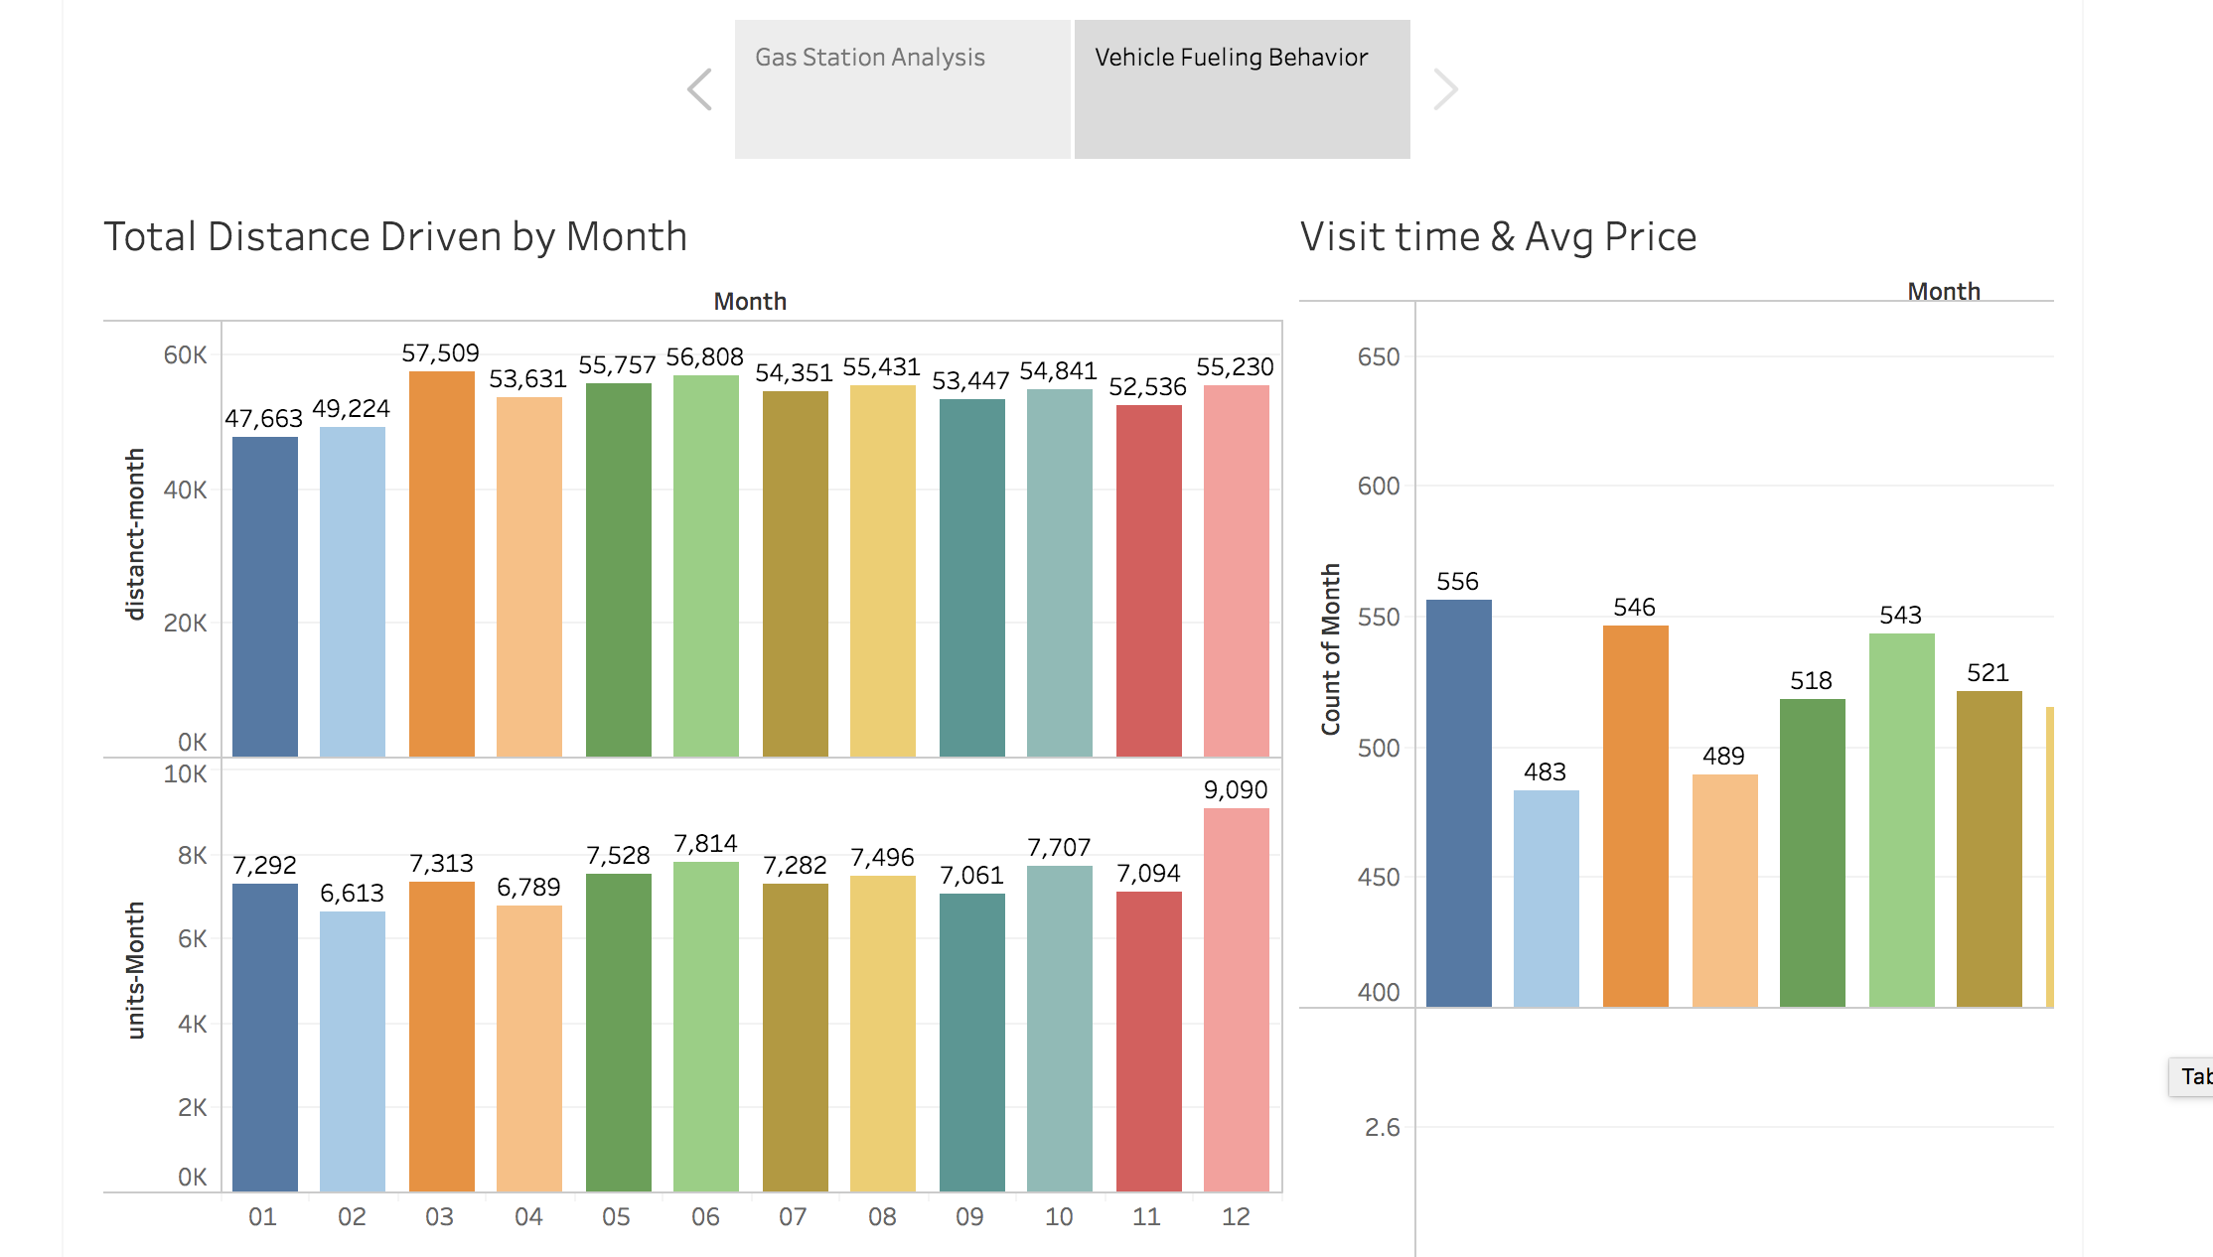
Reusable Interactive Dashboards
This will help fuel manager better understand the spend on gas station

Slide 10
Our Recommend Next Step
Implement the website for fleet driver to find the best gas station choice
Discover the potential partnership(bundle promotion, discount) with gas station brand who offers the most cost-effective fuel.

Slide 11
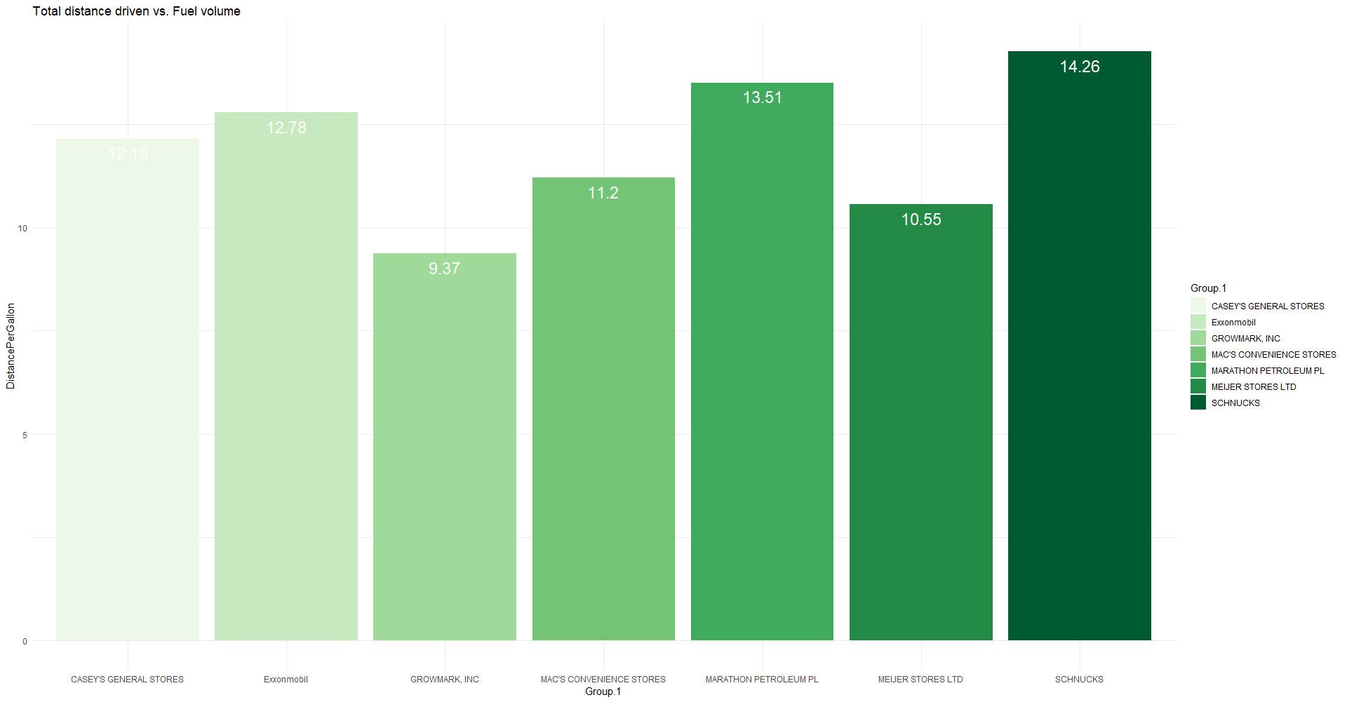
We also found some interesting insights
Fuel efficiency by brand, we found Schnucks is the best, while Growmark is the lowest.

Slide 12
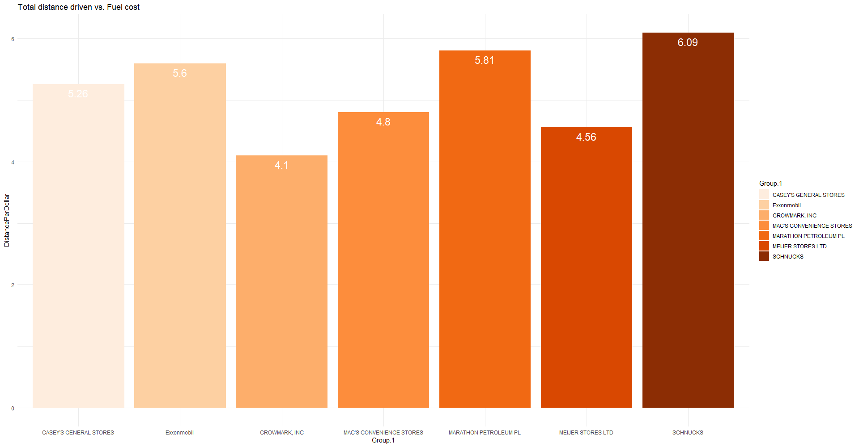
We also found some interesting insights
Distance per dollar by brand, we also found Schnucks is the best, while Growmark is the lowest.

Slide 13
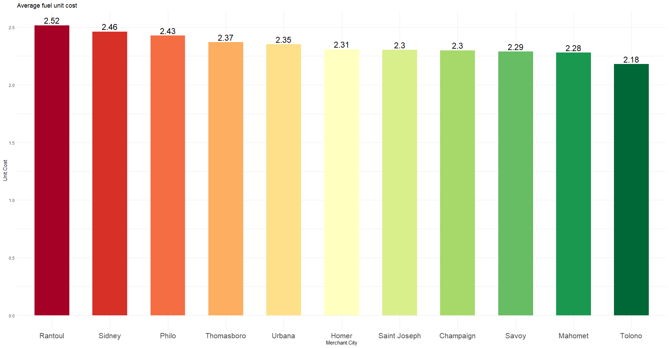
We also found some interesting insights
Avg fuel unit cost by city in Champaign county. Although our most driving area is around Urbana-Champaign, but the recommendation is if we are outside of Urbana-Champaign, we can make use the fact that gas station price in some cities like Rantoul, Sidney, Philo are cheaper than Urbana-Champaign.

Slide 14
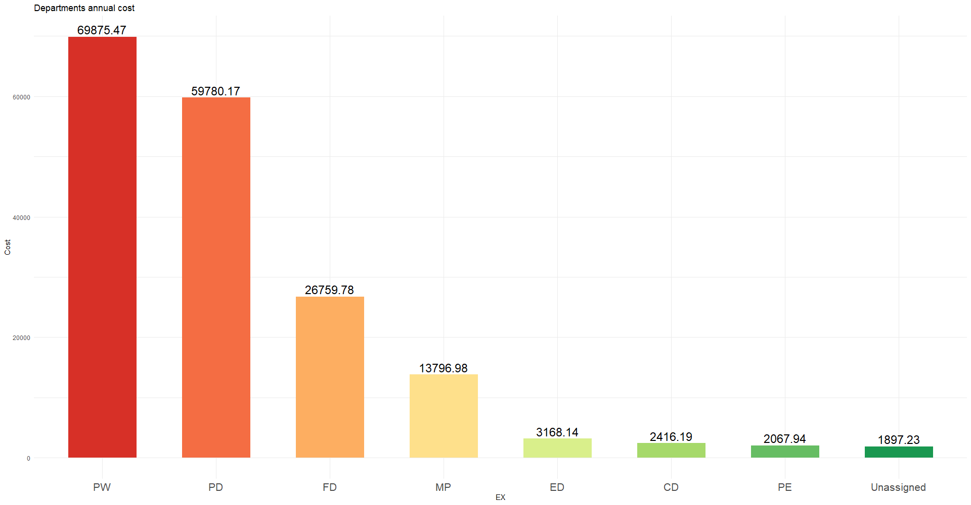
We also found some interesting insights
Total spend by department in 2017. Although we didn’t know the meaning of PW, PD (probably related to police), we can clearly see that PW & PD spent the most amount of gas spent last year.

