Slide 1
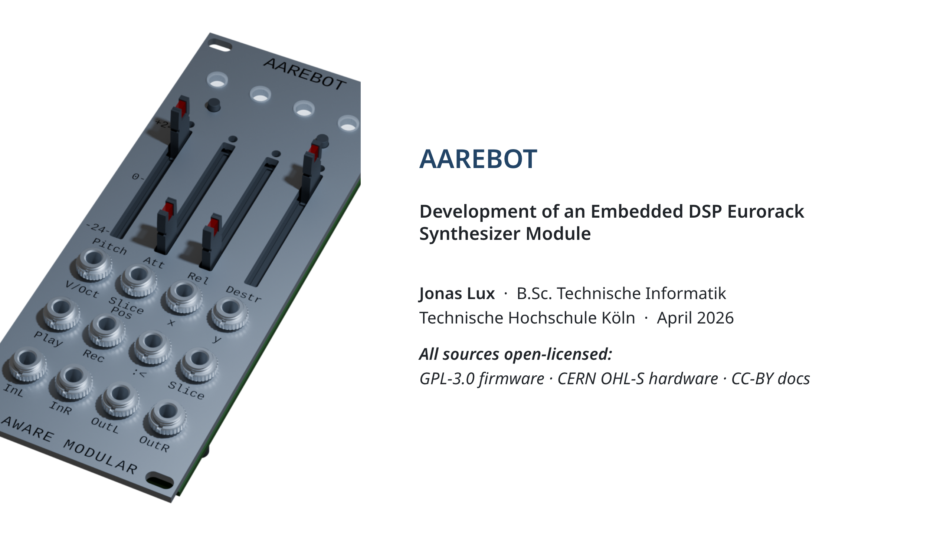

Slide 2
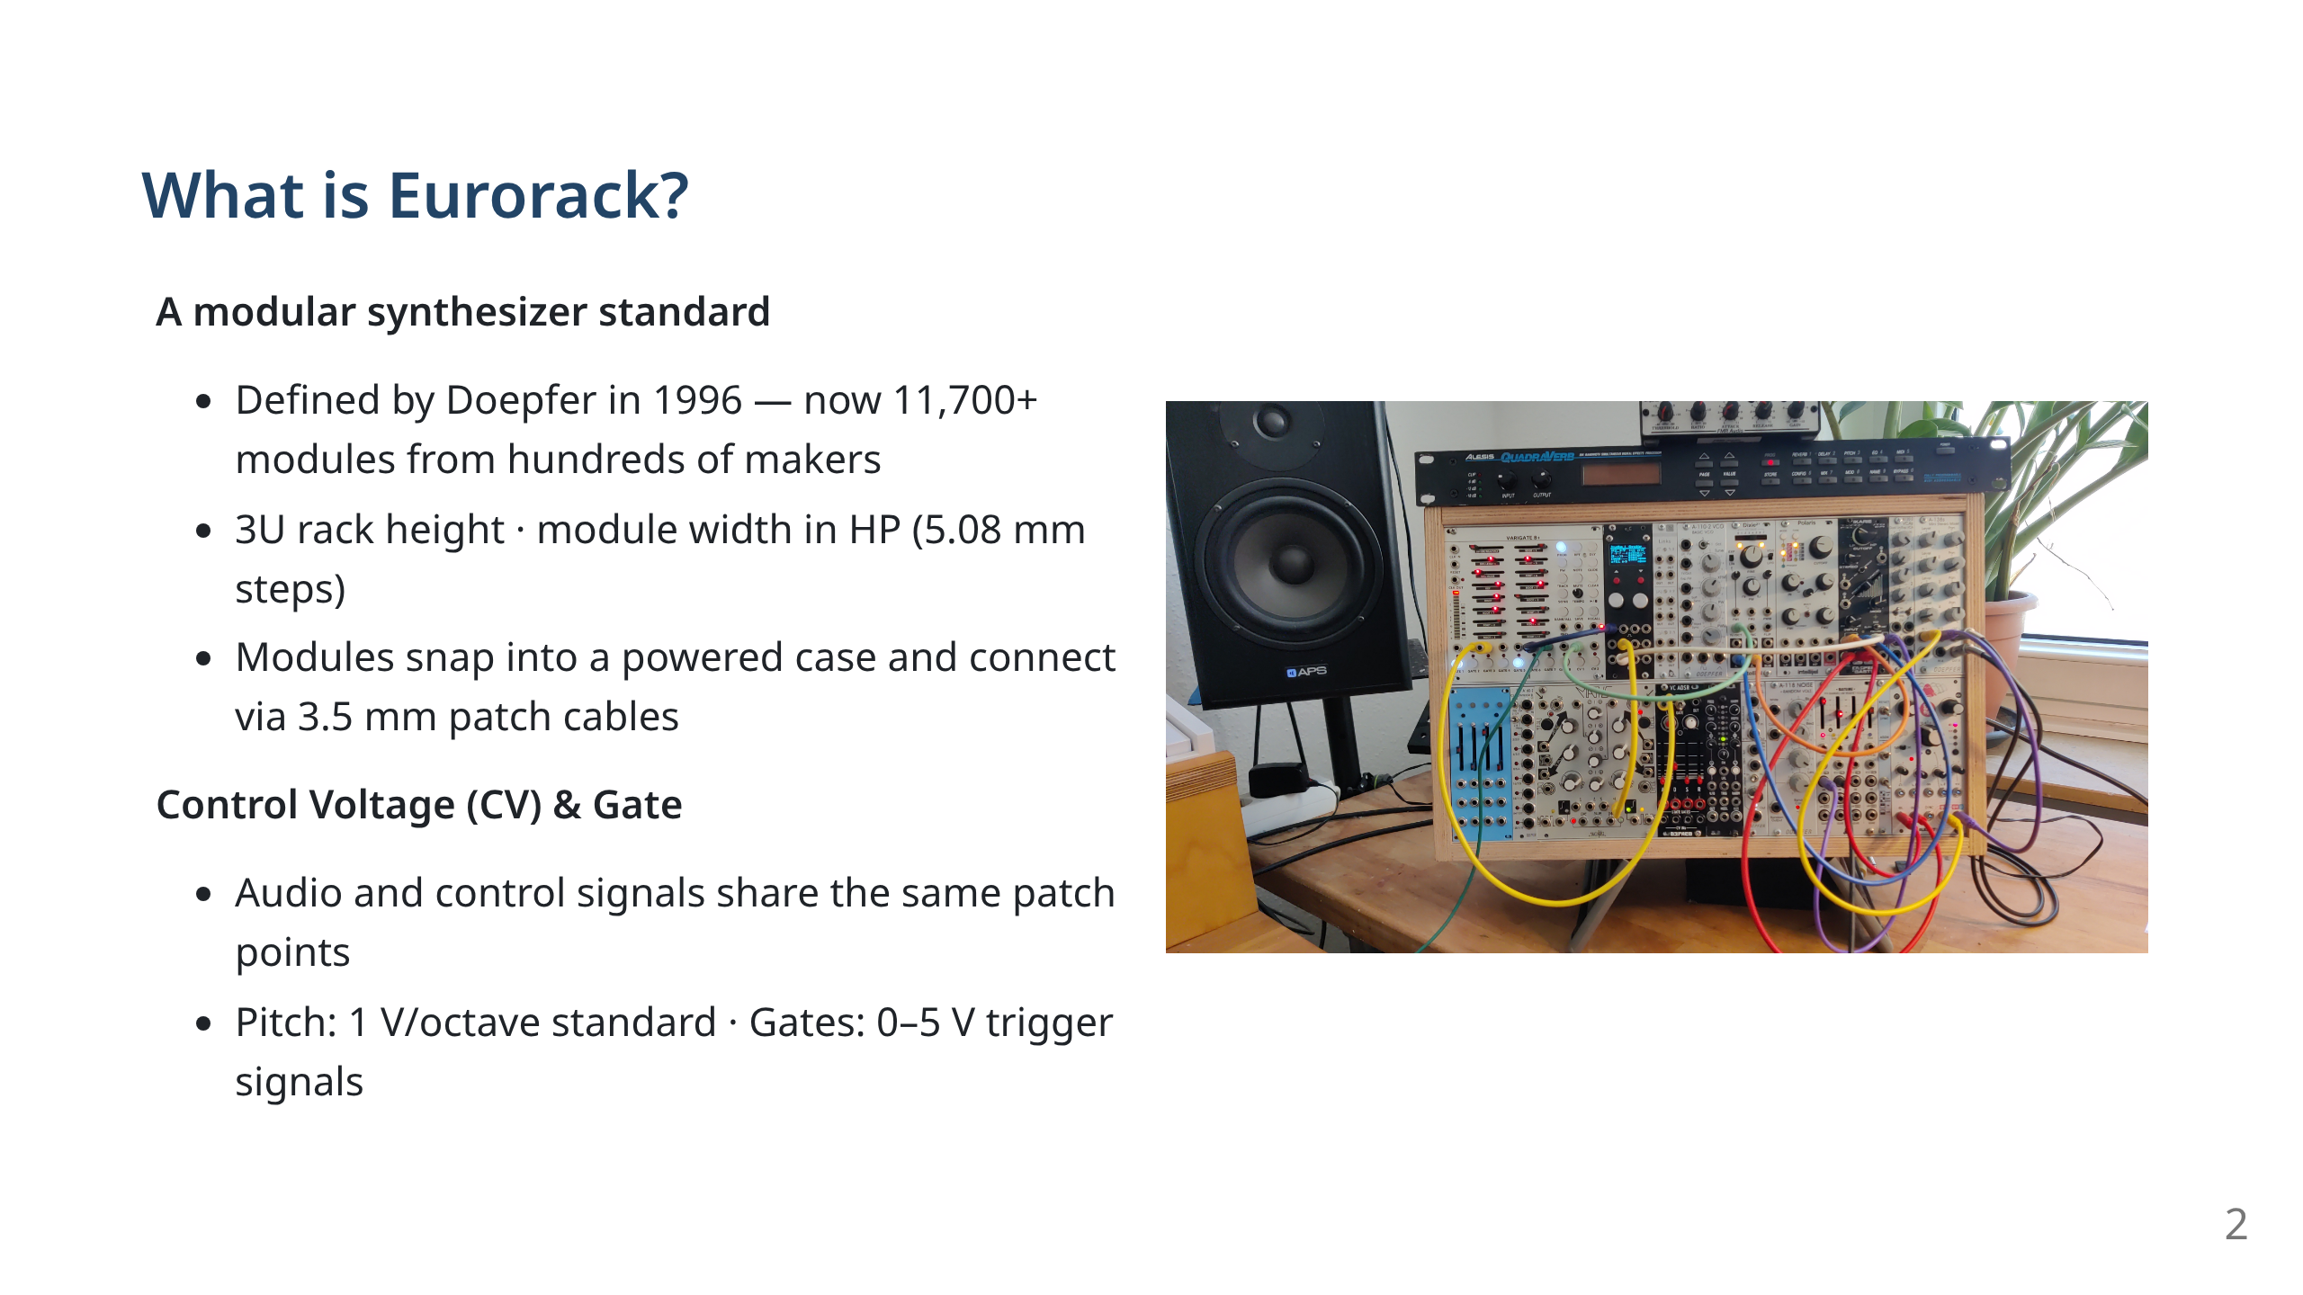
Notes:
- Signal flow is entirely user-defined — no fixed routing

Slide 3
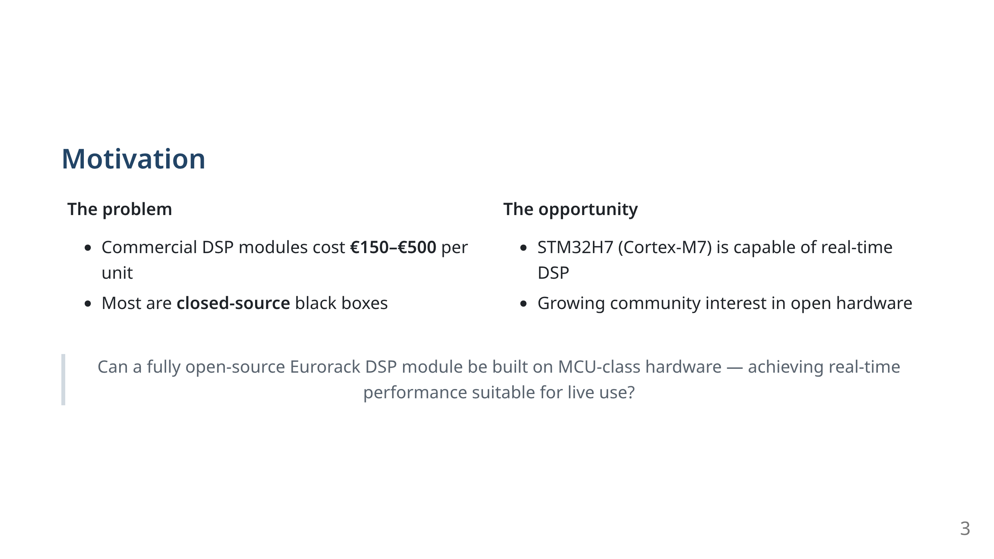

Slide 4
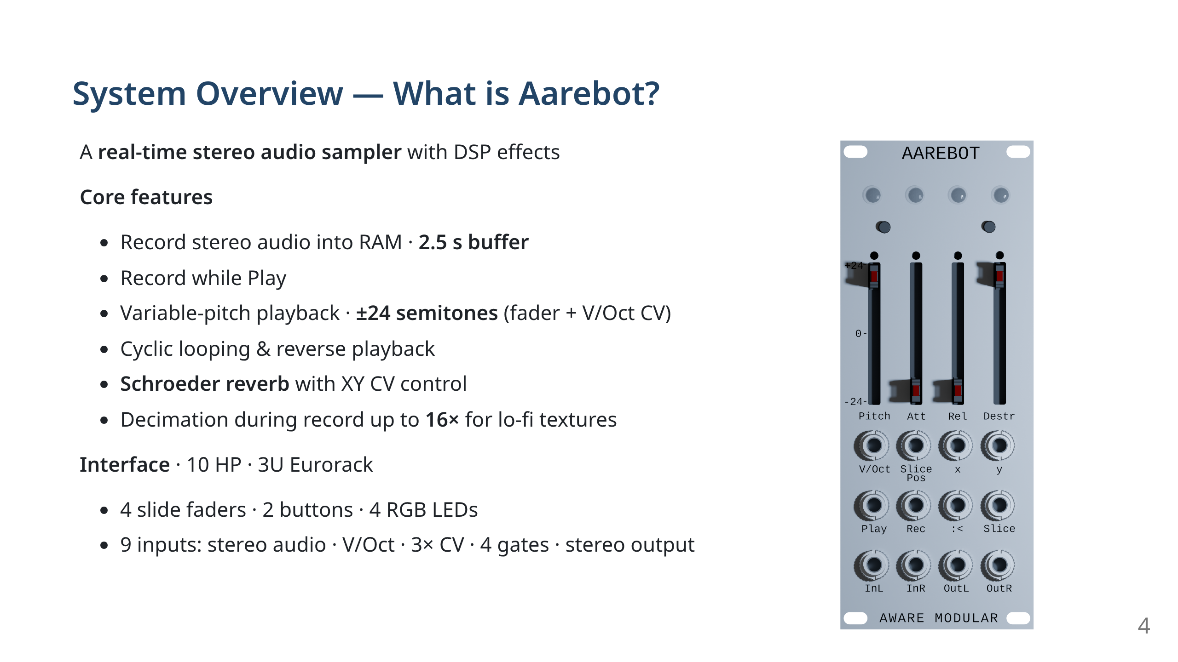

Slide 5
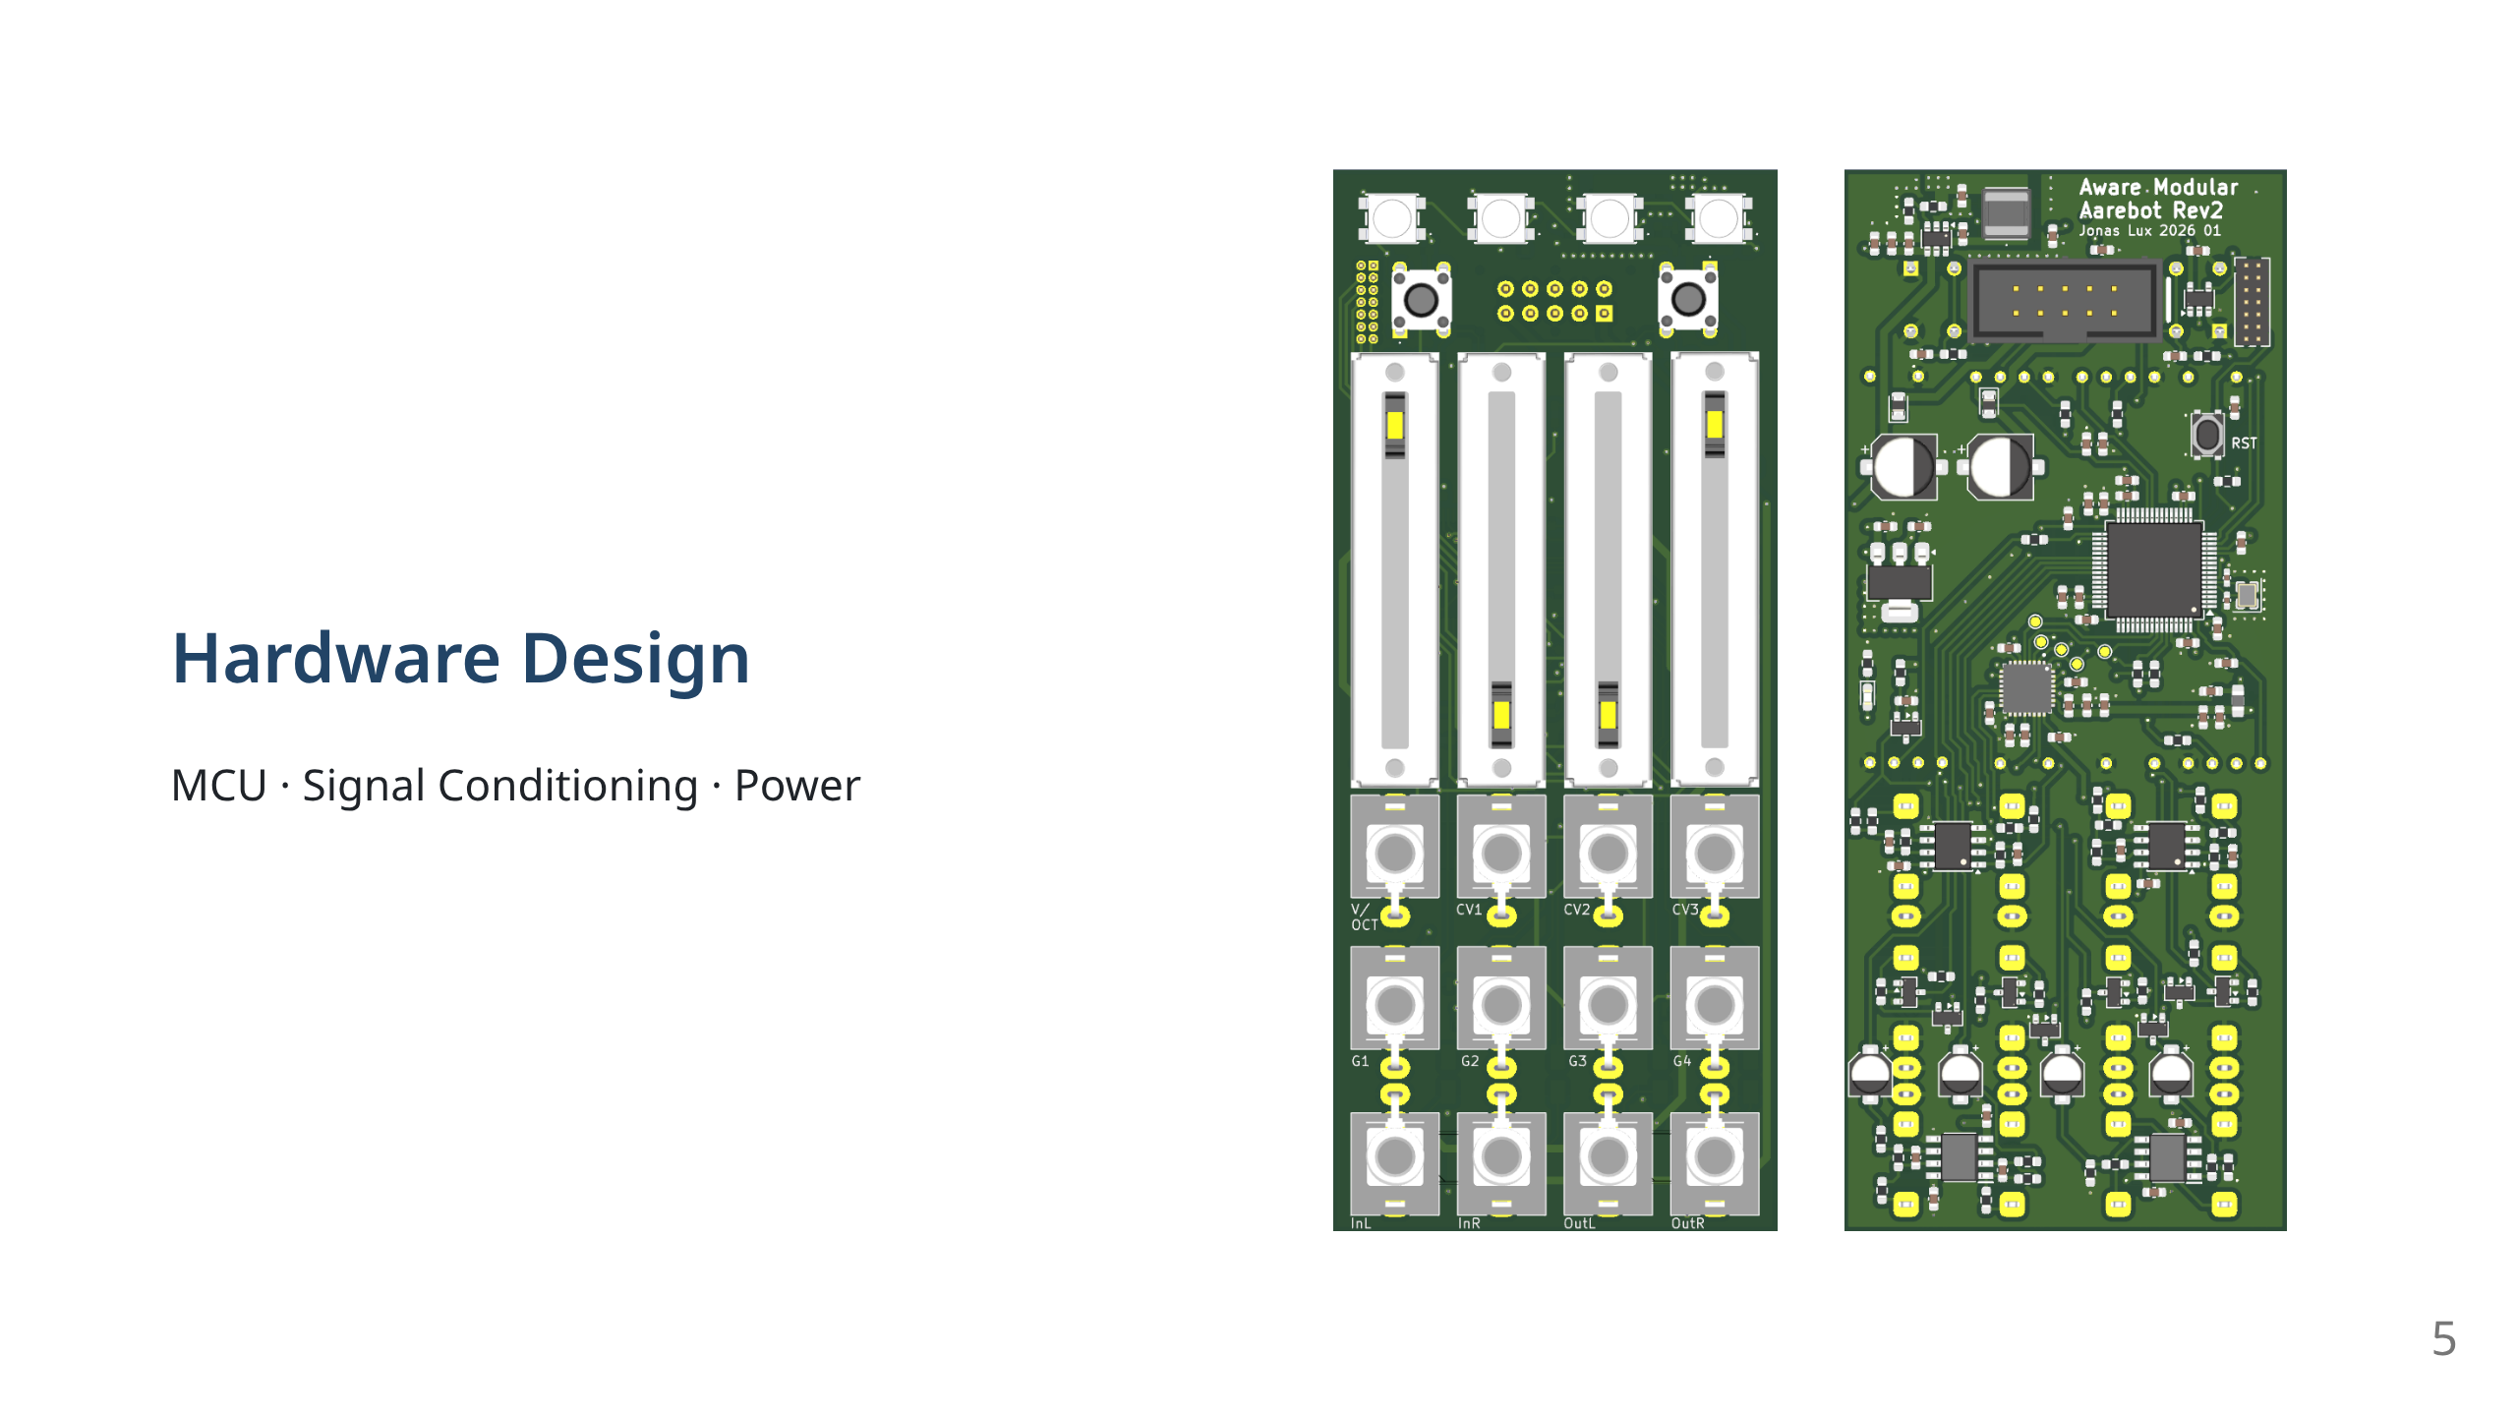

Slide 6
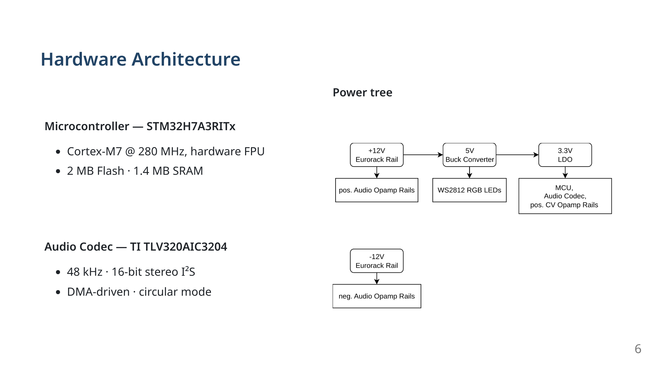
Notes:
**Signal conditioning** - Audio in/outs: AC-coupled, BAT54S Schottky clamp - CV in: ±10 V tolerance, op-amp rail guard - Gate in: ±12 V transistor clamping - V/Oct: 2-point calibration (C1 @ 1V, C3 @ 3V)

Slide 7
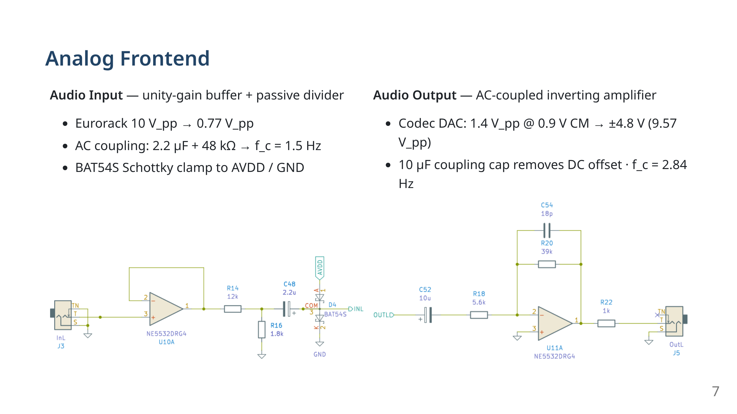
Notes:
**CV Input** — inverting summing amp + −10 V bias - Maps ±5 V CV → 0–3.3 V ADC range - V/Oct: −1.5 V … +5 V → 0.2–3.25 V ADC

Slide 8
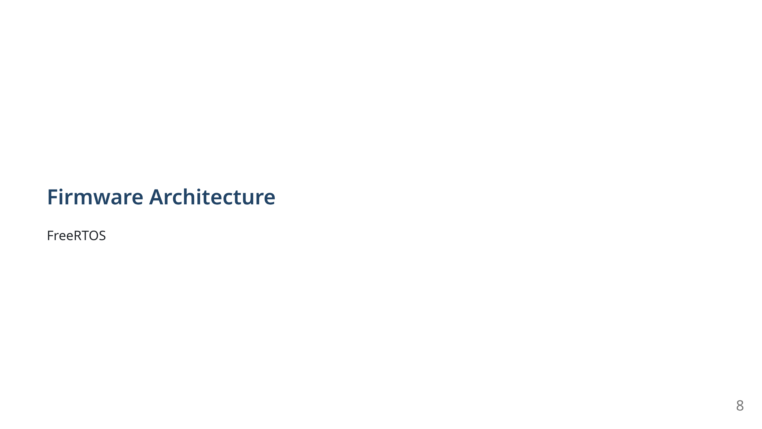

Slide 9
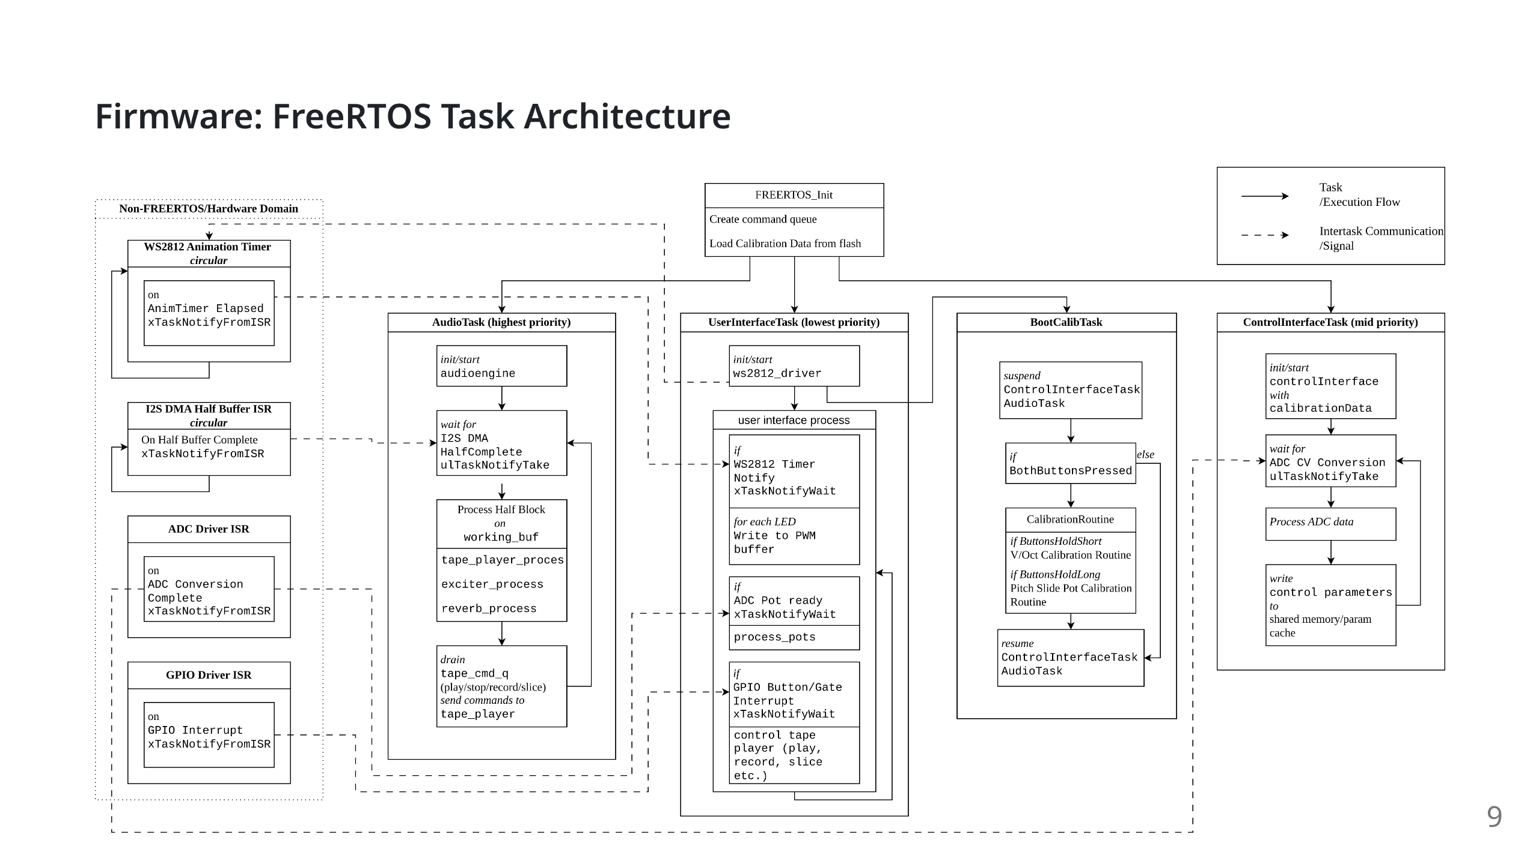
Notes:
- **Lock-free parameter cache** — no mutex in the audio path · DMA buffers in **non-cacheable SRAM** - Control + UI tasks: **0% CPU** during audio · Full DSP chain: **60–66% CPU** @ 48 kHz

Slide 10
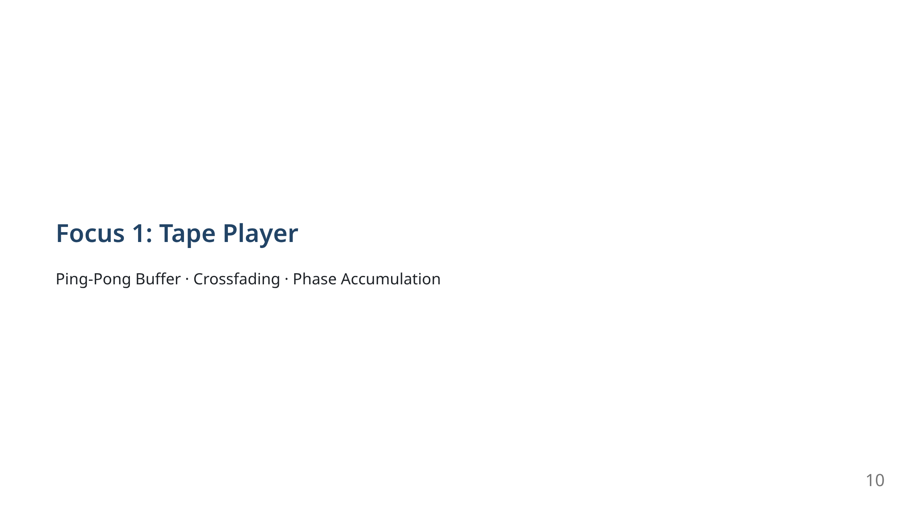

Slide 11
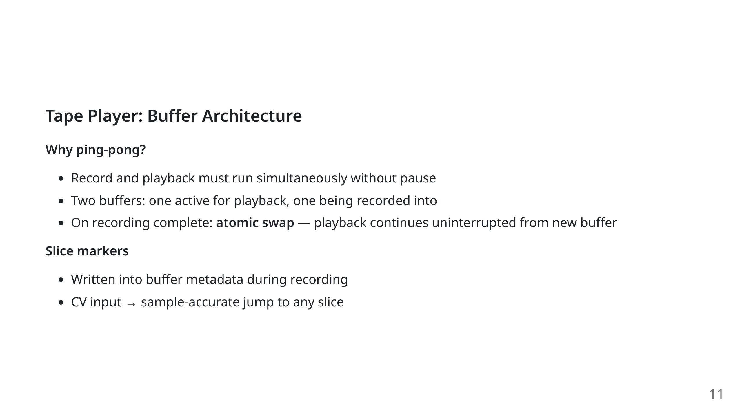

Slide 12
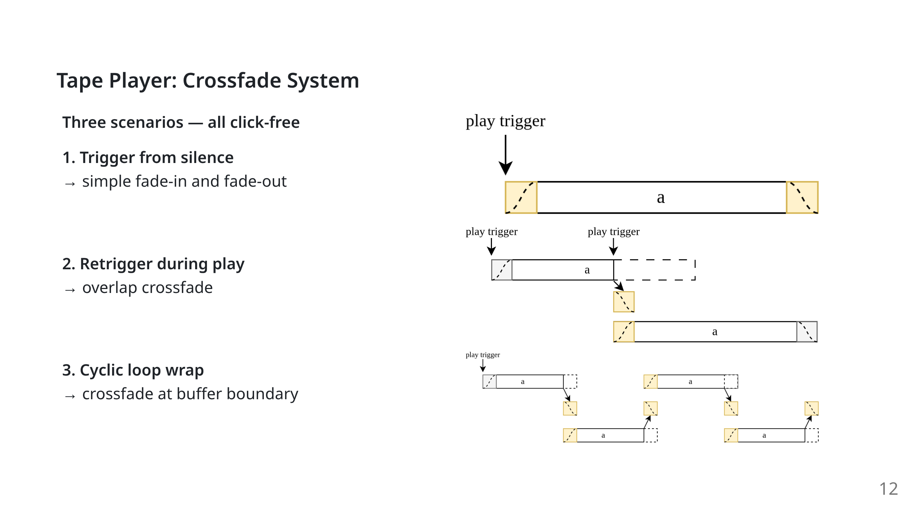
Notes:
- Quarter-sine LUT → constant-power (−3 dB) crossover - Fade accumulator **decoupled from playhead** → consistent duration at any pitch

Slide 13
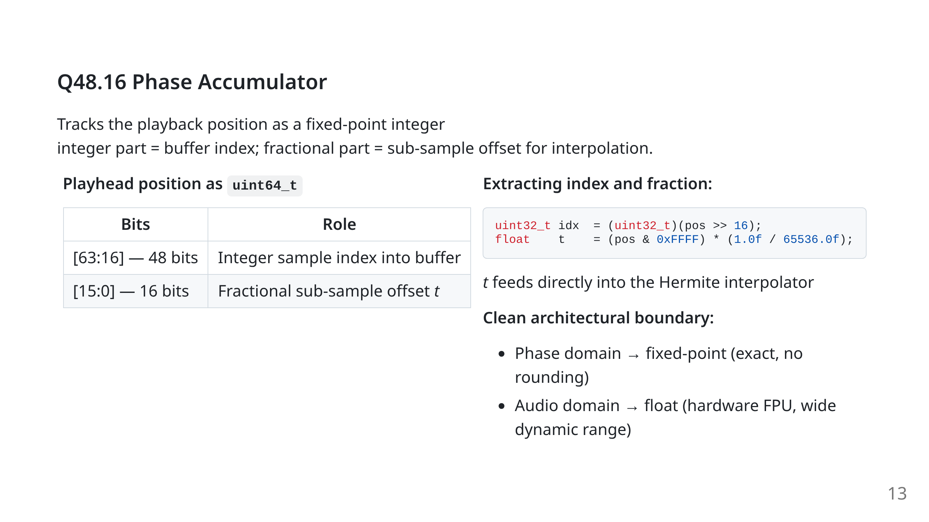
Notes:
**Why 48-bit integer part?** Buffer holds 48 000 × 2.5 s = **120 000 samples** — exceeds 16-bit max (65 535) All index comparisons and crossfade distances stay in Q.16 units — boundary checks become bit-shifts, no division

Slide 14
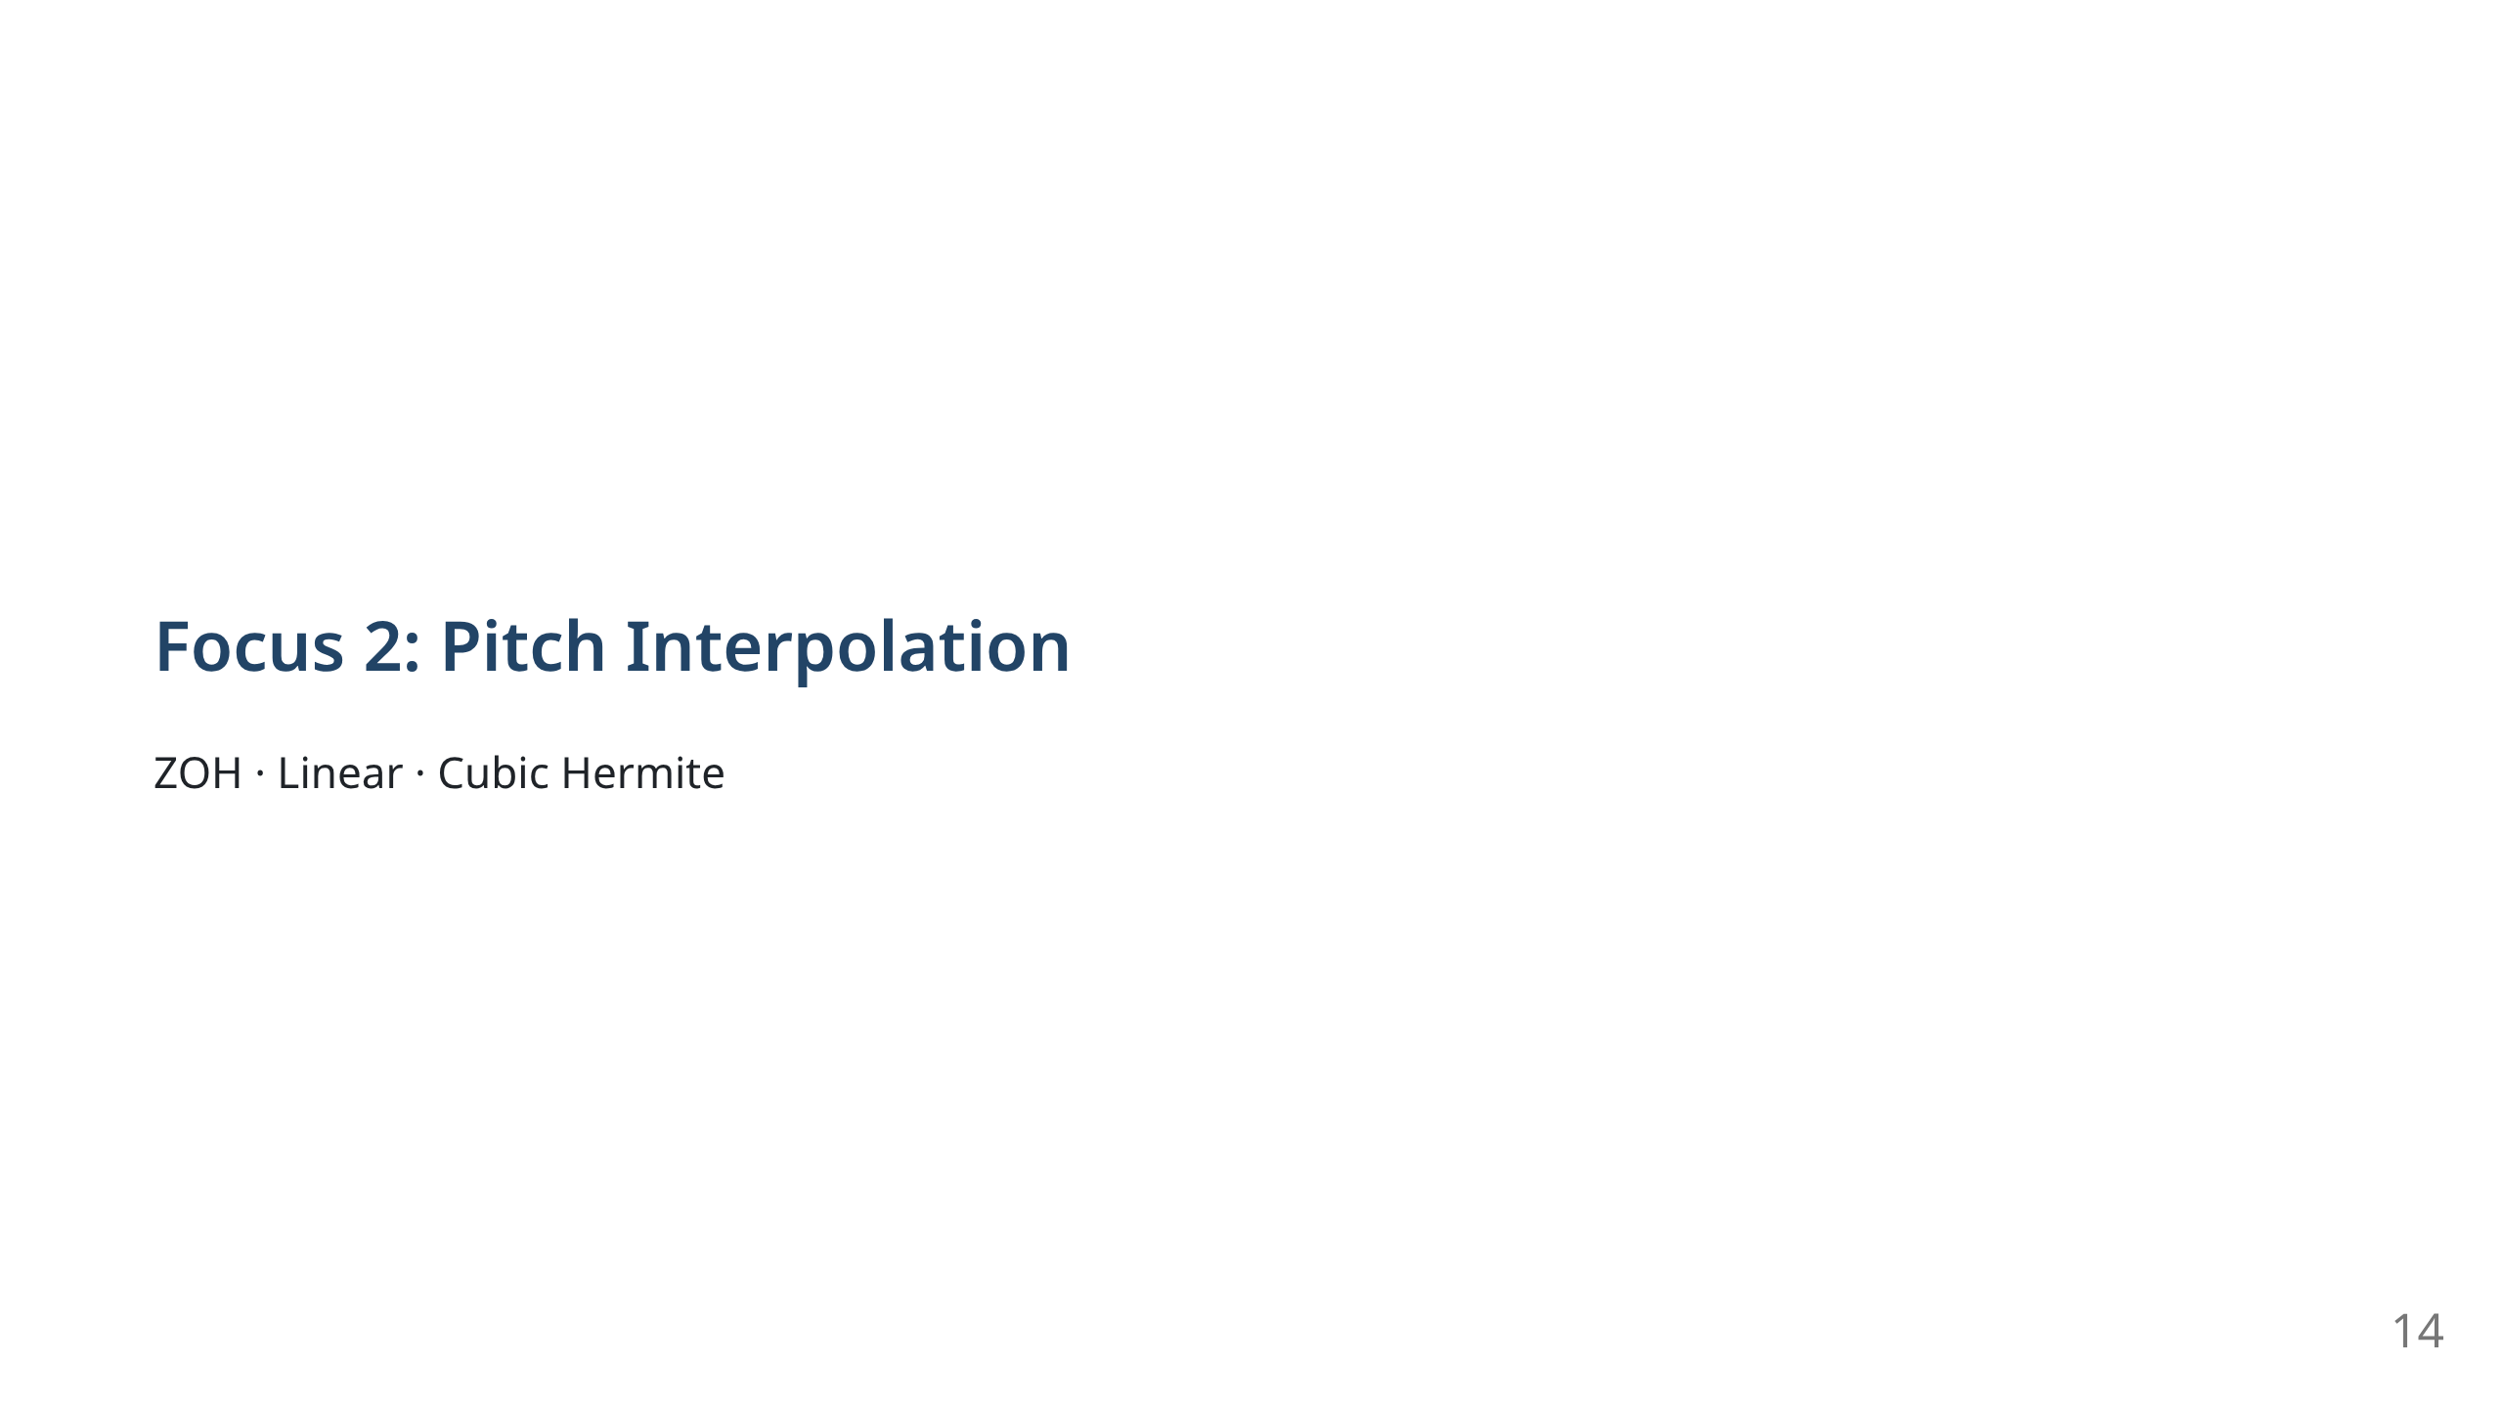

Slide 15
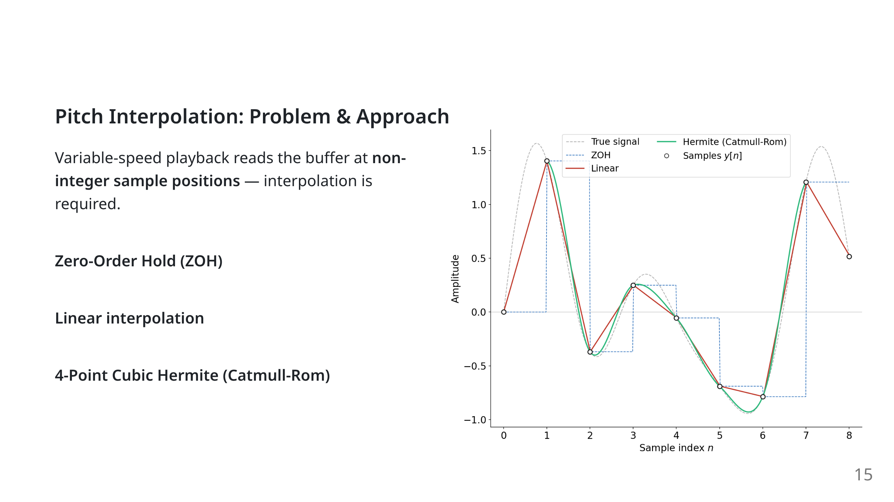
Notes:
Variable-speed playback means the playhead advances at a rate that is not an integer multiple of the sample period — so we land between two recorded samples. The actual sample value at that position was never stored, so we have to estimate it from the neighbors. ZOH last sample repeated → staircase waveform → strong aliasing, especially at slow speeds Linear Interpolation Weighted blend of two neighbors → smoother, but slope discontinuities remain Cubic Interpolation C¹-continuous, derivatives from finite differences → flat passband, suppressed aliasing

Slide 16
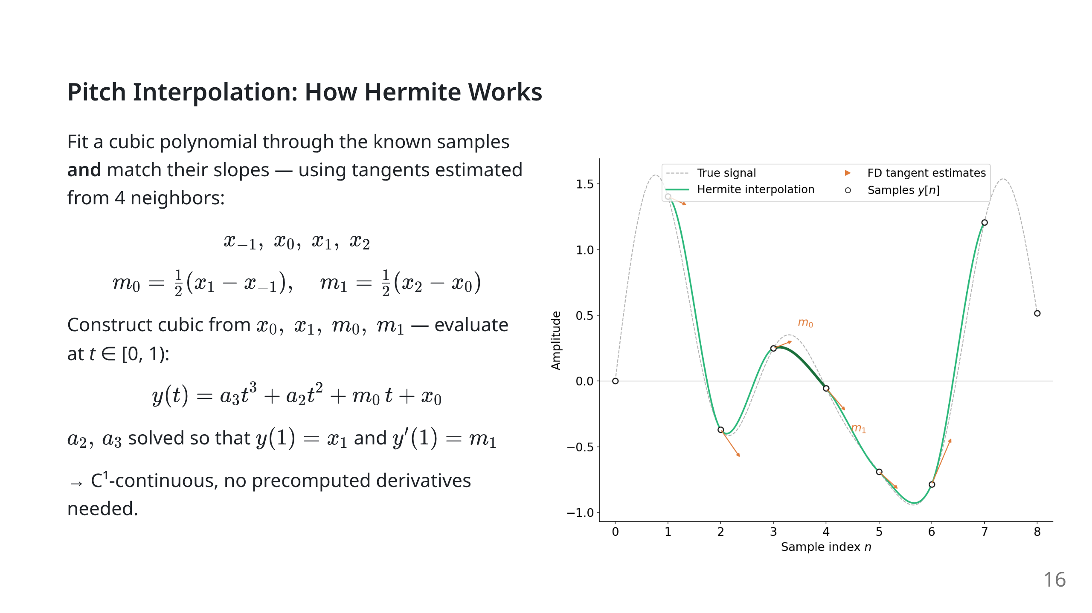
Notes:
1st order -> linear interpolation 2nd order -> quadratic interpolation (not used in audio, because asymmetric. Needs 3 samples) 2nd order cant match value and slope at both endpoints, therefore cubic (3rd order) interpolation is used.

Slide 17
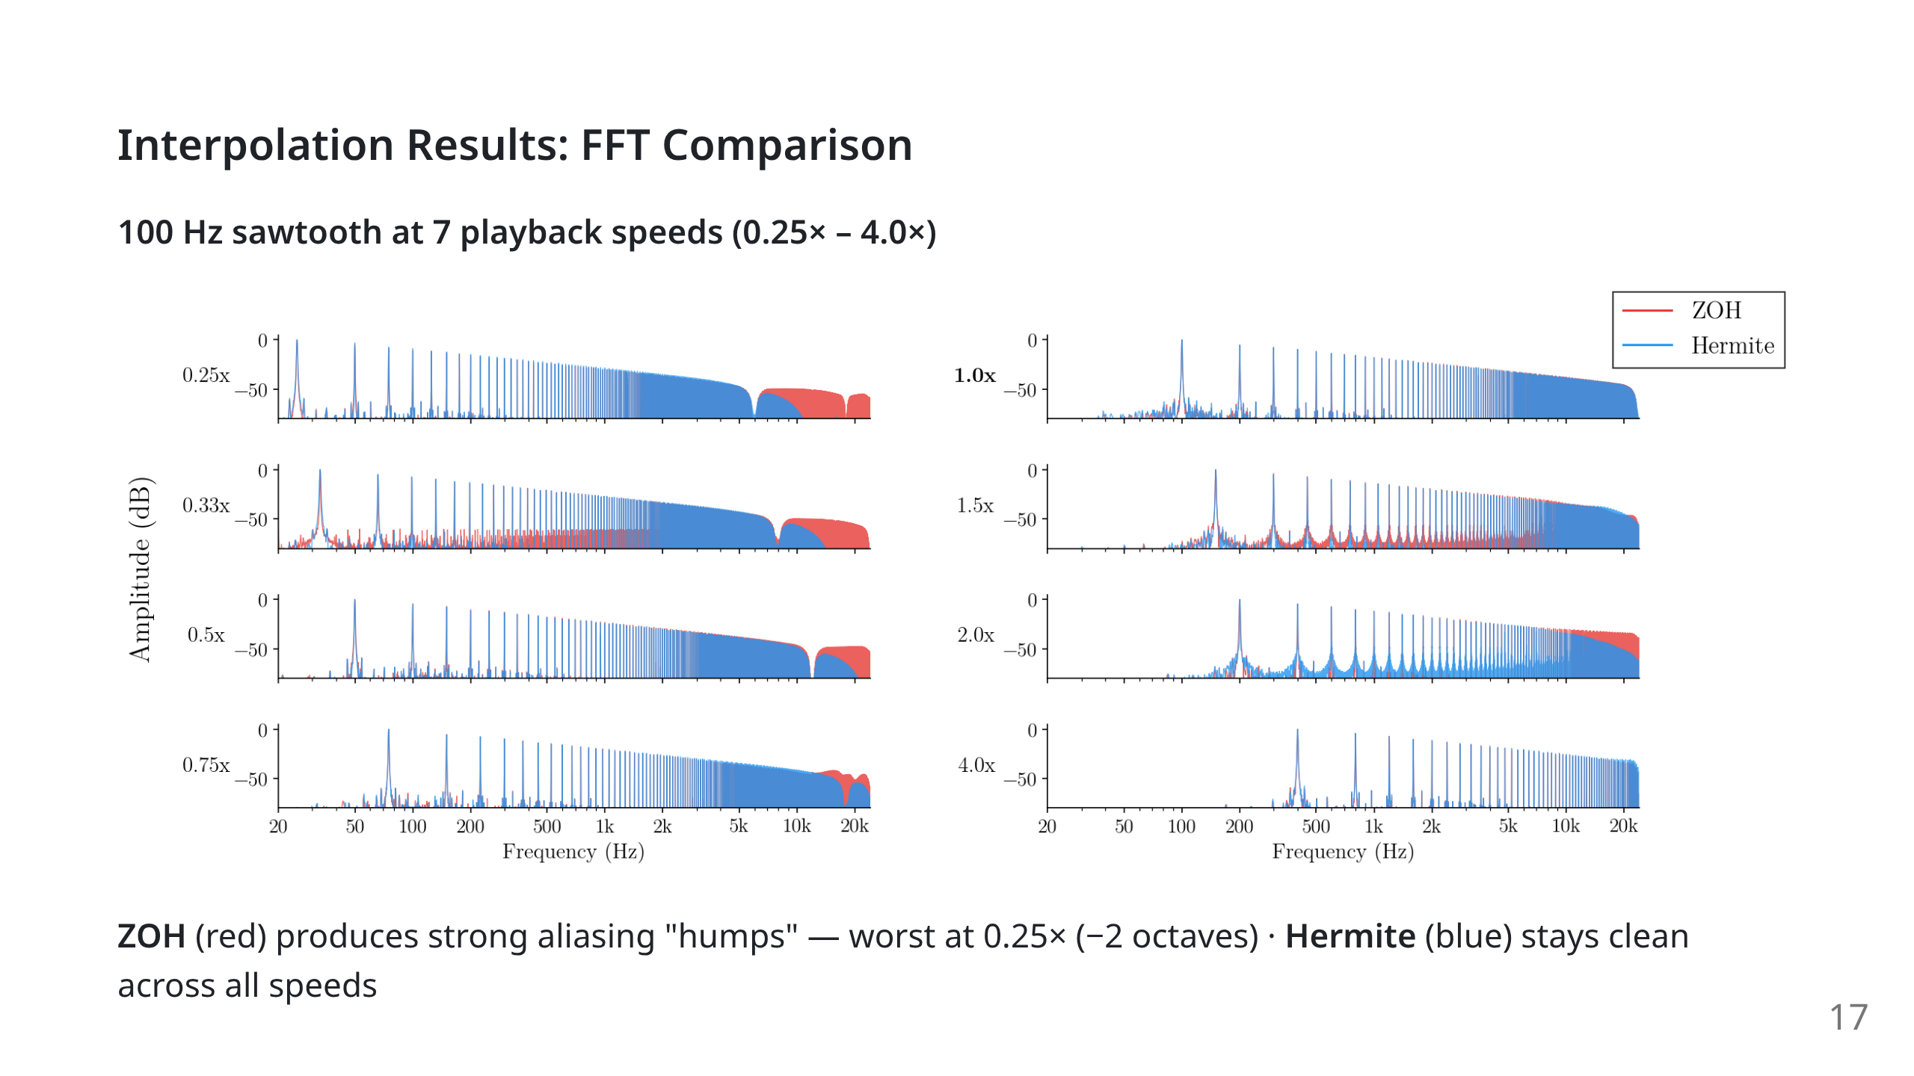

Slide 18
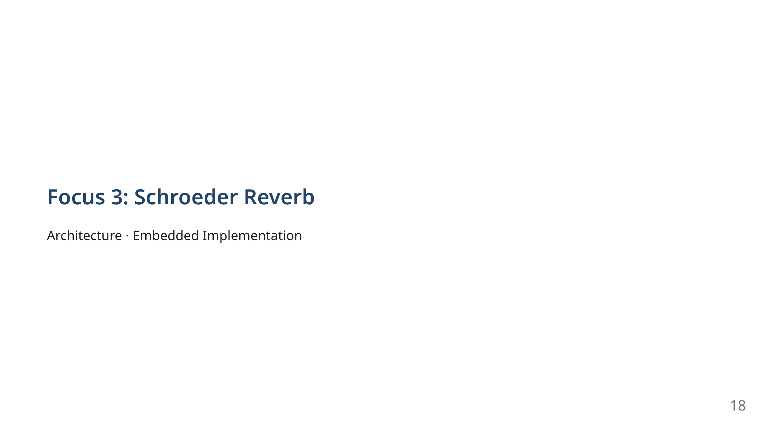
Notes:
Manfred R. Schroeder — Bell Labs researcher, published 1962: First algorithmic reverb using feedback comb + allpass filters to produce diffuse, natural-sounding decay without dedicated hardware. Still the basis of most algorithmic reverb designs today.

Slide 19
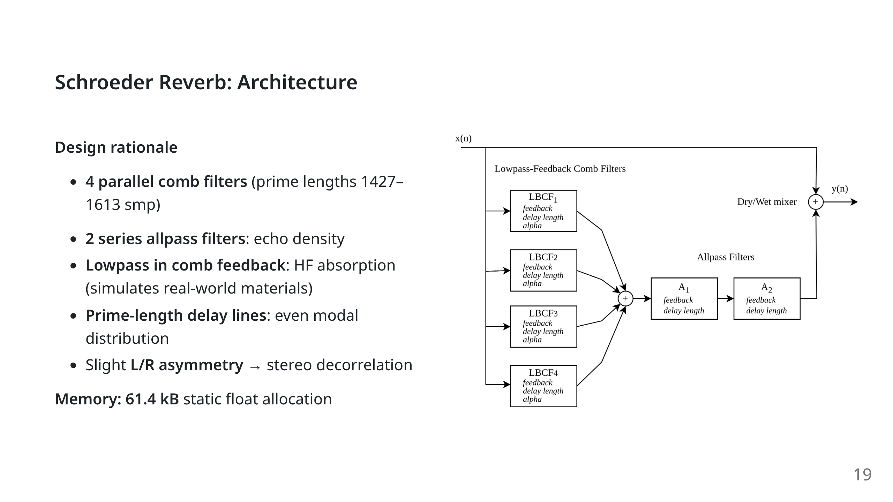
Notes:
characteristic decay + spectral coloring

Slide 20
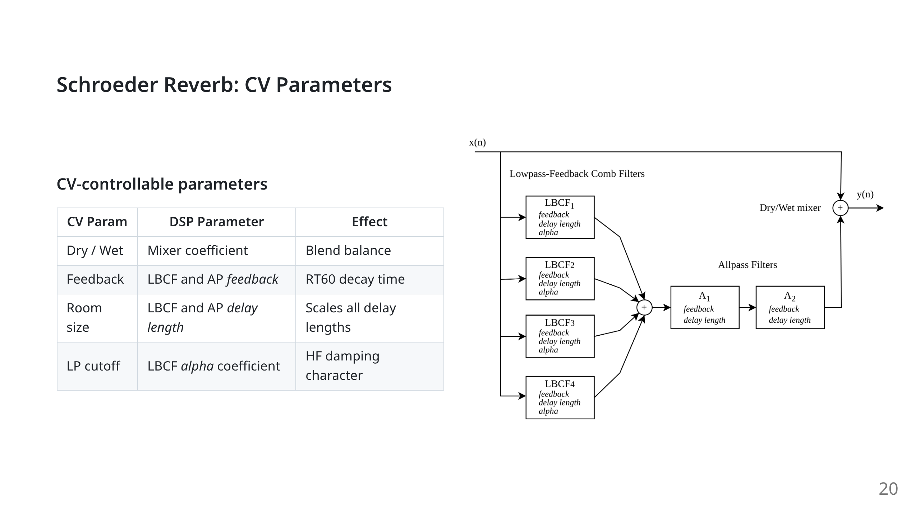

Slide 21
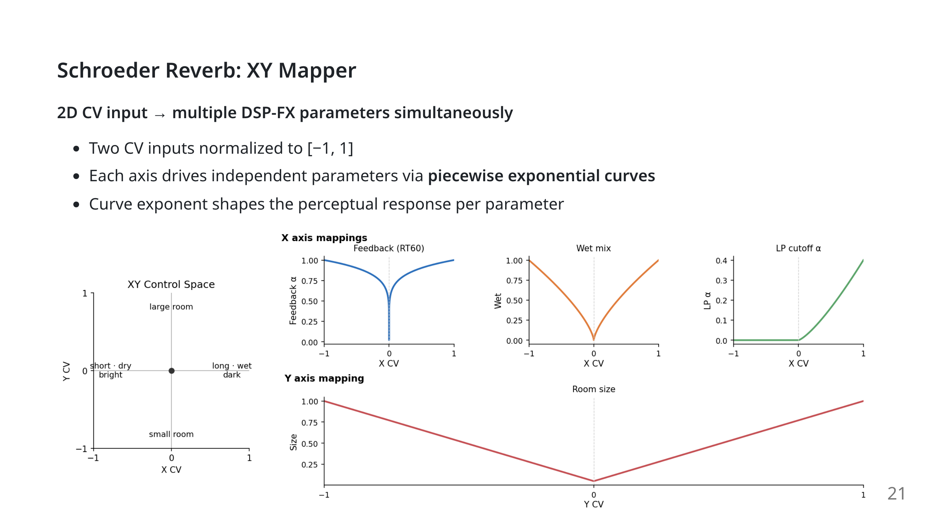
Notes:
Another feature not mentioned detailed in the thesis is the XY-Mapper Currently only mapped to reverb, but of course multiple DSP-FX parameters may be mapped onto it, to create a multi-FX rack, controlled by only 2 CV inputs

Slide 22
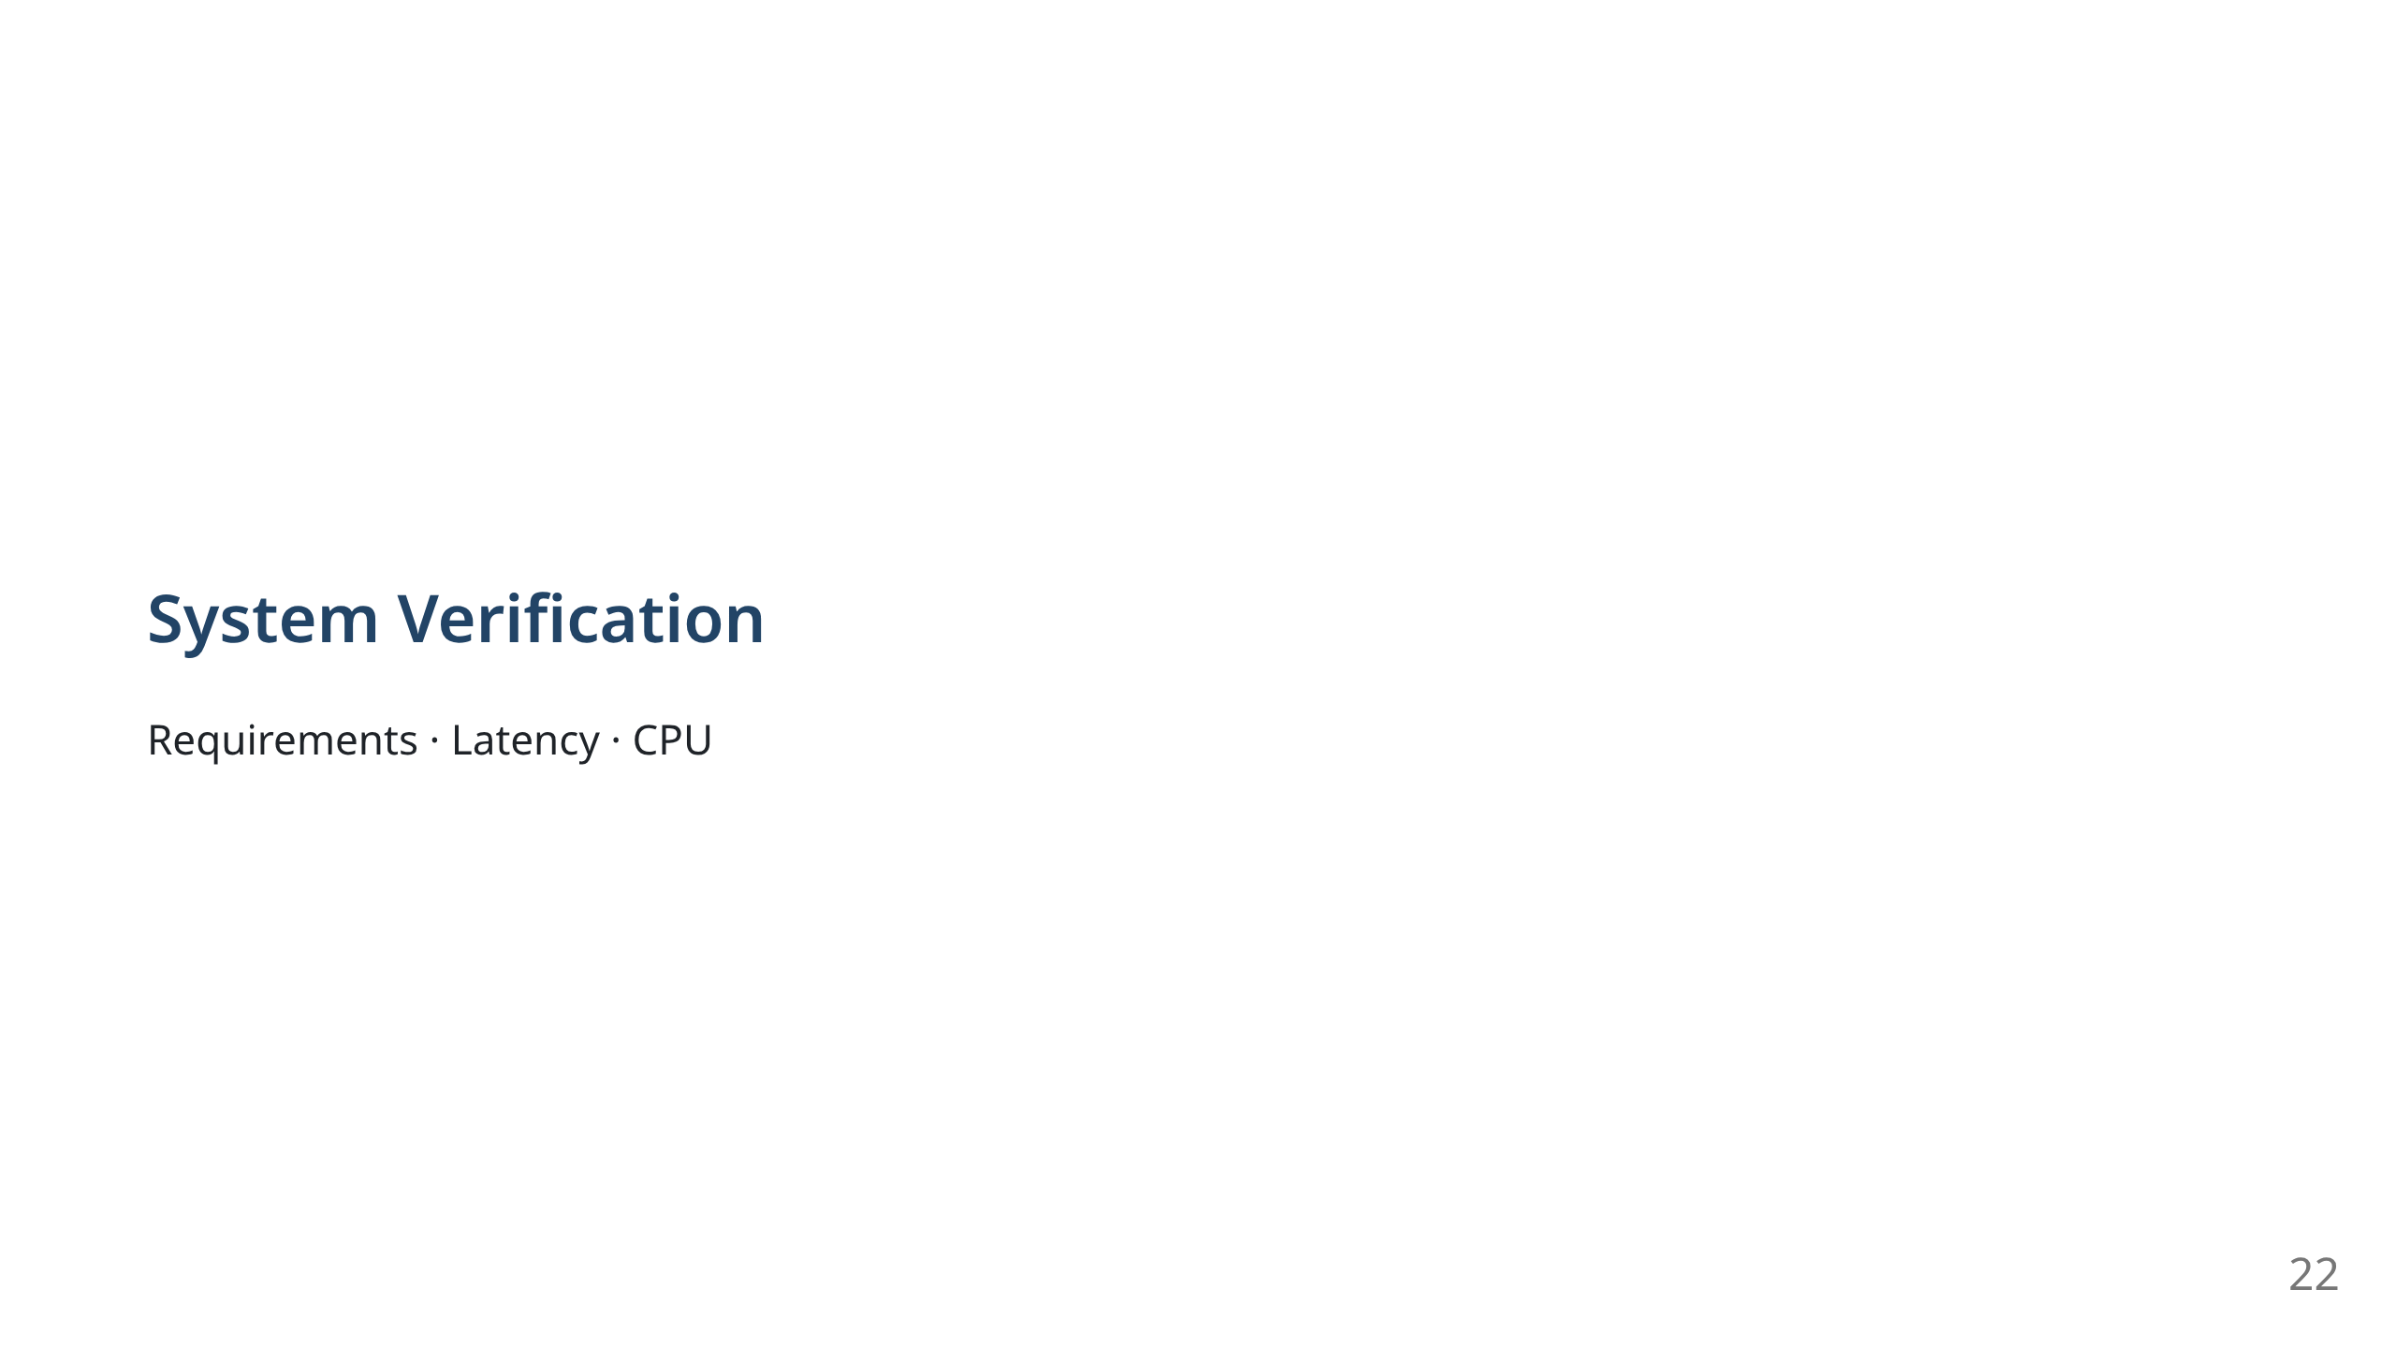

Slide 23
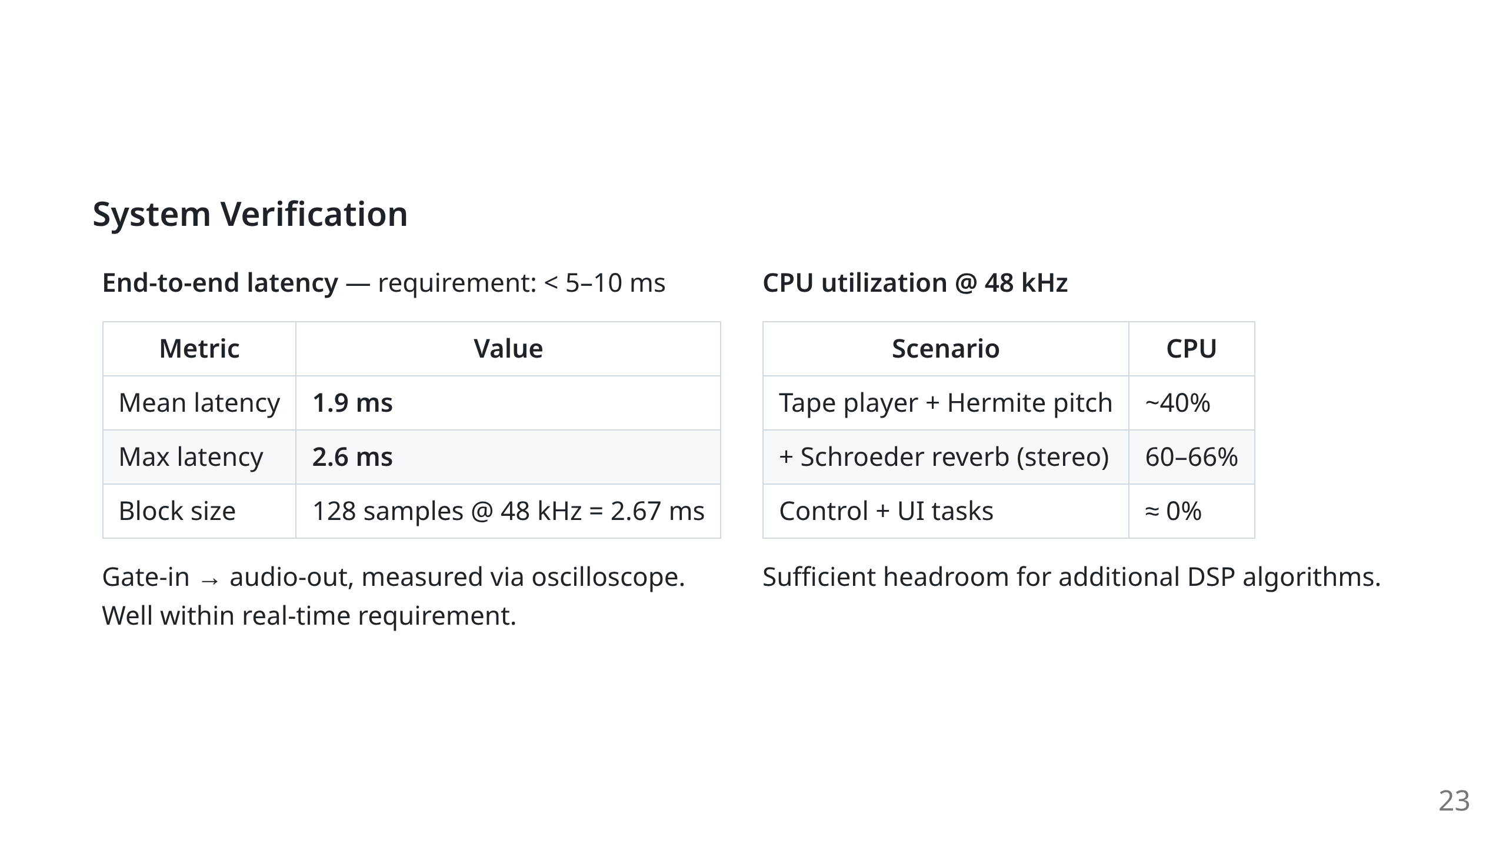
Notes:
Mean latency (1.9 ms) < block period (2.67 ms) makes sense: latency depends on where in the DMA cycle the gate arrives — varies between 0 and ~one block, so max ≈ block period (2.6 ms ≈ 2.67 ms). Per-stage cost (Ausschlussverfahren — incremental disabling): Schroeder reverb: 28–32 % Hermite interpolation: 7–9 % Fade processing: 5–6 % Remaining (tape): 18–21 %

Slide 24
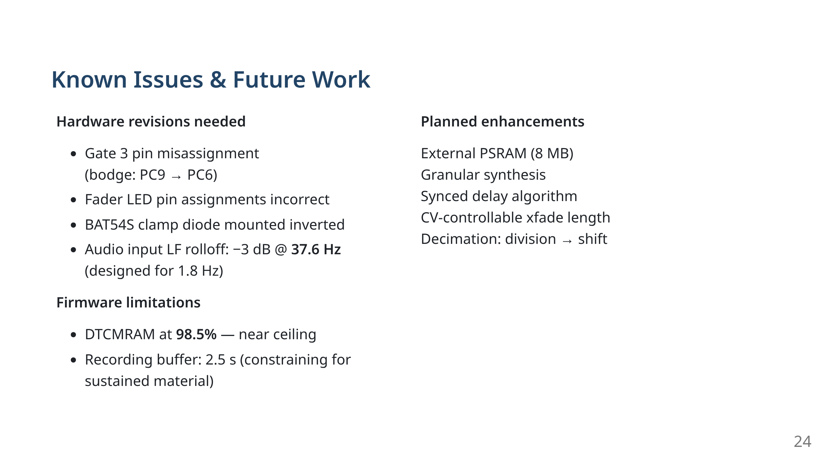

Slide 25
