Slide 1
Connect Four

Slide 2
Introduction
Connect Four is a classic two-player connection game in which the players take turns dropping colored discs from the top into a vertically suspended grid.
The objective of the game is to be the first to form a horizontal, vertical, or diagonal line of four of one's own discs. Connect Four is a popular game for both casual and competitive play.
Our project aims to implement a digital version of Connect Four, offering various gameplay features. By using different algorithms, the game will provide an interactive and enjoyable experience for users.

Slide 3
FEATURES
Our Code has the following features;
Player versus Player mode
Player versus AI Mode
AI versus AI Mode
Evolutionary AI with Genetic Algorithm
Moreover, each gameplay mode has wide range of difficulty settings, allowing players to expereince and match the challenge level they’re looking for.

Slide 4
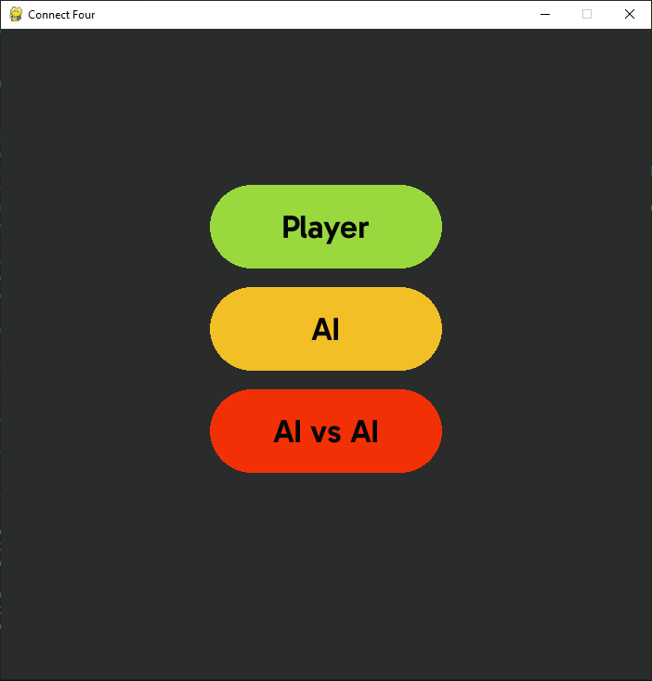
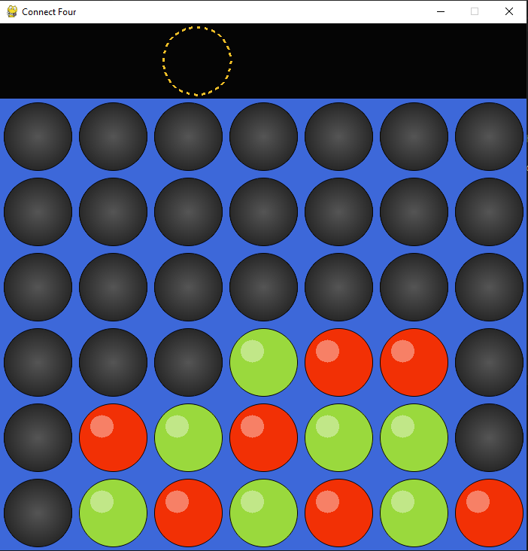
Play According to your liking

Slide 5
ALL the classes used
variables.py contains all the GLOBAL variables for the project so that they are easy to find and change if ever needed. Helps in writing clean code.
functions.py contains all the functions used in the game loop. This helps in bundling the functions together so that they are easy to find, edit and are easily accessible throughout the project. Keeps the main file clean as well.
ui_components.py contains all the UI elements for the game. Helps in keeping UI methods and other methods separate.
score_ai.py contains the functions for the score based AI version.
minmax_ai.py contains the functions for the min-max algorithm.
game.py contains the game loop and executes the software.
genetic.py plays against mini-max to get better at the game and print out the best strategy

Slide 6
State representation
Total squares – 7 * 6 = 42
Player 1 (green), Player 2 (red)
Possible states/configurations - 4,531,985,219,092 (about 4½ trillion)
Non-terminal states – 2,626,652,048,471 (over 2 trillion) [Play on/Keep playing the game]
Terminal/Finishing states – 1,905,333,170,621 (nearly 2 trillion) [Game Over/Win or Draw the game]
Draw Configurations – 713, 298, 878 (more than 700 million)
According to Numberphile video, 2013
S. Edelkamp and P. Kissman

Slide 7
Player versus player
When the game begins, the first player gets to choose one column among seven to place the colored disc. There are 7 columns in total, so there are 7 branches of a decision tree each time.
After the first player makes a move, the second player could choose one column out of seven, continuing from the first player’s choice.
First, if both players choose the same column 6 times in total, that column is no longer available for either player. It means that their branches of choice are reduced by one.
Second, when both players make all choices (42 in this case) and there are still no 4 discs in a row, the game ends as a draw
Finally, if any player makes 4 in a row, the game ends.

Slide 8
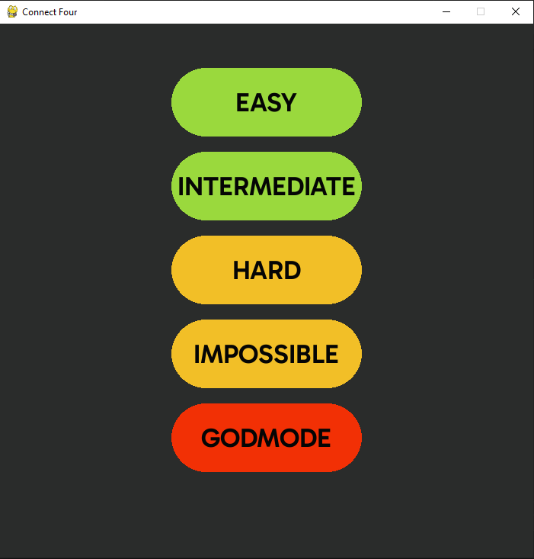
PLAYER Versus AI

Slide 9
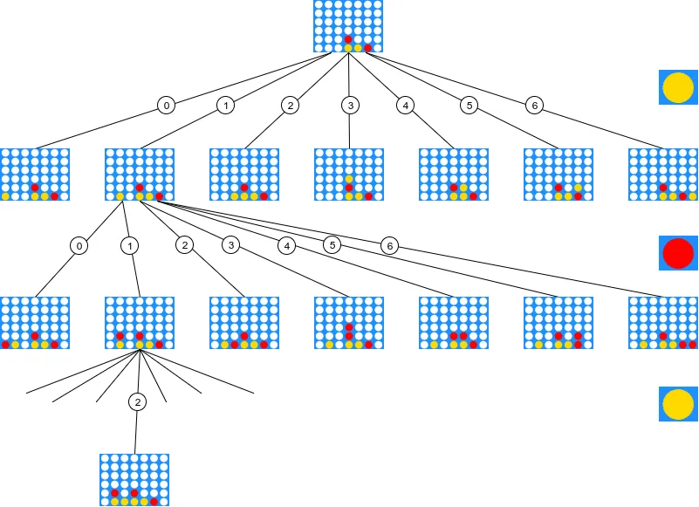
AI in connect four – implementing minimax

Slide 10
Heuristic in Minimax
In the minimax algorithm, the heuristic used to evaluate non-terminal game states is the score_position function from the score_ai class. This function assigns a score to each game state from the perspective of the AI player based on the position of pieces on the board.
The score_position function calculates a score for the AI player based on various factors such as the number of pieces in a row, their arrangement, and their proximity to winning positions. This score serves as an estimate of the desirability of the current board state for the AI player.
In the context of the minimax algorithm, this heuristic is used to evaluate the potential outcomes of different moves. During the search, the algorithm considers possible future game states up to a certain depth and uses the heuristic to assign scores to those states.
These scores are then used to determine the optimal move for the AI player by maximizing its chances of winning. Therefore, the score_position function acts as the heuristic evaluation function in the minimax algorithm implementation provided, guiding the AI player's decision-making process.
A connection of four pieces gets a high score of 100.
Three pieces in a row with one empty space is also given a high score of 50.
Two pieces with two empty spaces get a score of 10.
Scenarios where the opponent is close to winning are penalized with negative scores.
Like if three pieces in a row with one empty space is also given a score of -75.
Two pieces with two empty spaces get a score of -25.

Slide 11
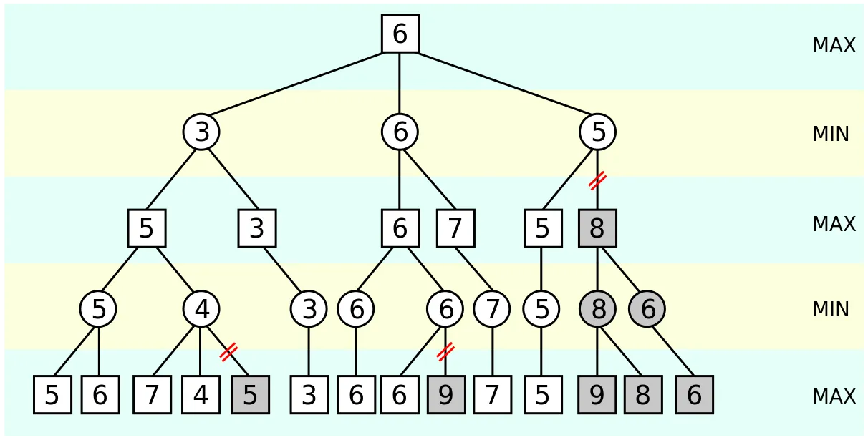
Minimax with alpha beta pruning
Player 1: Maximize Score
Player 2/AI : Minimize Score
Explores each possible move within the game tree
Recursive
Without Pruning = O(b^d)
With Pruning;
Best case: O(b^d / 2)
Worst case: O(b^d)
b = number of possible moves
d = max number of turns until the game ends (depth)

Slide 12
Differences in each difficulty
Easy: In the easy difficulty, the AI makes random moves without much strategy. It simply selects a random valid column to drop its piece without evaluating the game state or potential outcomes. If the player chooses "Player", then in the game_start method the game proceeds to the player vs player mode.
Intermediate: The intermediate difficulty uses a simple heuristic that evaluates potential moves based on immediate rewards, considering only the current game state. It prioritizes moves that lead to immediate opportunities for forming winning configurations or blocking the opponent's potential winning moves.
Hard: In the hard difficulty, the AI steps up the challenge by employing minimax algorithm. It looks several moves ahead using the minimax algorithm with a deeper search depth of 4. The AI employs the minimax algorithm with a depth of 4 , allowing it to search deeper into the game tree to anticipate future moves and outcomes. This depth enables the AI to make optimal moves, making it a formidable opponent.

Slide 13
continuation
Impossible: The impossible difficulty further enhances the AI's ability to anticipate the player's moves and choose the optimal response. It looks several moves ahead using the minimax algorithm with a deeper search depth of 6. The AI employs the minimax algorithm with a higher depth of 6 , allowing it to search deeper into the game tree to anticipate future moves and outcomes more accurately. This depth enables the AI to make optimal moves under most circumstances.
Godmode: This difficulty level represents the highest level of AI sophistication. The AI in godmode anticipates the player's moves, plans, and makes nearly perfect decisions to ensure victory or a draw in every game scenario. Similar to the Impossible difficulty but with an even higher depth of 7 in the minimax algorithm, providing the AI with an almost perfect understanding of the game state and making it extremely challenging for human players to win.
Alpha-beta pruning is used alongside Mini-Max which helps reduce the search space by ignoring branches that are unlikely to lead to a better outcome.

Slide 14
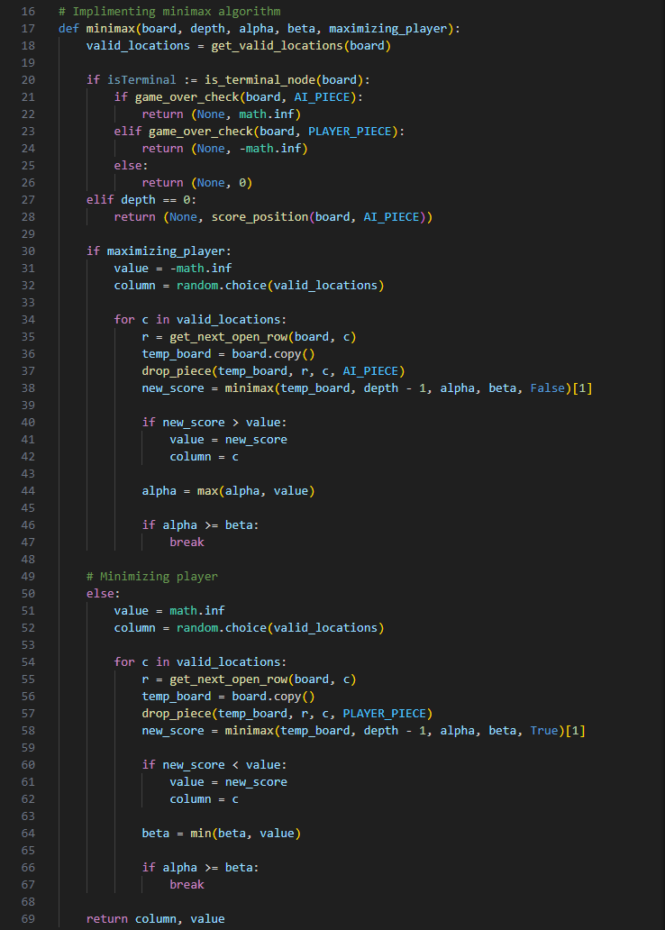
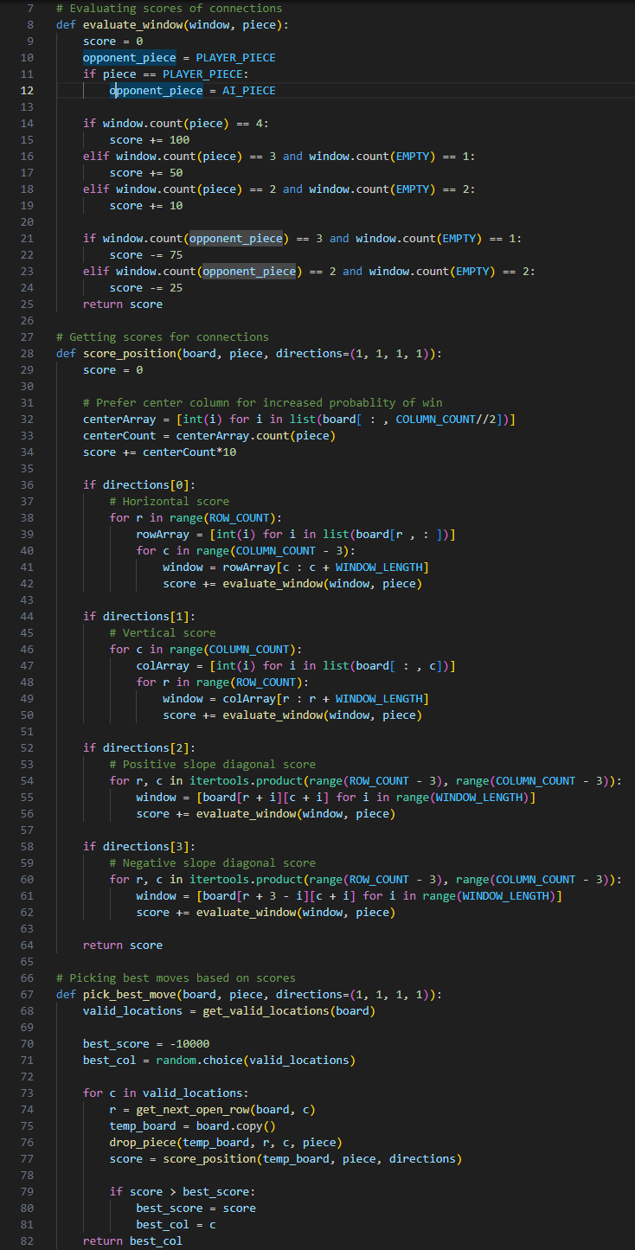
Heuristic Function
Minimax Algorithm With alpha-beta pruning

Slide 15
AI VERSUS AI
The Difficulty enum class defines different levels of difficulty, including EASY, INTERMEDIATE, HARD, IMPOSSIBLE, and GODMODE.
By setting the difficulty to any of them, the AI will employ more sophisticated strategies and decision-making algorithms to maximize their chances of winning.
The ai_move method is responsible for executing moves for the AI during the game. It determines the AI's move based on the selected difficulty level.
For lower difficulty levels it uses a simple heuristic. Whereas for higher difficulty levels, the ai_move method utilizes the minimax algorithm, the AI selects the move that leads to the best outcome.

Slide 16
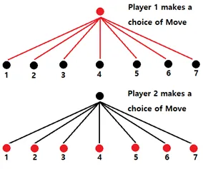
Decision trees

Slide 17
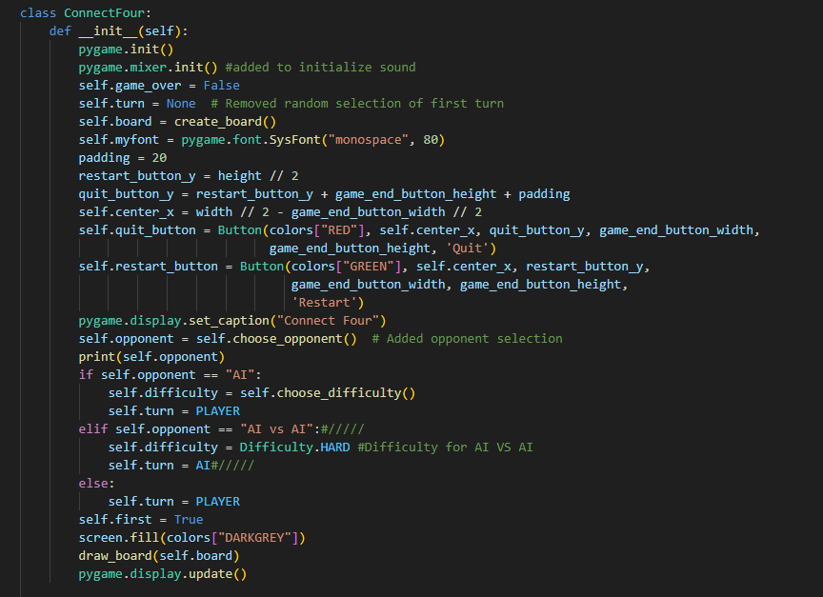
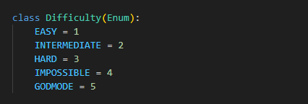
AI VERSUS AI CODE

Slide 18
Evolutionary AI with Genetic Algorithm

Slide 19
BASIC PLAN OF ATTACK
Step 1
Initialize Population
Step 2
Evaluate Strategies
Step 3
Selection
Step 4
Crossover and Mutation
Step 5
Next Generation

Slide 20
Implementation
Strategy Representation: Strategies are represented as lists of integers. Each integer corresponds to a column on the game board, representing where to drop the game piece.
Fitness Evaluation: The evaluate_strategy function simulates a game using a given strategy and returns a fitness score based on the outcome of the game. Higher scores indicate better strategies. The genetic algorithm player's moves are determined by the evolving strategy, while the Minimax AI's moves are determined by the Minimax algorithm.
Game Simulation: The play_game function simulates a single game between the genetic algorithm player and the Minimax AI.
Genetic Algorithm: The genetic algorithm evolves a population of strategies over multiple generations to find the best strategy. Each generation involves evaluating the fitness of all strategies, selecting the best-performing strategies (parents), and generating offspring through crossover and mutation.
Crossover and Mutation: Crossover is performed between pairs of parent strategies to create offspring. The crossover point is chosen randomly. Mutation introduces random changes to the offspring's strategies, with a probability determined by the mutation rate which is 0.1
Termination: After a 500 generations, the algorithm terminates, and the best strategy found is returned along with its fitness score.
Final Evaluation: The fitness scores of the final population are calculated, and the best strategy is identified.

Slide 21
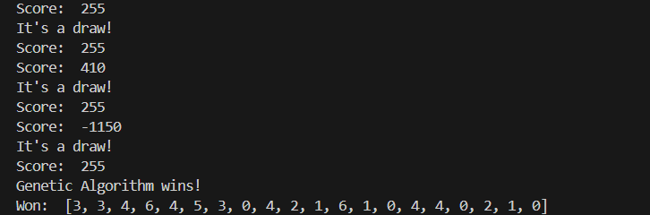
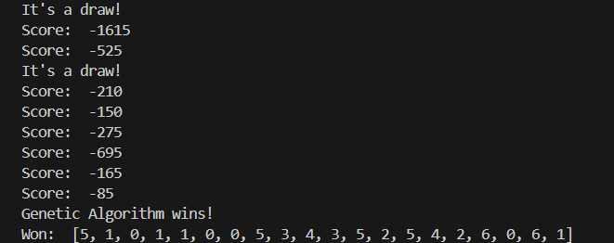
ANALYSIS OF THE best set of moves
These strategies will always win against minmax
AGAINST MINMAX ALGORTHIM AT DEPTH 1
AGAINST MINMAX ALGORTHIM AT DEPTH 2

Slide 22
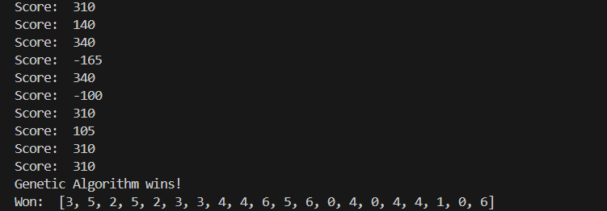
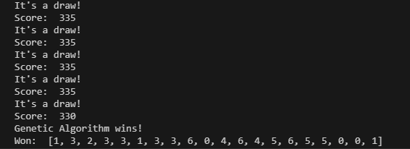
continuation
These strategies will always win against minmax
AGAINST MINMAX ALGORTHIM AT DEPTH 3
AGAINST MINMAX ALGORTHIM AT DEPTH 4

Slide 23
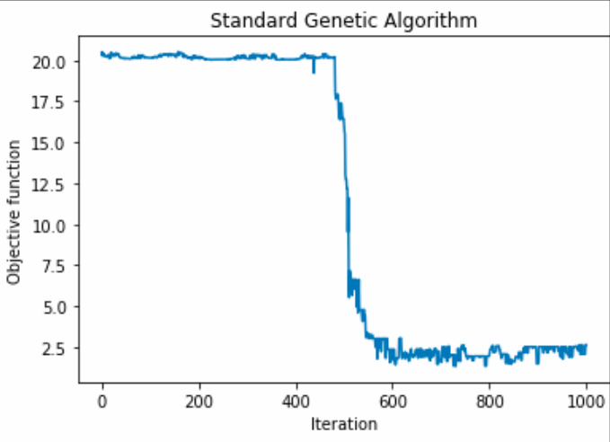
Standard Genetic Algorithm
#if the move is valid
#return the move
else:
#get valid locations
#randomly select a move
#if the move is valid
#set the move to the strategy
#return the move

Slide 24
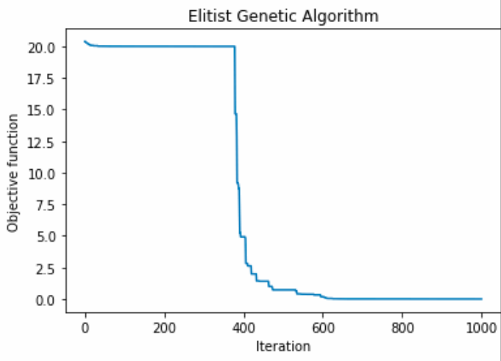
elitist Genetic Algorithm
#Use elitism
population = parents + offspring

Slide 25
Effects of changing parameters
Parameters | Impact on Fitness
Population Size | Increasing: Initially increases due to broader exploration but can lead to diminishing returns or decreased fitness. Decreasing: Decreased diversity may lead to premature convergence on suboptimal solutions.
Parents Size | Increasing: Initially increases fitness by preserving more high-performing solutions but may cause stagnation. Decreasing: Decreased preservation of good solutions may lead to fitness loss.
Generations | Increasing: More extensive exploration may lead to better solutions, but excessive generations may cause overfitting or stagnation. Decreasing: Insufficient exploration may result in premature convergence.
Mutation Rate | Increasing: Initial increase due to more exploration and escaping local optima, but excessively high rates can destabilize. Decreasing: Reduced exploration may lead to convergence on suboptimal solutions.
Crossover Method | Impact depends on the specific method used and its effect on genetic diversity. Fitness increases with the genetic combinations applied.
Mutation Method | Impact depends on how it influences genetic diversity and exploration. Fitness increases with more beneficial mutations.
Evaluation Function | Changing the function alters fitness landscapes, potentially favoring certain solutions. Fitness increases with the function applied capturing desired characteristics.
Selection Mechanism | Impact depends on how it influences genetic diversity and quality of selected parents. Fitness increases with the mechanism of better selecting high-quality solutions.

Slide 26
Analysis AT different minimax depth
As depth increases time also increases
O(N * G * M * E)
Where;
N (Population Size)
G (Number of Generations)
M (Games Played per Generation)
E (Time Complexity of Evaluating Fitness for One Strategy)

Slide 27
Analysis AT different Parent Size
SCORE CONVERGES TO POINT NEAR THE END OF THE POPLUATION SIZE

Slide 28
Analysis AT different Popluation Size
With a larger parent size, there's a higher likelihood of including better-performing strategies in each generation.
This can lead to an increase in the average fitness score of the population over generations.
A larger parent size allows for a more diverse set of strategies to be considered in each generation.
This diversity can help in exploring a broader range of potential solutions, potentially leading to the discovery of novel and effective strategies.

Slide 29
Analysis AT different mutation rate
higher mutation rate introduces more random changes into the population, leading to increased exploration of the solution space.
This can be beneficial for discovering new and potentially better solutions, which may lead to an increase in the diversity of strategies explored.
However, in some cases, a moderate increase in the mutation rate might help escape local optima by introducing variations that enable the algorithm to explore new regions of the solution space.
This can lead to the discovery of better solutions and potentially higher scores.

Slide 30
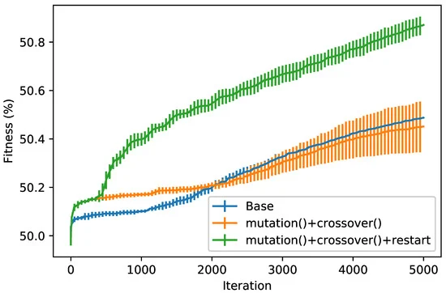
Analysis of fitness value
Best fitness value across 10 runs with Genetics algorithm functions and their combination together

Slide 31
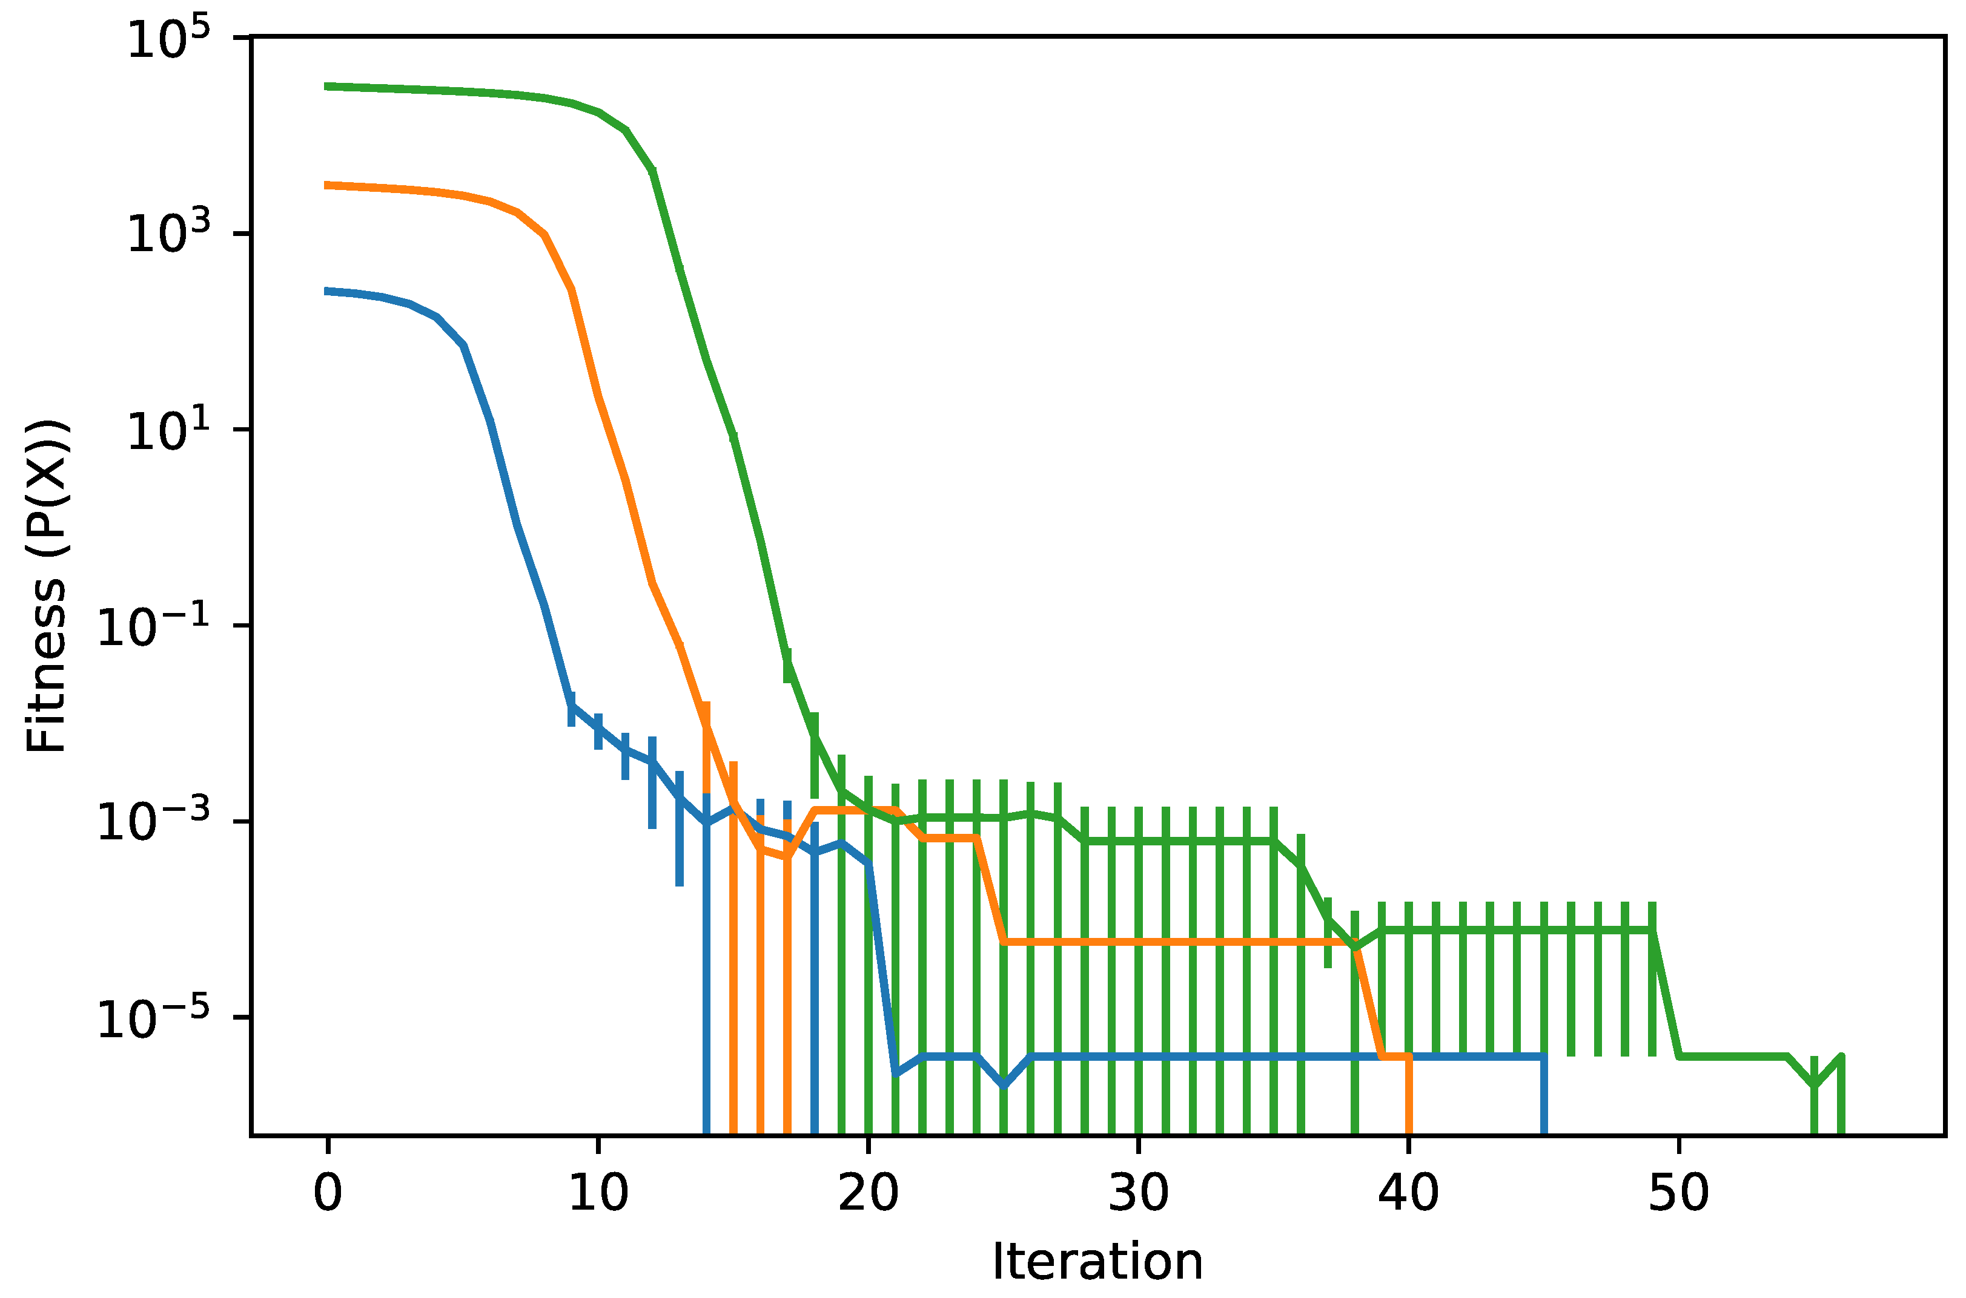
Continuation
Best fitness value per iteration of the genetic algorithm in three different runs.

Slide 32
IS BINARY TOURNAMENT BETTER?
Performance: Binary tournament selection doesn’t lead to improved performance in terms of convergence speed and final solution quality.
Diversity of Solutions: It's essential to ensure that the algorithm maintains diversity in the population to avoid premature convergence. This works better with binary tournament applied.
Robustness: Robustness indicates the algorithm's reliability in finding good solutions consistently. Testing the binary tournament with various settings and random seeds to ensure consistent performance across different runs.
Scalability: The pre-existing algorithm (uses a custom selection method based on sorting strategies by their fitness scores) performs good with larger populations and longer optimization runs. It maintains and improves its performance, indicating good scalability.
Even though binary tournament works better in some scenarios, but the algorithm applied is more reliable and consistent with its results according to our testing

Slide 33
Binary tournament
Illustrate how a population evolves over number of generations, with the best class becoming increasingly prevalent until it completely dominates. This pattern is for binary tournament where advantageous traits are selected for over successive generations, leading to the eventual dominance of those traits.

Slide 34
References and Additional Help
Artificial Intelligence: A Modern Approach, 4th US ed. by Stuart Russell and Peter Norvig
https://www.youtube.com/channel/UCq6XkhO5SZ66N04IcPbqNcw
https://www.youtube.com/watch?v=l-hh51ncgDI&t=37s
https://en.wikipedia.org/wiki/Alpha%E2%80%93beta_pruning
Yamaguchi, Y.; K. Yamaguchi; T. Tanaka; T. Kaneko (2012). "Infinite Connect-Four is solved: Draw". Advances in Computer Games, ACG 2011. LNCS 7168: 208–219.
https://archive.org/details/isbn_9781402756214
https://www.thescipub.com/pdf/jcssp.2009.283.289.pdf

Slide 35
Connect Four
THANK YOU!

