Slide 1
QURAN EXPLORER

Slide 2
IMPORTANCE
These days in the ever-evolving world, people utilize the web for everything. So, we chose to make a Quran Explorer that allow individuals who wish to learn or read the Quran with various features.
Our code is designed using efficient data structures alongside a modern and appealing GUI that makes learning the Quran simpler.

Slide 3
FEATURES
Our Code has the following features;
Search Quranic ayat using ayat number
Search Quranic Surah by Selecting its Name.
Search Quranic ayats and the subtopic of particular topics
Search Quranic ayats of the subtopics also
Word search for all words of the Holy Quran
Translations are also available for each ayat in English and Urdu.

Slide 4
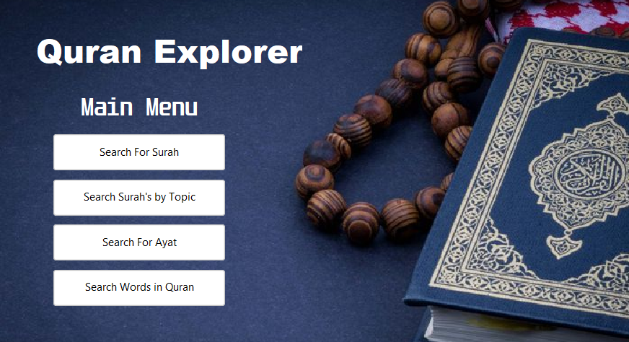
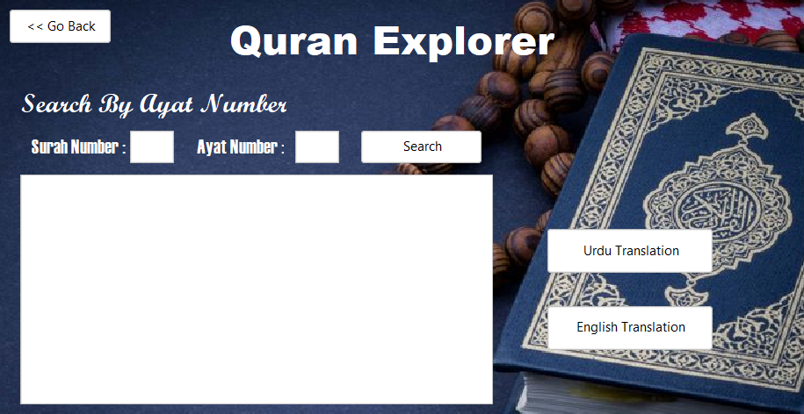
READ & learn Quran to your liking

Slide 5
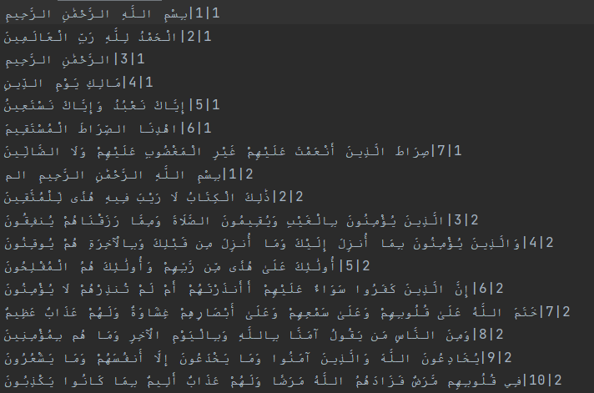
Arabic Data

Slide 6
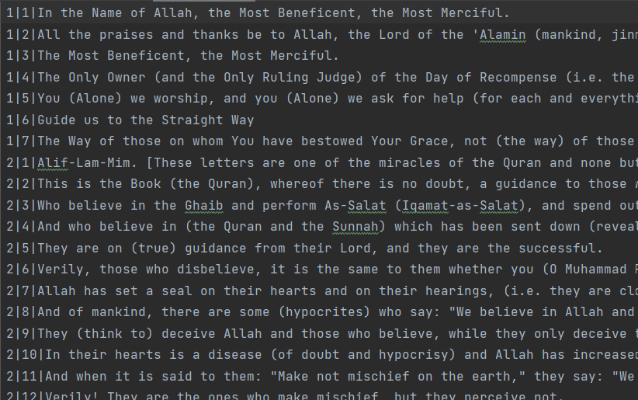
English Data

Slide 7
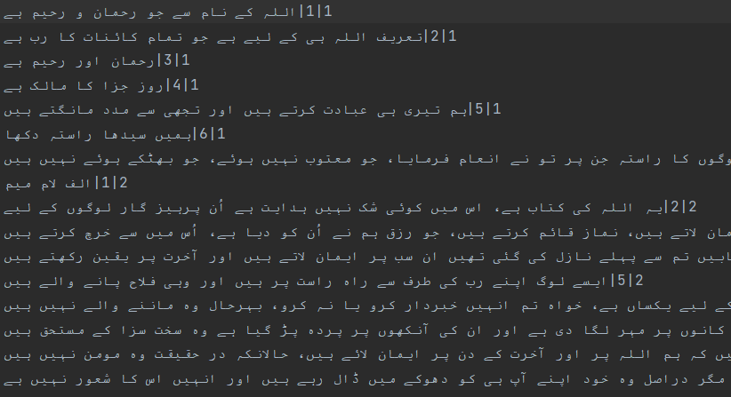
Urdu Data

Slide 8
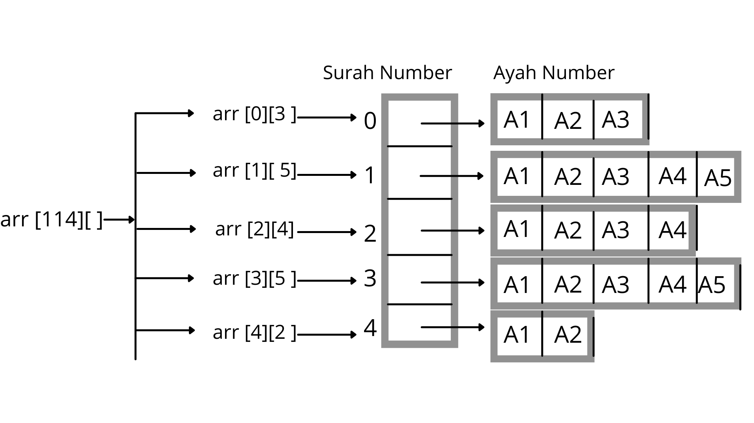
Data Structure : FOR Searching Surah and Ayah
2D ARRAY/JAGGED ARRAY

Slide 9
How Data is saved in Jagged/2D array?
A jagged array is an array whose each element is also an array. This way we can have a 2D array whose each row is of different length.
Since the Quran has 114 surahs, the length of the main array will be 114.
Now Each element of this array contains a reference to a new array whose size is equal to the length of each surah.
Each element of this Surah Array contains individual ayah of that surah in the form of a String.

Slide 10
Why Jagged/2D Array?
Every Line in our data is numbered.
Allows Direct Access to any piece of data stored in a cell by its number
Quickest Data Structure to Access Data in constant time O(1) as compared to any other data structure.
Fixed size of database.
Searching Big O: O(1).

Slide 11
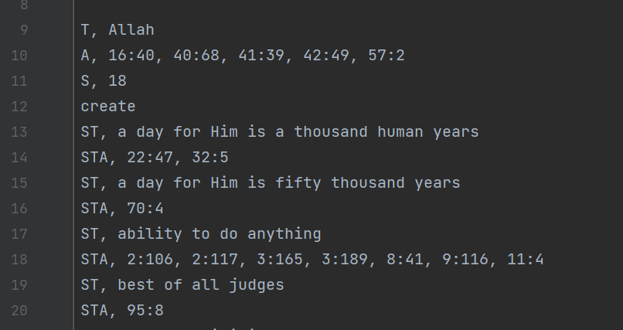
Topics data

Slide 12
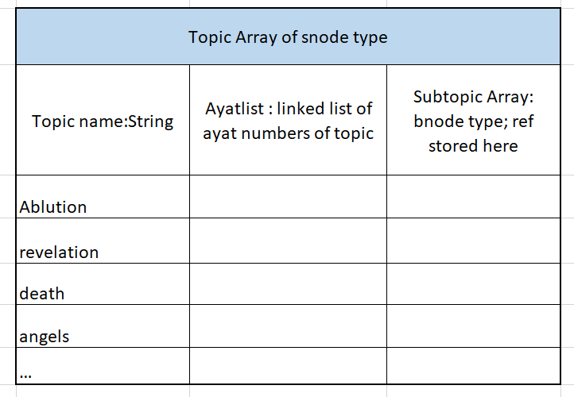
Data Structure : Topic and Subtopic ayat search

Slide 13
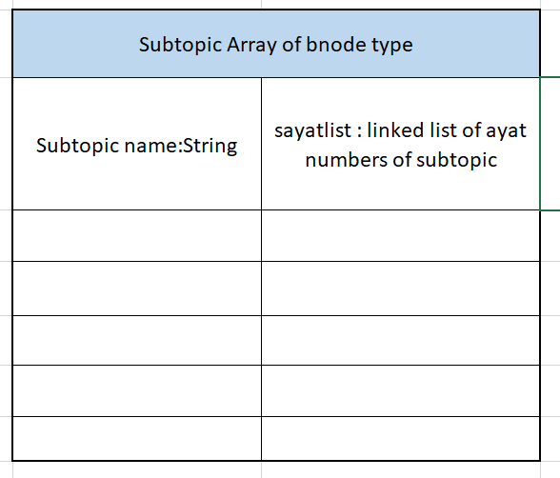
Data Structure : Topic and Subtopic ayat search

Slide 14
Why Node Type Array with Linked List?
Array has fast and random access.
Array made of node type to link with other array and linked list.
Linked List incorporated as number of ayat in each topic/subtopic are not known.
Very fast and direct access in searching.

Slide 15
Big Oh : Quran EXPLORER
Ayah and Surah Search
O(1)
Topic and Subtopic ayat search
O(n)

Slide 16
Word Search In QuraN Explorer

Slide 17
BASIC PLAN OF ATTACK
Step 1
Read A Line From The File
Step 2
Break The Line Into An Array
Checks Each Word Contains Only Characters
Step 3
Find Hash Value
For Rehash Quadratic Probing
Storage Array Is Full
Step 4
Insert Value In Given Location

Slide 18
IMPLEMENTATION
Hashing
On ArrayList With Changing Hash Value
0
Word Node | Word Node | Word Node
Word Node | Word Node | Word Node
Word Node | Word Node | Word Node
1
2
.
.
.
.
Word | Linked List
24
Word Node | Word Node | Word Node
Word Node | Word Node | Word Node
25

Slide 19
Working Behind Searching Algorithm
11 | 23 | 41 | 83 | 163
xyz | xyz | xyz | xyz | xyz
Using Some Hash Value
Using Some Other Hash Value

Slide 20
Answers To Some Questions
Why An ArrayList Was Used Instead Of Using Multiple Array Blocks?
Why Hashing?

Slide 21
BIG Oh Analysis
Best Case (Searching) | O(1)
Worst Case (Searching) | O(n)
Note: As hash values are also chose by running a loop. You could say it’s O(n^2).

Slide 22
References and Additional Help
Databases: https://tanzil.net/download/
Buffered Reader File Reading: https://stackoverflow.com/questions/4666748/how-to-read-bufferedreader-faster
For jagged array: https://www.geeksforgeeks.org/jagged-array-in-java/

Slide 23
QURAN Explorer
THANK YOU!

