Slide 1
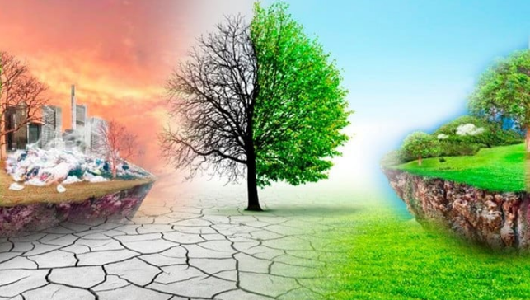
GLOBAL WARMING

