Slide 1
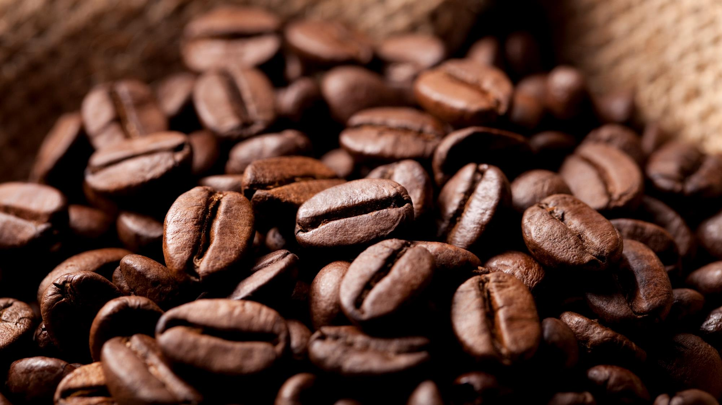

Coffee Shop
Expansive Analysis with SQL
Solve Business Problem with PostGresql Language

Slide 2
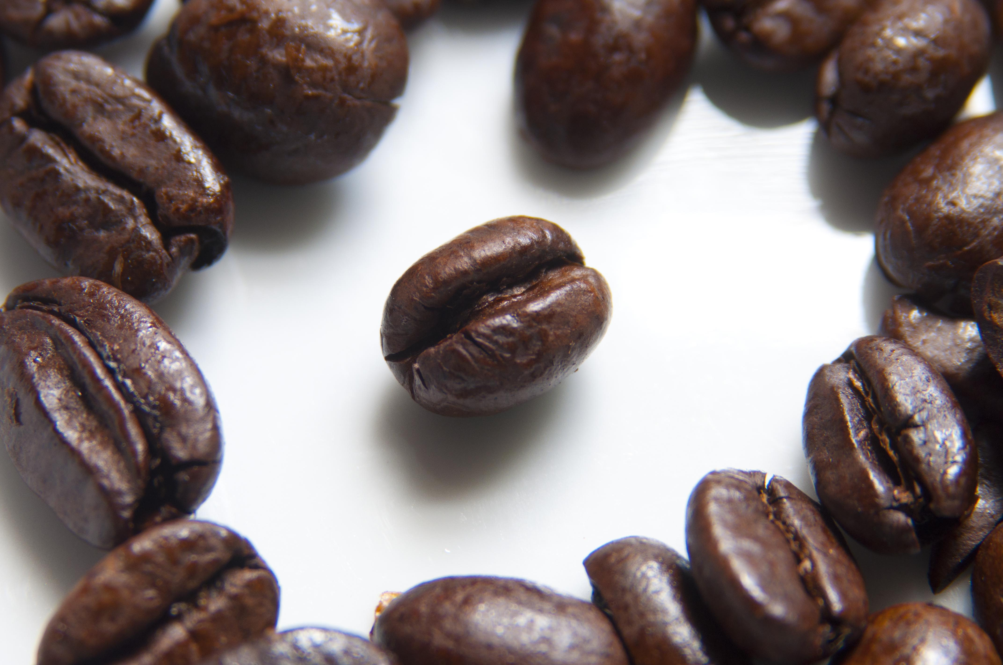
The business aims to expand by opening three coffees shops in India’s top three major cities. Since its launch in January 2023, the company has successfully sold its products online and received an overwhelmingly positive response in several cities. As a data analyst, your task is to analyze the sales data and provide insights to recommend the top three cities for this expansion.
Coffee Shop
Objective

Slide 3
Questions 1. **Coffee Consumers Count** How many people in each city are estimated to consume coffee, given that 25% of the population does? 2. **Total Revenue from Coffee Sales** What is the total revenue generated from coffee sales across all cities in the last quarter of 2023? 3. **Sales Count for Each Product** How many units of each coffee product have been sold? 4. **Average Sales Amount per City** What is the average sales amount per customer in each city? 5. **City Population and Coffee Consumers** Provide a list of cities along with their populations and estimated coffee consumers.

Slide 4
6. **Top Selling Products by City** What are the top 3 selling products in each city based on sales volume? 7. **Customer Segmentation by City** How many unique customers are there in each city who have purchased coffee products? 8. **Average Sale vs Rent** Find each city and their average sale per customer and avg rent per customer 9. **Monthly Sales Growth** Sales growth rate: Calculate the percentage growth (or decline) in sales over different time periods (monthly). 10. **Market Potential Analysis** Identify top 3 city based on highest sales, return city name, total sale, total rent, total customers, estimated coffee consumer

Slide 5
## Recommendations After analyzing the data, the recommended top three cities for new store openings are: **City 1: Pune** 1. Average rent per customer is very low. 2. Highest total revenue. 3. Average sales per customer is also high. **City 2: Delhi** 1. Highest estimated coffee consumers at 7.7 million. 2. Highest total number of customers, which is 68. 3. Average rent per customer is 330 (still under 500). **City 3: Jaipur** 1. Highest number of customers, which is 69. 2. Average rent per customer is very low at 156. 3. Average sales per customer is better at 11.6k.

Slide 6


Key to Success
Better Sales
Quicker Responses
Better Customers
Better Service
More Products

Slide 7


Thank You
Email kumarsubham@gmail.com

