Slide 1
DatascienceJob_Dashboard
File created on: 25-06-2024 15:23:06

Slide 2
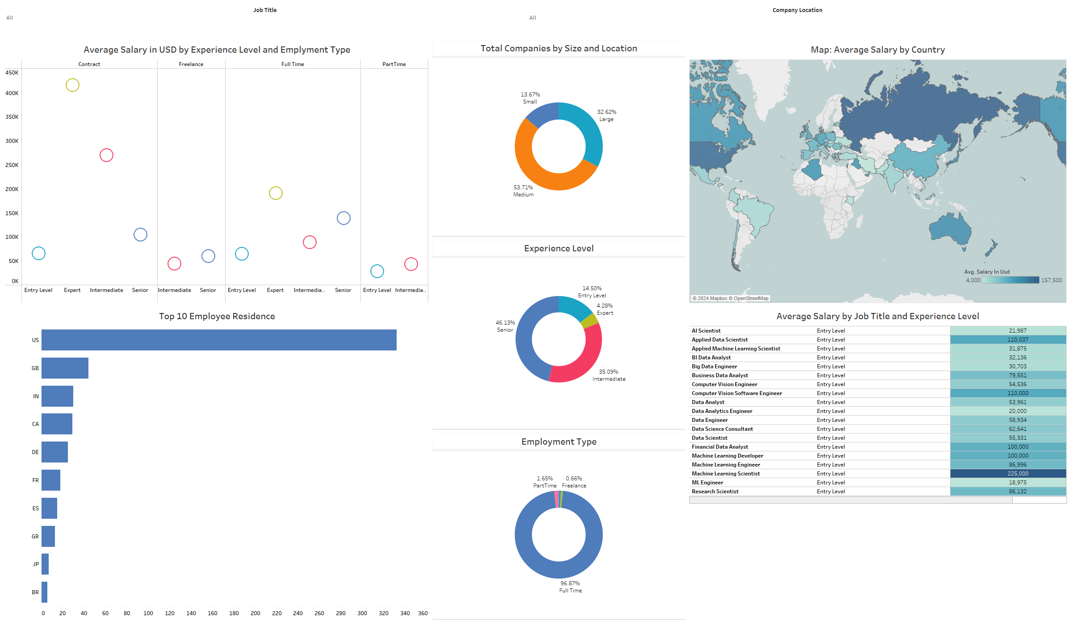

Slide 3
Column | Description
work_year | The year the salary was paid.
experience_level | The experience level in the job during the year with the following possible values: EN Entry-level / Junior MI Mid-level / Intermediate SE Senior-level / Expert EX Executive-level / Director
employment_type | The type of employement for the role: PT Part-time FT Full-time CT Contract FL Freelance
job_title | The role worked in during the year.
salary | The total gross salary amount paid.
salary_currency | The currency of the salary paid as an ISO 4217 currency code.
salary_in_usd | The salary in USD (FX rate divided by avg. USD rate for the respective year via fxdata.foorilla.com).
employee_residence | Employee's primary country of residence in during the work year as an ISO 3166 country code.
remote_ratio | The overall amount of work done remotely, possible values are as follows: 0 No remote work (less than 20%) 50 Partially remote 100 Fully remote (more than 80%)
company_location | The country of the employer's main office or contracting branch as an ISO 3166 country code.
company_size | The average number of people that worked for the company during the year: S less than 50 employees (small) M 50 to 250 employees (medium) L more than 250 employees (large)

