Slide 1
PROJECT TITLE
TS- WEB/CC/AI TRACK CAPSTONE PROJECT
Presented By:
1. Lanka Sai Priya (Rajiv Gandhi University of Knowledge Technologies,Srikakulam)
2. Peyyala Santosh Pavani
3.Thamada Anusha
4.Shaik Haseena
5.Salkapuram Rayna Danam
Guided By: Uma Maheswari

Slide 2
OUTLINE
Abstract
Problem Statement
Aims , Objective & Proposed System/Solution
System Design
System Development Approach(Technology Used)
Algorithm & Deployment
Conclusion
References
Future Scope

Slide 3
Abstract
The manual room allocation process currently in use in RGUKT SRIKAKULAM is time consuming, labour intensive and prone to human error. This project was carried out with an aim of developing a system that would address the above problems. A computer-based and standalone system was developed to effectively and efficiently match an applicant’s profile to the available room’s features and amenities. The methods used for collecting data for the development of the system included interviews, questionnaires and document review. Data analysis was carried out to determine the functional and non-functional requirements of the system. System design involved conceptual design, logical design and application design.

Slide 4
Problem Statement
The existing room allocation system in RGUKT SRIKAKULAM Hostel is time consuming, labour intensive and more prone to human error and manipulation. This makes the system unreliable in matching an applicant’s profile with room features and amenities. To address this problem a computer based room allocation system was developed to match the applicants.

Slide 5
Proposed Solution
Web based systems enable access to an information resource to be sent by the client to other system users by providing them with a copy of the Uniform Resource Locator (URL). Web based systems require starting sessions in order to access a resource. Each session has a unique ID. If the Session ID is to be permanently associated with the client-browser and their computer, it is possible for the client to “Save as a favourite”. This enables one to just look up a resource in their favourite’s folder on their personal computer.

Slide 6
System Architecture
SAMPLING: The methods for collecting data include interviews, questionnaires, and document reviews about allocation systems.
SAMPLING FRAMEWORK :
The study was using simple random sampling select respondents from resident student at RGUKT SRIKAKULAM Hostel.
SAMPLE SIZE:
A total of fifteen respondents were the sample size selected by simple random sampling, two hostel administrators /officials, and thirteen resident students at the RGUKT SRIKAKULAM Hostel were interviewed

Slide 7
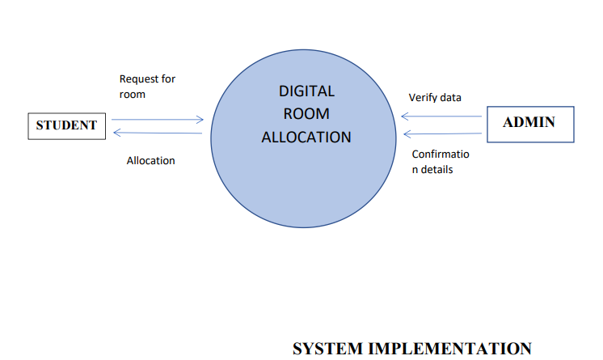
System Deployment Approach
This is the systemic implementation of the website.

Slide 8
Algorithm & Deployment
This project was carried out with an aim of developing a system that would address the above problems
This project was involved developing a web application system that matches the applicants profile with the room features and amenities in RGUKTSRIKAKULAM Hostel.
This project supports different residents that are of hostels or Dorms .
The Digital room allocation is developed for automating the activities of hostel rooms, It is a web application that will be great relief to the administration as well as the students.
It will help user in case of registering, searching of the data about students and rooms.
It will take the operations of hostel to an upper level providing faster access to data and allowing addition, upgradation, modification,and deletion of data in a systematic manner

Slide 9
THANK YOU

