Slide 1

Website: whatisthis
A guide to MOSFETS since I never had one.
By Erik Barkdull

Slide 2
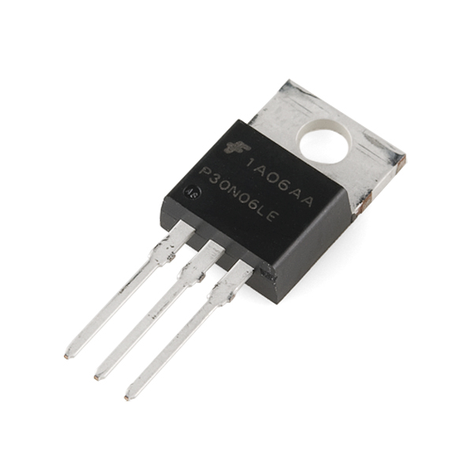
MOSFETS
What is a MOSFET? | What do they do? | Different MOSFETS | Explaining each MOSFET

Slide 3
Index.html(desktop) (titles and IDs may change)
<!DOCTYPE html>
<html lang="en">
<head>
<meta charset="UTF-8">
<meta name="viewport" content="width=device-width, initial-scale=1.0">
<title>mosfetswow</title>
<link rel="stylesheet" href="styles.css">
</head>
<body>
<header>
<h1></h1>
<nav>
<ul>
<li><a href="#">mosfet</a></li>
<li><a href="#">mosfet1</a></li>
<li><a href="#">mosfet2</a></li>
<li><a href="#">mosfet3</a></li>
</ul>
</nav>
</header>
<main>
<section>
<h2></h2>
<p></p>
</section>
</main>
<footer>
<p></p>
</footer>
</body>
</html>

Slide 4
Index.html(phone) titles and ids may change
<!DOCTYPE html>
<html lang="en">
<head>
<meta charset="UTF-8">
<meta name="viewport" content="width=device-width, initial-scale=1.0">
<title>Mobile mosfets</title>
<link rel="stylesheet" href="styles.css">
</head>
<body>
<header>
<h1>mosfets</h1>
</header>
<nav>
<ul>
<li><a href="#">mosfet</a></li>
<li><a href="#">mosfet1</a></li>
<li><a href="#">mosfet2</a></li>
<li><a href="#">mosfet3</a></li>
</ul>
</nav>
<main>
<section>
<h2></h2>
<p></p>
</section>
</main>
<footer>
<p>mobile</p>
</footer>
</body>
</html>

Slide 5
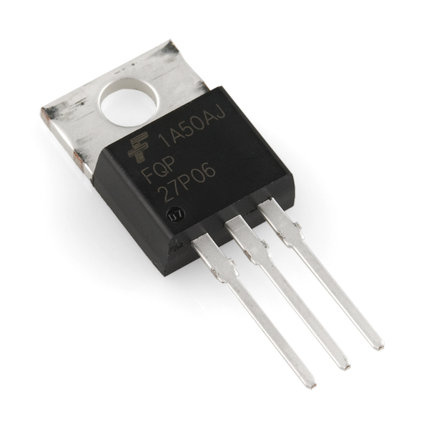
What is a Mosfet?
A MOSFET (Metal-Oxide-Semiconductor Field-Effect Transistor) is a type of electronic switch used to control electricity flow in various devices. Imagine it like a gate that opens or closes to let electricity through, depending on whether it's "on" or "off." It's commonly used in computers, audio equipment, and other gadgets because it can switch electricity quickly and efficiently.

Slide 6
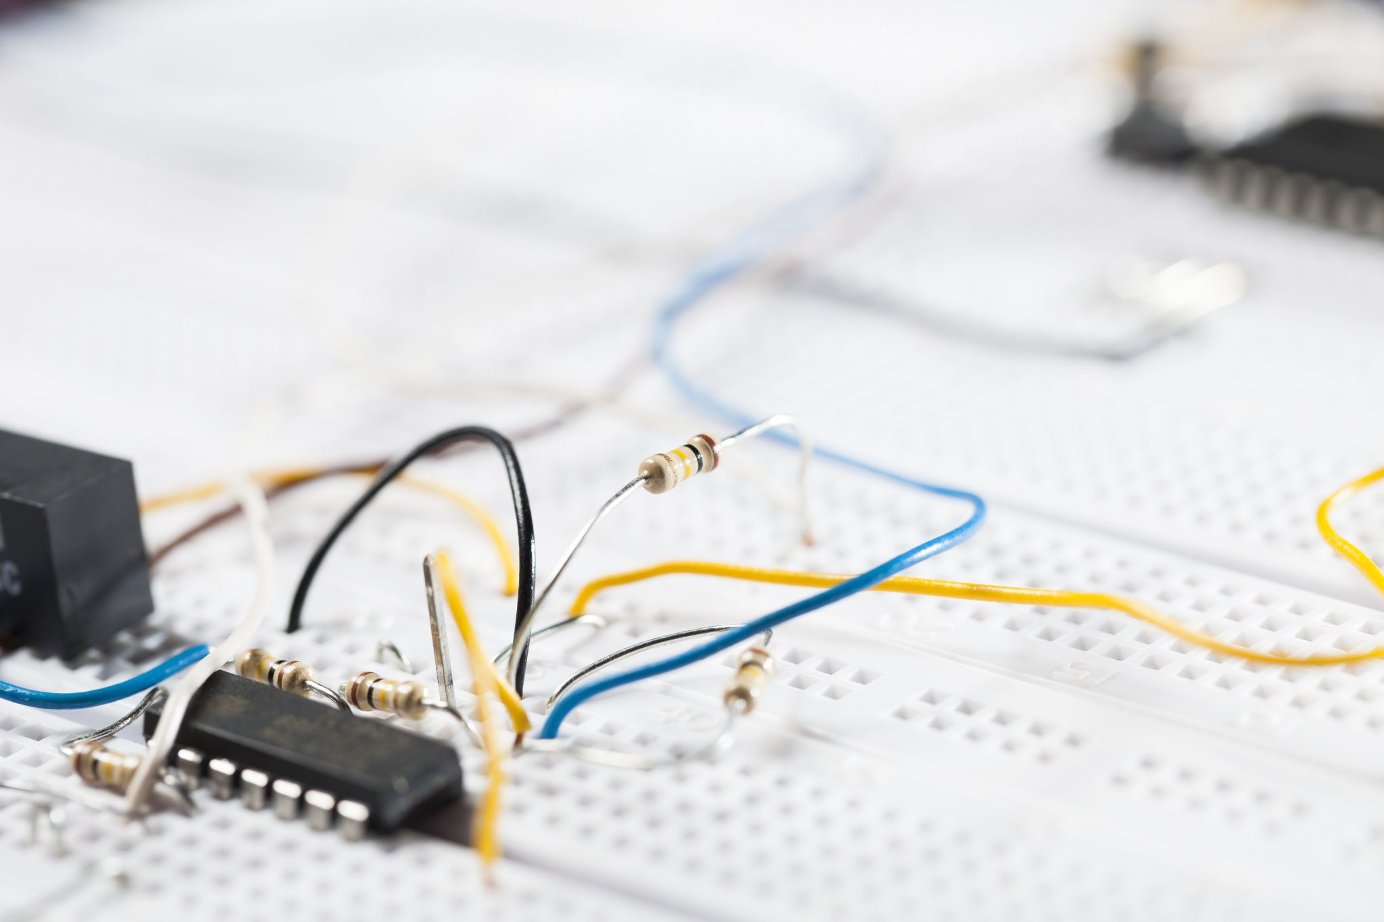
What do they do?
Switching: They can turn circuits on or off by allowing or blocking the flow of current, making them useful in power supplies and other circuits that need precise control.
Amplifying: They can increase the strength of electrical signals. For instance, in audio equipment, they amplify weak audio signals to drive loudspeakers.
Voltage Control: They can control high voltage with a low-voltage input, making them valuable in microcontrollers and logic circuits.
Power Management: They efficiently manage power in electronic devices like smartphones and computers to minimize energy consumption.

Slide 7
Different Types of Mosfets (click on each to learn more)
Enhancement Mode MOSFETs
Depletion Mode MOSFETs
Power MOSFETs
Logic Level MOSFETs
Dual-Gate MOSFETs
VMOS, UMOS, TMOS, Trench MOSFETs

Slide 8

Enhancement Mode MOSFETs
Current doesn't flow until a specific voltage is applied to the gate, creating a conducting path.
N-channel Enhancement: Conducts current when a positive voltage is applied to the gate.
P-channel Enhancement: Conducts current when a negative voltage is applied to the gate.

Slide 9
Depletion Mode MOSFETs
Current flows through them by default (like a closed switch) and requires a voltage to be turned off.
N-channel Depletion: Conducts current by default and requires a negative gate voltage to stop the current flow.
P-channel Depletion: Conducts current by default and requires a positive gate voltage to stop the current flow.

Slide 10
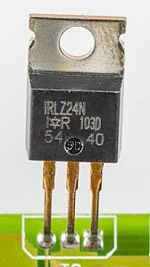
Power MOSFETs
Designed to handle higher power levels efficiently and are commonly used in circuits requiring significant power switching.

Slide 11
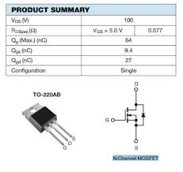
Logic Level MOSFETs
Operate with the lower voltage levels used in logic circuits, which are usually around 5V or 3.3V.

Slide 12
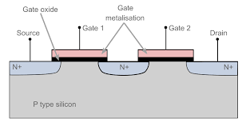
Dual-Gate MOSFETs:
Have two gates that can independently control the flow of current, providing more flexible signal control.

Slide 13

VMOS, UMOS, TMOS, and Trench MOSFETs
These are specialized MOSFET designs aimed at optimizing performance. For instance, they can reduce electrical resistance, increase switching speed, or improve efficiency:
VMOS: V-shaped grooves in the structure for faster switching.
UMOS/TMOS: Improved versions with U-shaped grooves.
Trench: Minimize resistance and optimize for high current.

Slide 14
CSS
All of my pages will link to an engaging and elaborate css that will handle majority of my formatting while having an appropriately styled css layout that uses flex. As well as containing sizing for both desktop and mobile.

Slide 15
Navigation
<nav id="navBar">
<table id="menu">
<tr>
<td><a href="whatisamosfet.html">What is a MOSFET?</a></td>
<td><a href="whatdotheydo.html">What do they do?</a></td>
<td><a href="different.html">Different MOSFETS</a></td>
<td><a href="explain.html">Explaining each MOSFET</a></td>
</tr>
</table>
</nav>
These will guide to my clickable portions.

Slide 16
Media Query explained
@media only screen and (max-width: 600px) {
header {
padding: 5px;
}
This is a rough code that I will use in order to have my website setup for both mobile and desktop.

