Slide 1
S ARAVINTH
B. TECH
AI & DS
211521243018
3/21/2024 Annual Review

Slide 2
TITLE
OBJECT DETECTION USING AI
3/21/2024 Annual Review

Slide 3


AGENDA
Introduction
Project Overview
Implementation Details
Additional Processes
Demonstration
Conclusion & Discussion
3/21/2024 Annual Review

Slide 4

PROBLEM STATEMENT
Object detection is a significant aspect of computer vision that enables machines to identify and locate objects within images or videos. With the rapid advancements in artificial intelligence (AI) and deep learning, object detection has become more accurate and efficient. In this article, we will explore the process of developing an AI-based object detection system, its applications, and the steps involved in creating such a solution.
3/21/2024 Annual Review

Slide 5

PROJECT OVERVIEW
Object detection is a crucial computer vision task that aims to identify and locate objects within an image or video. This problem statement focuses on developing an AI-based solution to automate the process of identifying various objects in real-world scenarios
3/21/2024 Annual Review

Slide 6

WHO ARE THE END USERS?
The end user for this content is a researcher or engineer working in the field of computer vision and artificial intelligence. This professional is interested in learning about object detection, its applications, and the process of developing an AI-based object detection system. They may be looking to expand their knowledge, improve their skills, or explore new opportunities in their field.
3/21/2024 Annual Review

Slide 7

YOUR SOLUTION AND ITS VALUE PROPOSITION
Gather a Diverse Dataset: Collect a large and diverse dataset containing images or videos with annotated objects. This dataset should represent various categories, sizes, orientations, and lighting conditions of the objects to be detected. The annotations should include object boundaries and class labels. Preprocess the Data: Apply appropriate image preprocessing techniques such as resizing, normalization, and data augmentation to improve the model's generalization capabilities and handle variations in the input data. This step ensures that the model can handle different scenarios and maintain high accuracy.
3/21/2024 Annual Review

Slide 8

THE WOW IN YOUR SOLUTION
The wow factor of this project lies in its ability to accurately translate text between multiple languages while preserving semantic meaning and contextual nuances, as well as to generate paraphrases that maintain fluency and coherence across languages. Additionally, the incorporation of advanced deep learning techniques ensures the system's adaptability to various linguistic styles and contexts.
3/21/2024 Annual Review

Slide 9
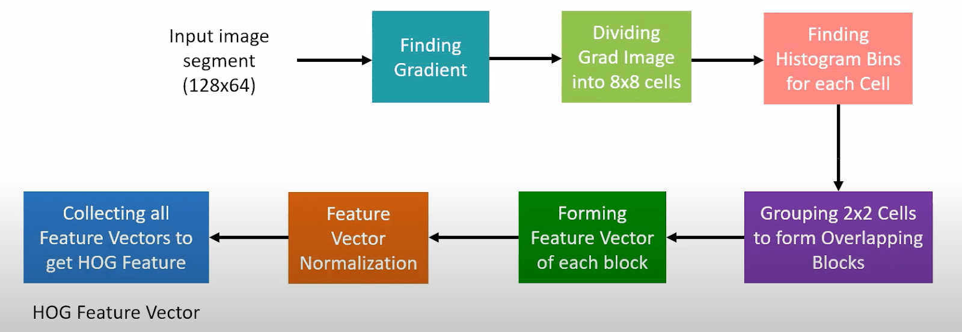
MODELLING
3/21/2024 Annual Review

Slide 10
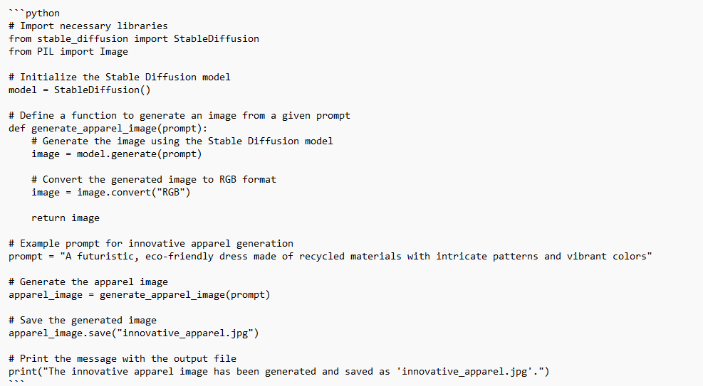
RESULTS
Demo Link
3/21/2024 Annual Review

