Slide 1
Global Terroirs
Data Analysis

Slide 2

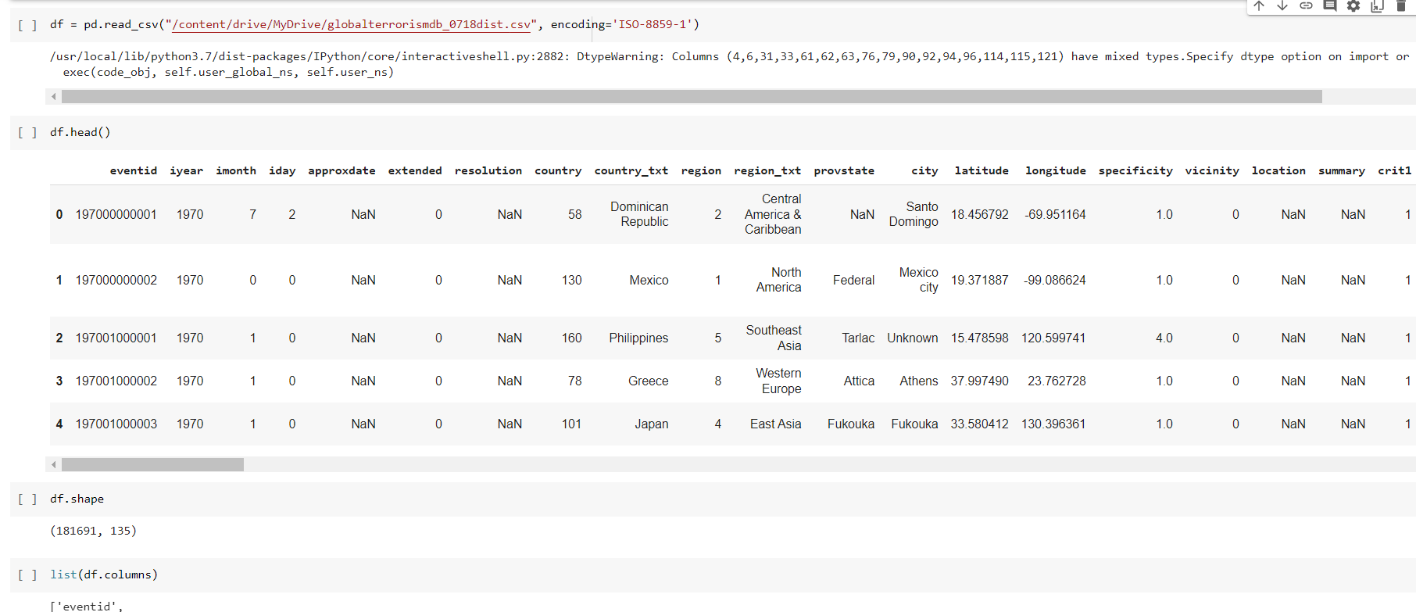
Data loading
Global Terrorist size of 181681 row X 135 column

Slide 3
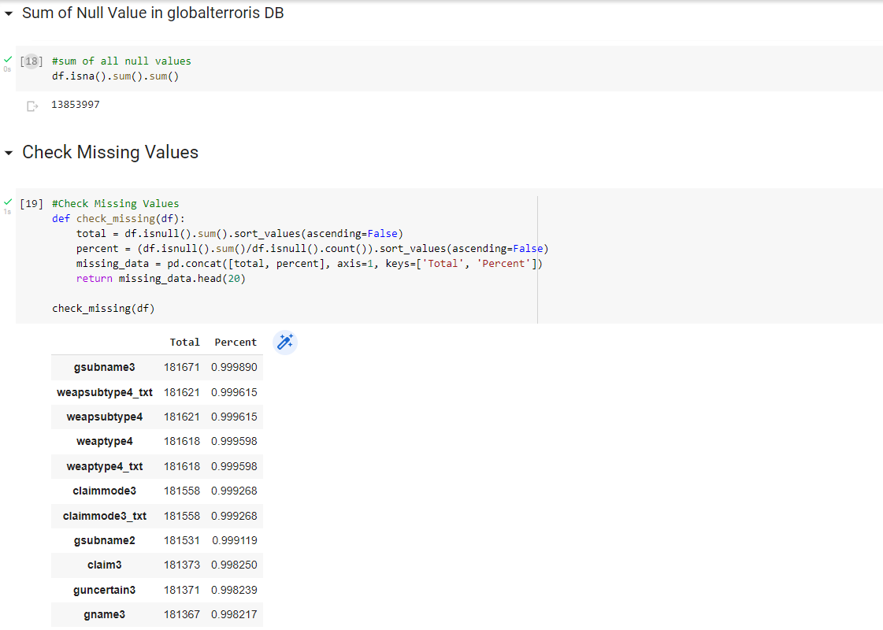
Finding of missing value in data
Around 13853997 missing value are there.
Percentage of missing value in each columns.
If the column has more the 50% null value remove that columns from data.

Slide 4
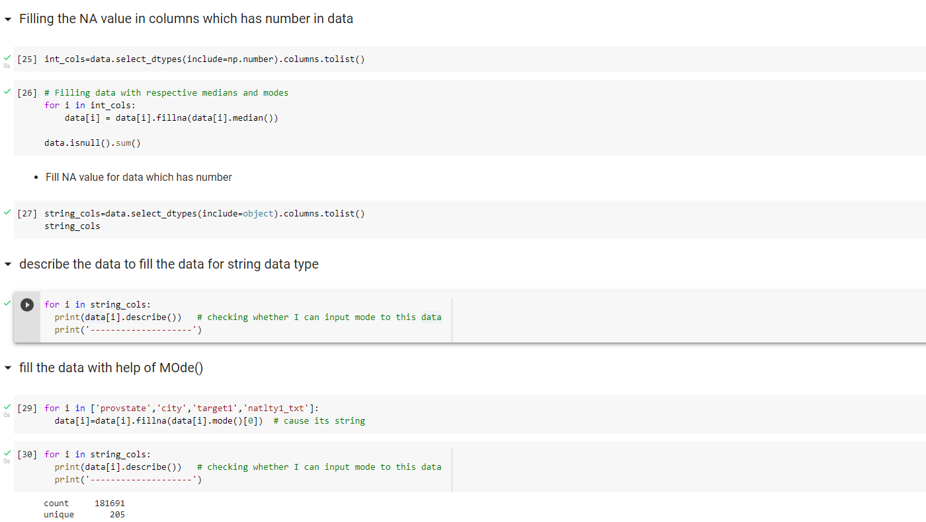
Filling Null value in missing row
Number columns with mean
Character columns with mode

Slide 5
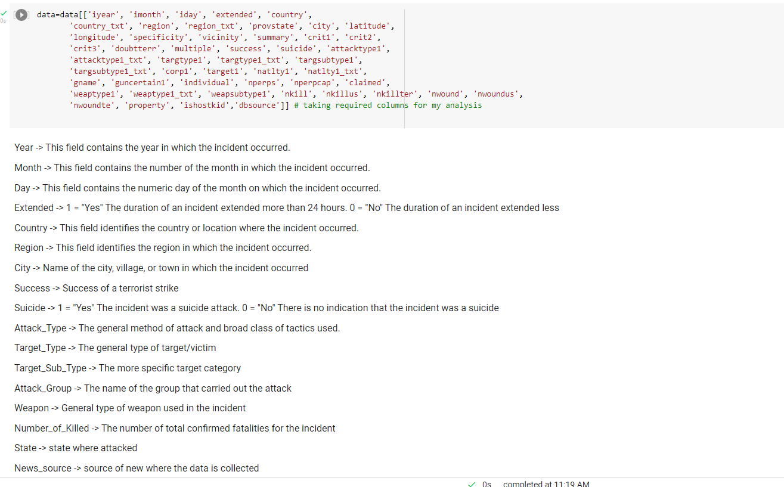
Columns which are used for analysis
Columns which are used for analysis.
Renaming the column.

Slide 6
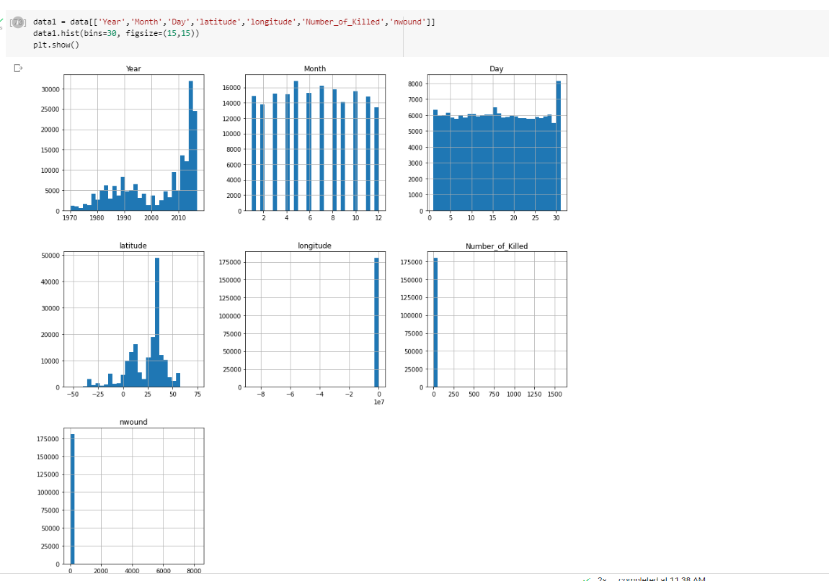
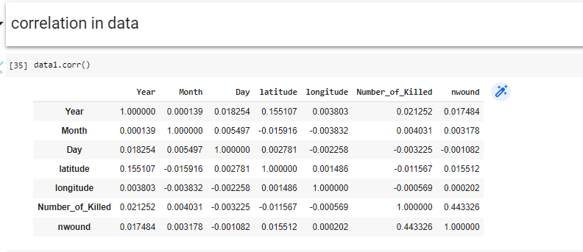
Correlation of data
Here we see that the correlation of data b/n year,month,day and number of people killed

Slide 7
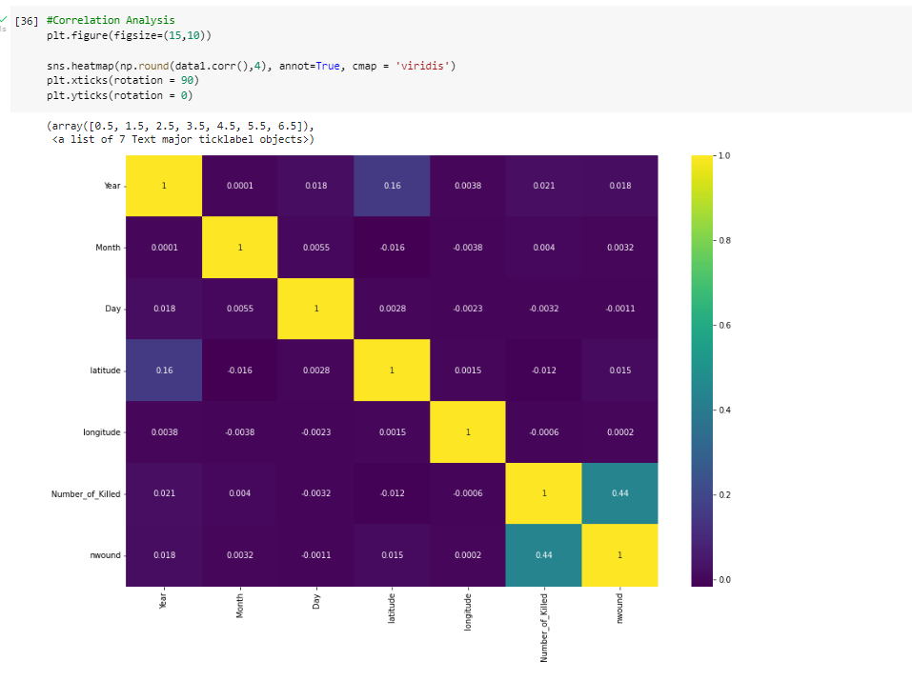
Plotting the correlation
With help of heat map we can find out the relation between data

Slide 8
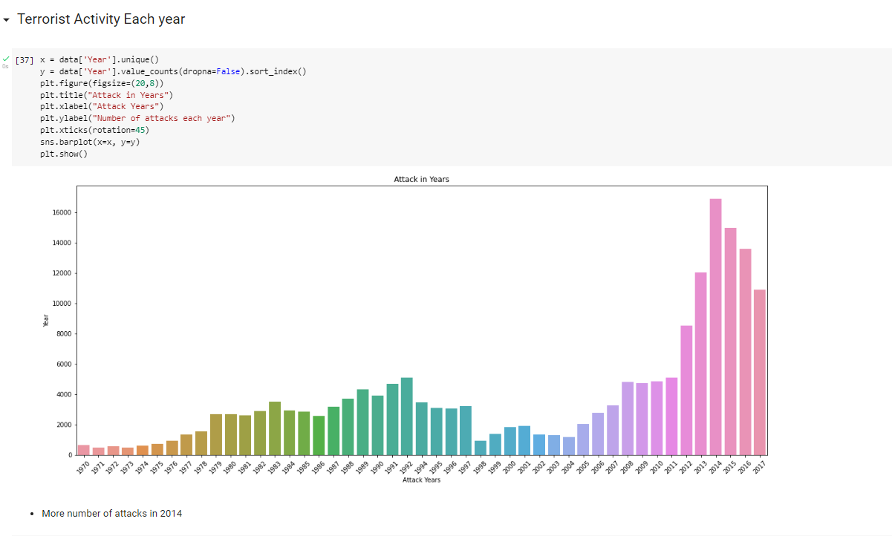
Terrorist activity each year
Terrorist activity is more in 2014 year

Slide 9
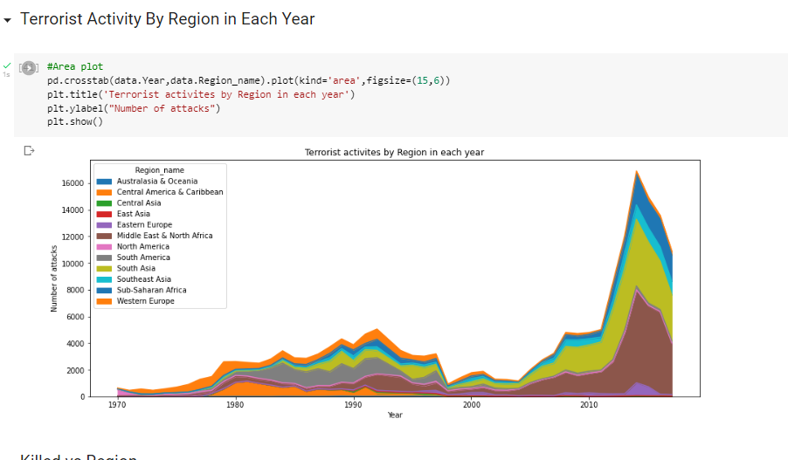
Terrorist Activity By Region in Each Year

Slide 10
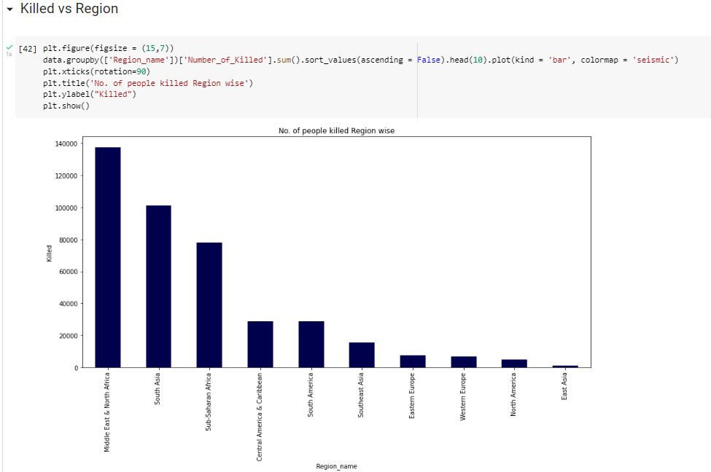
Killed vs Region
In middle east and north Africa is most affected region

Slide 11
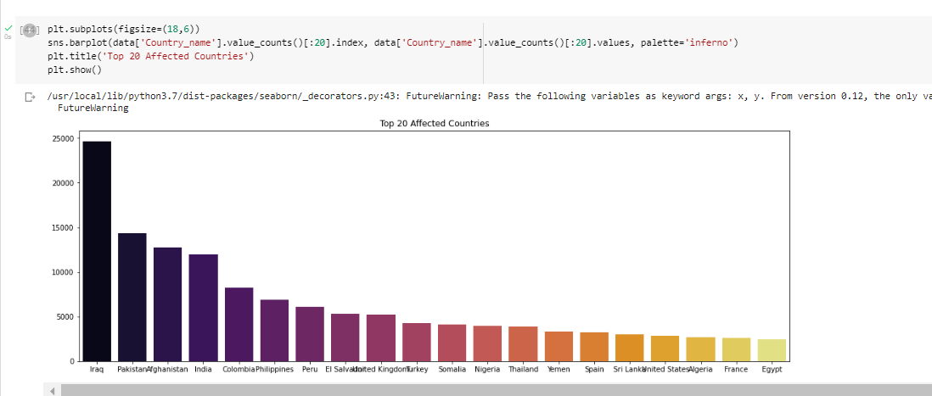
Most affected country’s
Most affected top 20 country’s
Iraq is most affected counter

Slide 12
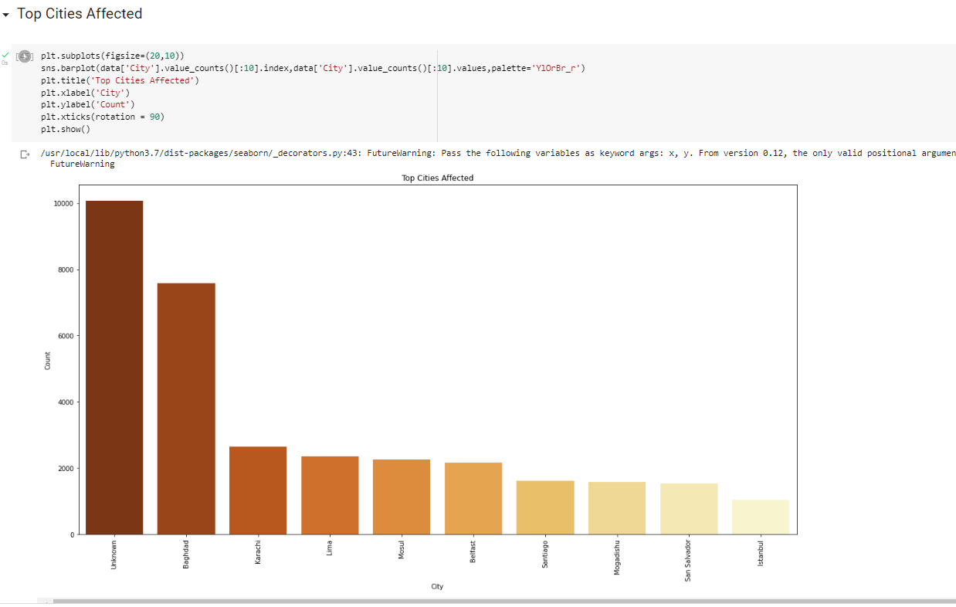
Most affected city
Top 10 affected with attack city
1st unknow
2nd Baghdad

Slide 13
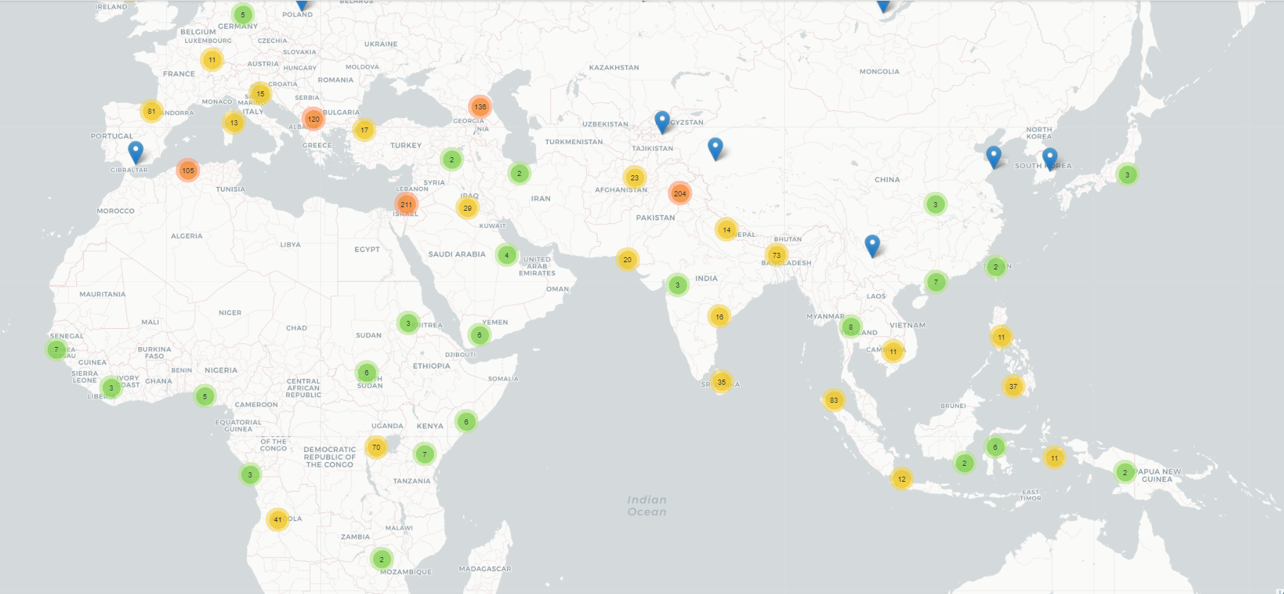
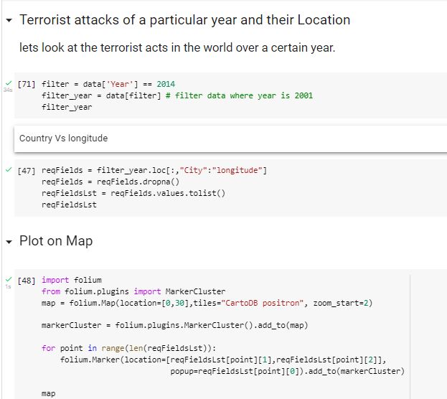
Plotting in map
Plotting in map addacted County in 2014

Slide 14
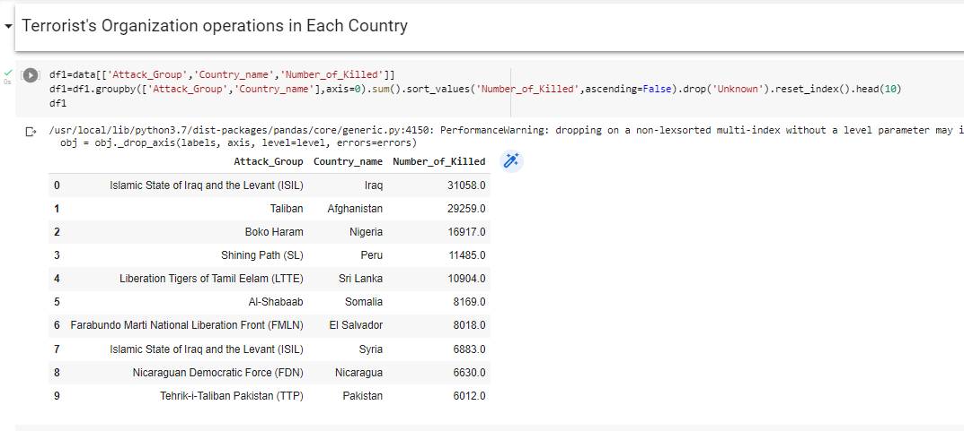
Terrorist's Organization operations in Each Country
Group attack ,country and killed person

Slide 15
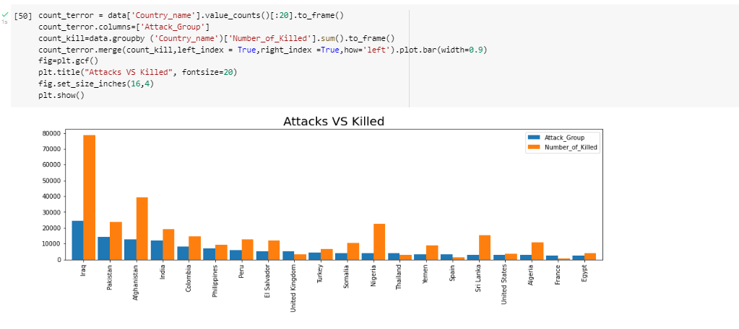
Attack vs Killed person in country

Slide 16
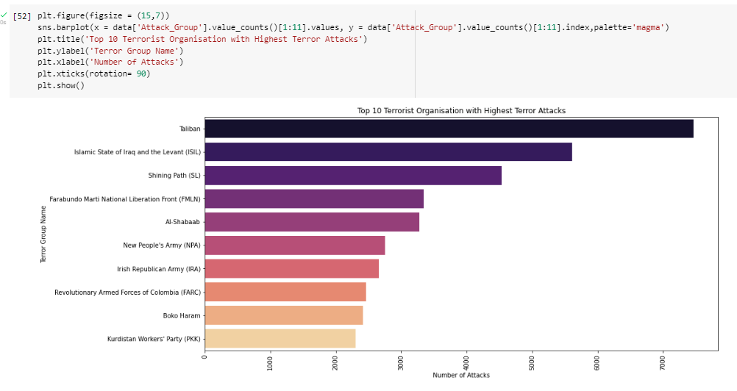
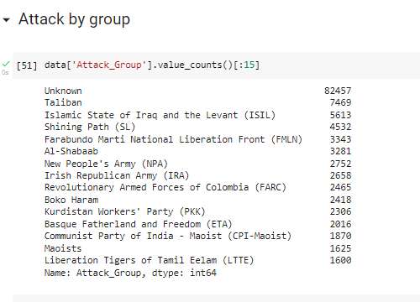

Slide 17
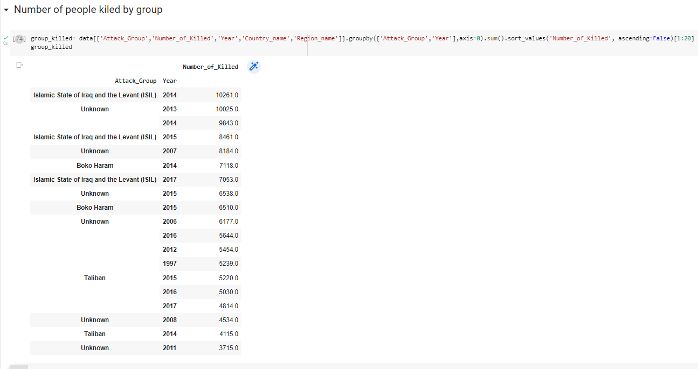

Slide 18
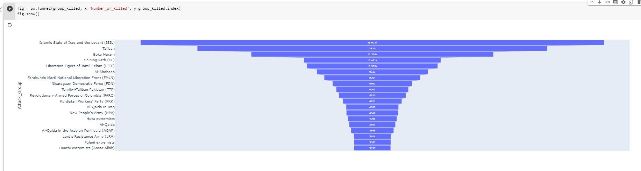

Slide 19
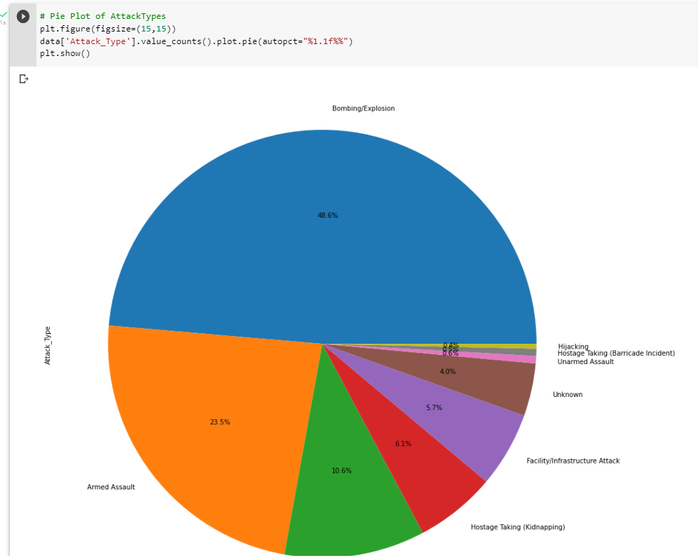
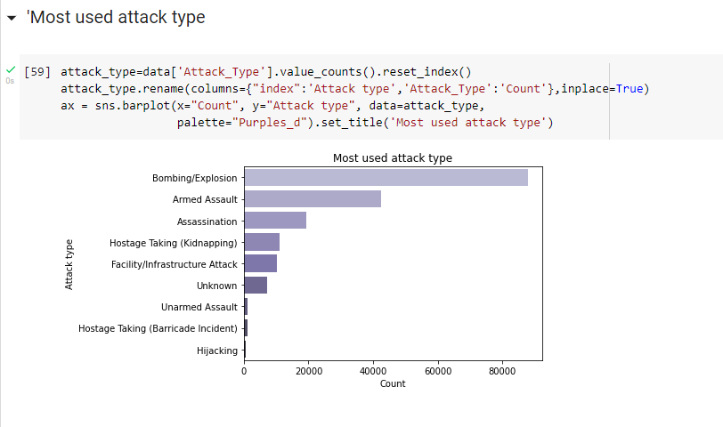

Slide 20
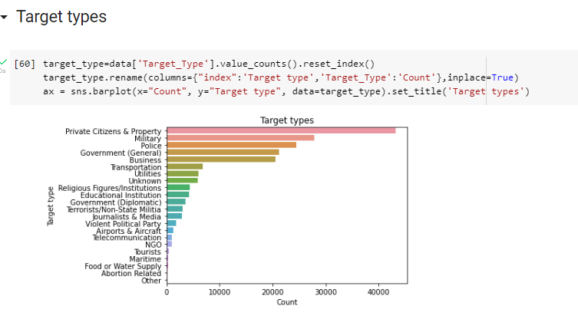

Slide 21
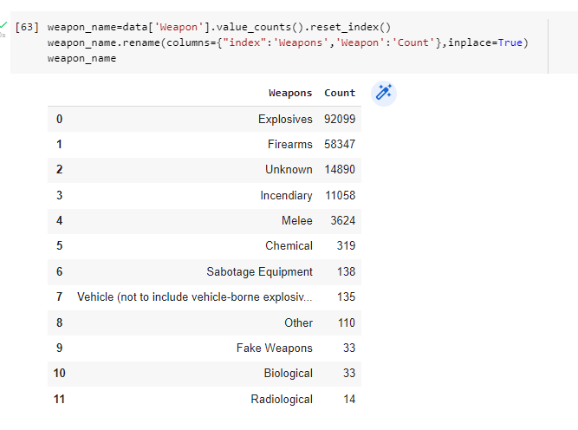
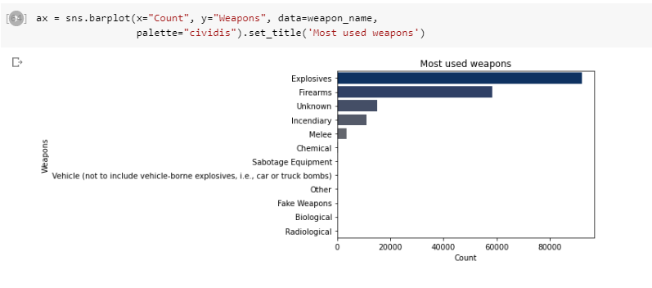

Slide 22
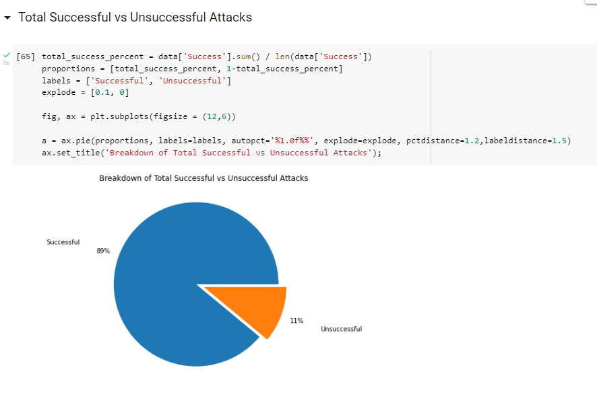

Slide 23
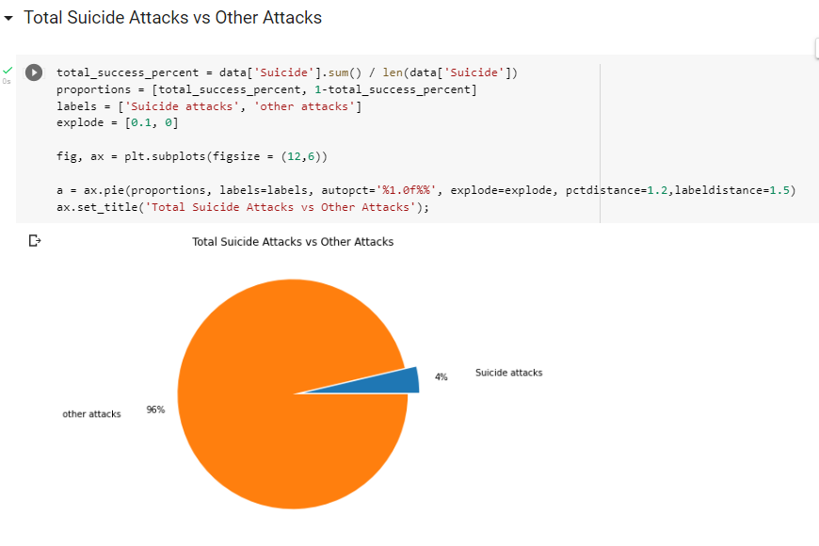

Slide 24
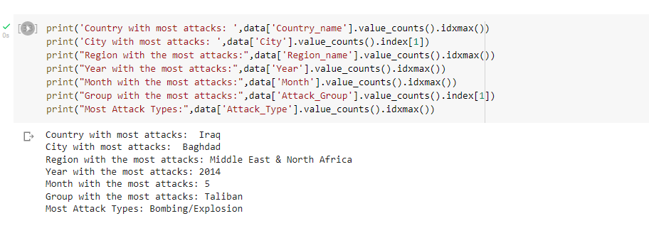
conclusion
Iraq ranked first on global terrorist activity followed by Pakistan, Afghanistan then India and so on.
Most Targeted Areas are Private Citizens&Property, Military,Police and so on.
Global Terror attack rise sharply from 2011 and Maximum Attacks are in 2014 and Maximum people where died in 2014.
Taliban and ISIL are the most active terrorist Groups.

