Slide 1

Anime Recommendation System
Cheung Ka Ho
Li Hao Yu
You Yi
Yau Ho Ting
Cyrus Leung
Zheng Jincai
Zhou Jianing

Slide 2
Objective
An algorithm in recommending movies to users according to their past viewing history
Diversity
Videos that associate with videos the user watched
Videos that associate with the initial recommendations
New features: Q score, R score

Slide 3
Method
Data Introduction
Data Preprocessing
Data Mining
Evaluation

Slide 4
Data Introduction
Animation
ID, name, genre and rating for each animation
User
users’ ID and their rating for every animation watched

Slide 5
DataFrame - Animation
Field | Description
anime_id | Myanimelist.net's unique id identifying an anime
name | Full name of anime
genre | Comma separated list of genres for this anime
type | Movie, TV, OVA, etc
episodes | How many episodes in this show. (1 if movie)
Rating | Average rating out of 10 for this anime
member | Number of community members that are in this anime's "group"

Slide 6
DataFrame - User
Field | Description
user_id | Non identifiable randomly generated user id
anime_id | The anime that this user has rated
rating | Rating out of 10 this user has assigned (-1 if the user watched it but didn't assign a rating)

Slide 7
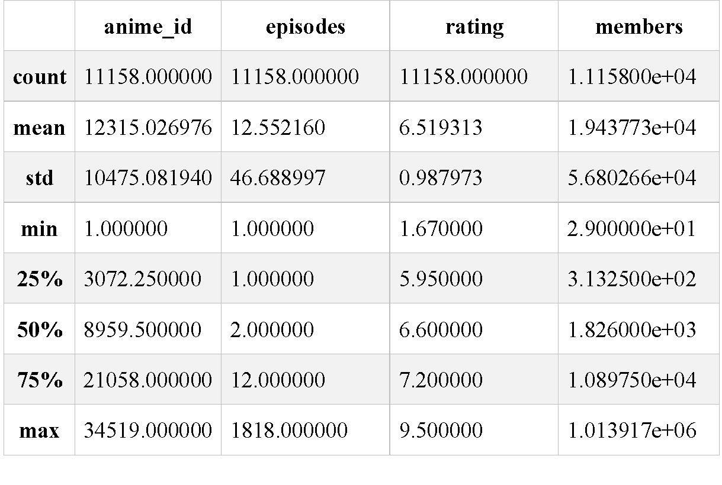
Data Cleaning
Drop missing value
Drop unknown subset
Change data type

Slide 8
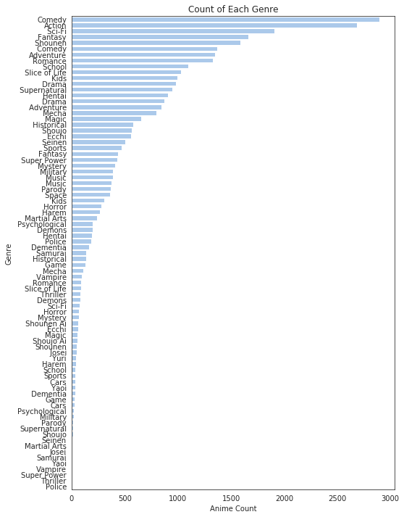
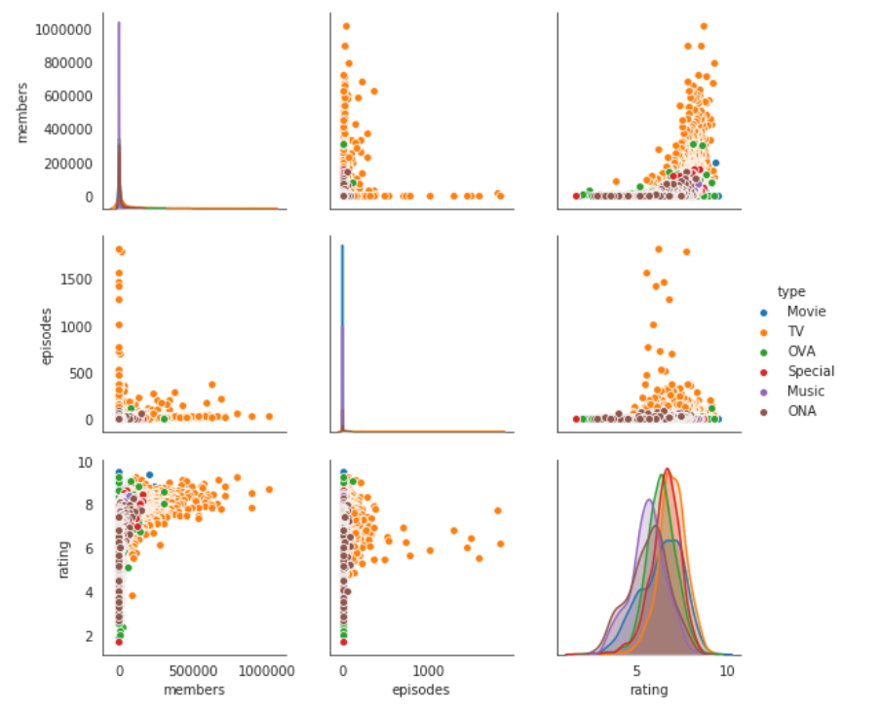
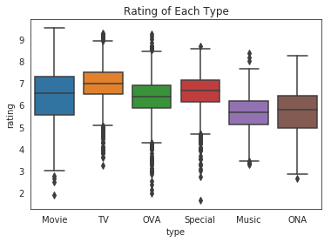
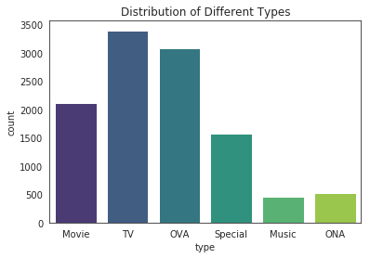
Data Visualization

Slide 9

Data Mining

Slide 10

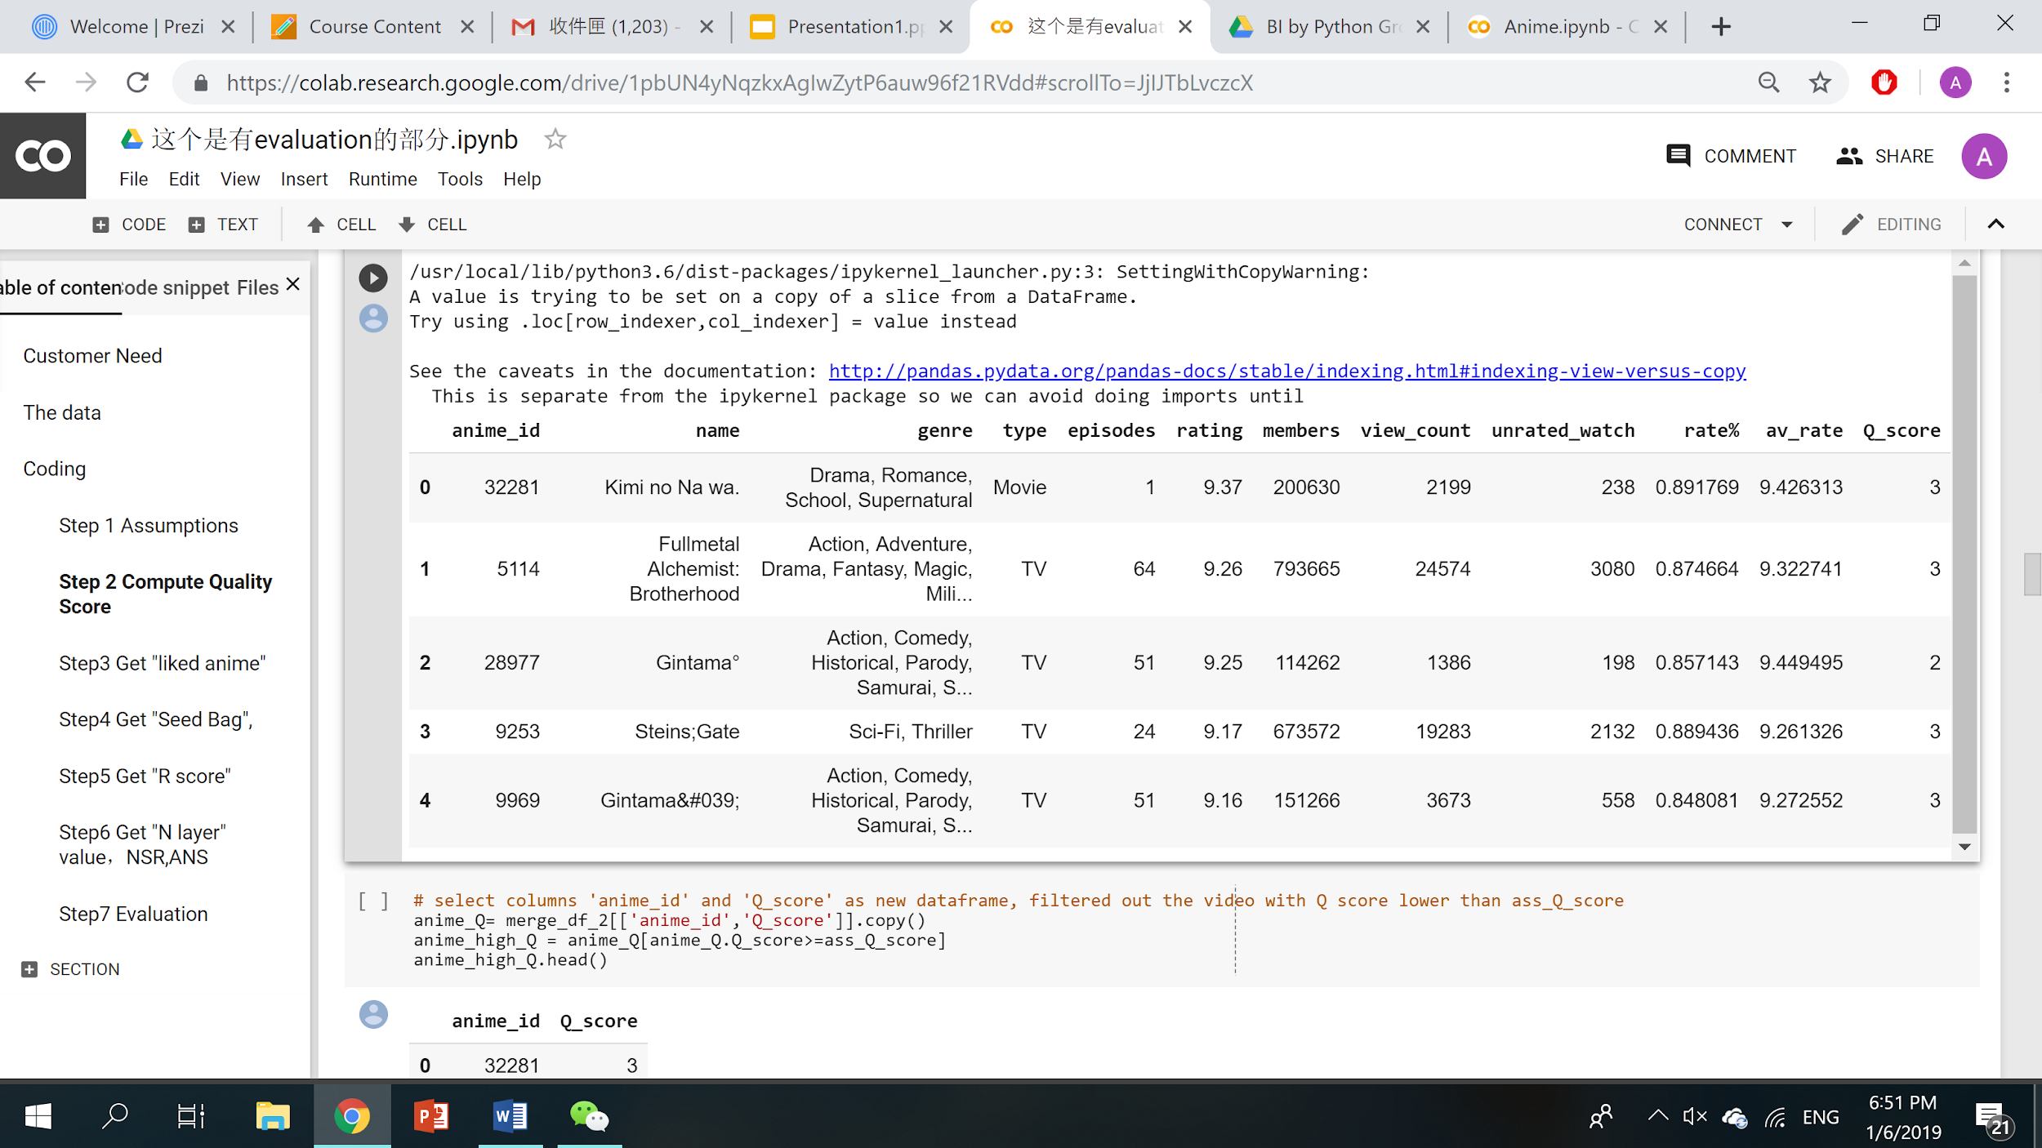
Step 1 – New Feature - Q score
Quality Score
Q score = View counts + Rate% + Average rating

Slide 11
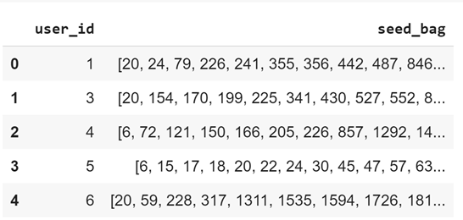
Step 2 – Seed Bag Selection
Seed Bag
Q score > 1
Basis for recommendation

Slide 12
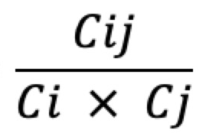
Step 3 - New Feature: R Score
Related Video Score
Indicate the relationship between two videos
Lift (Association Rule)
Simultaneous occurrence of two videos divided by the product of two videos’ occurrence
R score =

Slide 13
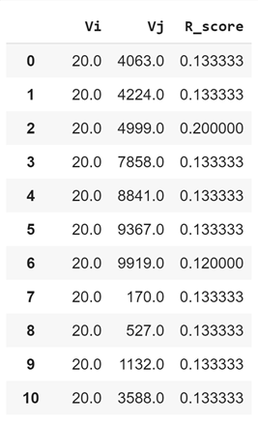
Step 3 - New Feature: R Score
Only recommend movies with R score above a certain threshold
e.g. R score > 0.1
Work out videos associated with each seed video

Slide 14
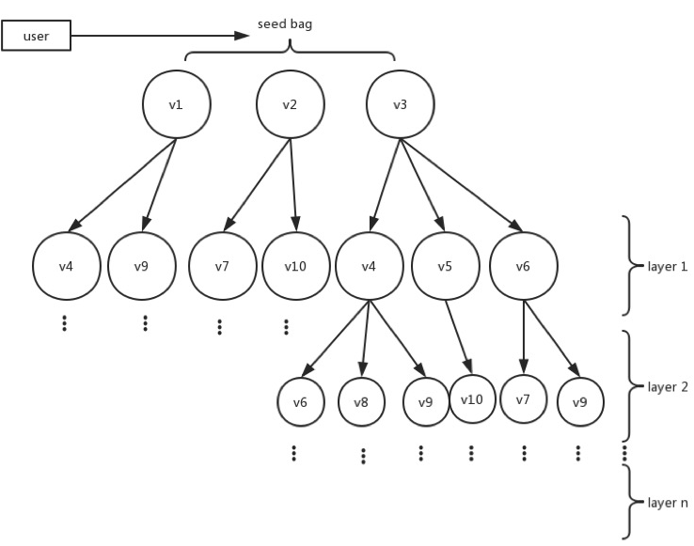
Step 4 - Layers
if R-score > 0.1, Upper node produces sub-nodes :
Layer 1: Directly related to Seed
Layer 2: Indirectly related to Seed

Slide 15
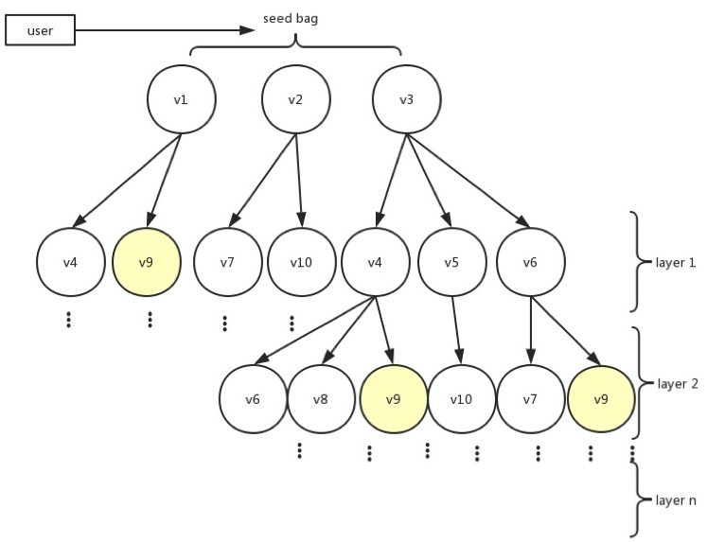
Number of seeds related
NSR V9 = 2
Higher NSR = More Evidence
Step 5 - NSR - Definition

Slide 16
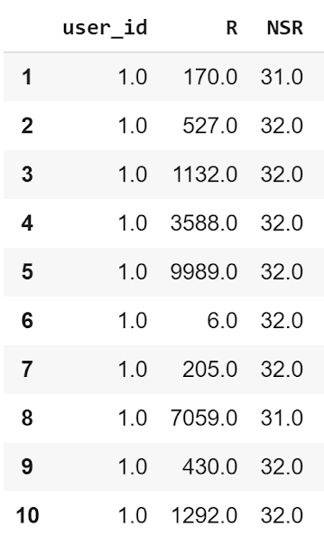
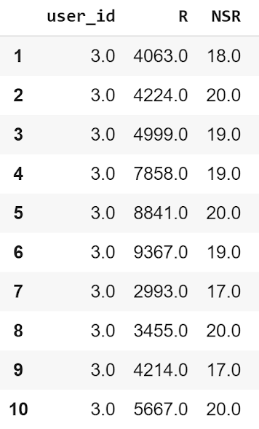
Step 5 - NSR - Result
Recommendations for User 1: Movie #170, 527, 1132, etc.
Recommendations for User 3: Movie #4063, 4224, 4999, etc.

Slide 17
Evaluation
Train-set split is 5:5 (assume: train → history; test → near future)
Confusion matrix is not applicable
Unwatched != “Not interested” but = “Not yet watched”
Unpredicted by the engine may not be a problem as split some to train and some to test, which may cause no evidence on some movies that the users actually watched.

Slide 18
Limitation
focusing on existing animes in the dataset.(Consider only anime with view counts >3)
Only offline-experiment possible for us
Time effect neglected due to lacking of timeseries data

Slide 19
Evaluation
Lift is used
Comparing recommendation system with simple random
Average the lift to get the improvement

Slide 20
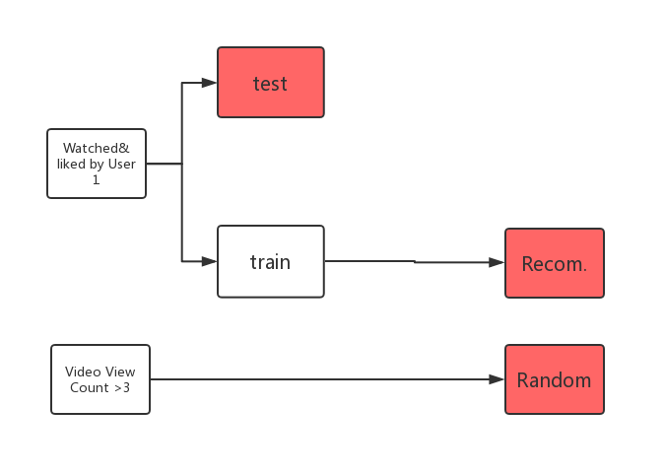
Evaluation

Slide 21
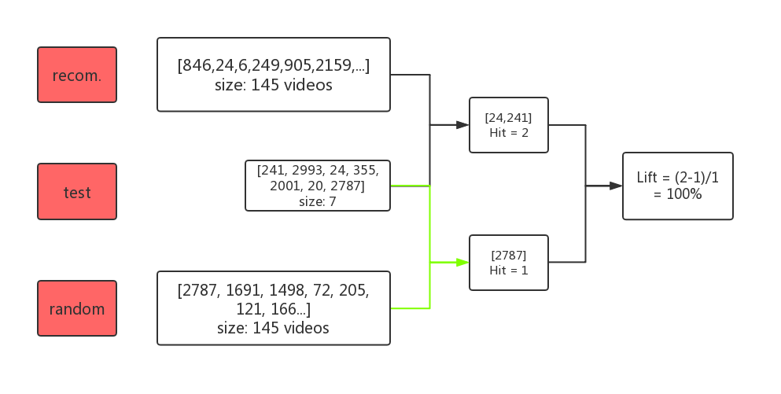

Slide 22
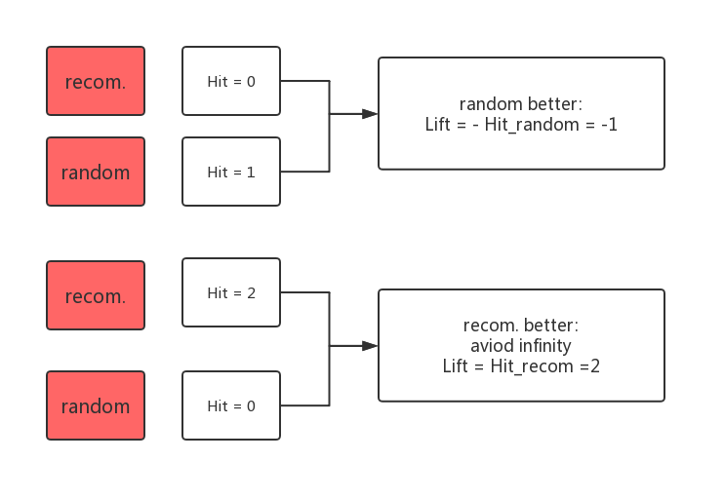

Slide 24
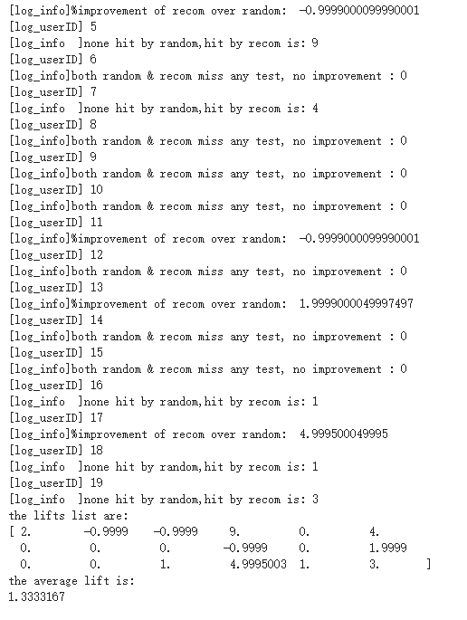
Result: 18 users, layer =1,133% improve

