Slide 1

Movie Recommendation System
Cheung Ka Ho Li Hao Yu You Yi Yau Ho Ting Cyrus Leung
Zheng Jincai
Zhou Jianing

Slide 2
Objective
An algorithm in recommending movies to users according to their past viewing history
Diversity
Videos that associate with videos the user watched
Videos that associate with the initial recommendations
New features: Q score, R score

Slide 3
Method
Data Introduction
Data Preprocessing
Data Mining
Evaluation

Slide 4
Data Introduction
Animation
ID, name, genre and rating for each animation
User
users’ ID and their rating for every animation watched

Slide 5
Data Frame - Animation
Anime.csv
Field | Description
anime_id | Myanimelist.net's unique id identifying an anime
name | Full name of anime
genre | Comma separated list of genres for this anime
type | Movie, TV, OVA, etc
episodes | How many episodes in this show. (1 if movie)
Rating | Average rating out of 10 for this anime
member | Number of community members that are in this anime's "group"

Slide 6
Data Frame - User
Rating.csv
Field | Description
user_id | Non identifiable randomly generated user id
anime_id | The anime that this user has rated
rating | Rating out of 10 this user has assigned (-1 if the user watched it but didn't assign a rating)

Slide 7
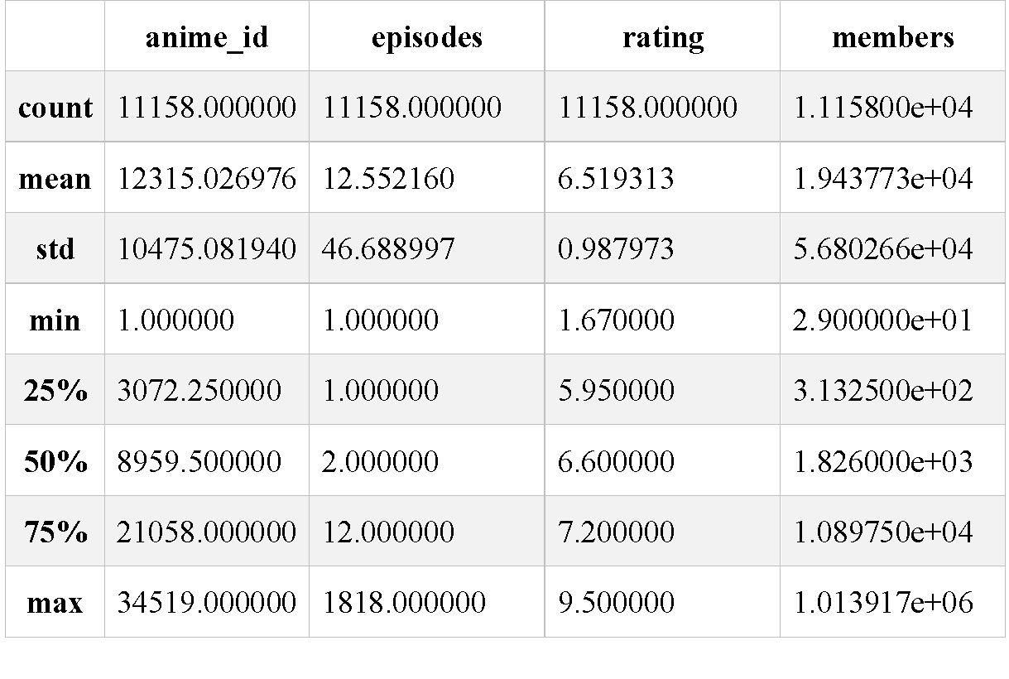
Data Cleaning
Drop missing value
Drop unknown subset
Change data type

Slide 8
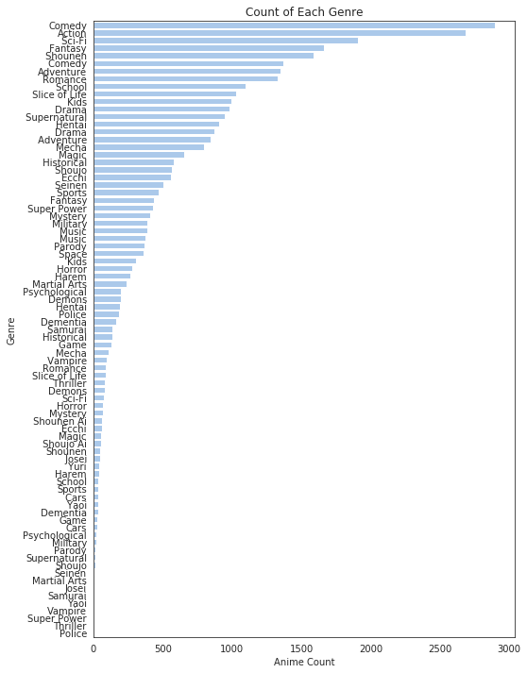
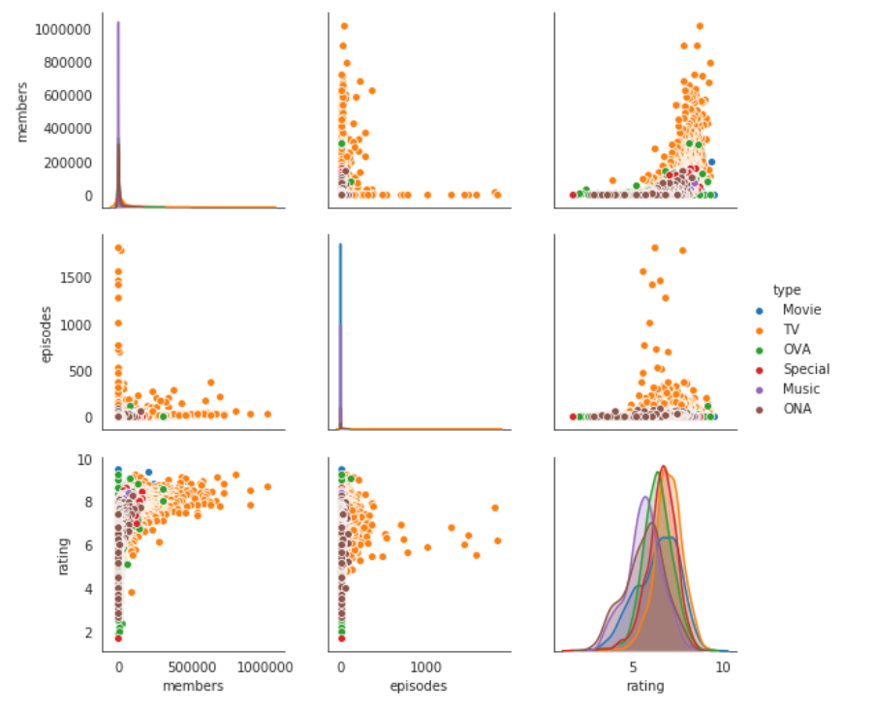
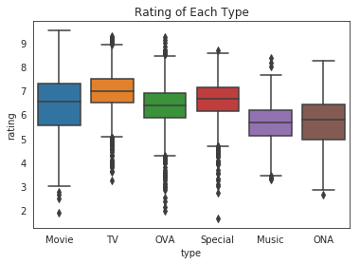
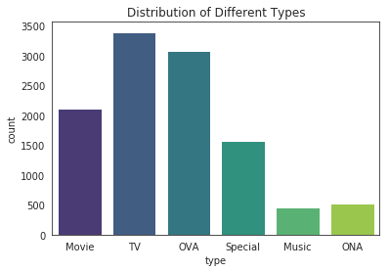
Data Visualization

Slide 9
Data Mining

Slide 10

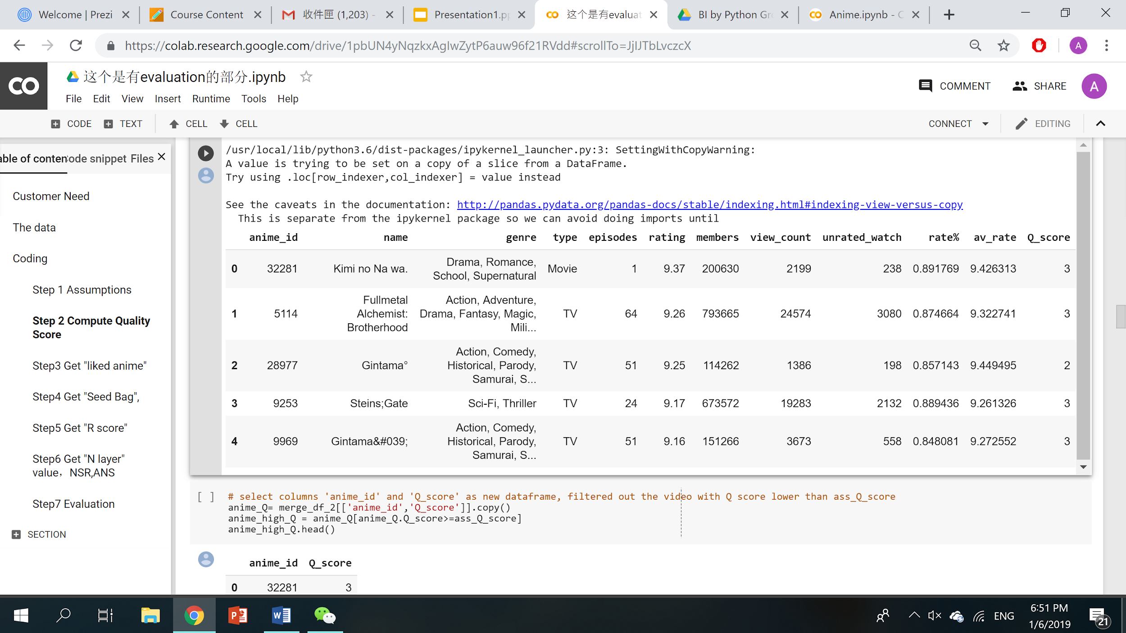
Step 1 – New Feature - Q score
Quality Score
Q score = View counts + Rate% + Average rating

Slide 11
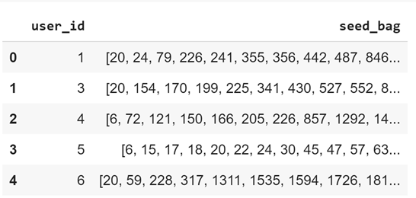
Step 2 – Seed Bag Selection
Seed Bag
Q score > 1
Basis for recommendation

Slide 12
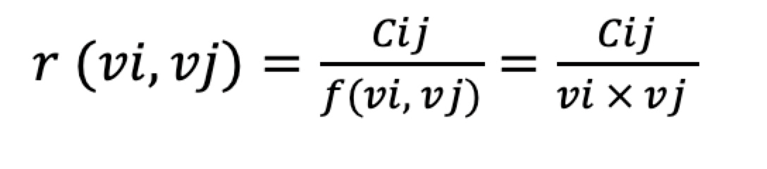
Step 3 - New Feature: R Score
Related Video Score
Indicate the relationship between two videos
Lift (Association Rule)
Simultaneous occurrence of two videos divided by the product of two videos’ occurrence
R score =

Slide 13
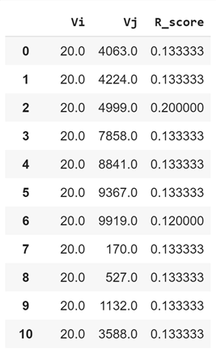
Step 3 - New Feature: R Score
Only recommend movies with R score above a certain threshold
e.g. R score > 0.1
Work out videos associated with each seed video

Slide 14
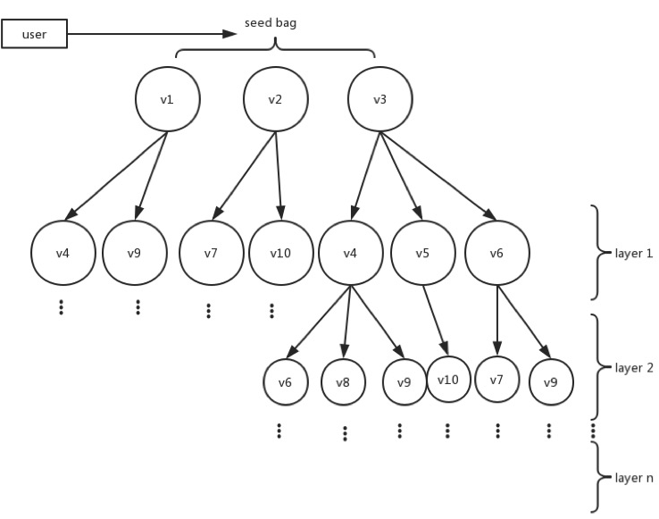
Step 4 - Layers
Each node produces sub-nodes according to R-score
Maximum number of layers: 2
Layer 1: Directly related to Seed
Layer 2: Indirectly related Seed- extend from layer 1
Enhance Diversity

Slide 15
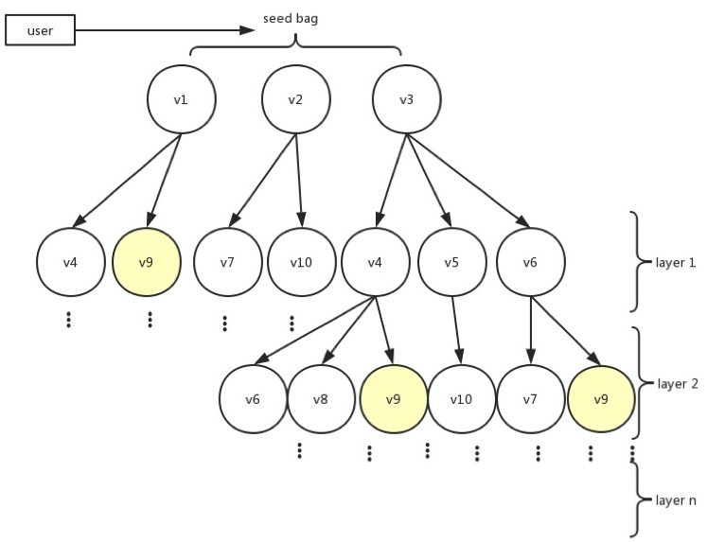
Step 5 - NSR - Definition
Number of seeds related
NSR V9 = 2
Higher NSR = More Evidence

Slide 16
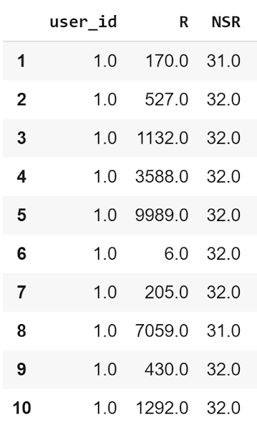
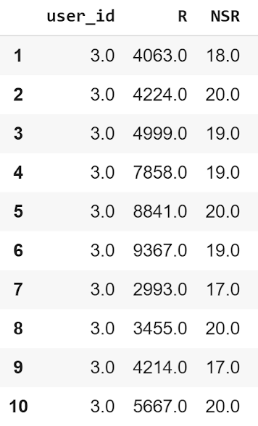
Step 5 - NSR - Result
Recommendations for User 1: Movie #170, 527, 1132, etc.
Recommendations for User 3: Movie #4063, 4224, 4999, etc.

Slide 17
Evaluation

