Slide 1
Building Inspection with Drones

Slide 2
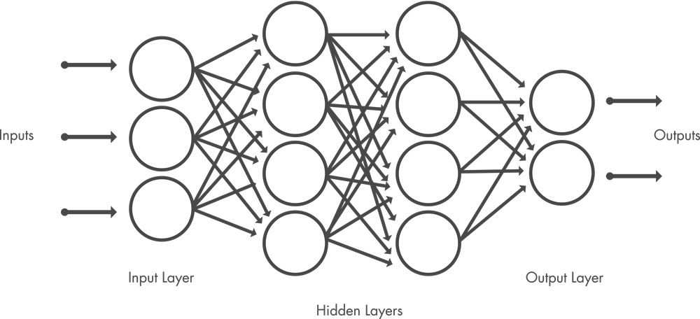
Detection of wall damages with deep learning
Using a convolutional neural network (CNN)
Shared weights and bias values the network detects the trained object wherever it is. A traditional neural network needs fixed positions
VGG16
Using a pretrained model so we don‘t have to
train it from scratch
VGG16 is trained on the ImageNet dataset
over 14 million images
Train the fully connected network with the wall crack dataset

Slide 3
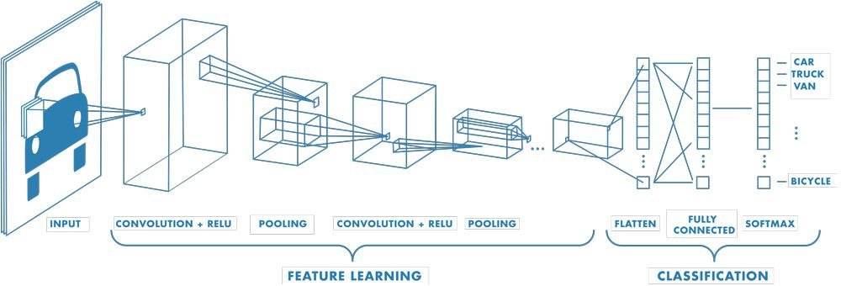
VGG16 Model

Slide 4
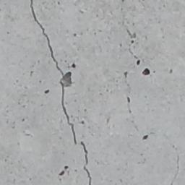
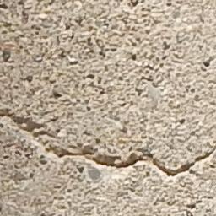
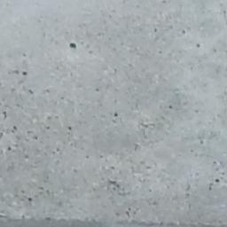
Dataset
Concrete crack dataset from the Utah State University
56,000 images of cracked and non-cracked concrete bridge decks, walls, and pavements
Really easy to download

Slide 5
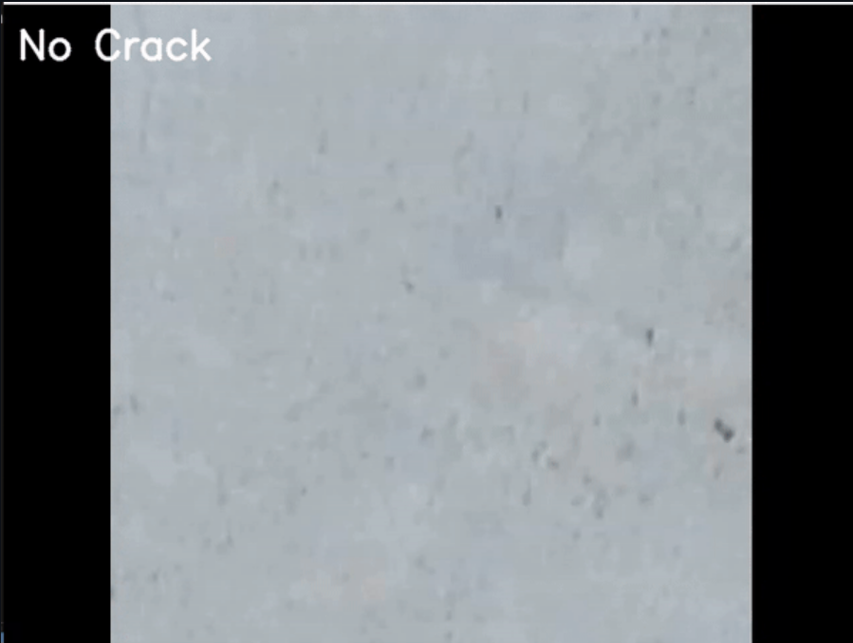
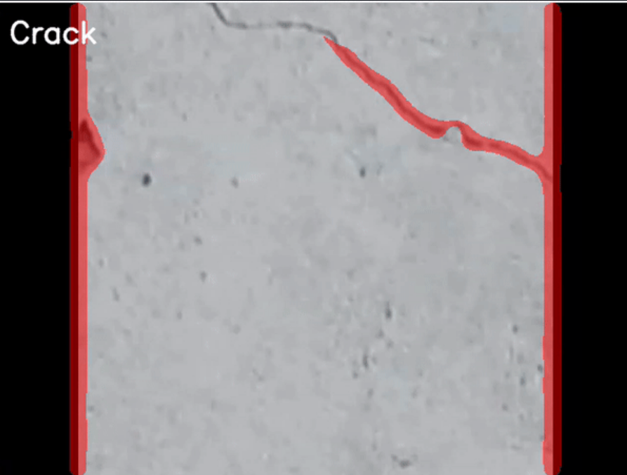
Classification of Images
Predict the class of every 10th frame of a video file
Classification of every frame would require a lot of computing power. The lag is nearly not noticeable

Slide 6
Add more wall defects
It is possible to add more defects than just cracks
Retraining of the model is necessary
Wiki Page
Notes:
A good database of images of these wall defects would be needed

Slide 7
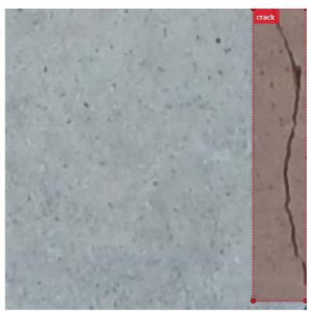
Localization of the defect
State: If a crack is detected the output frame is overlaid with a mask written by the person before me
What I tried: Working with Azure ML Studio to achieve a localization with a bounding box
Problem: Azure ML is pretty complex therefore the implementation
of the model is really hard
What I tried 2: Implement GRAD-CAM

Slide 8
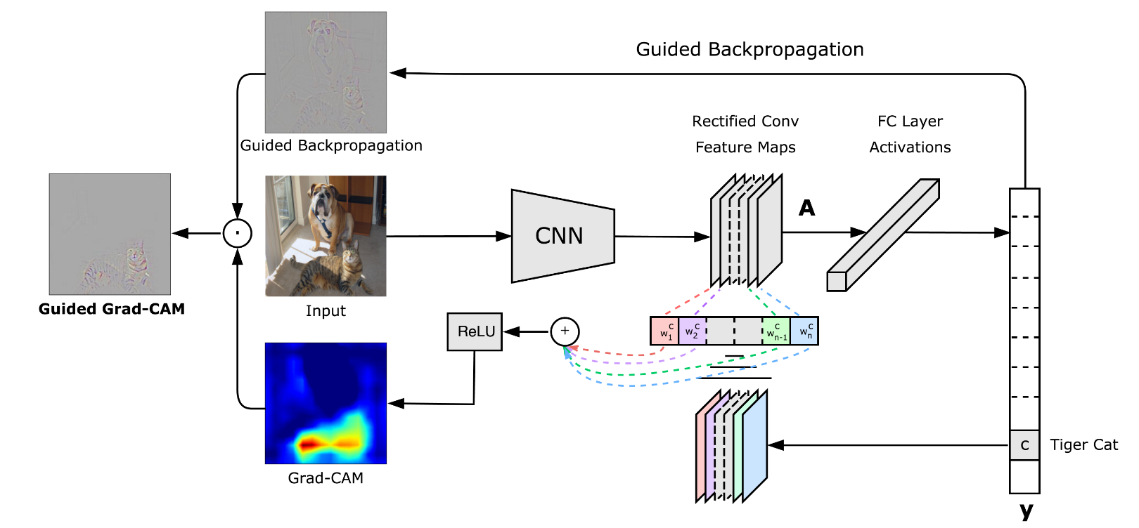
Grad-cam

Slide 9
Next steps
Try the model on some real world data, ideally some drone footage of a building facade with wall damages
Adding more wall defects, determine which defects are important like wall cracks for the structural integrity of the building

Slide 10
Link Collection
https://www.kaggle.com/code/carloalbertobarbano/vgg16-transfer-learning-pytorch
https://www.mathworks.com/discovery/convolutional-neural-network-matlab.html
https://image-net.org/
http://gradcam.cloudcv.org/
https://digitalcommons.usu.edu/all_datasets/48/

