Slide 2
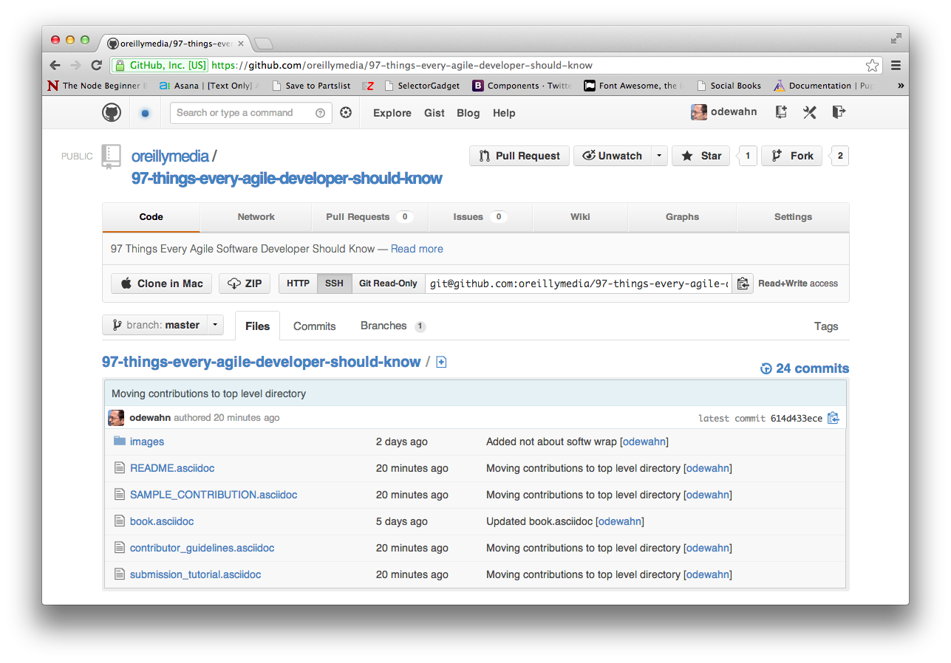
Click “Fork”

Slide 3

Click the “+” to add a new file.

Slide 4
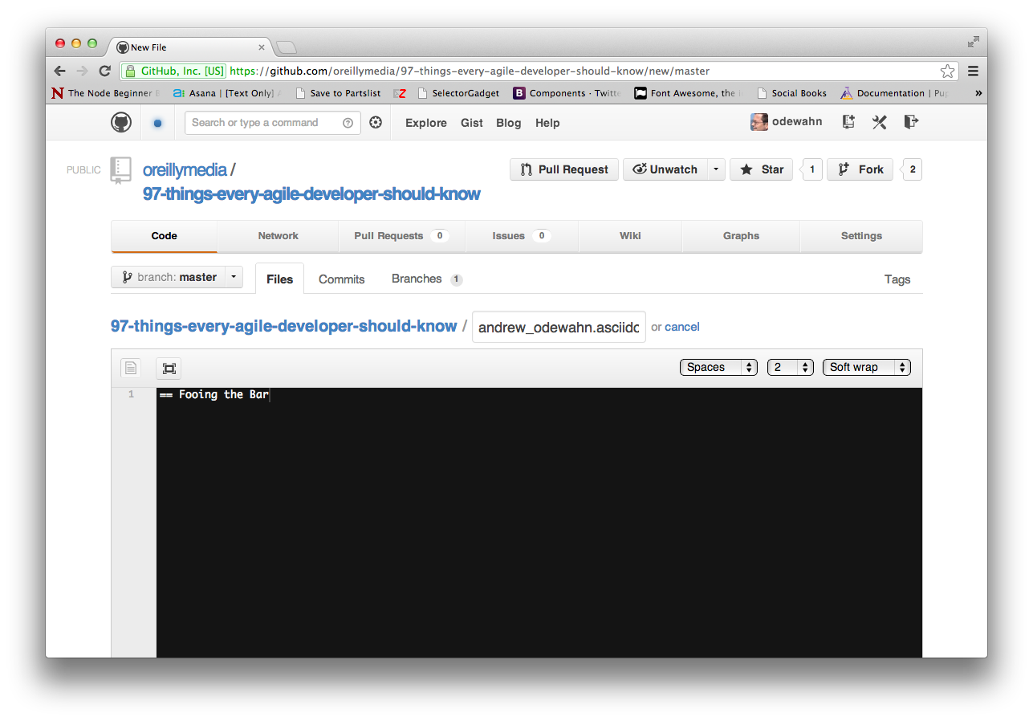
Put your file name here
Enter your title here
Change the wrap mode to “Soft Wrap”

Slide 5
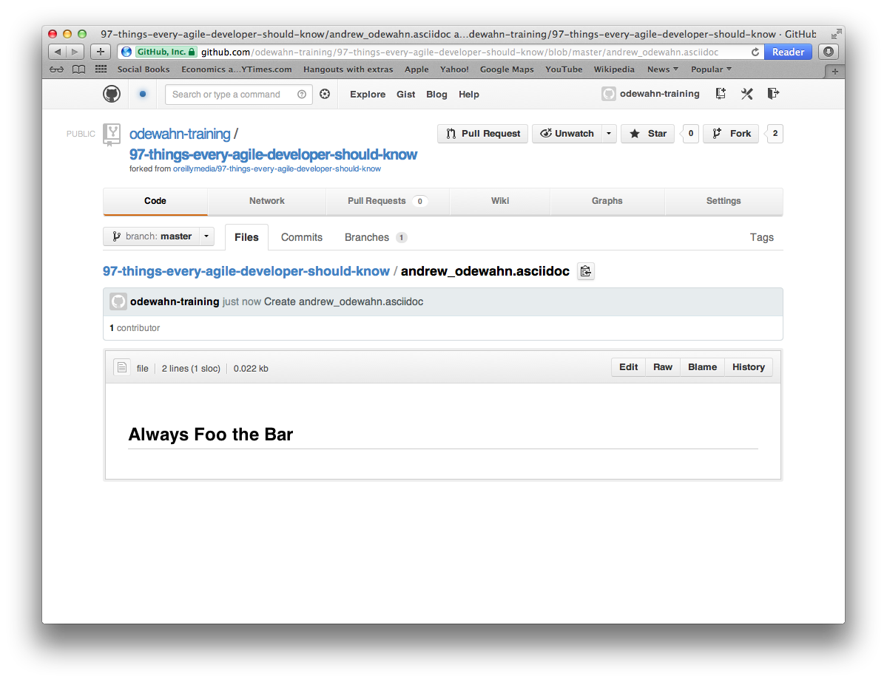
Click “Edit”

Slide 6
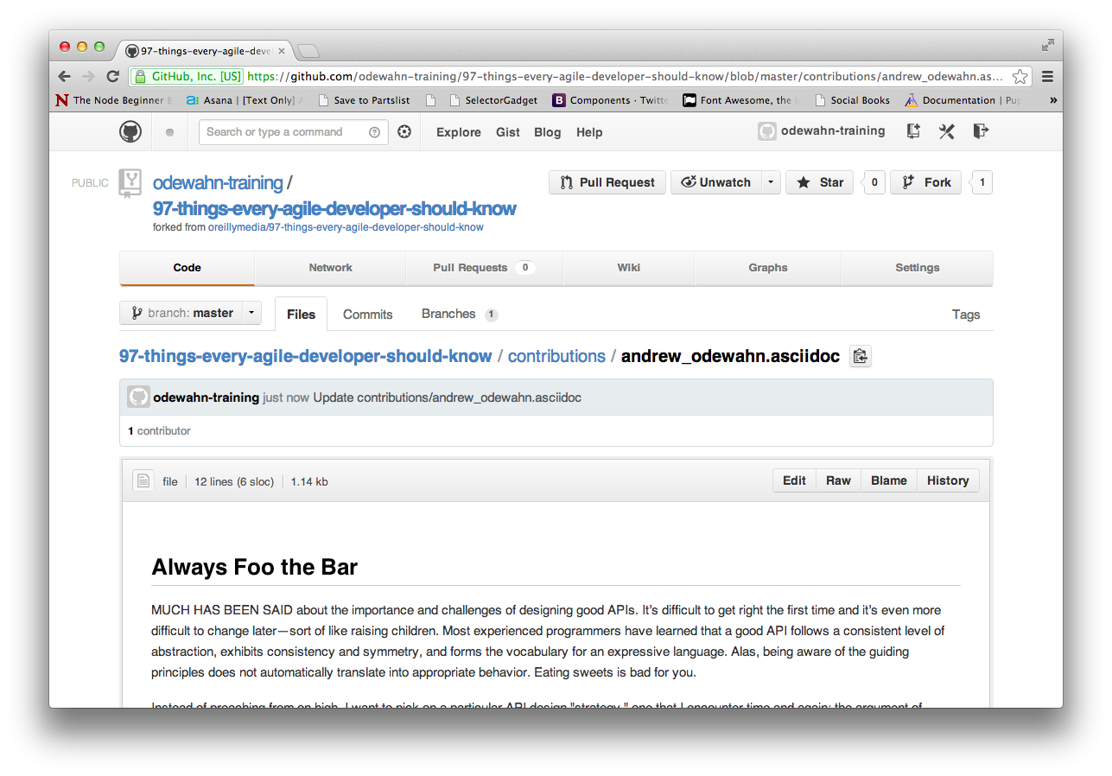
Submit a pull request when your contribution is complete

