Slide 2
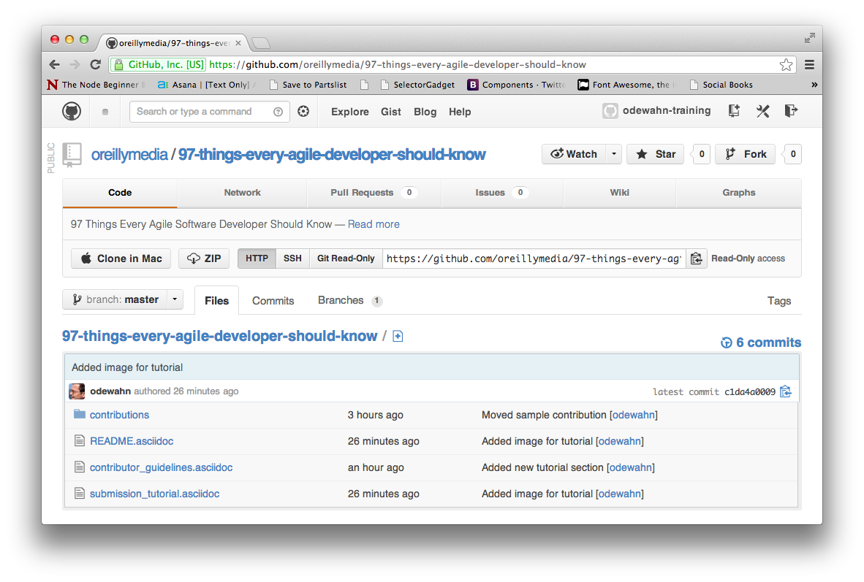
Click “Fork”

Slide 3
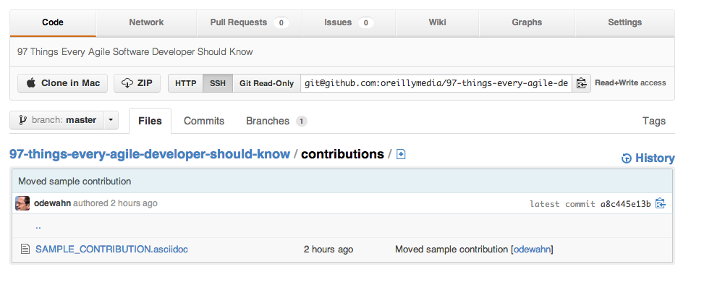
Click the “+” to add a new file to the “contributions” directory.

Slide 4
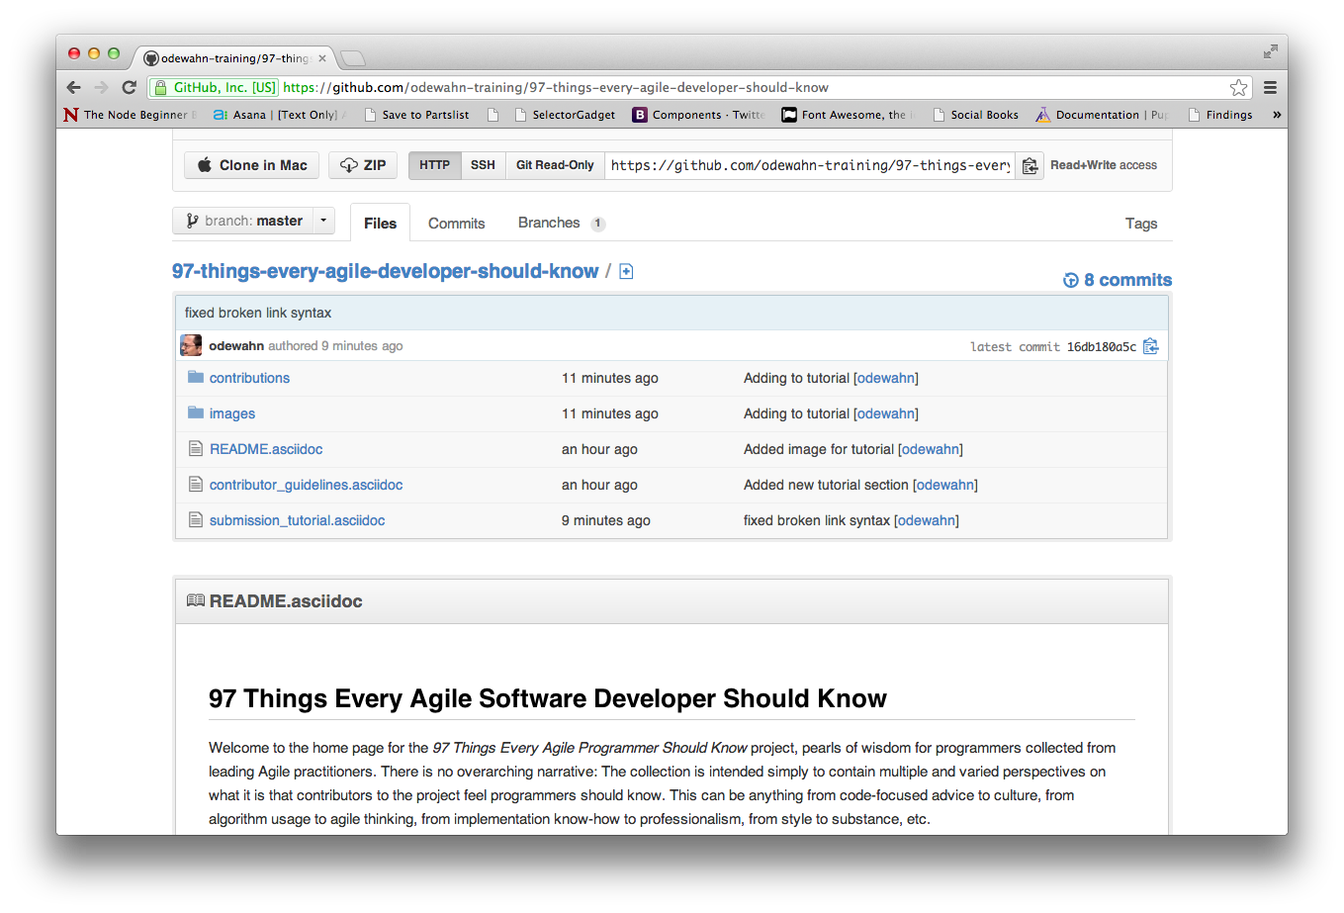
Click the “contributions” directory

Slide 5
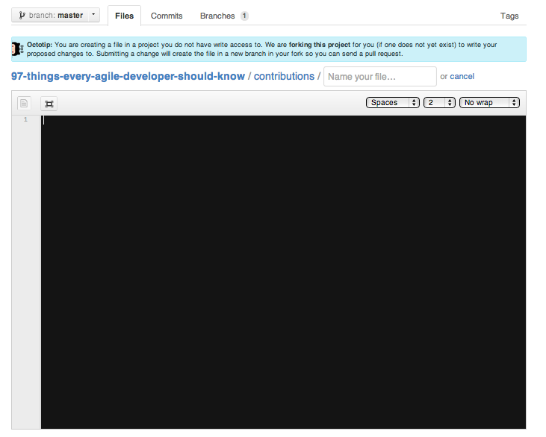
Put your file name here
Enter your title here
Start editing here

Slide 6
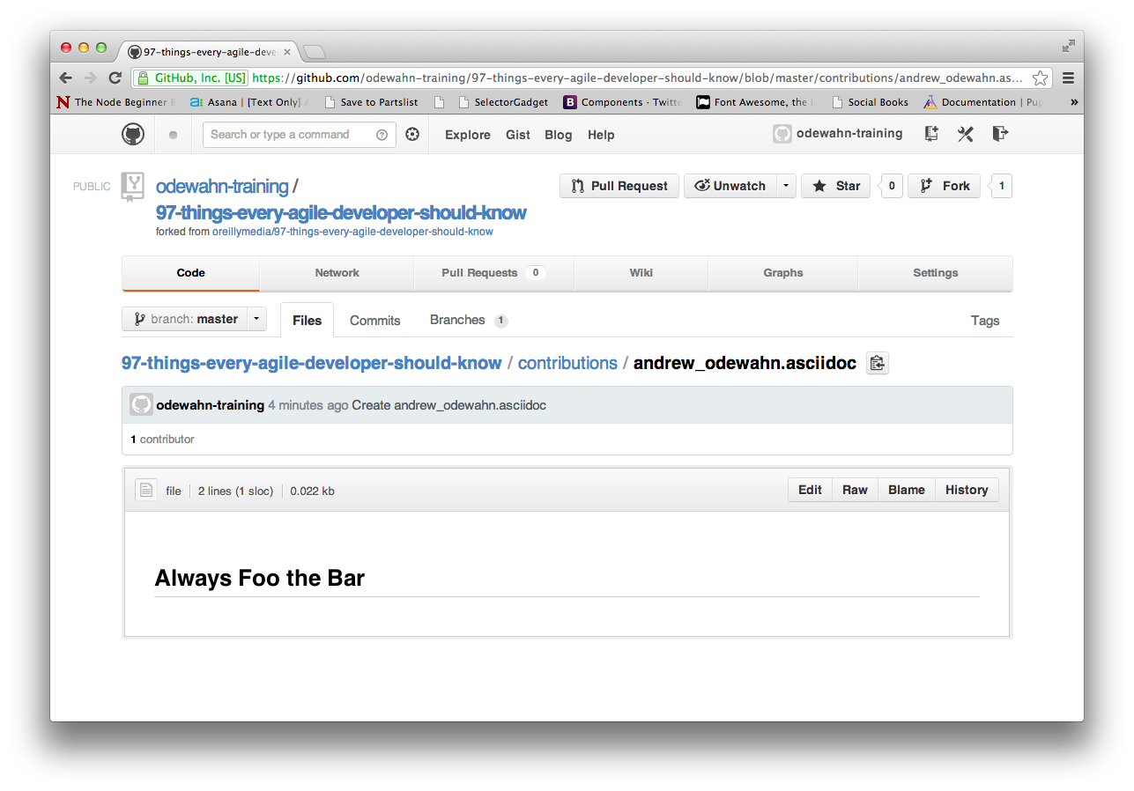
Click “Edit”

Slide 7
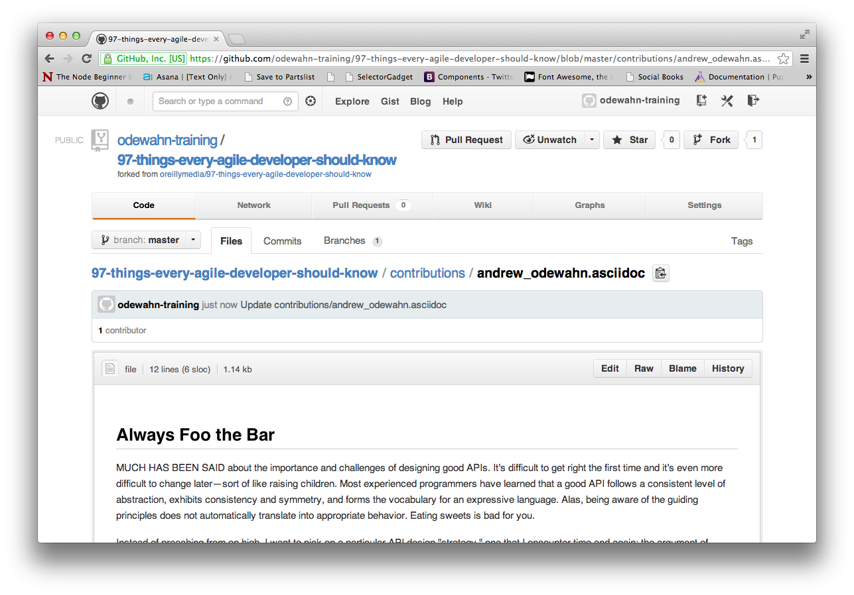
Submit a pull request when your contribution is complete

