Slide 1


CAPSTONE PROJECT
Outpatient Schedule Tracking
Routhu Rambabu
Simple Solutions!

Slide 2
Project Overview
Introduction : "Sarvotham's Spine Care," a growing hospital in Bengaluru, is experiencing an increase in patient volume. While they have an effective support system, their current processes for managing outpatient schedules, records, and billing are maintained manually in physical registers. This manual process is inefficient and hinders productivity. The hospital seeks a digital solution to streamline these operations
Simple Solutions!

Slide 3
Actors & Their Roles
Actor | Primary Responsibilities
Doctor | Review comprehensive patient history and diagnostic reports Provide diagnoses and treatment plans Prescribe medications and order lab tests or imaging Communicate clearly with patients and caregivers Approve and validate health records Record consultation notes and follow-up instructions Coordinate with support staff for continuous patient care Manage outpatient schedules and availability
Patient | Create and manage personal account credentials securely Register and update personal and insurance information View detailed treatment history and progress Access billing statements, payment history, and lab results digitally Receive notifications about appointments, test results, and billing Raise queries or support requests Maintain privacy settings and consent for data sharing
Simple Solutions!

Slide 4
Actors & Their Roles
Actor | Primary Responsibilities
Support Staff (Nurse / Attender / Lab Technician) | Preauthorization of Patient Admit patients: register patients Manage patient data and medical information during admission and stay. Submit and track insurance claims of Each patient Upload required medical bills, reports, and discharge summaries. Respond to queries or requests for medical documents.
Front Desk | Register and align patients with their specific doctors Track and update real-time status of patients (waiting, under consultation, completed, etc.) Redirect and escalate patient requests to the appropriate support staff promptly Manage appointment scheduling and rescheduling Verify patient identity and appointment details during check-in
Simple Solutions!

Slide 5
Actors & Their Roles
Actor | Primary Responsibilities
Billing Desk | Validate treatment codes and types prior to billing Generate accurate bills based on all treatments, investigations, and medicines Process payments via cash, credit, insurance claims, or other modes Manage billing disputes and queries Generate financial reports and audit trails Ensure compliance with regulatory and insurance requirements Coordinate with patients and insurance providers for claims processing
Simple Solutions!

Slide 6
Key Functionalities
Automated Admission & Room Management
Patients can view real-time room availability, book rooms, or request transfers via an online system.
Hospital admins review and approve these requests with instant notifications.
Streamlined Discharge Processing
Hospital staff generate discharge details automatically, coordinate with administrative teams, and notify patients promptly to improve transparency and reduce delays.
​
Cashless Insurance Claim Workflow
The system manages end-to-end insurance clearance for cashless treatment — including claim submission by hospitals, verification by insurers, and status tracking by patients.
Centralized Communication & Request Tracking
All stakeholders—patients, hospital staff, insurers, and administrators—can track request statuses, communicate updates, and respond to queries within a unified platform.
Simple Solutions!

Slide 7
System Architecture
Database (MongoDB): Stores all users (admins, insurers, customers), covers, hospitals, policies, bookRoom, hospitalClaims, hospitalClaimQueries, notifications, room and roomTransfer
Backend (Spring Boot Microservices):
REST APIs to manage data.
Frontend (React + MUI):
Responsive user interface for booking, transfer, notifications, docs upload, and Track Status.
Patient, insurance, and hospital admin dashboards for management tasks.
Simple Solutions!

Slide 8
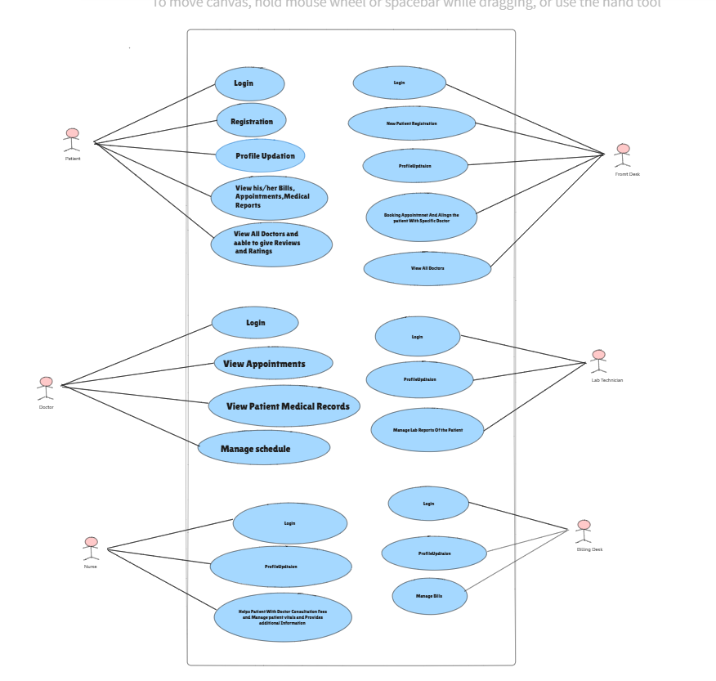
Use Case Diagram
Simple Solutions!

Slide 9
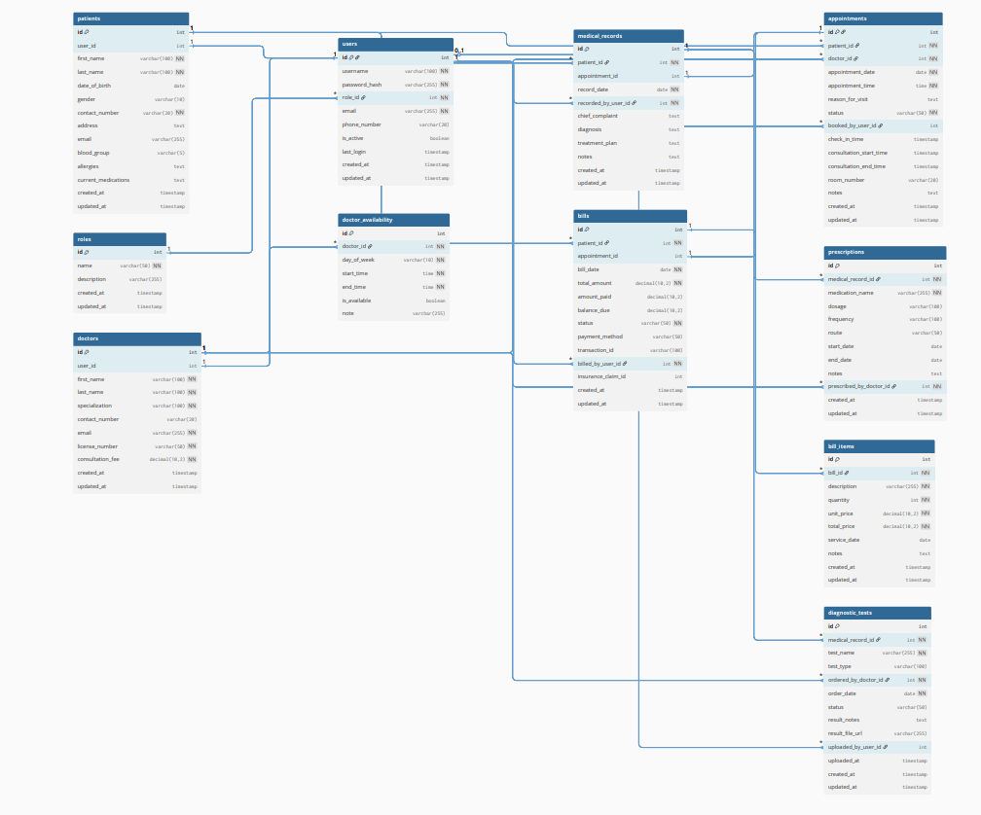
DB Diagram
Simple Solutions!

Slide 10
Documents
SRS
HLD
LLD
QSC
Test Reports
Simple Solutions!

Slide 11

Q/A
Simple Solutions!

Slide 12
Thank You
Simple Solutions!

