Slide 1
Opening a restaurant in Nashville
Will Lee

Slide 2
Need for analysis
Nashville is very quickly growing – opportunities arise
However, the more developed the city gets, more saturated it becomes
Need to analyze locations and the optimal type of food venue for maximum profit
Especially for popular places such as the Gulch and Green Hills, since significant amount of capital will be needed

Slide 3
Data acquisition and cleaning
Nashville neighborhoods webscraped (https://en.wikipedia.org/wiki/Category:Neighborhoods_in_Nashville,_Tennessee)
ArcGIS used to determine latitude and longitude values of neighborhoods
Foursquare API was used to get food venue details
Unnecessary information from Foursquare API response was dropped

Slide 4
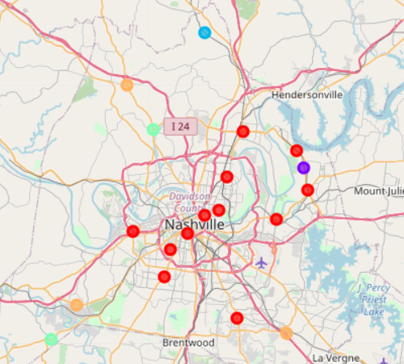
clusters
Neighborhoods that are more developed/have a lot of population show similar trend
Outskirts show similar characteristics

Slide 5
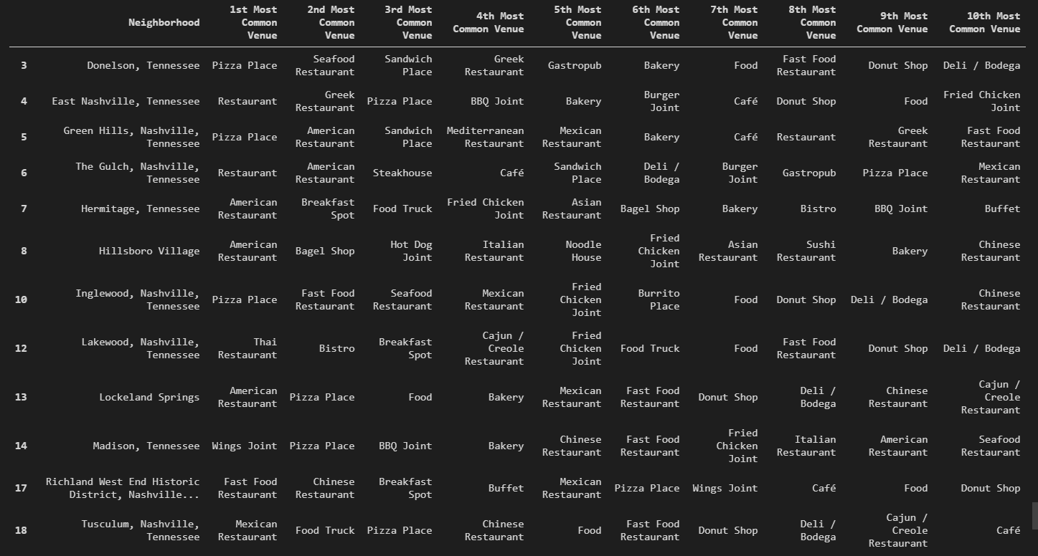
Cluster 1
Mostly American restaurants but has quite a lot of variety as it’s developed

Slide 6
Cluster 2
Mostly fast food, not a destination for tourism or travel

Slide 7
Cluster 3
Far from center of the city, seems suboptimal

Slide 8
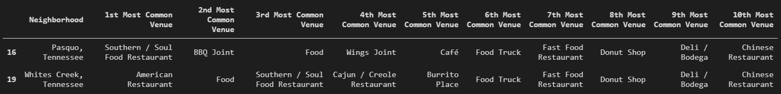
Cluster 4
Seems to be expanding and shows promise, but wait until expansion wave hits these two neighborhoods.

Slide 9
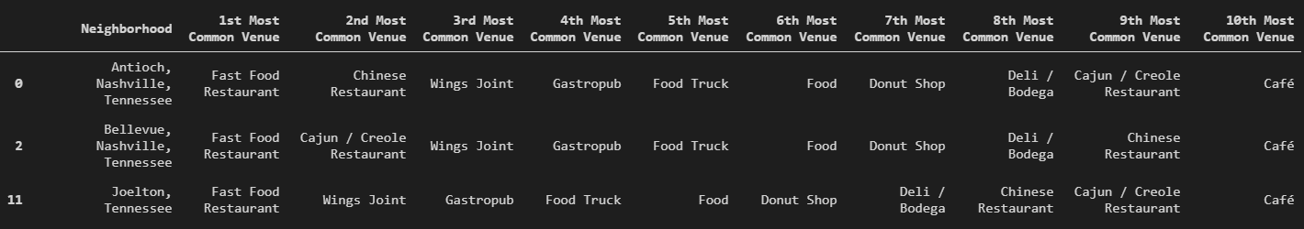
Cluster 5
Towards the outskirts of the city, less competition – seems probable

Slide 10
Conclusions and future directions
High capital – Cluster 1, American + non-American cuisine
Low capital – Cluster 5, American Restaurant.
Need a more reliable database for Nashville
Factor in population and popular venues into analysis.

