Slide 1

Project – Full stack using Nodejs
TRIP MATE
Presented by:
Aadaya Agrawal
Ankit Anand
Manvi Singhal
Vidisha Singhal
Mentor: Mr. Bhanu Kapoor

Slide 2
Know our site…
The Hotel Hub is a tourist agent which provides the facilities for booking hotels, holiday apartments and other accommodations for customers. Any customers need to book hotel, ins or apartment they need to visit their office. It will help them to manage the customers booking easily and also to keep the customers data safer. It will also help staffs to keep in track their customer’s online booking request as well as easily to reply feedback to the customers. A hotel reservation system enables guests to schedule dates and length of stay, room selection, extras, and payment all in one place.

Slide 3
Why this SITE is needed?
The main objective of the Project on Hotel Booking System is to manage the details of Hotel, Rooms, Services, Payments, Bookings.
It manages all the information about Hotel, Customers, Bookings, Hotel.
The purpose of the project is to build an application program to reduce the manual work for managing the Hotel, Rooms, Customers, Services. It tracks all the details about the Services, Payments, Booking

Slide 4
ROADMAP
Landing Page
Sign In Screen
Profile Page
1
3
5
2
4
6
Registration screen
Home Page
Admin Page

Slide 5
Features:
Select Room
Select Category
View Room details
Reserve Room
Manage User Profile
Maintain User information.
Add User Information
Modify User Information
Manage Reservation
Registration
Enter Username and Password
Sign Up the new user
Make new Reservation
Verify reservation Details
Pay Bill
Admin
User Management
Offers Management
Configuration

Slide 6
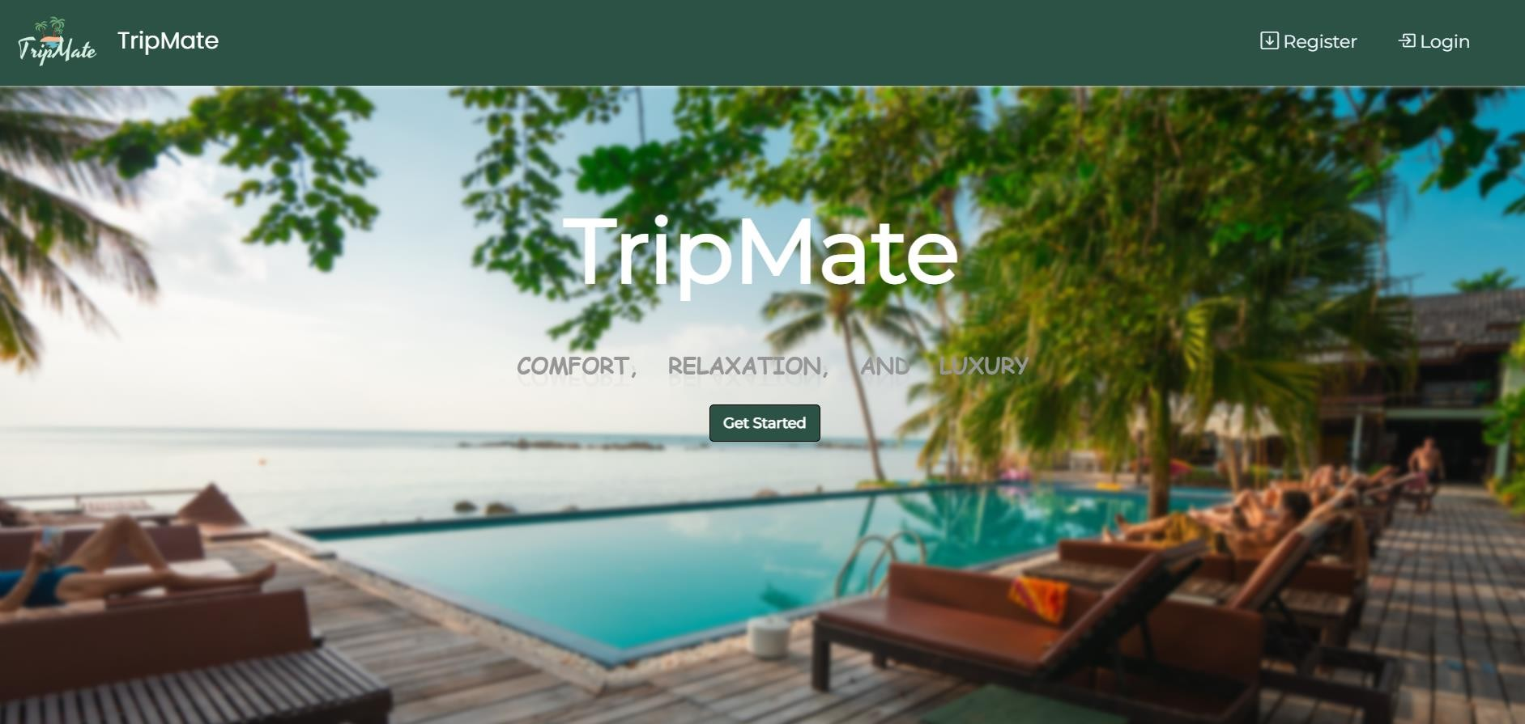
1. Landing Page: This is the first page of the website and contains the icon and theme related information of the website.

Slide 7
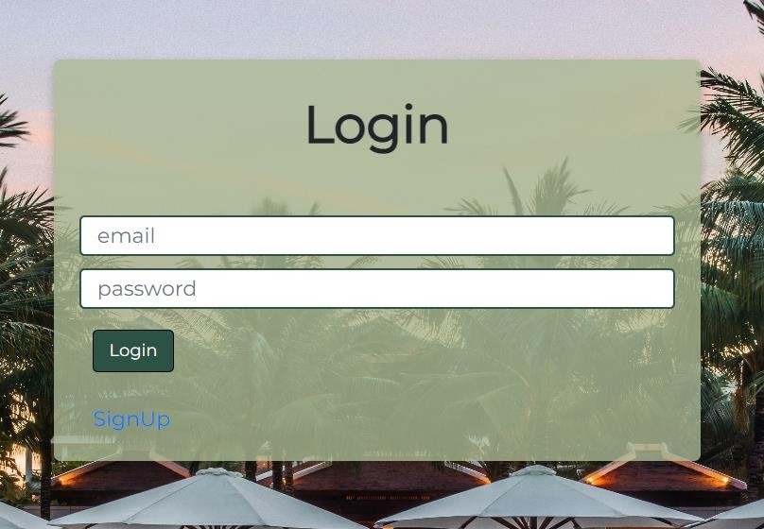
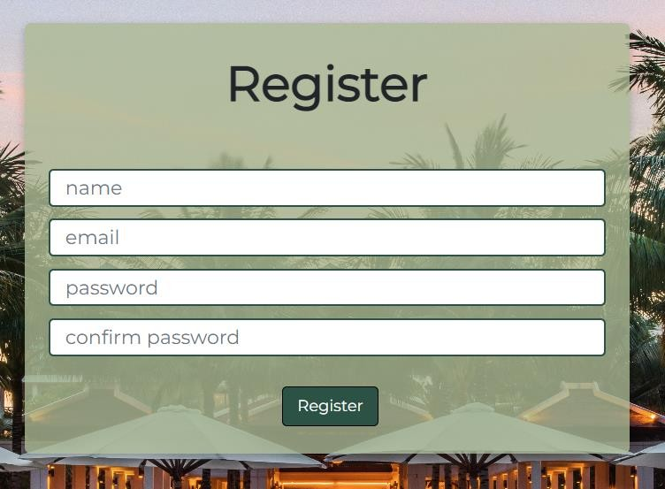
2. Login Page :
3.Registration/SignUp Page:

Slide 8
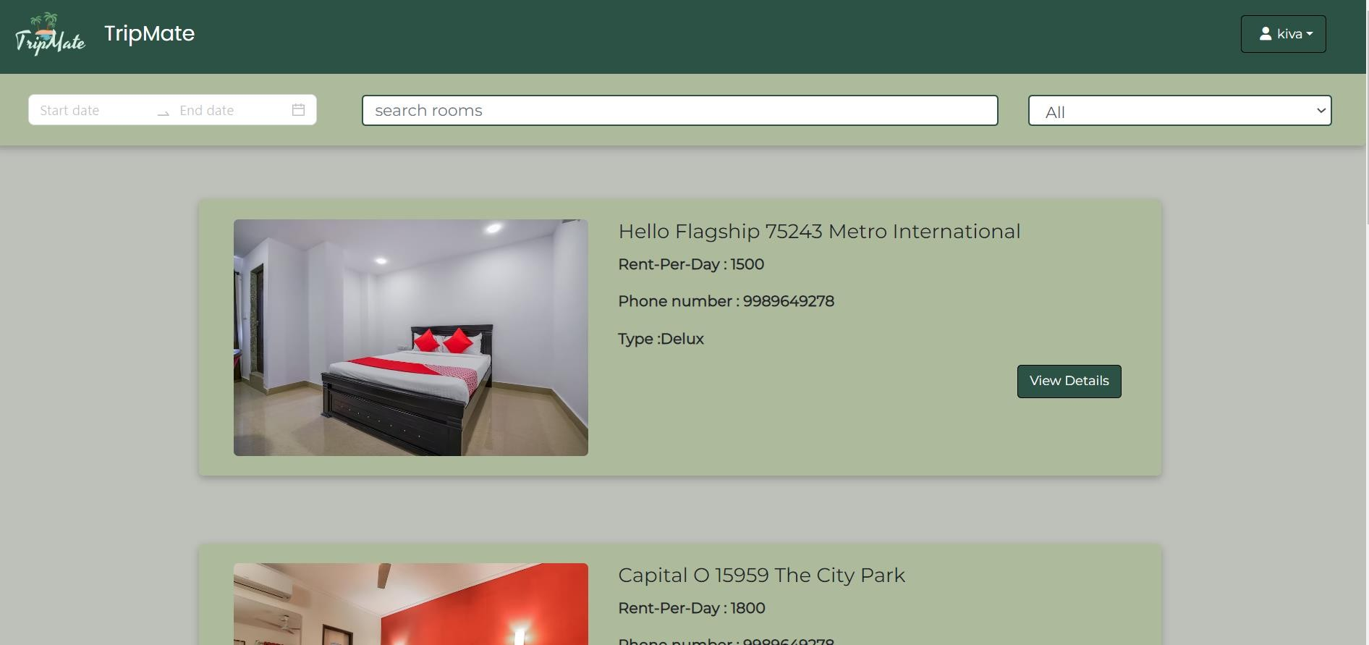
4. Home Page: The home page contains details of all the hotels and properties linked with the website.

Slide 9
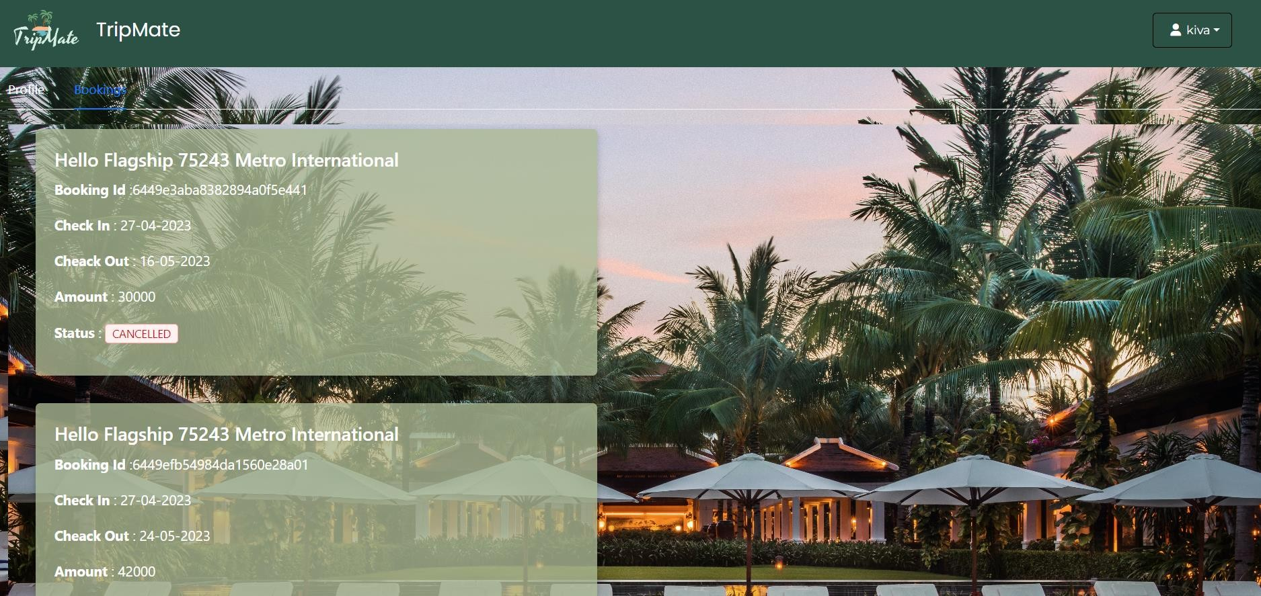
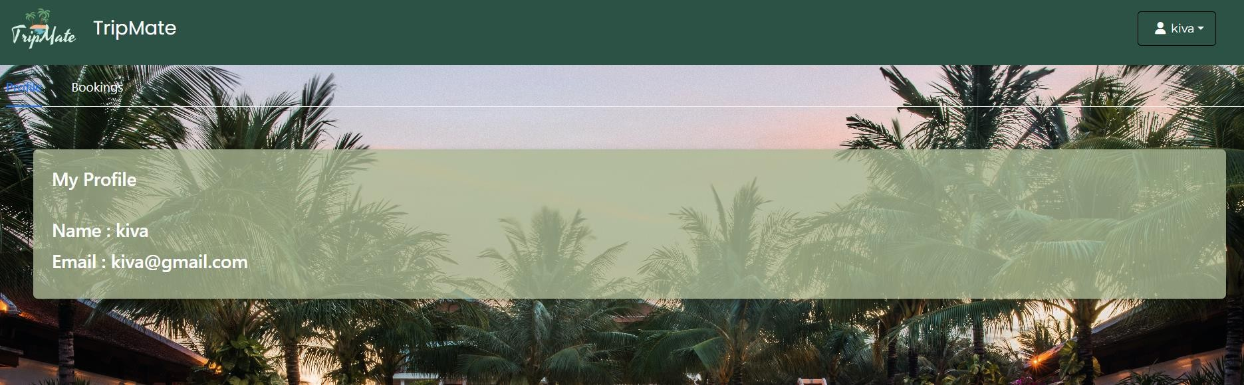
5. Profile Page: This page contains the account details of the user and also the booking details done by the user.

Slide 10
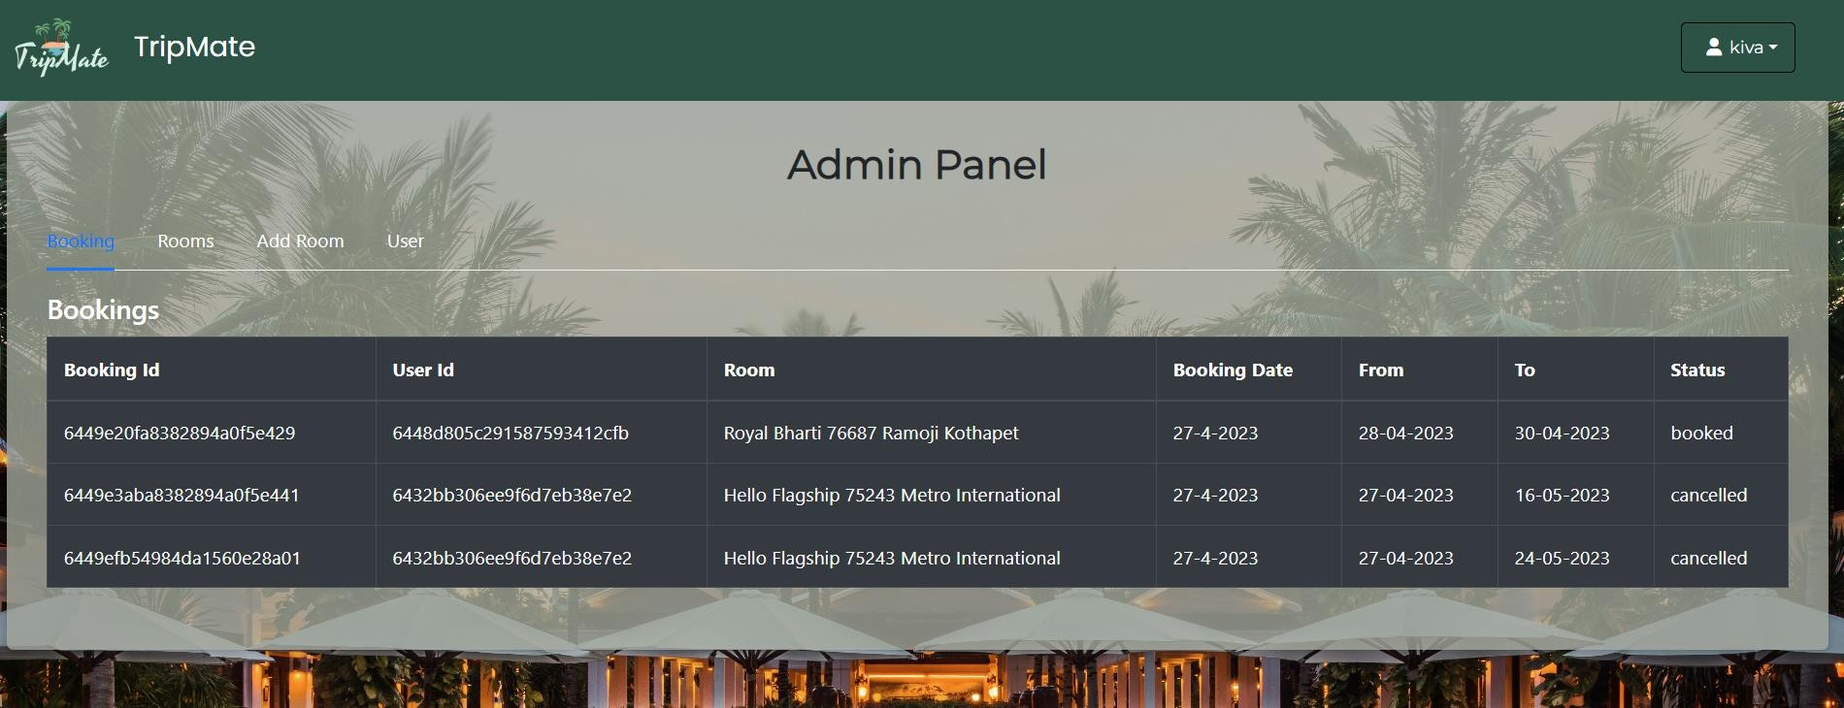
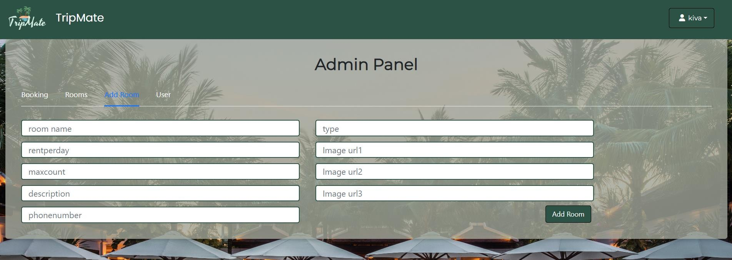
6. Admin Panel: This page contains the booking details of the selected rooms, the date of booking, dates of check-in and check-out also provides the option to add rooms.

Slide 11
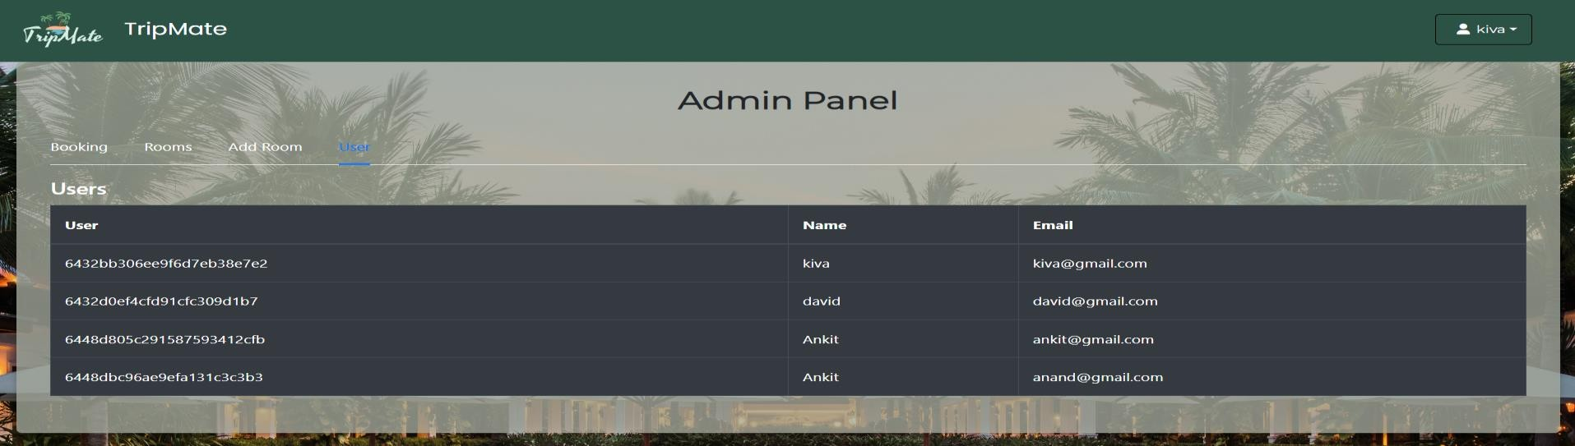
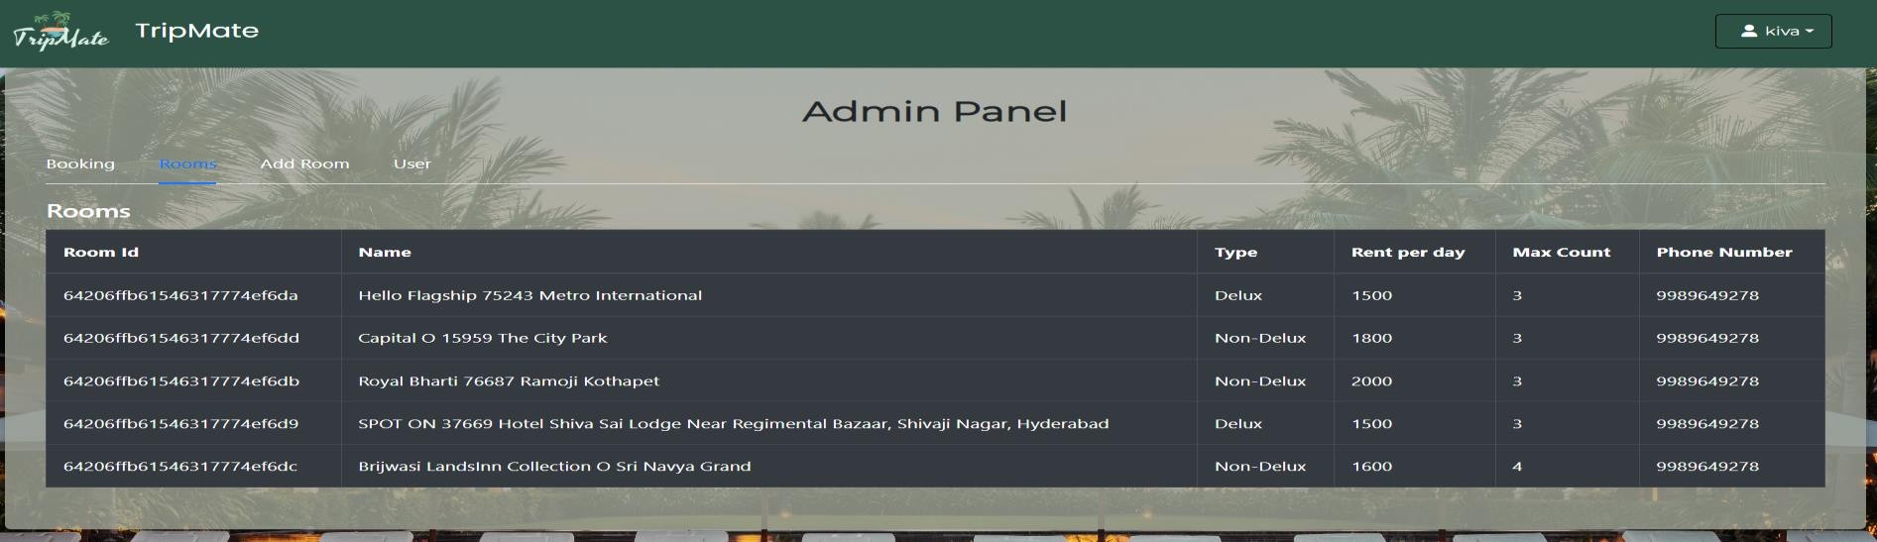

Slide 12
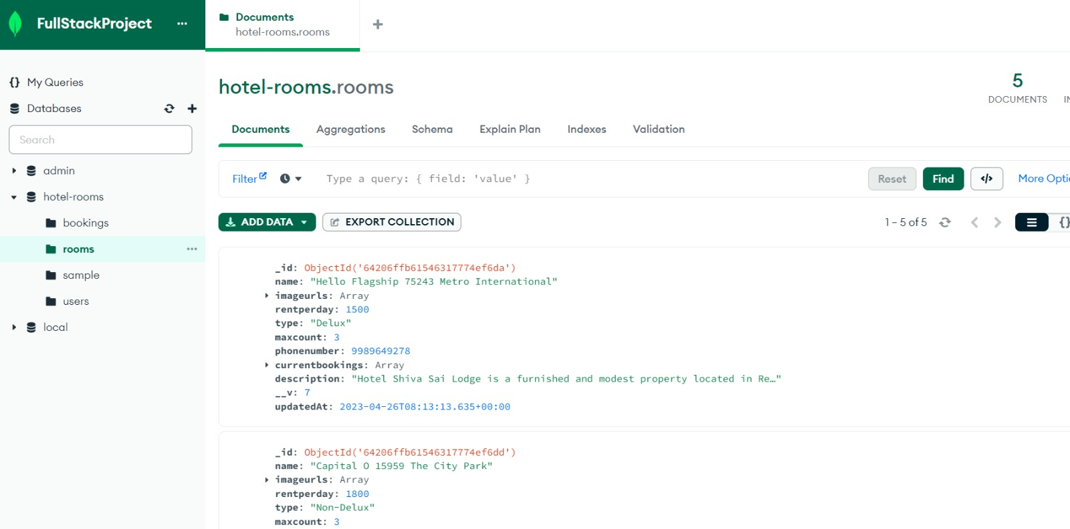
Database

Slide 13
Functionalities provided by Hotel Booking System are as follows:
Provides the searching facilities based on various factors. Such as Hotel, Services, Payments, Bookings
Hotel Booking System also manage the Customers details online for Payments details, Bookings details, Hotel.
It tracks all the information of Rooms, Customers, Payments.
Manage the information of Rooms
Shows the information and description of the Hotel, Services
It deals with monitoring the information and transactions of Payments.
Manage the information of Hotel
Editing, adding and updating of Records is improved which results in proper resource management of Hotel data

Slide 14
Dependencies
{
"name": "client",
"version": "0.1.0",
"private": true,
"dependencies": {
"@testing-library/jest-dom": "^5.16.5",
"@testing-library/react": "^13.4.0",
"@testing-library/user-event": "^13.5.0",
"antd": "^5.4.0",
"axios": "^1.3.4",
"bootstrap-icons": "^1.10.3",
"moment": "^2.29.4",
"react": "^18.2.0",
"react-bootstrap": "^2.7.2",
"react-dom": "^18.2.0",
"react-router-dom": "^6.9.0",
"react-scripts": "5.0.1",
"react-spinners": "^0.13.8",
"react-stripe-checkout": "^2.6.3",
"sweetalert2": "^11.7.3",
"web-vitals": "^2.1.4"
},
"dependencies": {
"@stripe/stripe-js": "^1.52.1",
"babel": "^6.23.0",
"bcryptjs": "^2.4.3",
"cors": "^2.8.5",
"express": "^4.18.2",
"moment": "^2.29.4",
"mongodb": "^5.1.0",
"mongoose": "^7.0.3",
"nodemon": "^2.0.22",
"react-stripe-js": "^1.1.5",
"router": "^1.3.8",
"stripe": "^12.1.1",
"tsc": "^2.0.4",
"uuid": "^9.0.0"
}

Slide 15




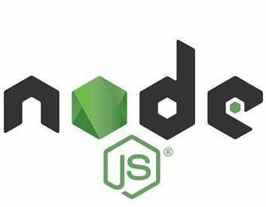
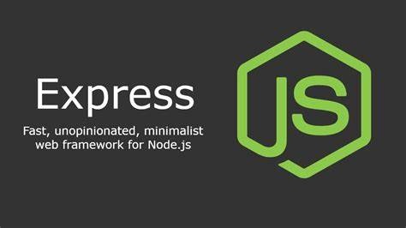

Technologies
Tells the browser how to display the content & label pieces of content such as "this is a heading", "this is a paragraph", "this is a link", etc.
Used to style and layout web pages.
Lets you add functionality and behaviors to your website, allowing your website’s visitors to interact with content
Used to build single-page applications & allows us to create reusable UI components.
Back-end JavaScript runtime environment, runs on the JavaScript
Engine, and executes JavaScript code outside a web browser.
It makes it easier to organize your application’s functionality with middleware and routing. It adds helpful utilities to Node.js HTTP objects and facilitates the rendering of dynamic HTTP objects.
A NoSQL database that stores data in JSON-like documents with flexible schemas.

Slide 16

Thank You

