Slide 1
1 · 标题页
EN ▶
中文 ▶
LLP307 An Introduction to Sport Analytics
Bess Chan
English for Academic Purposes Tutor
p.chan@lboro.ac.uk
LLP307 体育分析导论
Bess Chan（学术英语辅导老师）
p.chan@lboro.ac.uk

Slide 2
2 · Intended Learning Objectives
EN ▶
中文 ▶
By the end of this session, you should be able to have a better understanding of:
• A report you need to write for your assessment
• Planning your writing
• Writing critically
预期学习目标
本课结束时你应更好理解：
• 你要为评估写的一份报告
• 规划写作
• 批判性写作

Slide 3
3 · Assessment Overview
EN ▶
中文 ▶
What do you know already?
• How much is this assessment worth?
• When is the submission date?
• What is the word count?
• What is the task?
评估总览
你目前知道什么？
• 占多少分？
• 截止日期？
• 字数？
• 任务是什么？

Slide 4
4 · Assessment Overview
EN ▶
中文 ▶
Weighting: 100% of the module
Submission Date: Friday 24th October 2025 3:00pm
Length: 1500 words (+/- 10%), i.e. 1350-1650
Task: Consider a scenario given by your tutor, and write a research report
评估总览（答案）
权重：占模块 100%
截止：2025年10月24日(周五)15:00（⚠️旧版）
字数：1500词(±10%=1350–1650)
任务：根据导师场景写研究报告

Slide 5
5 · Brief
EN ▶
中文 ▶
Using the premise that ‘culture shapes and dictates organisational practices’ outline how you, as a new hire would convince your line manager and other top-level individuals at your organisation to adopt this new, AI-based technology and institute a culture of analytics within the organisational operations and create a competitive advantage.
题目
以「文化塑造并主导组织实践」为前提，作为新员工，如何说服你的直线经理与高层：
• 采纳这项新型 AI 技术
• 建立分析文化
• 创造竞争优势

Slide 6
6 · Requirements
EN ▶
中文 ▶
Include the definitions of organisational culture either outlined in the module (e.g., Buchanan & Huczynski, 2017; Deal & Kennedy, 1982; Lundy & Cowling, 1996; Schneider, Brief, & Guzzo, 1996; Skinner and Stewart, 2017), or other key organisational culture literature (e.g., from Dr. Jacky Mueller’s lecture), as well as Alamar’s (2013) sports analytics framework including various leadership components (e.g., transformation, transactional, delegative, participative). Most leadership or organisation literature works from a top-down perspective, but I want you to think of how you would utilise these principles to work from a bottom-up perspective to convince your leadership team.
要求
• 引用组织文化定义（Buchanan&Huczynski 2017 等）
• 用 Alamar(2013) 框架 + 领导力要素（变革/交易/委托/参与）
• 关键：文献多自上而下，你要思考【自下而上】如何说服领导

Slide 7
7 · 选择一个领域 Topic
EN ▶
中文 ▶
Topic: Choose either a SPORT/INDUSTRY or a COMMERCIAL DOMAIN
1. A particular sport or industry
· Type of sport: Football / Cricket / Boxing / Basketball / Baseball / E-sports
· Industry: Sports apparel or equipment / Sports betting
2. Use of AI-based technology in commercial domain
· Ticketing / Fan engagement / Customer engagement / Fantasy leagues / Sponsorship evaluation
Areas AI-based technology can be used:
· Personalised training & injury prevention
· Performance analysis & technique refinement
· Advances in talent identification
· Game plans / tactics for matches
· Personalisation of content
· Automated sports journalism
· Optimisation of broadcasts
· Fan engagement & marketing
· Automated refereeing
· Event security / abuse
· Sustainability
选择一个领域（主题）
选「运动/行业」或「商业领域」其一：
1. 某个运动或行业
· 运动类型：足球/板球/拳击/篮球/棒球/电竞
· 行业：运动服装装备/体育博彩
2. 商业领域的 AI 技术应用
· 票务/球迷互动/客户互动/梦幻联赛/赞助评估
AI 技术可应用领域：
· 个性化训练与伤病预防
· 表现分析与技术优化
· 人才识别进展
· 比赛战术/战略运用
· 内容个性化
· 体育新闻自动化
· 转播优化
· 球迷互动与营销
· 自动裁判
· 赛事安全/防滥用
· 可持续性

Slide 8
8 · Referencing Requirements
EN ▶
中文 ▶
APA Style should be used for all referencing, and you are required to use a minimum of five scholarly sources (peer-reviewed journal articles, books, theses/dissertations) as well as a minimum of five non-scholarly sources (industry reports, newspaper articles, websites, etc.) In-text citations are required for ALL sources, as well as a References list at the end of the report.
引用要求
• APA 格式
• ≥5 学术来源（期刊/书/论文）
• ≥5 非学术来源（行业报告/新闻/网站）
• 全部来源需 in-text 引用 + 文末 References

Slide 9
9 · Assessment Criteria
EN ▶
中文 ▶
Research: e.g., comprehensiveness (depth, currency and variety of sources) (40 points)
Analysis: e.g., cohesiveness, integration and synthesis of information, depth to which position is supported, link between literature, analysis/discussion and recommendations for cultural change (50 points)
Presentation quality: e.g., structure and flow, syntax, grammar, spelling referencing (10 points)
评分标准
研究：深度/时效/多样 = 40分
分析：综合/立场/关联 = 50分
呈现：结构/语法/引用 = 10分

Slide 10
10 · Ways to Achieve Higher Scores
EN ▶
中文 ▶
There are several strategies to help you get higher scores in the assessment.
• Identify a new or innovative AI-based technology
• Plan your writing
• Prepare a research matrix
• Structure your paragraphs appropriately
• Add your voice
• FOLLOW THE INSTRUCTIONS!!
拿高分的方法
• 选新型 AI 技术
• 规划写作
• 研究矩阵
• 组织段落
• 加你的声音
• 严格照说明做！

Slide 11
11 · Strategy 1: Identify a New AI-based Technology
EN ▶
中文 ▶
Talk to the person next to you and discuss the questions you need to ask yourself when identifying a new or innovative AI-based technology which best suits your topic. Come up with at least 5 questions.
策略1：选新型 AI 技术
和旁边的人讨论：选 AI 技术要问自己什么？至少想 5 个问题。

Slide 12
12 · Strategy 1 (possible questions)
EN ▶
中文 ▶
Here are some possible questions to consider when identifying “the best” AI-based technology:
• What are the specific needs of your organisation? / Which area requires improvement?
• Where can you find reliable information about different AI-based technologies?
• What criteria should be used to evaluate and compare?
• What makes each AI-based technology unique or valuable?
• In what industry/industries is the technology used, and how does it function? What improvements does it bring?
策略1（参考问题）
• 组织具体需求？哪个领域需改进？
• 哪找可靠的 AI 技术信息？
• 用什么标准评估比较？
• 每种技术独特价值？
• 用在哪个行业、如何运作、带来什么改进？

Slide 13
13 · Strategy 2: Plan Your Writing
EN ▶
中文 ▶
When you plan your writing, you should consider the following:
Content
Structure
Evidence
策略2：规划写作
要考虑：内容 / 结构 / 证据

Slide 14
14 · Strategy 2: Content
EN ▶
中文 ▶
Do you still recall what you are required to do?
策略2：内容 Content
你记得要做什么吗？

Slide 15
15 · Strategy 2: Structure — Report
EN ▶
中文 ▶
Title Page
Executive Summary
Introduction
Literature or organisational frameworks
Recommendations/Results/Discussion
References
Appendices
Detailed information for each of the above is available from the assessment brief.
策略2：结构（报告）
标题页 / 执行摘要 / 引言 / 文献或组织框架 / 建议·结果·讨论 / 参考文献 / 附录
详细见 assessment brief

Slide 16
16 · Strategy 2: Evidence
EN ▶
中文 ▶
No matter whether you are writing an essay or a report, it is common practice that you need to cite evidence in order to strengthen your argument.
• Where can you find the information you need?
• After collecting the information, what are the next steps?
策略2：证据 Evidence
报告/论文都要 cite 证据强化论点。
• 资料去哪找？
• 收集后下一步？

Slide 17
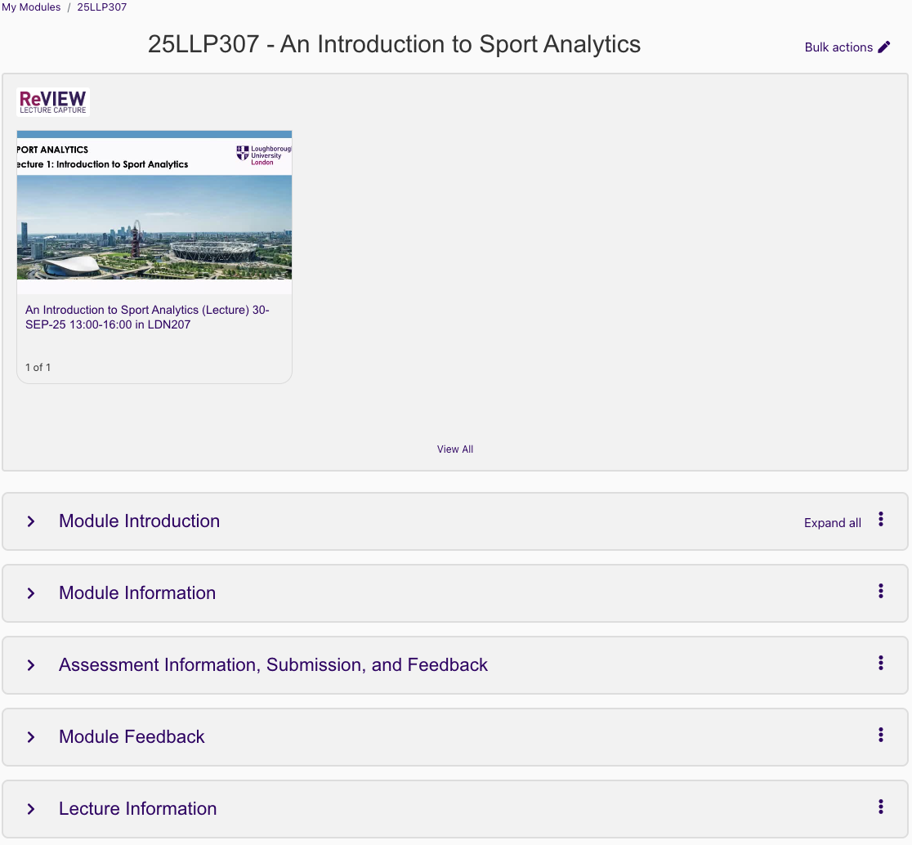
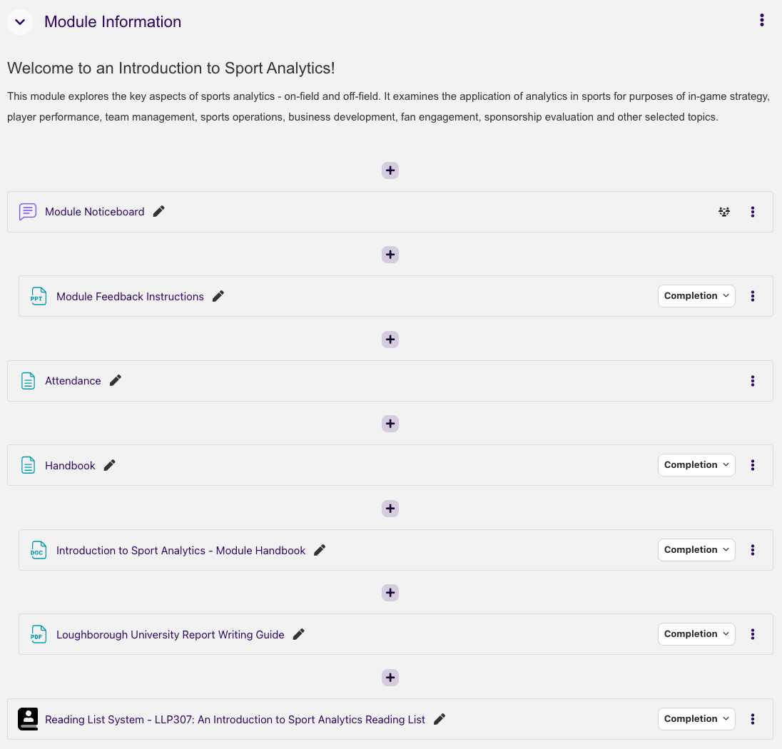
Sources that You Need
中译：你需要的来源：本页两张图示意「学术来源」与「非学术来源」两类。

Slide 18
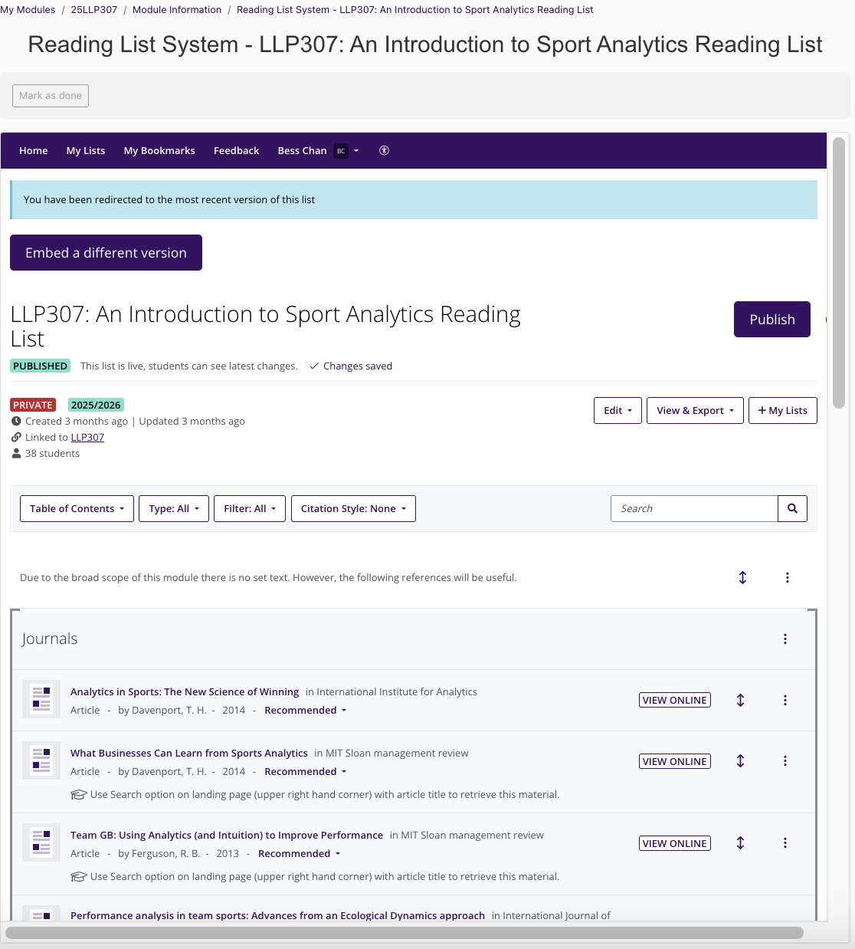
Sources that
You Need
中译：你需要的来源：本页图示意各类来源（期刊、书籍、行业报告等）。

Slide 19
19 · Task 1
EN ▶
中文 ▶
Read the assessment guidelines again and answer:
• Which part(s) of the question require(s) you to cite evidence?
• What are the keywords that help you look for relevant literature?
任务1
重读评估指引：
• 哪些部分需 cite 证据？
• 哪些关键词帮你找文献？

Slide 20
20 · Task 1 (Answers)
EN ▶
中文 ▶
Which part(s) require cite evidence?
• Introduction
• Literature or organisational frameworks
• Recommendations / Results / Discussion
Keywords:
• Background of your sport/industry
• Name of AI-based technology
• Organisational culture
• Organisational barriers
• Leadership types
• Recommendations
任务1（答案）
需引用：引言 / 文献框架 / 讨论建议
关键词：运动行业背景、AI技术名、组织文化、组织障碍、领导力类型、建议

Slide 21
21 · Strategy 3: Prepare a Research Matrix
EN ▶
中文 ▶
You may probably have the following questions:
• What is a research matrix?
• Why is the research matrix introduced to us?
• It seems like extra work – is it really worth my time and effort?
策略3：研究矩阵
• 什么是研究矩阵？
• 为什么引入？
• 值得花时间吗？

Slide 22
Research Matrix Template
 | Source A | Source B | Source C | Source D
Topic 1
Topic 2
Topic 3
In each grid, write down the evidence with the page number or even the secondary in-text citation
These topics are usually the recurring key terms you identified from sources.
Colour-code the pieces of evidence if you think that they are related to the same sub-topic.
中译：研究矩阵模板：横轴=来源A/B/C/D，纵轴=主题1/2/3。每个格子写「证据+页码」，同主题可用颜色标注。

Slide 23
Research Matrix – Example
 | Source 1 Skinner & Stewart (2017) | Source 2 Díaz et al., 2018 | Source 3 Hofstede (2001) | Source 4 Deal & Kennedy (1982)
Theme 1 Name of AI-based technology
Theme 2 Organisational culture
中译：研究矩阵示例：来源=Skinner&Stewart/Díaz/Hofstede/Deal&Kennedy；两条主题=AI技术名、组织文化。

Slide 24
Research Matrix – Example
 | Source 1 Skinner & Stewart (2017) | Source 2 Díaz et al., 2018 | Source 3 Hofstede (2001) | Source 4 Deal & Kennedy (1982)
Theme 1 Name of AI-based technology
Theme 2 Organisational culture | 3 features: Common knowledge in the company 2. Inflexible and consistent 3. More impact -> more employees embrace Both explicit/ implicit: range of policy etc. | “with the goal of achieving deep business engagement, creating employee pull, and cultivating a sense of purpose, so that data can support your operations instead of the other way around” | “the collective programming of the mind that distinguishes the members of one group or category of people from others” | “the way we do things round here”
中译：研究矩阵示例（组织文化定义已填入）：Skinner3特征 / Díaz数据文化 / Hofstede集体编程 / Deal「做事方式」。

Slide 25
Research Matrix – Example
 | Source 1 Skinner & Stewart (2017) | Source 2 Díaz et al., 2018 | Source 3 Hofstede (2001) | Source 4 Deal & Kennedy (1982)
Theme 1 Name of AI-based technology
Theme 2 Organisational culture | 3 features: Common knowledge in the company 2. Inflexible and consistent 3. More impact -> more employees embrace Both explicit/ implicit: range of policy etc. | “with the goal of achieving deep business engagement, creating employee pull, and cultivating a sense of purpose, so that data can support your operations instead of the other way around” | “the collective programming of the mind that distinguishes the members of one group or category of people from others” | “the way we do things round here”
No information
中译：研究矩阵示例（续）：注意「AI技术名」一格为空，说明此示例缺少所选技术的资料。

Slide 26
26 · Strategy 3: issues with the matrix
EN ▶
中文 ▶
• No information on the chosen AI-based technology → find more sources
• Too many quotations → need to paraphrase
• No page numbers for quotations (APA requires, e.g. Chan, 2025, p.78)
• No examples of your voice → include comments
矩阵常见问题
• 没写所选 AI 技术
• 引文过多，要 paraphrase
• 引文没页码
• 没有你的 voice，要加评论

Slide 27
27 · Strategy 4: Structure Your Paragraphs — PEEL
EN ▶
中文 ▶
What is a good body paragraph structure?
PEEL
P – point / topic sentence (just 1 main point!)
E – evidence
E – evaluation: your explanation, your commentary
(L – link / concluding sentence; optional)
策略4：PEEL 段落结构
P 观点/主题句(每段只一个点)
E 证据
E 评价(你的解释+评论)
L 结尾句(可省略)

Slide 28
28 · Task 2
EN ▶
中文 ▶
Is this a successful paragraph? Why / why not?
“Organisational culture consists of 3 features. The first feature ... is common knowledge ... The second ... unchanging and consistent. The third ... greater impact if more people accept ... can be explicit or implicit ... examples are mission statement or unwritten rules.”
Previous student's work – DO NOT COPY!
任务2
判断前学生段落是否成功？为什么？
（段落：组织文化3特征…）

Slide 29
29 · Task 2 (annotation)
EN ▶
中文 ▶
Topic sentence + Evidence (without citations)
任务2（结构标注）
该段只有主题句+证据(无引用)

Slide 30
30 · Task 2 (Answers)
EN ▶
中文 ▶
NO
• There are no citations
• It only looks at information from one source
• It only describes the source
任务2（答案）
NO
• 无引用
• 只单一来源
• 只描述不分析

Slide 31
31 · Task 3
EN ▶
中文 ▶
Decide whether we need a citation:
1. Tranmere Rovers used a piece of AI software to scout new players, and they improved their signing rate by 10%.
2. Artificial intelligence is becoming more prevalent in the sports industry.
3. Peter Robinson has stated that AI will reduce costs in the sport industry by significant amounts.
4. The argument for introducing AI software within the rugby union may not be completely feasible.
任务3：判断是否引用
① Tranmere Rovers 提高10%签约率
② AI在体育行业越来越普及
③ Peter Robinson 说降成本
④ 引入AI可能不可行

Slide 32
32 · Task 3 (Answers)
EN ▶
中文 ▶
1. Tranmere Rovers ... 10% → CITATION NEEDED
2. AI becoming more prevalent → (no)
3. Peter Robinson ... reduce costs → CITATION NEEDED
4. may not be feasible → (no)
任务3（答案）
① 要引用
② 不用(常识)
③ 要引用
④ 不用(你的论点)

Slide 33
33 · When to use citations
EN ▶
中文 ▶
You have to reference everything not your own work: Texts / Media / Data
Generally accepted facts are allowed. E.g. Water boils at 100°C.
Cite Them Right (citethemrightonline.com)
References (apa.org)
何时引用
非你原创都要引用：文字/媒体/数据
公认事实不用(水100℃沸腾)
资源：citethemrightonline.com / apa.org

Slide 34
34 · Task 4
EN ▶
中文 ▶
Is this a more successful paragraph? Are there any problems?
“Skinner and Stewart (2017) see organisational culture ... Hofstede (2001) states ... Deal & Kennedy (1982) state that organisational culture is ‘the way we do things round here’.”
Previous student's work – DO NOT COPY!
任务4
判断改进段落是否更成功？有问题吗？
（段落引用3个来源定义组织文化）

Slide 35
35 · Task 4 (annotation)
EN ▶
中文 ▶
Evidence (with citations)
任务4（结构标注）
该段只有证据(有引用)

Slide 36
36 · Task 4 (Answers)
EN ▶
中文 ▶
Yes, it is more successful.
Problems:
• No topic sentence
• No commentary
• No analysis
• Only describes what others say — cannot show relationship between sources
You need to show your opinion (rephrasing / comparing-contrasting / analysing).
任务4（答案）
更成功。但缺：
• 无主题句
• 无评论/分析
• 只罗列没展示关系
需加自己观点(改述/对比/分析)

Slide 37
37 · Strategy 5: Add Your Voice
EN ▶
中文 ▶
A voice:
• Communicates the writer's perspective/stance
• Guides the reader through signposting words
• Conveys personality through tone and style
• Establishes credibility (expertise/authority)
• Creates cohesiveness (relationship between ideas)
• Shows criticality (nuanced/analytical perspective)
Helms-Park and Stapleton (2003)
策略5：加入你的声音
voice=
• 传达立场
• 路标词引导读者
• 语气个性
• 建立可信度
• 连贯性
• 批判性
(Helms-Park & Stapleton 2003)

Slide 38
38 · Paragraph Structure and Your Voice
EN ▶
中文 ▶
P – point: your key point/claim is your voice
E – evidence: your synthesis (comparison/cause-effect/addition/exemplification) is your voice
E – evaluation: your comment is your voice
L – link: to your argument is your voice
段落结构与你的声音
P 观点=你的声音
E 证据综合=你的声音
E 评价=你的声音
L 回扣=你的声音

Slide 39
39 · Ways to Show Your Voice in Evaluation
EN ▶
中文 ▶
• Frame problems, not just gap-spotting
• Question dominant assumptions or approaches
• Make evaluative judgments
• Question and challenge the gaps
• Establish links between literature and your research
• Think about the implications
评价中展示声音
• 框定问题非只找空白
• 质疑主流假设
• 评判性判断
• 挑战空白
• 建立文献关联
• 想影响

Slide 40
40 · Task 5
EN ▶
中文 ▶
Can you see any examples of the author's voice (opinion)?
“Organisational culture is a key factor in sports organisations but is difficult to define. Skinner and Stewart (2017) offer the most comprehensive depiction ... Hofstede (2001) agrees ... Although these groups might be undefined ... To summarise this concept holistically, Deal & Kennedy (1982) ... ‘the way we do things round here’.”
Previous student's work – DO NOT COPY!
任务5
找段落中作者的声音(观点)
（更完善的段落，含作者评判）

Slide 41
41 · Task 5 (Answers)
EN ▶
中文 ▶
Examples of voice:
• “…but is difficult to define”
• “offer the most comprehensive depiction”
• “Although these groups might be undefined…”
• “To summarise this concept holistically…”
任务5（答案）
• 「but is difficult to define」
• 「the most comprehensive」
• 「Although these groups…」
• 「To summarise holistically」

Slide 42
42 · Strategy 5: reporting verbs
EN ▶
中文 ▶
You can show your voice by using a variety of reporting verbs. The choice can subtly or strongly convey stance, confidence, and evaluation.
Sort the reporting verbs on the next slide into the correct categories.
策略5：报告动词
用多样 reporting verbs 展示立场，动词传达态度/信心/评价。
把下一页动词分类。

Slide 43
Task 6
demonstrates | posits | suggests | considers | reveals | describes
claims | indicates | proves | illustrates | states | notes
argues | believes | highlights | discusses | shows
Neutral | Fact after analysis | Agreement | Disagreement | One possibility | Probably true
中译：任务6：把动词分类到 中性/分析后事实/同意/不同意/一种可能/可能为真。

Slide 44
Task 6 (Answers)
Neutral | Fact after analysis | Agreement | Disagreement | One possibility | Probably true
States Describes Discusses | Demonstrates Highlights Reveals | Shows Proves Illustrates | Claims Believes | Posits Argues Considers | Suggests Indicates Notes
Reporting Verbs - Academic Skills Kit - Newcastle University (ncl.ac.uk)
中译：任务6答案：中性=States等 / 分析后事实=Demonstrates等 / 同意=Shows等 / 不同意=Claims等 / 一种可能=Posits等 / 可能为真=Suggests等。

Slide 45
45 · Useful Language – Showing Criticality
EN ▶
中文 ▶
You can find critical language from the Manchester Phrasebank.
https://www.phrasebank.manchester.ac.uk/being-critical/
批判性表达语言
Manchester Phrasebank:
phrasebank.manchester.ac.uk/being-critical/

Slide 46
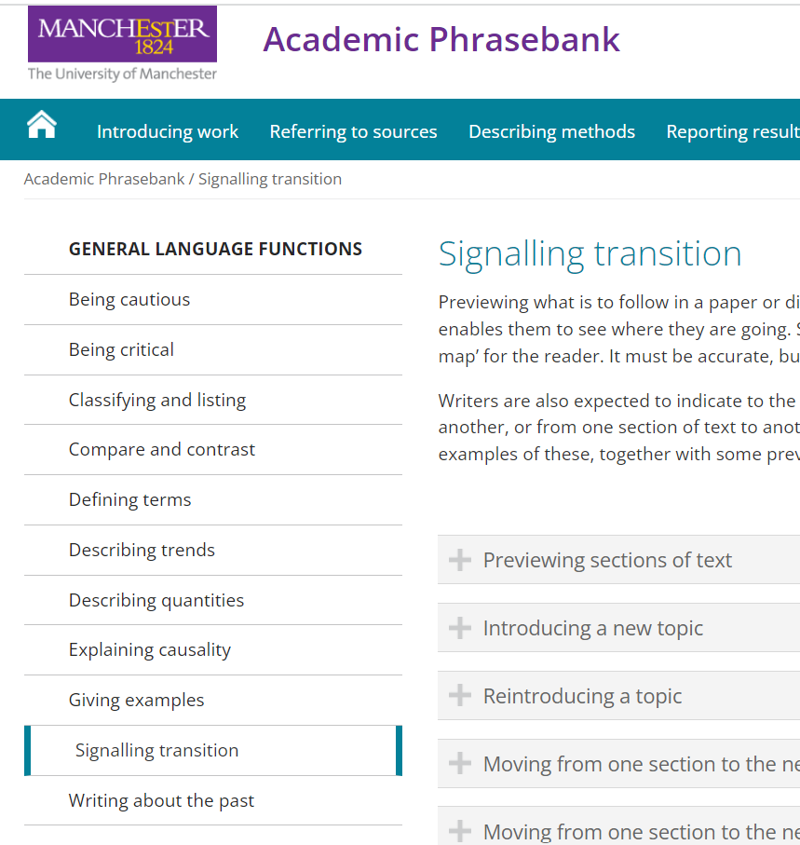
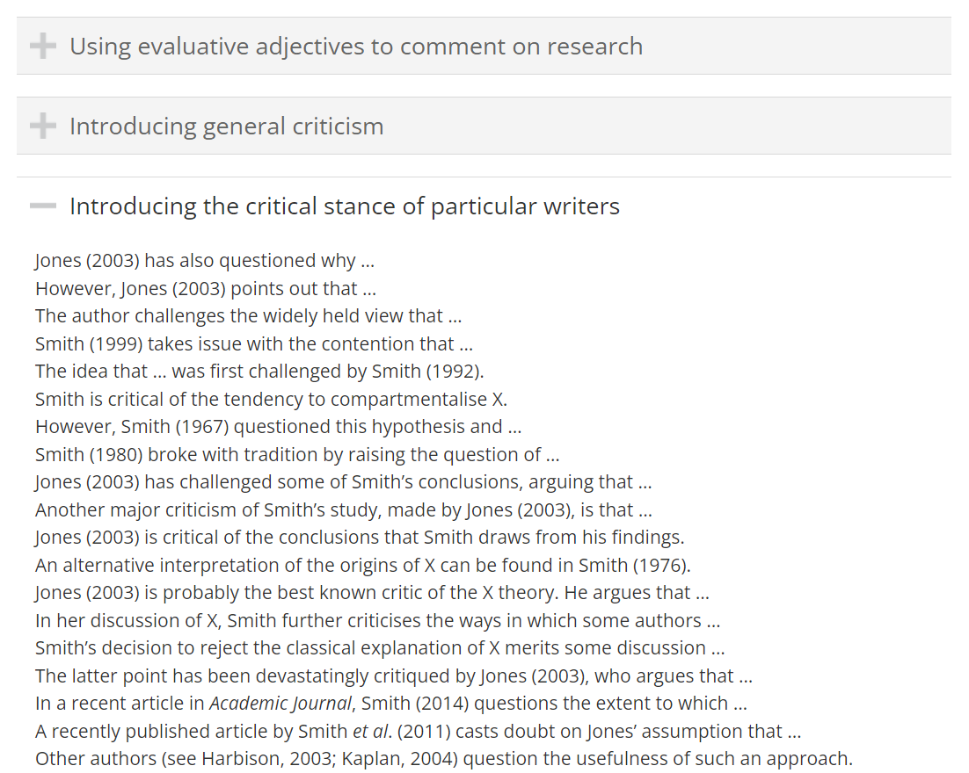
Being Critical
中译：保持批判性：本页提示可参考 Manchester Phrasebank 的批判性语言（见下一页链接）。

Slide 47
47 · Step 6: Follow the Instructions!
EN ▶
中文 ▶
• Make sure you read all instructions thoroughly and understand them
• If anything is unclear, don't hesitate to ask
• Final reminder: you may choose any AI-based technology, but must follow the structure in your assessment guidelines
策略6：严格照说明做
• 通读并理解说明
• 不清楚主动问
• 可自由选 AI 技术，但必须遵循评估指引结构

Slide 48
48 · Your Feedback, Please!
EN ▶
中文 ▶
Please fill in a short survey by scanning this QR code.
Your feedback helps improve our support for students.
请填反馈
扫二维码填简短调查，帮助改进学生支持

Slide 49
49 · References
EN ▶
中文 ▶
Deal & Kennedy (1982) Corporate cultures. Addison-Wesley.
Díaz et al. (2018) Why data culture matters. McKinsey Quarterly.
Hofstede (2001) Cultures and organizations. Sage.
Shields (2017) Integrating Analytics in Your Organization. MIT SMR.
Skinner & Stewart (2017) Organizational Behaviour in Sport. Routledge.
参考文献
Deal&Kennedy 1982 / Díaz等 2018 McKinsey / Hofstede 2001 / Shields 2017 MIT SMR / Skinner&Stewart 2017 Routledge

Slide 50
50 · Thank you
EN ▶
中文 ▶
Inspiring Winners Since 1909
Thank you!
自1909年激励冠军
谢谢！

